Slide 1
E-Commerce Website

Slide 2
Hello!
I am Gaurav Purohit
I am here to present my project workflow in the form of PPT.

Slide 3
title
Here you have a list of items
Functionality of our project
Screenshots of Screens which we have created in our project

Slide 4
Quotations are commonly printed as a means of inspiration and to invoke philosophical thoughts from the reader.

Slide 5
Functionality
Security Features
.
Features
User-Friendly
Mobile-Friendly Website
Advanced Payment Options
Detailed Shipping Information

Slide 6
Points to Notice :
User-Friendly
The objective is to help shoppers get to what they want faster and without running into unnecessary complexity that can clog up the path to purchase.
Mobile-Friendly Website
With a responsive website, content intuitively adapts to whatever device is accessing it to provide the most user-friendly experience.
Detailed Shipping Information
It’s also helpful to include delivery time and options for faster delivery.

Slide 7
Admin diagram :
Admin
Manage Products
Manage User/Sellers
Can add product
view/delete or edit
Can add seller
view/delete or edit

Slide 8
UseR diagram
user
Can search Product
add Product
By P_name
By Category_name
To cart
Can purchase product

Slide 9
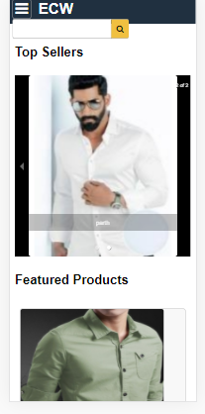

Mobile View of our Project

Slide 10
Screenshots

Slide 11
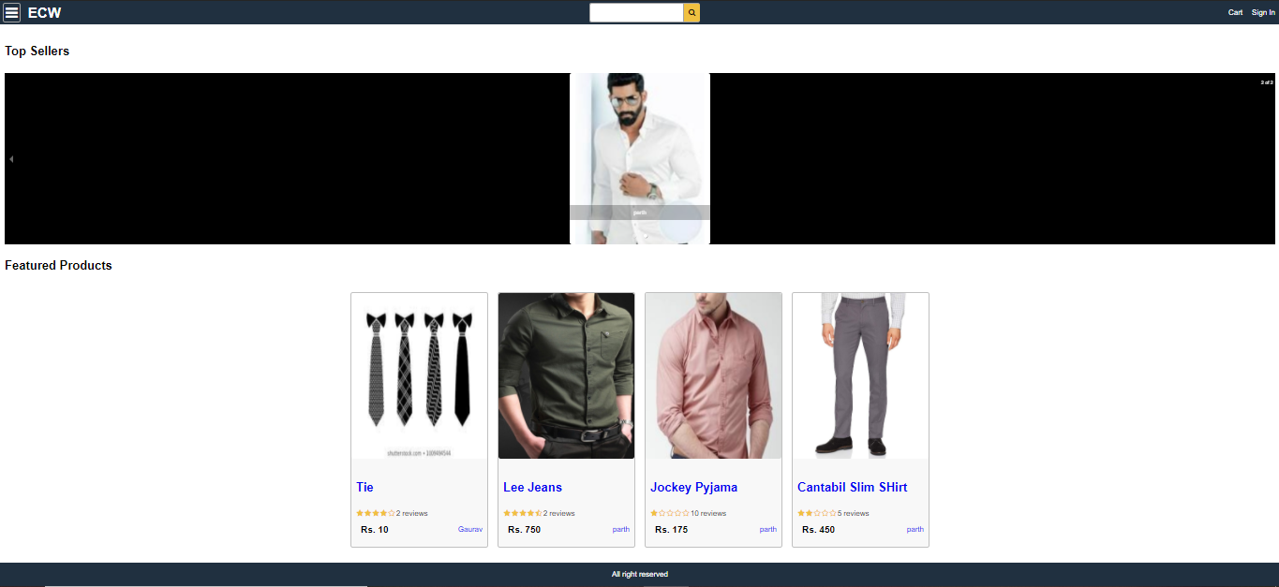
HomeScreen

Slide 12
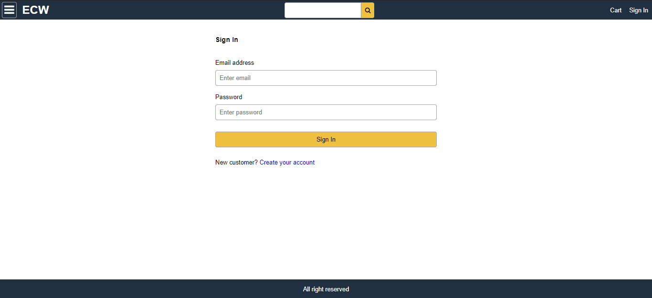
LoginScreen

Slide 13
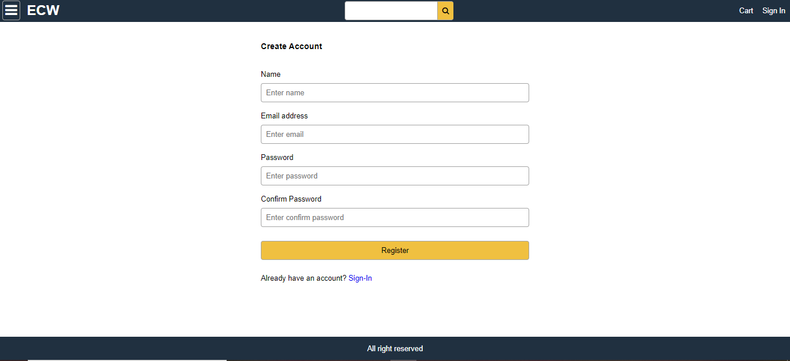
Create Account Screen

Slide 14
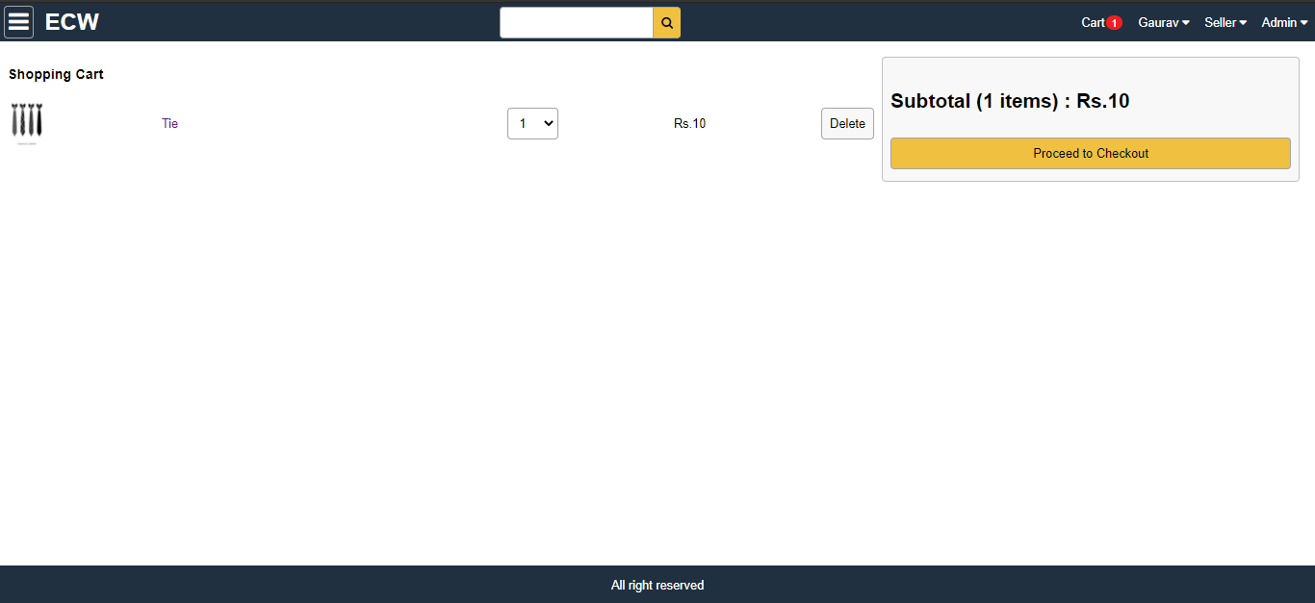
Cart Screen

Slide 15
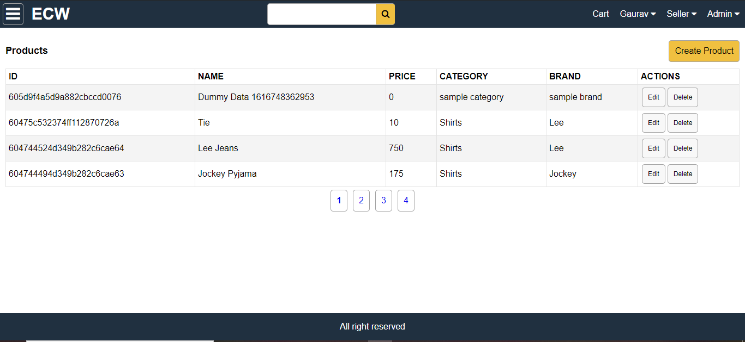
Admin Product List Screen

Slide 16
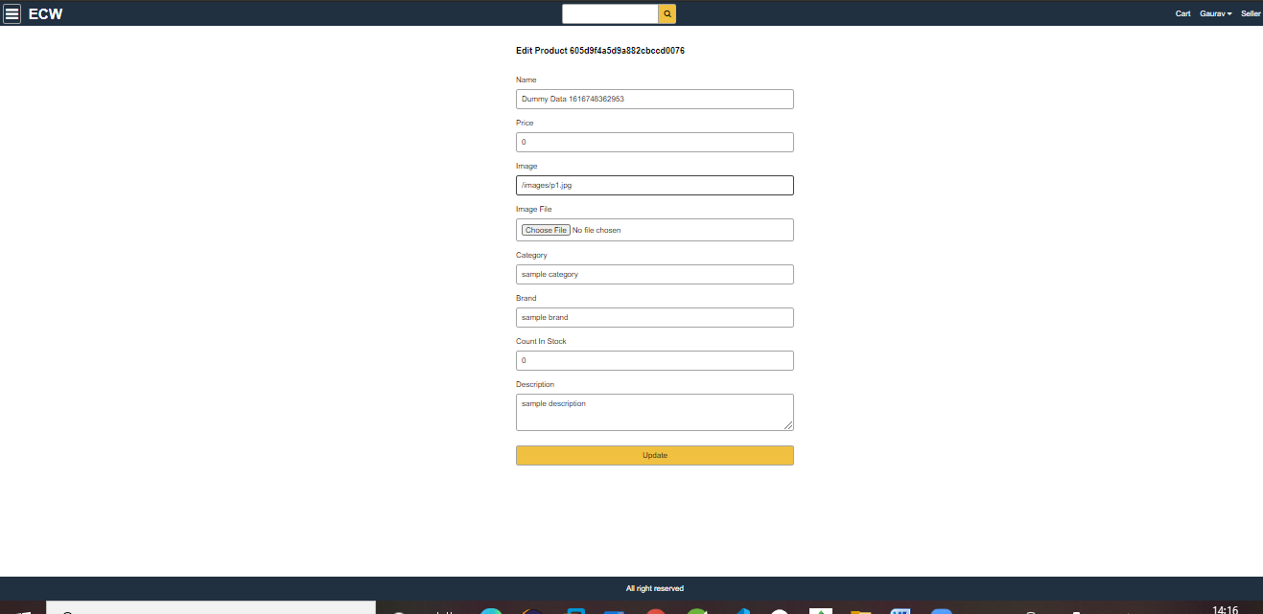
Create Product Screen

Slide 17
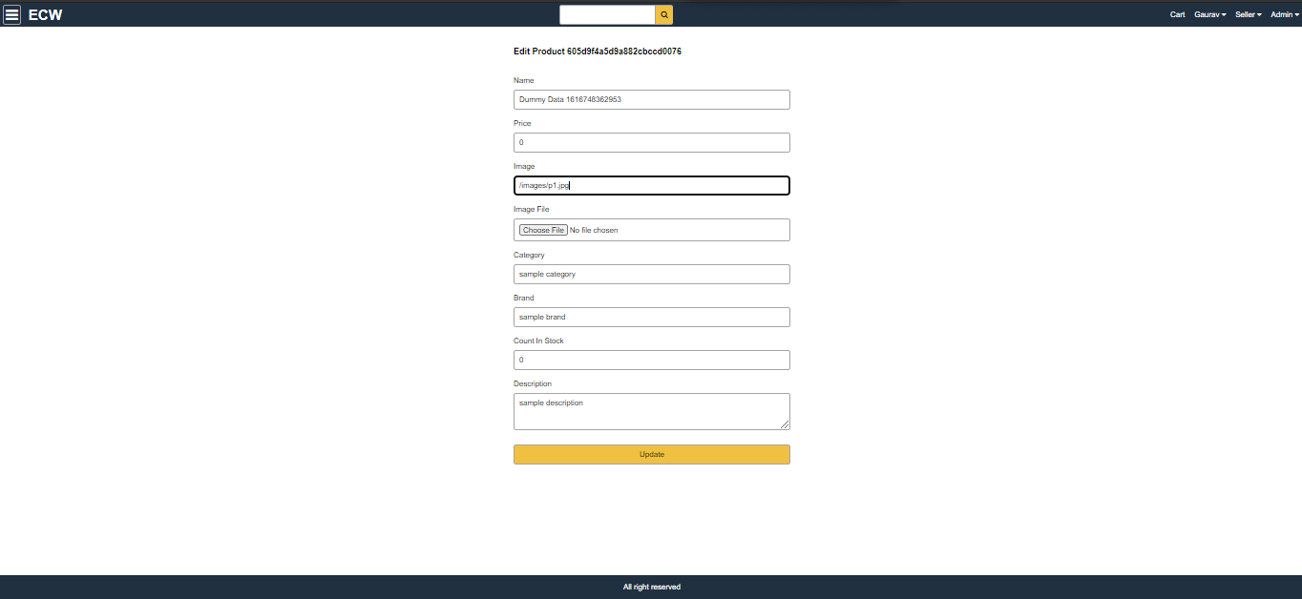
Edit Product

Slide 18
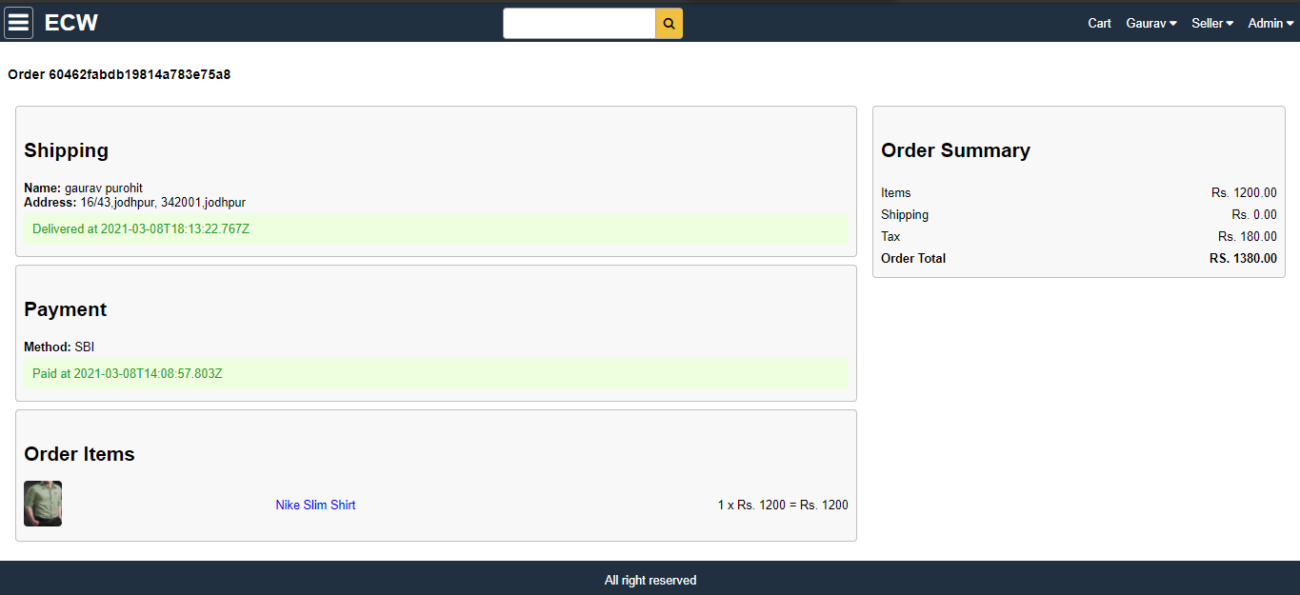
Order Details

Slide 19
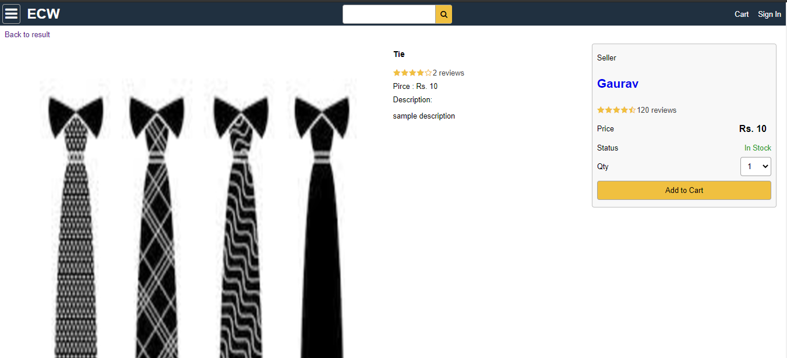
Product screen

Slide 20
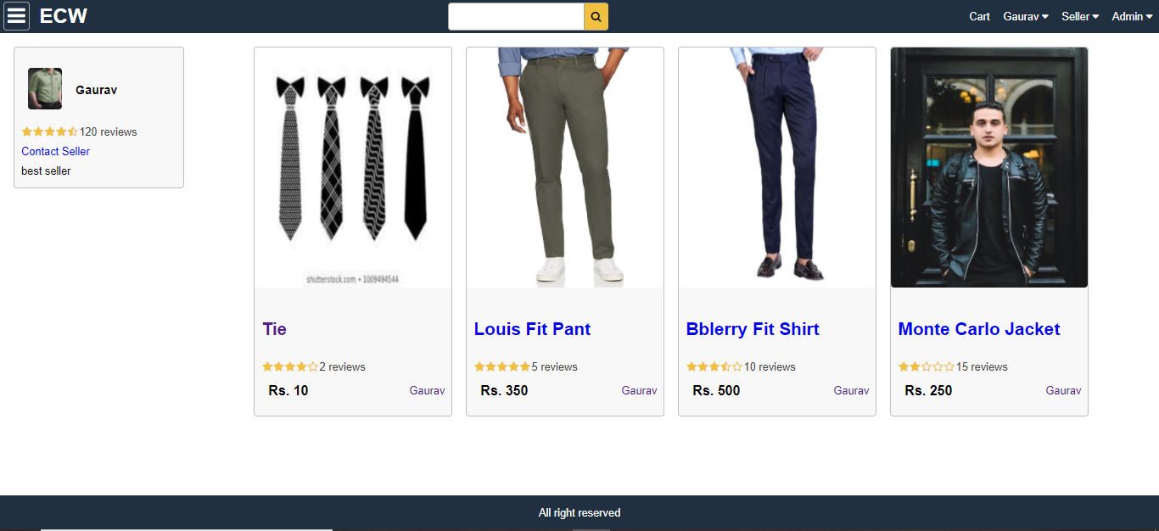
Seller Screen

Slide 21
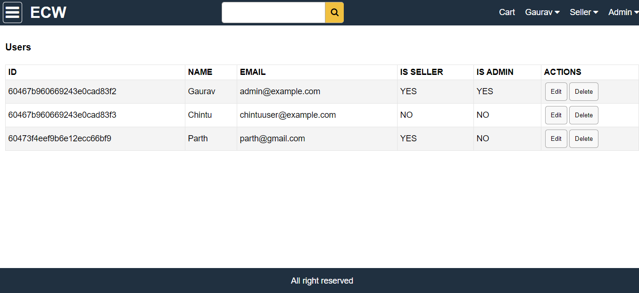
User List

Slide 22
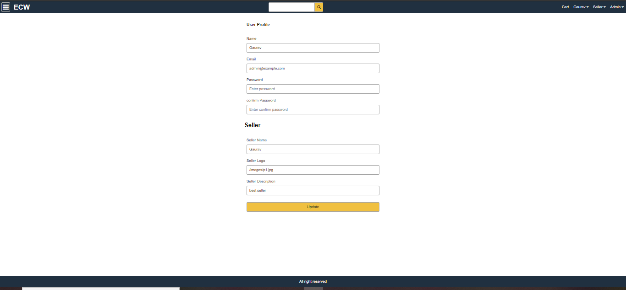
User//Seller Profile

