Slide 1
Inventra – Intelligent
Inventory Management
System
Module 1 - Authentication

Slide 2
Meaning of the Project
Inventra is a smart inventory management system.
It automatically tracks stock, predicts future needs, and manages orders.
The system helps reduce human errors, maintain proper stock levels, and improve business efficiency.
Inventra ensures smooth inventory and supply chain operations.
Inventra = Inventory + Intelligent Automation

Slide 3
Problem Statement
Many companies manage inventory manually, which can cause mistakes, missing items, and stock shortages. These methods do not show real-time stock details and make inventory control difficult. To avoid these problems, an automated and intelligent inventory management system is needed.

Slide 4
Solution Overview
Inventra addresses these challenges by:-
Automating inventory tracking
Providing real-time stock monitoring
Generating low-stock alerts automatically
Offering detailed reports and analytics
Ensuring secure access using authentication
Reducing human errors and improving efficiency

Slide 5
System CONFIGURATION
Front-End: HTML, CSS, JavaScript
Back-End: Java (JDK 8/11)
Frameworks: Springboot
Database: Postgre SQL
Tools: VS Code
User → Frontend → Backend → Database → Alerts / Reports

Slide 6
Key Classes - Authentication
AuthController – Manages login, signup, and password requests.
AuthService – Handles authentication logic and validation.
User – Represents user information in the system.
UserRepository – Performs database operations for users.
JWTUtility – Creates and verifies JWT tokens.
EmailService – Sends password recovery emails.

Slide 7
Module 1
Authentication
Handles secure user login and logout functionality
Validates user credentials against stored data
Ensures authorized access to the system
Prevents unauthorized users from accessing inventory data
Maintains session control for logged-in users
Uses role-based access (Admin/User)

Slide 8
Module 1
Authentication
Input:
Username and password entered by user
Process:
Validates credentials against database
Verifies user role (Admin / Staff)
Creates and manages user session
Output:
Secure login access
Role-based dashboard displayed

Slide 9
Dataflow
AuthController
↓
AuthService
↓
UserRepository
↓
DATABASE
↓
users table

Slide 10
Database Schema
Field | Datatype | Description
User_id | Primary Key | Unique User ID
Username | Varchar | Unique Username
Password | Varchar | User Email Address
Email | Varchar | Encrypted Password
Role | Varchar | Authorization/Permissions
Created_at | Datetime | Automatically records

Slide 11
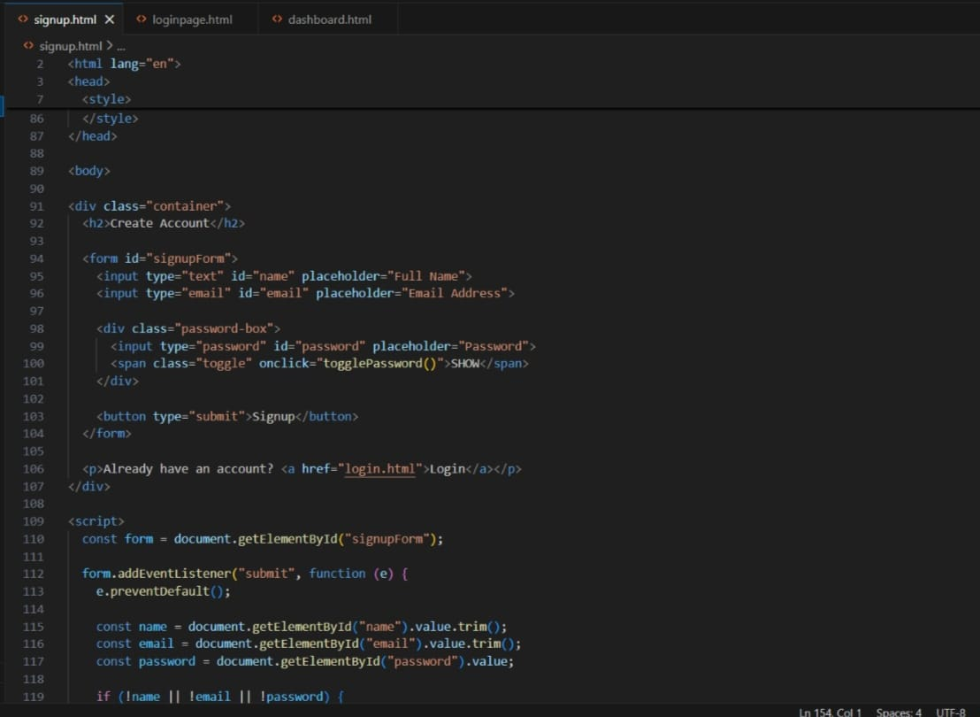
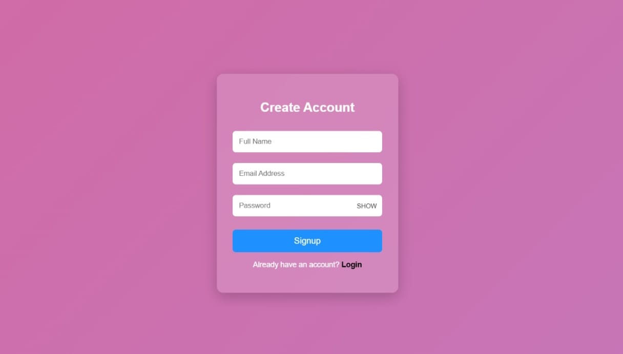
Signup

Slide 12
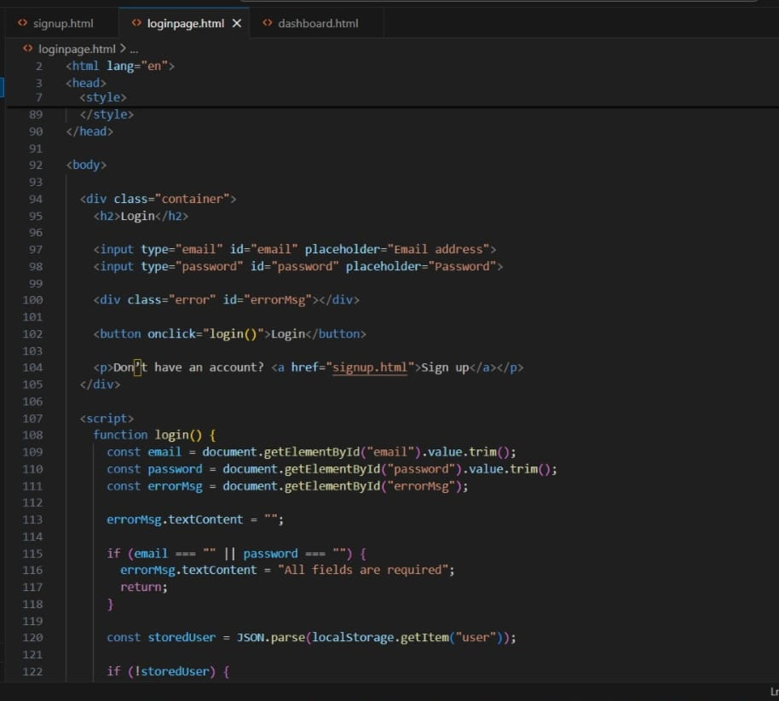
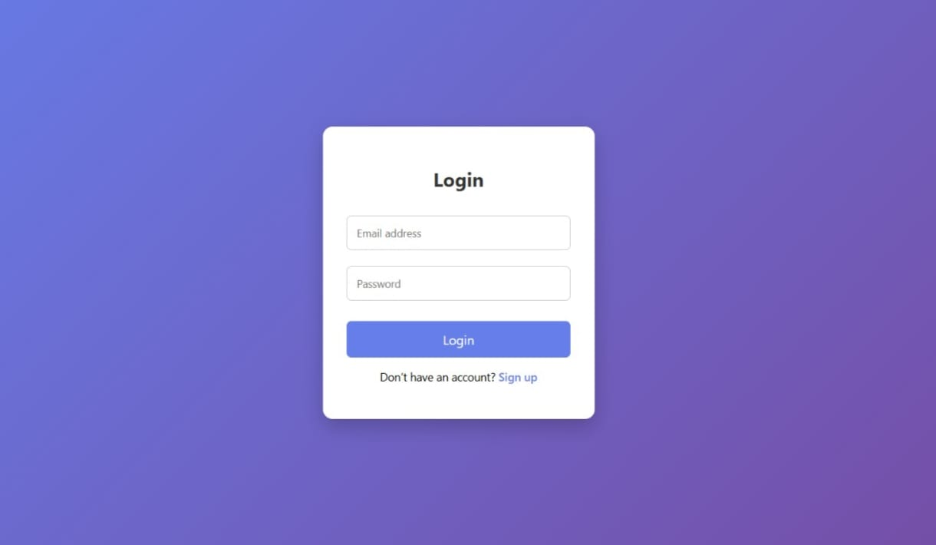
Loginpage

Slide 13
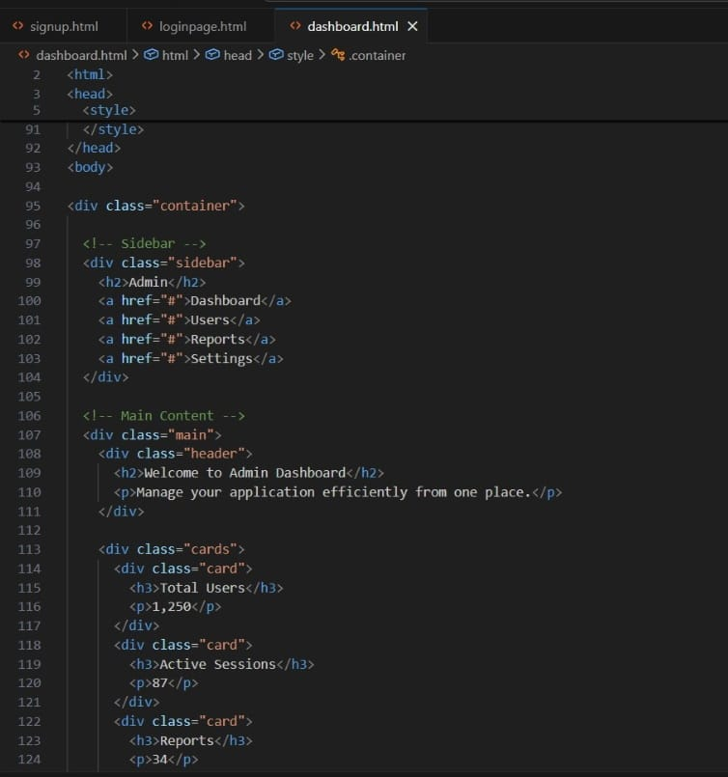
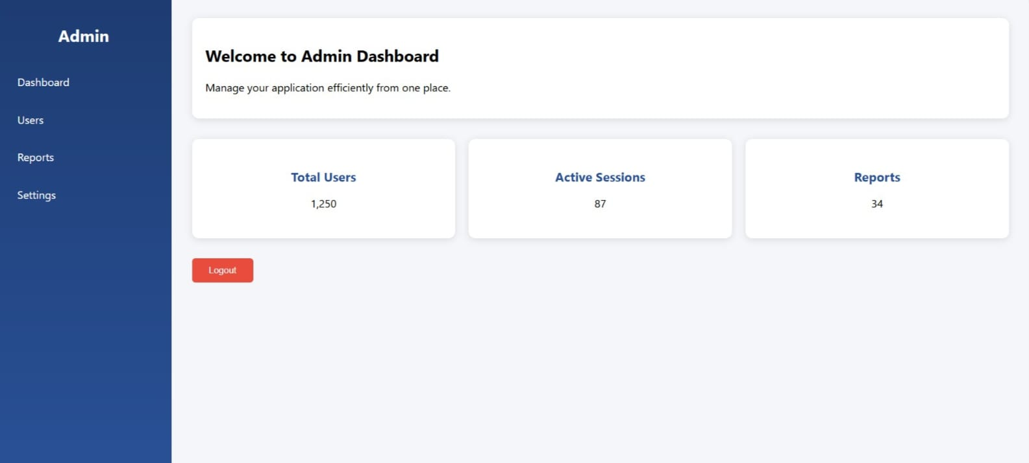
Dashboard

Slide 14
CONCLUSION
Inventory management is essential for organizations
Manual inventory systems lead to errors and inefficiency
An automated system is required for better control
Inventra provides real-time inventory tracking and alerts
The system helps reduce errors and improve operational efficiency

Slide 15
THANK YOU

