Slide 1
DOCKER

Slide 2
Docker commands
docker --version
To run an application in docker hub.com
sudo docker run in28min/todo-rest-api-h2:1.0.0.RELEASE
sudo docker run -p 5000:5000 in28min/todo-rest-api-h2:1.0.0.RELEASE
docker run -p 8761:8761 springcloud/eureka
sudo docker run -p 8761:8761 springcloud/eureka
To detach unneccesary logs
sudo docker run -d -p 8761:8761 springcloud/eureka
sudo docker run -d -p 5000:5000 in28min/todo-rest-api-h2:1.0.0.RELEASE

Slide 3
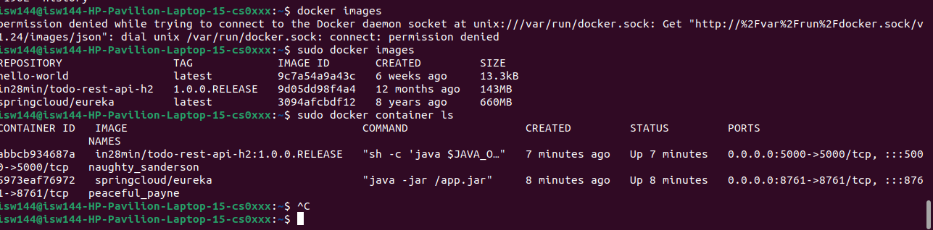
To pull docker images and containers

Slide 4
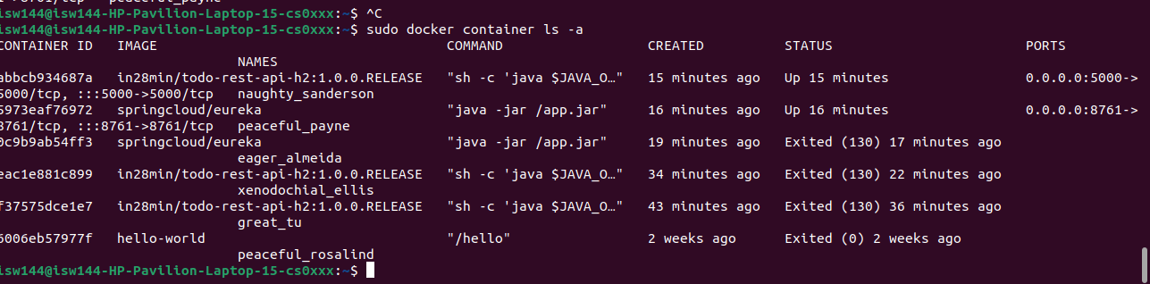

Slide 5
docker build -t springbootimg2 .
In this command, the dot . after -t springbootimg2 specifies the current directory as the build context. It means Docker will look for the Dockerfile in the current directory and use it as the starting point to build the image with the tag springbootimg2.

Slide 6
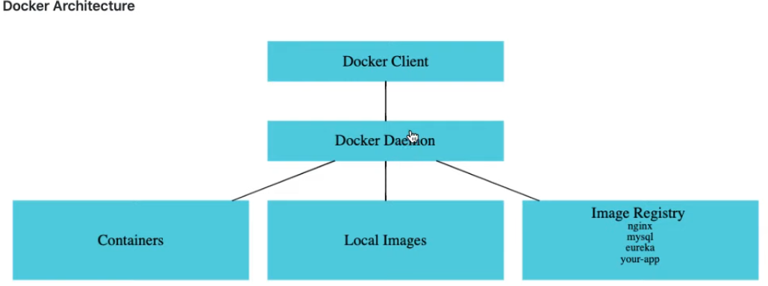

Slide 7
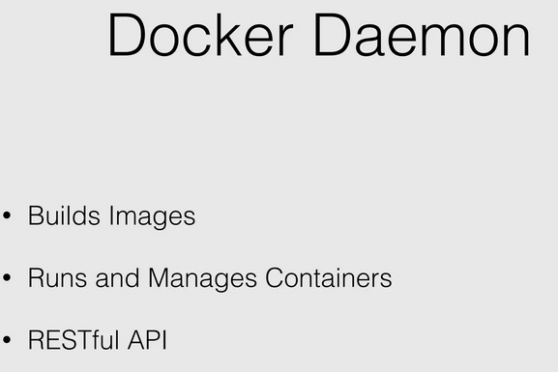

Slide 8
Differnce b/w docker image and container
Docker Image vs Container
1. An image is a read-only filesystem But a container an encapsulate set of processes which are running in a read-write copy of that filesystem.
2. Instead of regular copy copy-on-write use to optimize container boot time.
3. From a given image, Docker run starts a container.
4. The top writable layer is the major difference between a container and an image. Basically, all writes that add new or modify existing data to the container stores in this writable layer. And, while the container erases, that writable layer is also erased. But, that underlying image remains unchanged.

Slide 9
Docker Volumes
https://phoenixnap.com/kb/docker-volumes

Slide 10
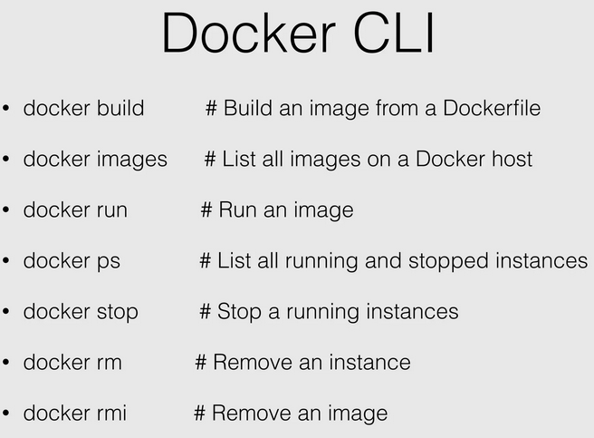

Slide 11
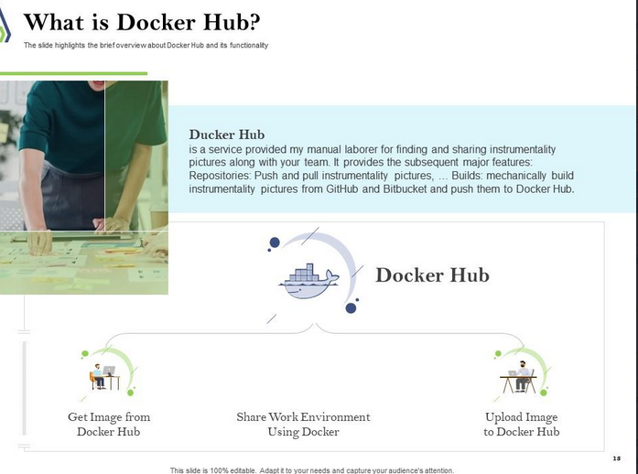

Slide 12
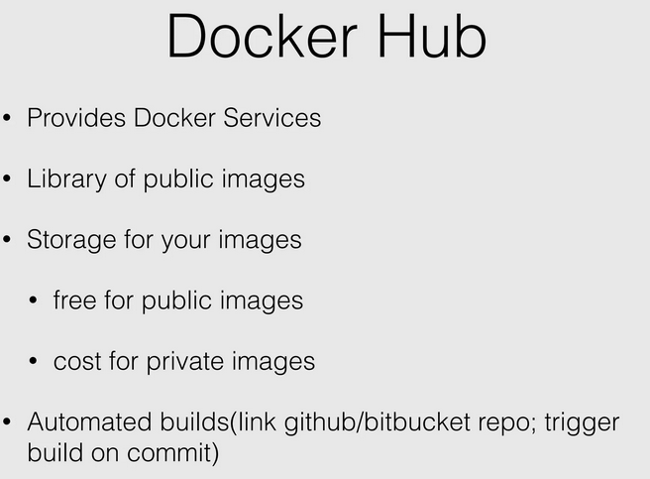

Slide 13
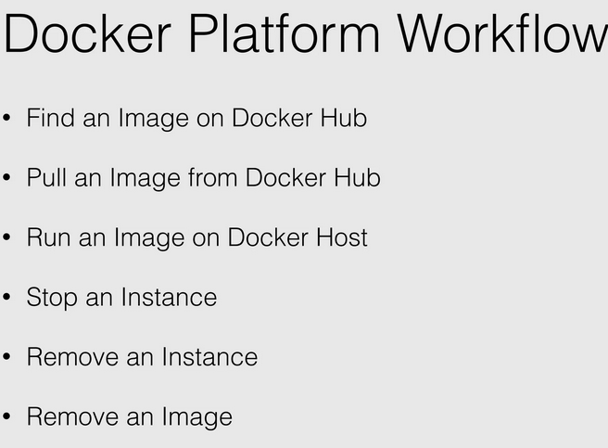

Slide 14
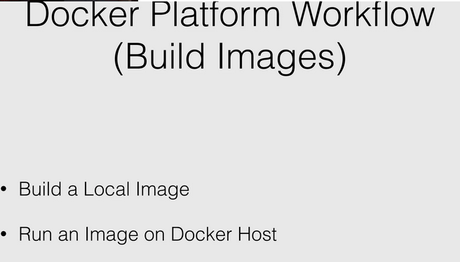

Slide 15
Docker networking
https://docs.docker.com/engine/tutorials/networkingcontainers/
https://www.aquasec.com/cloud-native-academy/docker-container/docker-networking/
https://training.play-with-docker.com/docker-networking-hol/#task1
What is a Docker in networking?
Docker networking allows you to attach a container to as many networks as you like. You can also attach an already running container.
Docker networking types:
There are three common Docker network types – bridge networks, used within a single host, overlay networks, for multi-host communication, and macvlan networks which are used to connect Docker containers directly to host network interfaces.

Slide 16

DOCKER AND JENKINS

Slide 17
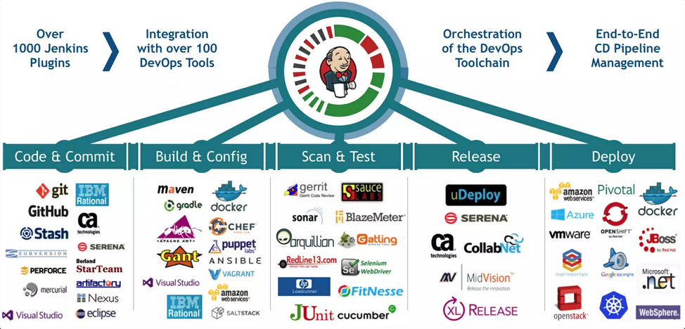

Slide 18
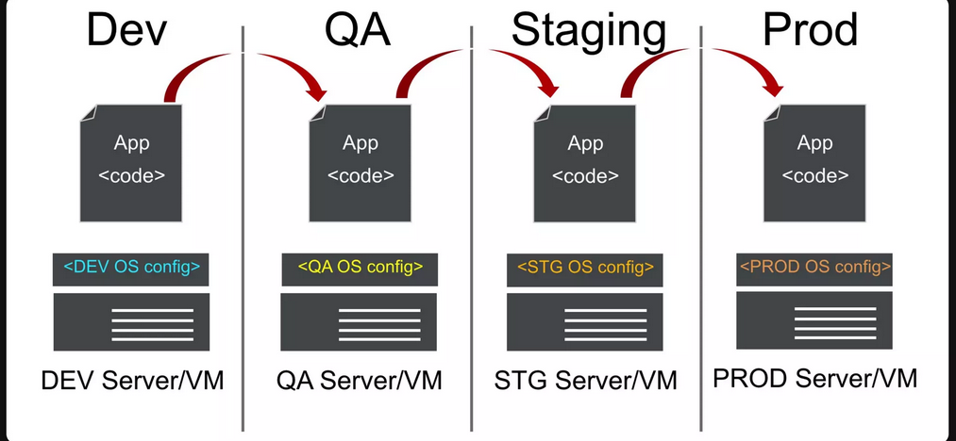

Slide 19
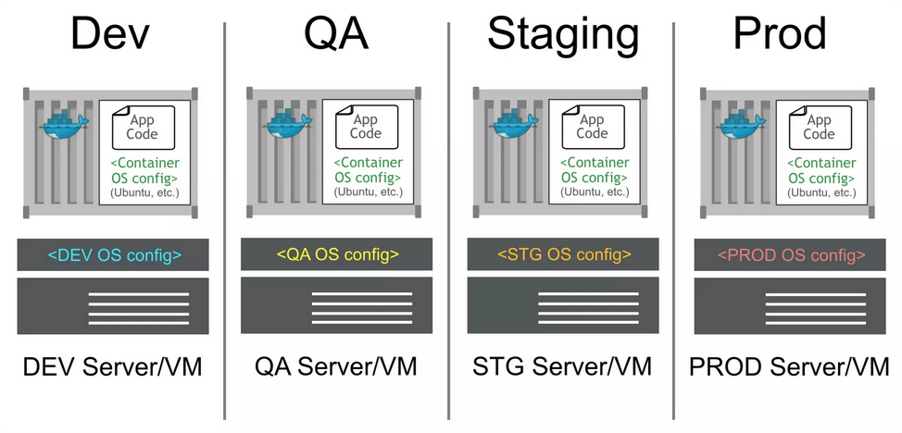
Containers codify OS config

Slide 20
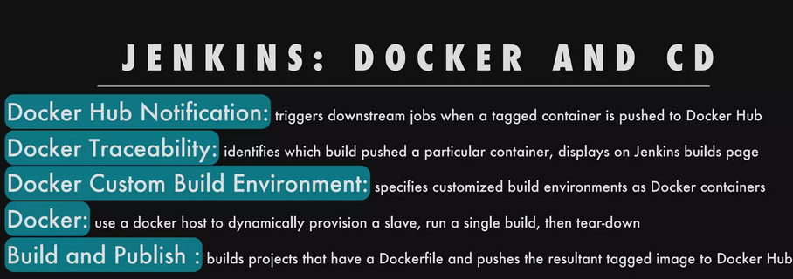

Slide 21
