Slide 1
UE19CS345 – Network Analysis and Mining
Course Project
Project Title :
YOUTUBE SOCIAL NETWORK ANALYSIS
TEAM NO : 10
SEC : B
PES2UG19CS082 Basanagouda S Hadimani
PES2UG19CS083 Batchu Sai Suraj
PES2UG19CS096 Chandrahas LG
PES2UG19CS099 Chintamani Bhat

Slide 2
Topic and its uniqueness
We know that Youtube is a video-sharing web site that includes a social network. In the Youtube social network, users form friendship each other and users can create groups which other users can join.
In this how well the users/ nodes are connected using different models like K-Core , and also finding the communities using SBM(Stochastic Block Mode)

Slide 3
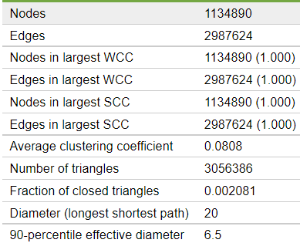
Dataset
The Dataset is taken from Stanford ( SNAP )
The Two Main attributes in the dataset are the User ID and the edges between them.
The Dataset consists of more than 10 lakh nodes (Different users ID’s), with more than 25 lakh edges ( Connections between users)
Dataset link : https://snap.stanford.edu/data/com-Youtube.html

Slide 4
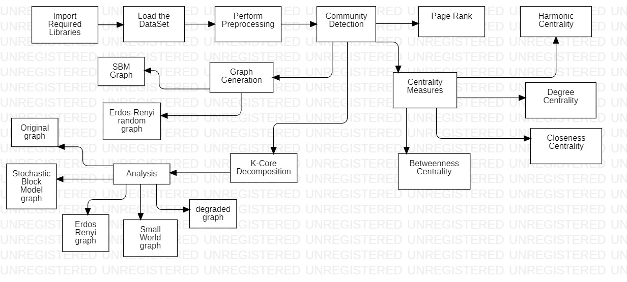
Overall design or approach in a free hand diagram

Slide 5
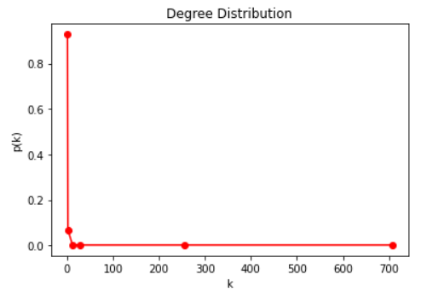
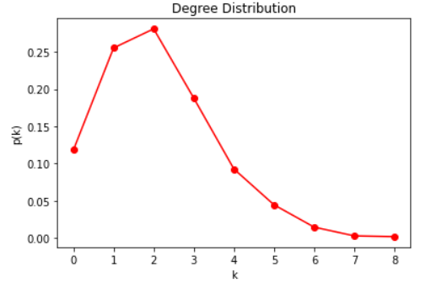


Final results
K-Core
SBM Graph

Slide 6
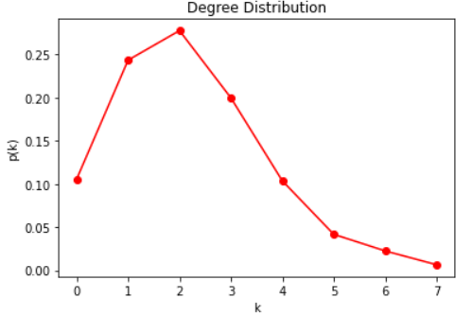

Final results
Erdos-Renyi random graph

Slide 7
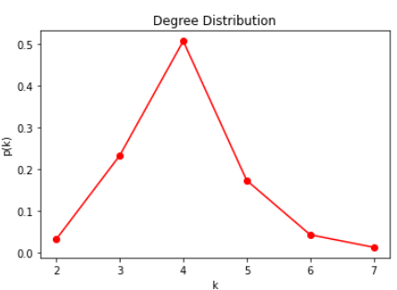
Final results
SMALL WORLD GRAPH:
The number of nodes is: 937
The number of edges is:
1874 The average degree (undirected graph) is: 4.0

Slide 8
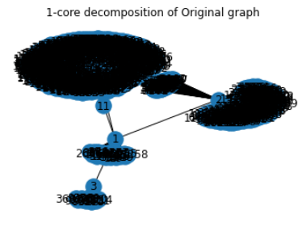
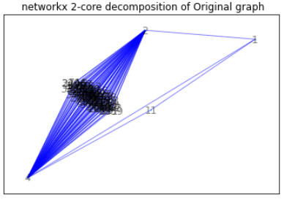
Final results
K –Core Decomposition

Slide 9
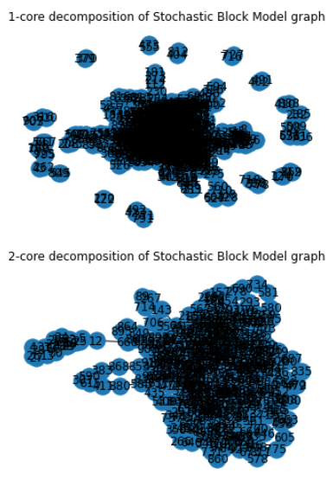
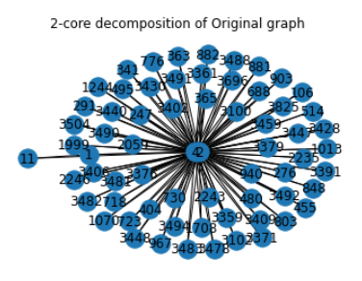
Final results
K –Core Decomposition

Slide 10
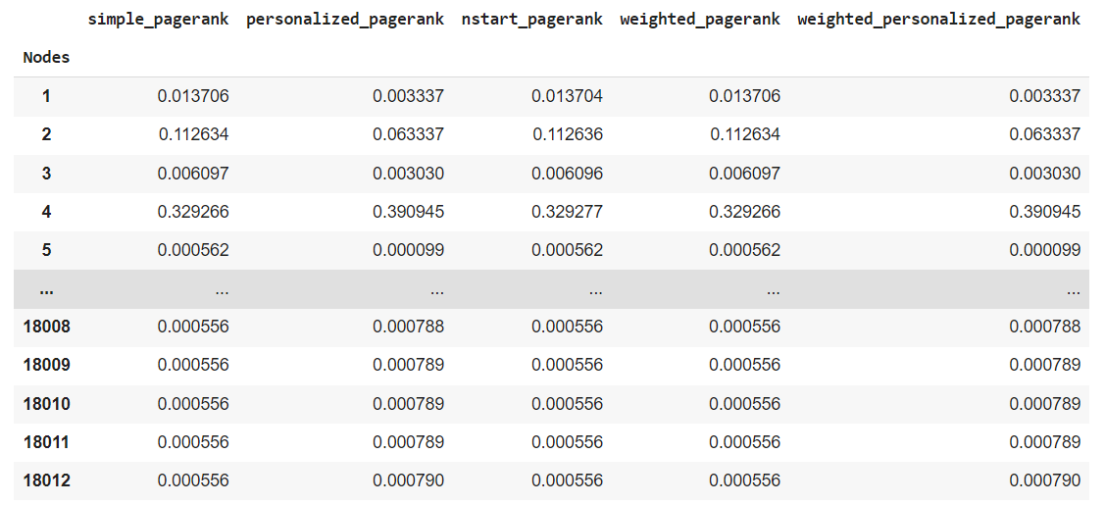
Final Result(Page Rank)

Slide 11
Final Result(Page Rank)
Analysis & Considerations:
The k-core decomposition on the original network generates graphs that seem to follow a preferential attachment behavior. There are nodes with very high degree and very few with low degree. This is compatible with the starting network, which is a natural. The decomposition of the Random and Small world graphs is not easily observable but surely for ER the subgraphs are random because the original distribution is normal and consequentially the sub graph distribution are normal and thus random. The same evaluation applies to SW. Degraded graphs also follow how it is possible to observe a power law.

Slide 12
Quantity and quality of work
no | Code functionality | % Complete | Runs without problem (Y/N) | If there are minor issues, indicate
1. | EDA | 100 | Y
2. | Featurization | 100 | Y
3. | Feature Engineering | 100 | Y
4. | Implementing (K-core) | 100 | Y
5. | Implementing (SBM) | 100 | Y
6. | Implementing (Erdos-Renyi random ) | 100 | Y
7. | Different Centralities | 100 | Y
8. | Analysis with Diff graphs | 100 | Y

Slide 13
Top few learning
Serial No | Top learning in this project
1 | Learnt to implement and learn about what is Erdos-Renyi random graph
2. | Learnt to implement and learn about what is Harmonic Centrality and different Centrality measures.
3. | Learnt to implement and learn about what is K-core Decomposition with different types of graphs

Slide 14
Reference papers, if any
No | Paper Title | Authors
1 | Defining and Evaluating Network Communities based on Ground-truth | J. Yang and J. Leskovec
2 | A semantic model for academic social network analysis | Jie Hu;Mengchi Liu;Junchi Zhang
3 | Predicting Social Network Measures | Przemyslaw Kazienko;Radoslaw Michalski;Dawid Krol

