Slide 1
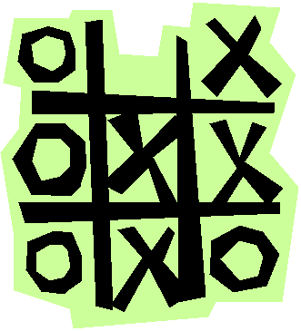

Slide 2
PYTHON PROGRAMMING
TICTACTOE GAME
PREPARED BY:CHINTAN VEKARIYA
ID NO:19DCS156
DEPSTAR-CSE
GUIDED BY: PROF. KRISHNA PATEL

Slide 3
CONTENT:
INTRODUCTION
STRATEGY
IMPLEMENTATION
FUTURE ENHANCEMENT
LIMITATION

Slide 4

INTRODUCTION:
Tic-tac-toe, also called noughts and crosses (in the British Commonwealth countries), Xs and Os (in Ireland) and X and 0 (in India) is a pencil-and-paper game for two players, X and O, who take turns marking the spaces in a 3×3 grid. The player who succeeds in placing three respective marks in a horizontal, vertical, or diagonal row wins the game. Players soon discover that best play from both parties leads to a draw (often referred to as cat or cat's game). Hence, tic-tac-toe is most often played by young children.
The following game example is won by player-’X’:

Slide 5
STRATEGY:
Optimal strategy for player X. In each grid, the shaded red X denotes the optimal move, and the location of O's next move gives the next subgrid to examine. Note that only two sequences of moves by O (both starting with center, top-right, left-mid) lead to a draw, with the remaining sequences leading to wins from X.
A player can play perfect tic-tac-toe (win or draw) given they choose the first possible move from the following list.
Win: If the player has two in a row, he or she can place a third to get three in a row.
Block: If the [opponent] has two in a row, the player must play the third himself or herself to block them.
Fork: Creation of an opportunity where the player has two threats to win (two non-blocked lines of 2).
BLOCKING AN OPPONENT’S FORK:
Option 1 : The player should create two in a row to force the opponent into defending, as long as it doesn't result in them creating a fork. For example, if "X" has a corner, "O" has the center, and "X" has the opposite corner as well, "O" must not play a corner in order to win. (Playing a corner in this scenario creates a fork for "X" to win.)
Option 2: If there is a configuration where the opponent can fork, the player should block that fork.
Center : A player marks the center. (If it is the first move of the game, playing on a corner gives "O" more opportunities to make a mistake and may therefore be the better choice; however, it makes no difference between perfect players.)
Opposite corner : If the opponent is in the corner, the player plays the opposite corner.

Slide 6
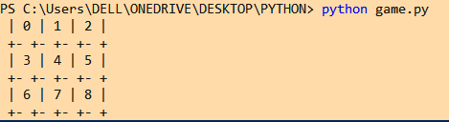
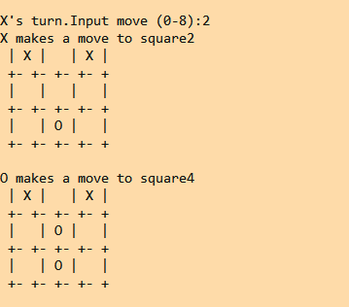
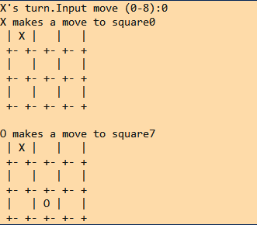
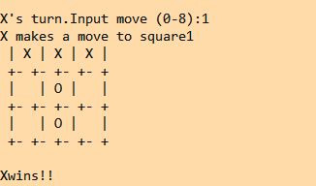
IMPLEMENTATION:
COMPUTER OPPONENT

Slide 7
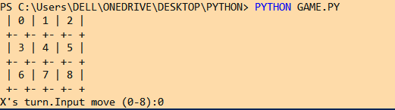
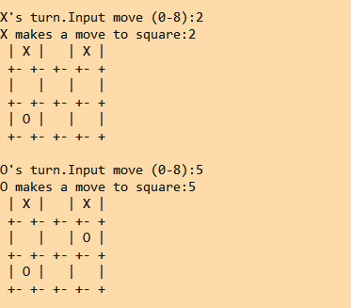
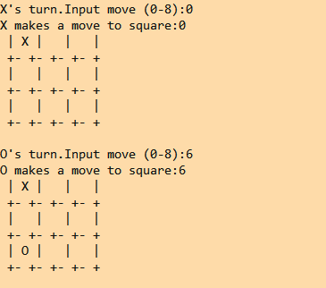
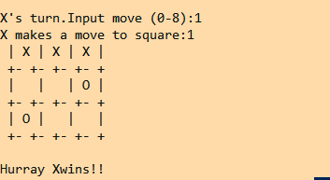
IMPLEMENTATION:
HUMAN OPPONENT

Slide 8
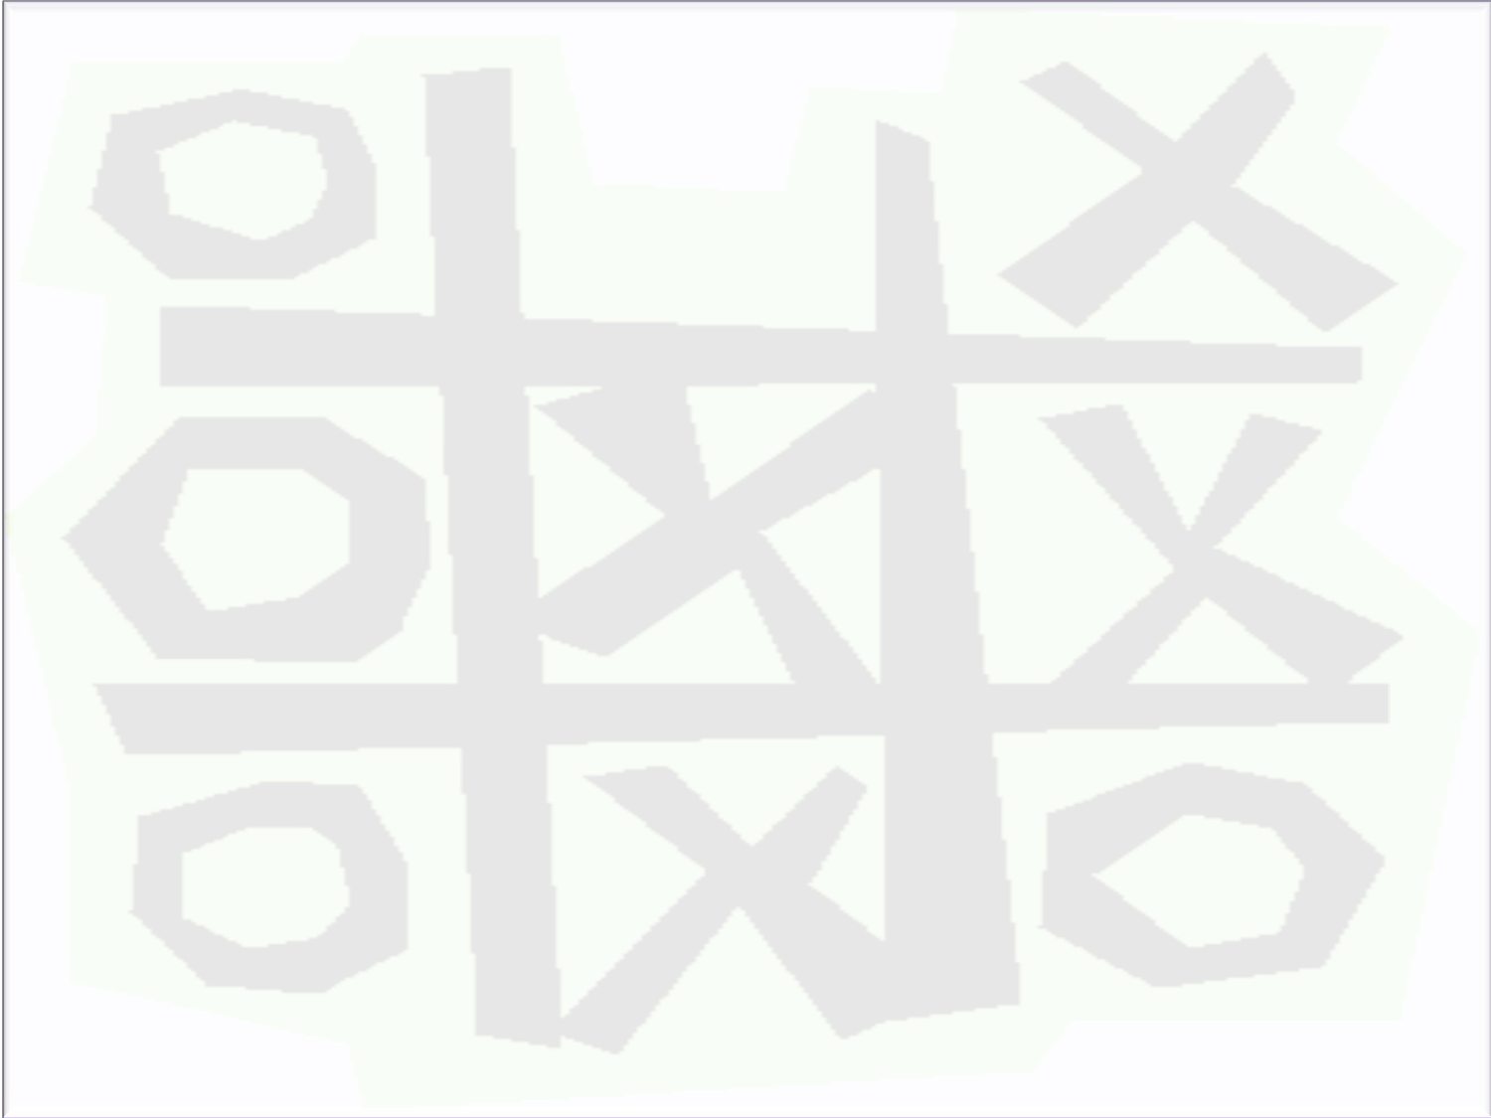
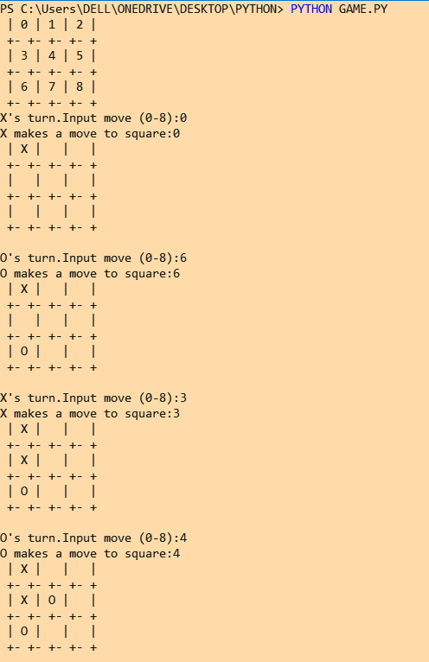
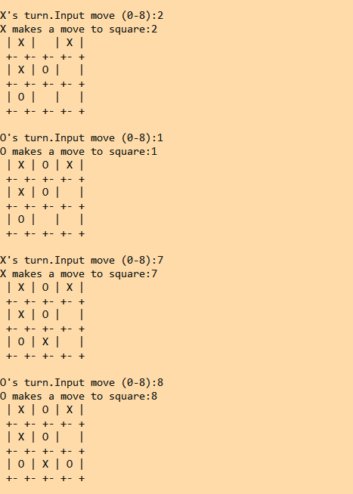
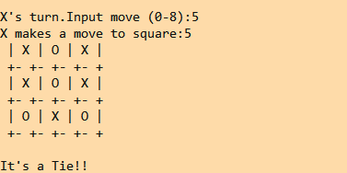
IIMPLEMENTATION:
TIE GAME

Slide 9
FURTHER ENHANCEMENTS:
Players soon discover that best play from both parties leads to a draw (often referred to as cat or cat's game). Hence, tic-tac-toe is most often played by young children.
The friendliness of tic-tac-toe games makes them ideal as a pedagogical tool for teaching the concepts of good sportsmanship and the branch of artificial intelligence that deals with the searching of game trees. It is straightforward to write a computer program to play tic-tac-toe perfectly, to enumerate the 765 essentially different positions (the state space complexity), or the 26,830 possible games up to rotations and reflections (the game tree complexity) on this space
With the use of minimax algorithm we can design this game such that the computer player never loses their can be aa tie game but never loses.
A minimax algorithm is a recursive algorithm for choosing the next move in an n-player game, usually a two-player game. A value is associated with each position or state of the game. This value is computed by means of a position evaluation function and it indicates how good it would be for a player to reach that position.

Slide 10
LIMITATION:
This game cannot be played by one or more than 2 players.
It is not a high level game.
It doesn’t contain levels.

Slide 11


