Slide 1
SUPPLY CABINET
Prepared by:
CHINTAN VEKARIYA-19DCS156
Android Application Development
DEPSTAR-CSE(SEM-3)
GUIDED BY:
PROF. RIMA PATEL AND PROF. PRIYAL VAGHELA

Slide 2
CONTENTS:
DEFINTION-MOTIVATION.
SCOPE OF SYSTEM.
PROBLEM STATEMENT AND SOLUTION.
LIST OF REQUIREMENTS.
FLOWCHART AND IMPLEMENTATIONS.
SOFTWARE REQUIREMENTS.
FUTURE SCOPE.
CONCLUSION.

Slide 3
DEFINITION
Stock management is the function of understanding the stock mix of a company and the different demands on that stock.
The two basic inventory decisions that managers face are:
1.) How much additional inventory to order or produce.
2.) When to order or produce it.
Typically, the objective is to minimize total inventory costs. Total inventory costs typically include holding, ordering, shortage, and purchasing costs.
In a continuous review system, managers continuously monitor the inventory position. Whenever the inventory position falls at or below a level R, called the reorder point, the manager orders Q units, called the order quantity. In order to manage all these information ,there arises a need of building a system which holds all this data in order to make the inventory operations a bit clarified for the users.

Slide 4
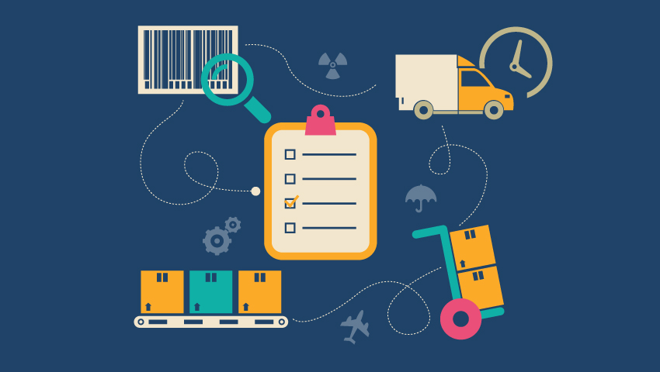
MOTIVATION:
Accuracy is everything when it comes to efficient distribution. Smart warehouse distribution application is critical to getting eyes on your inventory and accuracy in your data. With the right distribution ERP(Enterprise Resource Planning ) system, distributors can avoid costly mistakes found in paper-based and manual processes, where there is ample room for error.
Easy-to-use wireless technology synced with modern inventory management app gives distributors real-time visibility as well as streamlined and improved warehouse efficiency.
REAL-TIME VISIBILITY on warehouse inventory
ACCURACY in tracking receiving, put-away and picking
OPTIMIZED inventory management.

Slide 5
SCOPE OF SYSTEM
The scope of an inventory system can cover many needs, including valuing the inventory, measuring the change in inventory and planning for future inventory levels.
Measuring the change in inventory allows the company to determine the cost of inventory sold during the period.
This allows the company to plan for future inventory needs.
The value of the inventory at the end of each period provides a basis for financial reporting on the balance sheet.

Slide 6
PROBLEM STATEMENT:
Inventories are necessary for sales, which generate profits and poor management of inventories results in excess inventory, resulting in a lower return on capital invested, affecting the cash conversion cycle.
The approximate cost to hold inventory is very high, so maintaining excessive levels of inventories can ruin the company, as they have to reduce prices and absorb losses, and if missing could reduce sales, now maintain inventory levels according to sales forecasts.
Good planning and sales forecast before setting optimal inventory levels, appropriate inventory management requires close coordination between the areas of sales, purchasing and finance.

Slide 7
SOLUTION TO THE CURRENT PROBLEM:
The one of the possible solution for the prevailing problem is to develop a native app for the company central that manages all the inventory up’s and down’s of the stocks for the company.
Using these the user get the full access of all the inventory information of the company at one single platform reducing the paper work of the vendor’s details, stock details, and many more.

Slide 8
CONSOLIDATED LIST OF REQUIREMENTS
This app will be flexible in the android OS in Android Pie ( Android version 9 ) or more.
This app will have sustainability for the long time and will be able to work for longer time.
This app can run in any android phone and app have the facility of safety of your account.

Slide 9
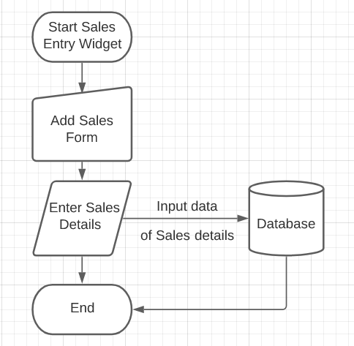
FLOWCHART:
Gives the idea about the Sales as well as Product entry of the app.

Slide 10
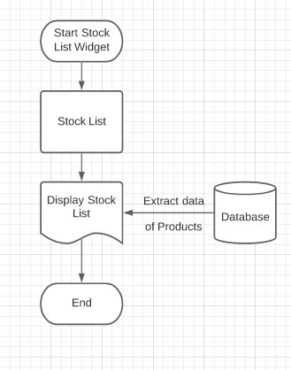
Shows the Stock List details of the app.

Slide 11
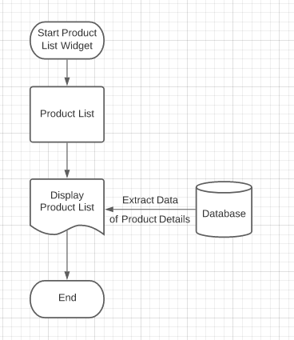
Gives the details of Product list in the app.

Slide 12
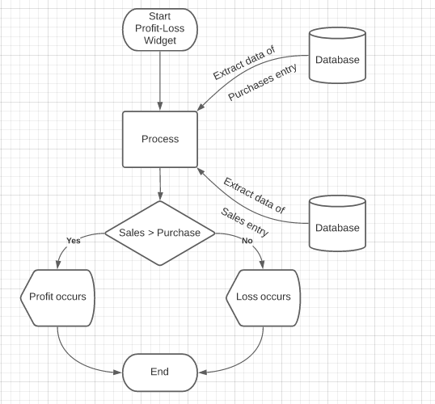
For calculating the profit-loss of the company.

Slide 13
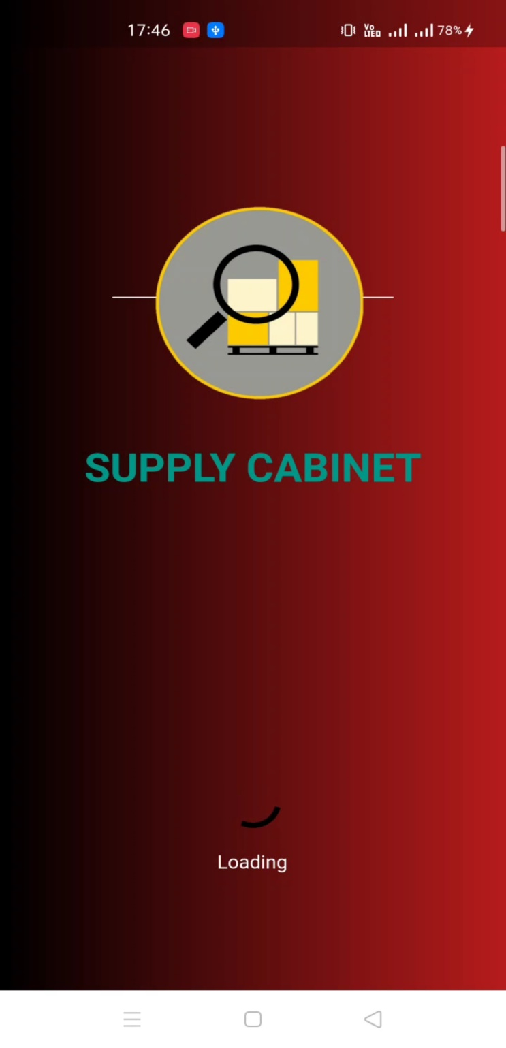
IMPLEMENTATION:
The basic splash screen of the app that is implemented till date.

Slide 14
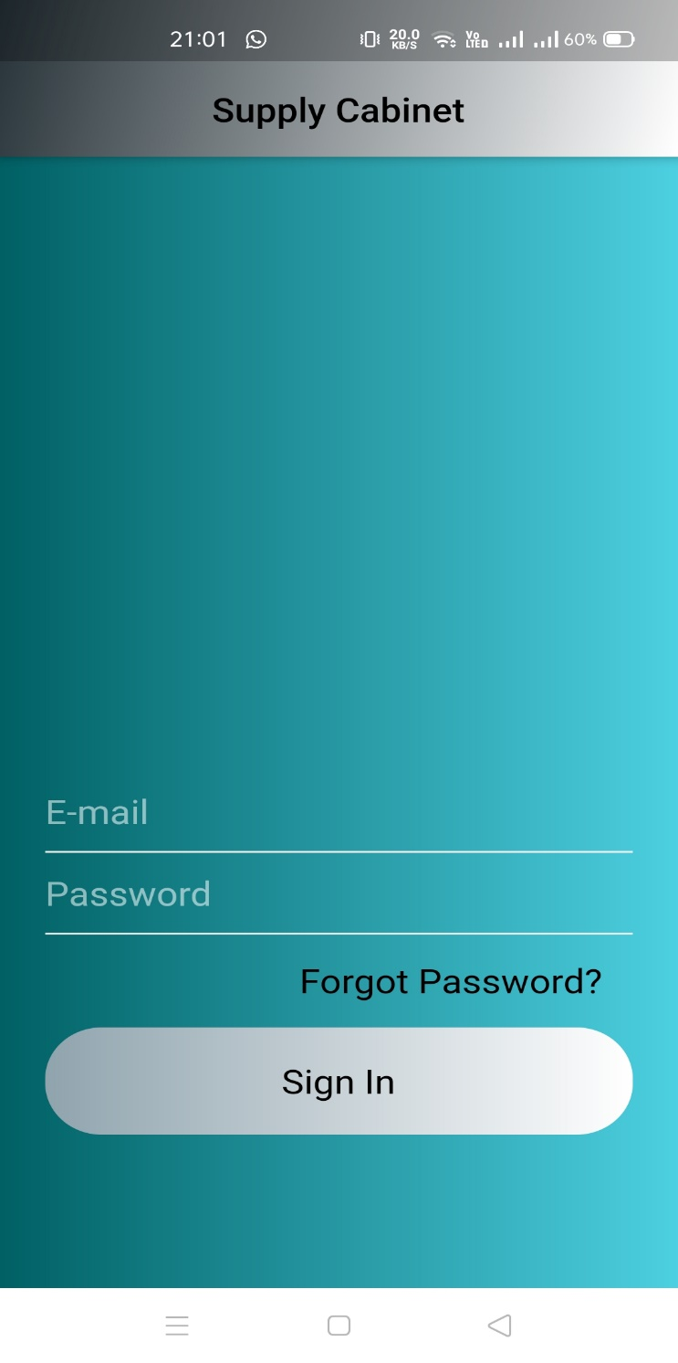
IMPLEMENTATION:
The Logging-In screen of the app that is implemented till date.

Slide 15
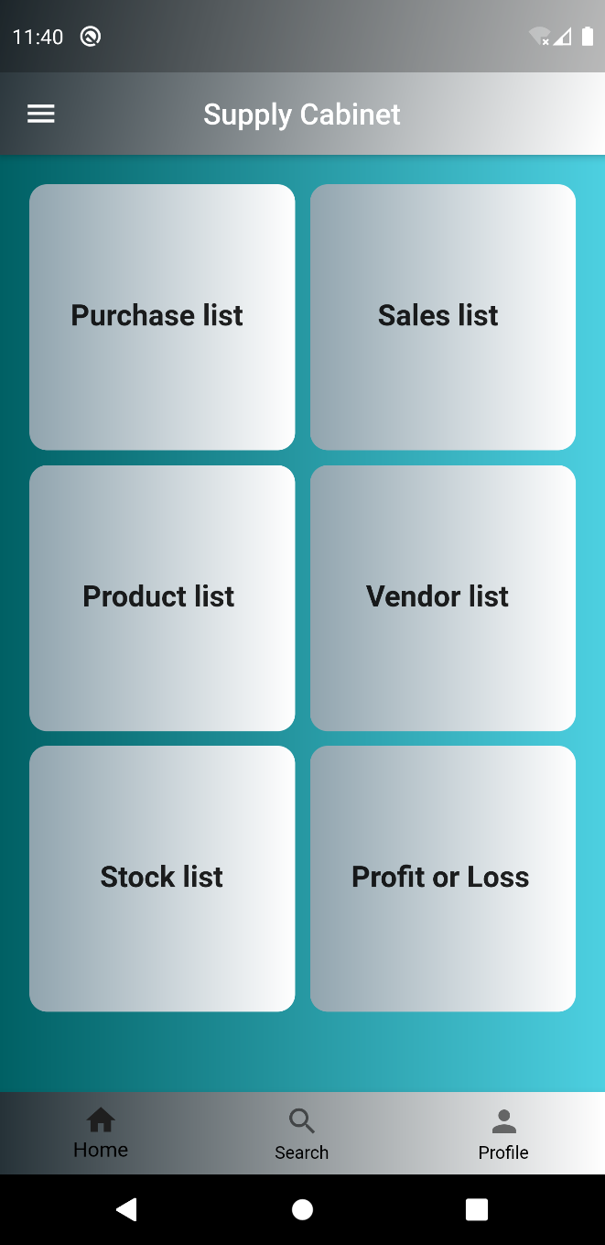
IMPLEMENTATION:
The basic home page of the app that is implemented till date.

Slide 16
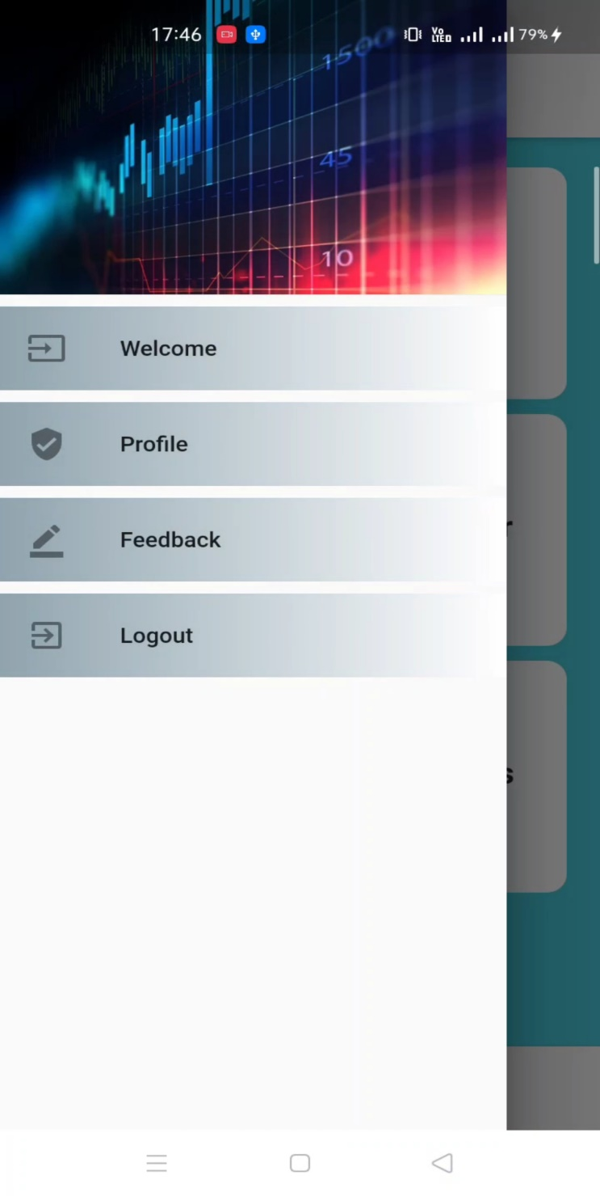
IMPLEMENTATION:
The basic side menu page of the app that is implemented till date.

Slide 17
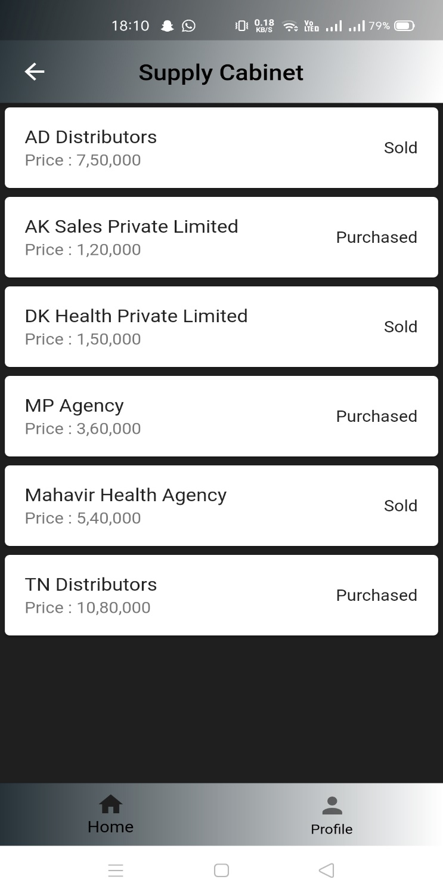
IMPLEMENTATION:
The profit-loss page of the app that is implemented till date.

Slide 18
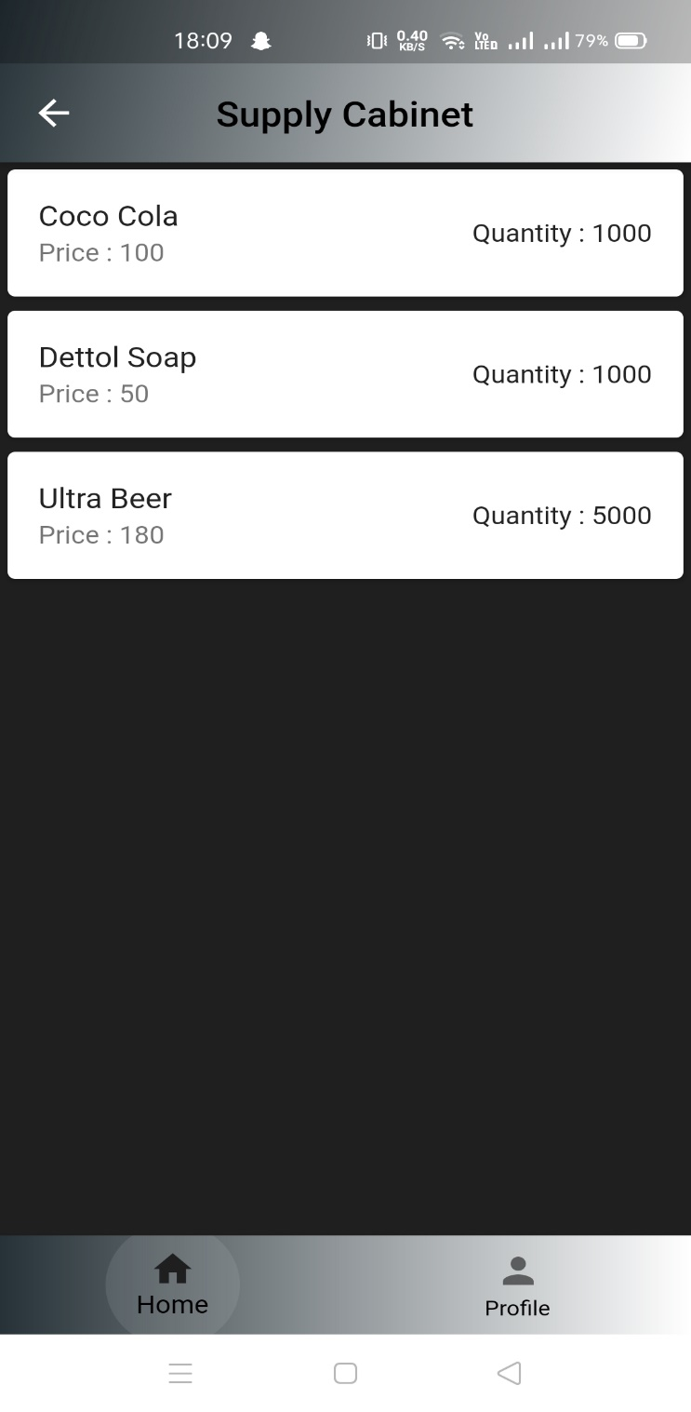
IMPLEMENTATION:
The Stocks List page of the app that is implemented.

Slide 19
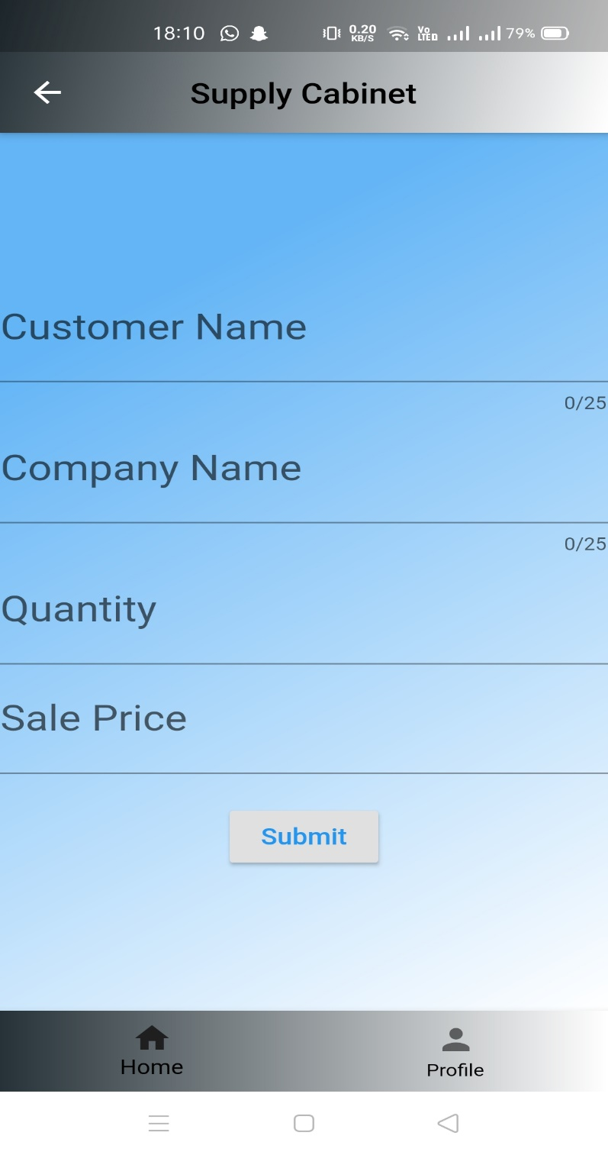
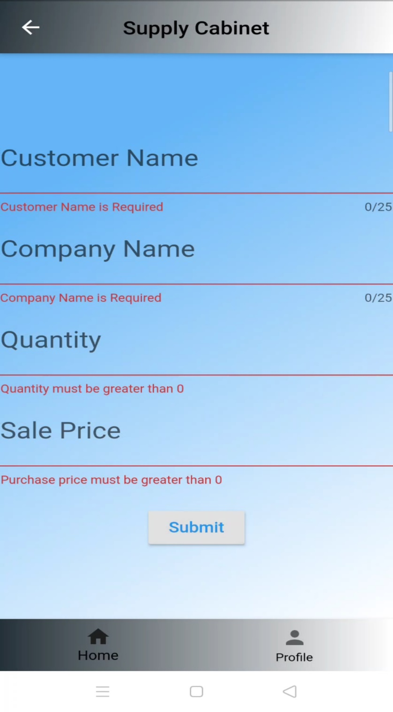
IMPLEMENTATION:
The Sale Form page of the app that is implemented.

Slide 20
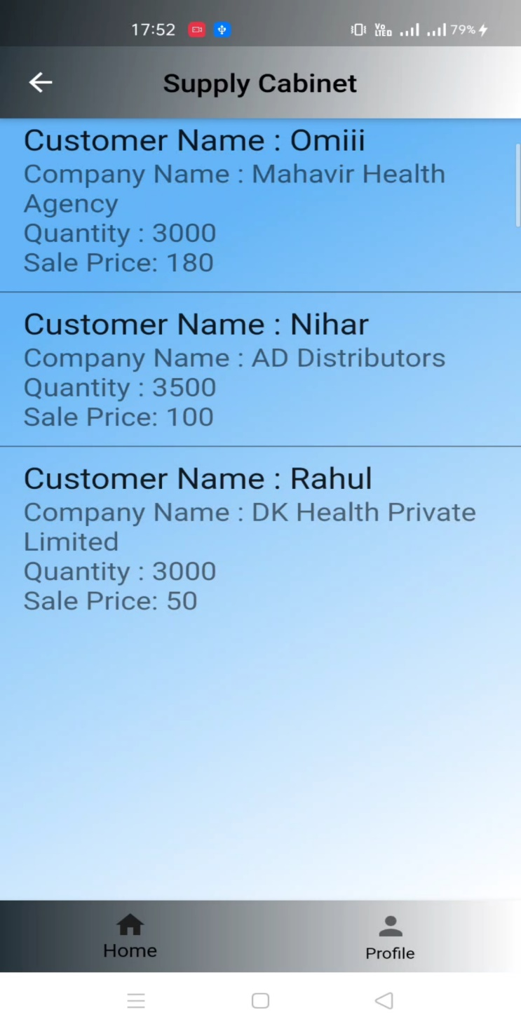
IMPLEMENTATION:
The Sale List page of the app that is implemented till date.

Slide 21
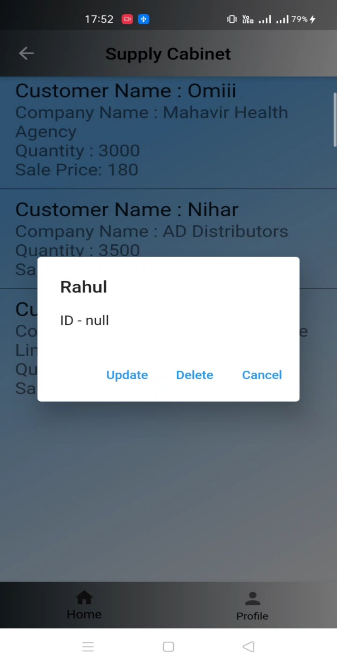
IMPLEMENTATION:
The Sale List Page for updating the values or deleting the whole information of the customer.

Slide 22
SOFTWARE REQUIREMENTS:
FRONTEND DEVELOPING:
Flutter.
Android Studio.
Visual Studio Code.
Dart Packages.
BACKEND DEVELOPING:
SQFlite packages for CRUD operation for database.
Visual Studio Code.
Dart Packages.

Slide 23
FUTURE SCOPE
Collaboration with supply chain partners, coupled with a holistic approach to supply chain management, will be key to effective inventory management.
The nature of globalization will change, impacting inventory deployment decisions dramatically.
Increased focus on supply chain security, and concerns about the quality of inventory itself, will be primary motivators to changing supply chain and inventory strategy.
In order to get a computer-based inventory and sale system to the customer as soon as possible, the entire system will not be delivered at once. A basic system to control sales and inventory will be delivered first. This section contains information on upcoming software to enhance the capabilities of the basic product.

Slide 24
CONCLUSION
Inventory management has to do with keeping accurate records of goods that are ready for shipment.
Inventory management is important for keeping costs down and to maintain a balance in demand-supply of goods.
High maintained applications will help the inventory management system to be become better as well as efficient in all way.
This will lead to customer satisfaction as well in it.

Slide 25
REFERENCES:
https://play.google.com/store/apps/details?id=com.sfvinfotech.stockmsystem
https://play.google.com/store/apps/details?id=com.learn24bd.ssm
https://www.youtube.com/watch?v=x0uinJvhNxI
https://www.youtube.com/watch?v=dolq0svRexQ
https://youtu.be/tj7Lj9a3fyM
https://www.youtube.com/playlist?list=PL-1QdJ8od_eyxntzYQhwCkcVZlqWVrmSf

Slide 26


