Slide 1
TrafficIQ — Smart Traffic System
Intelligent Traffic Congestion Prediction & Authority Control Hub
Built for Delhi-NCR Urban Management

Slide 2
Project Overview
• Real-time city-wide traffic monitoring via interactive dashboard
• ML-powered congestion prediction with 48h forecasts
• Live mapping using Leaflet with segmented Delhi-NCR corridors
• Command & Control Hub for Police and City Authorities

Slide 3
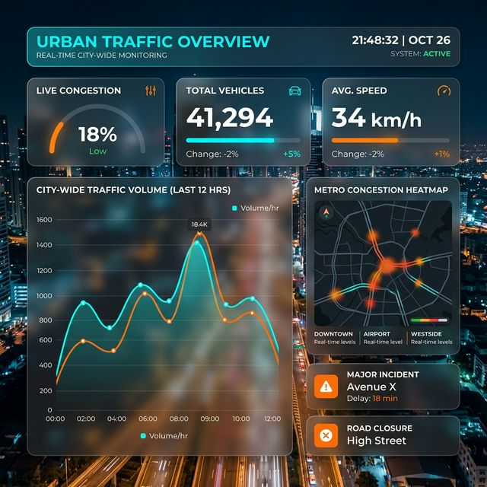
Live Traffic Dashboard
• Real-time stats cards (Active segments, Congested zones)
• Integrated 24h Traffic Volume Analytics
• Instant Incident notifications & reports
• Cross-platform responsive Design

Slide 4
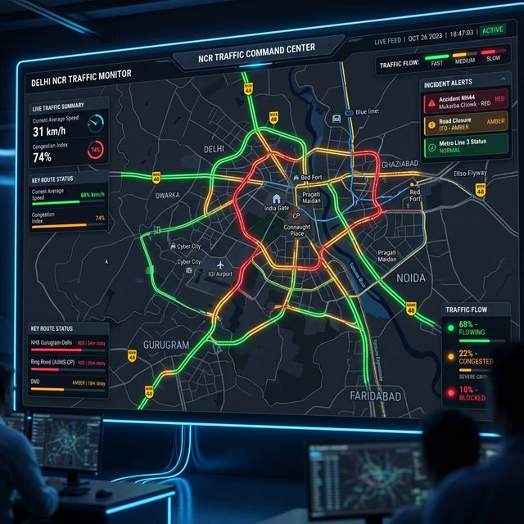
Delhi-NCR Live Map
• Interactive Leaflet.js mapping engine
• Region-specific segments (Central, South, Noida, Gurgaon)
• Traffic Level Color Coding (Green, Amber, Red)
• Dynamic segment stats & speed metrics

Slide 5
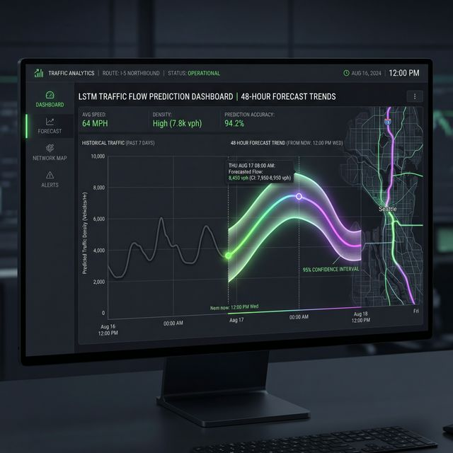
ML Prediction Engine
• Hybrid Architecture: LSTM + ARIMA + Gradient Boosting
• 48-Hour High-Confidence Forecasts
• Accuracy Rating: 94.2% (MAPE 5.8%)
• Feature Importance analysis for urban planning

Slide 6
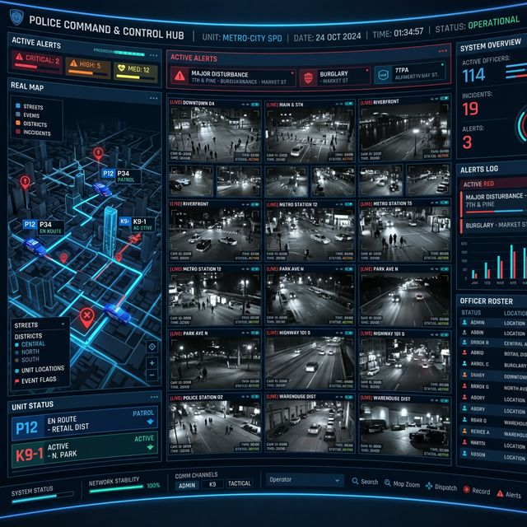
Police Command & Authority Hub
• Live CCTV surveillance integration
• PCR Unit Tracking & E-Challan generation
• Emergency Signal Override Control
• Crisis Simulation (Evacuation & Flood routes)

Slide 7
Technology Stack
• Frontend: HTML5, CSS3, Javascript (Modern ES6+)
• Backend: Python 3.x, Flask, Flask-CORS
• Libraries: Leaflet (Maps), Chart.js (Data Viz)
• AI/ML: Scikit-learn, TensorFlow, Random Forest Ensemble

Slide 8
Future Scope & Conclusion
• Scalability: Easy integration for other metropolitan cities
• AI Refinement: Real-time sensor data ingestion via IoT
• Mobile Integration: Dedicated app for commuters & field officers
• Conclusion: A robust tool for the future of Smart Cities

