Slide 1
Play Store Analysis
In This we Analyze the Apps on Google Playstore and Get the Business insights from them with Respect to Features like:
1. Category
2. Reviews on Playstore
3. Size of app
4. No of Installs
5. Type of app
6. Price of app
7. Content of app
8. Rating on Playstore
9. Android Version Supported
By:
Chintan Chitroda

Slide 2
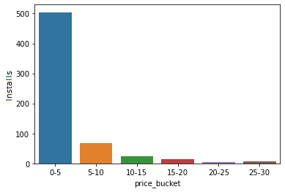
Apps analysis based Price
We see that Play store has most apps free and Less number of apps are paid .
The Install of Free application is much higher than the paid apps
Price in Dollar

Slide 3
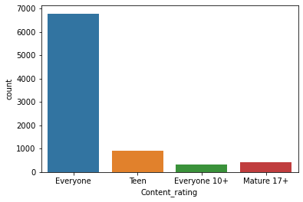
Content Rating
We see that Content Rating for category ‘Everyone’ is highest.
Installation and Rating for category “Everyone” is more in compare to “Teen”, “Everyone 10+” and “Mature 17+”

Slide 4
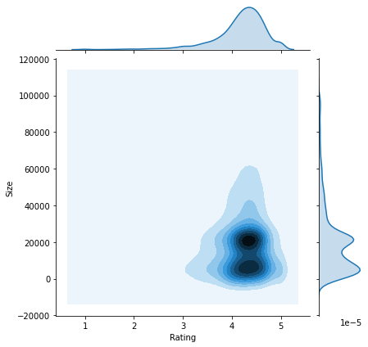
Effect of Size on Rating
We see that the near rating between 4 and 5 and Size 0 to 20K has the high Density.
This show us that the small size Apps has Higher Rating in comparison to big/Large size Apps
People rate more small sized apps as they high number of Download.
Joint Plot

Slide 5
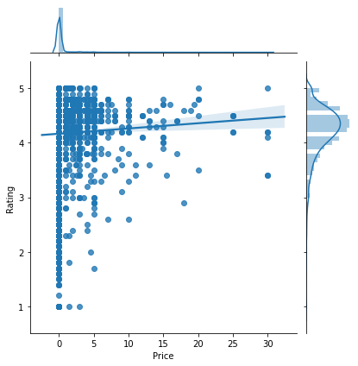
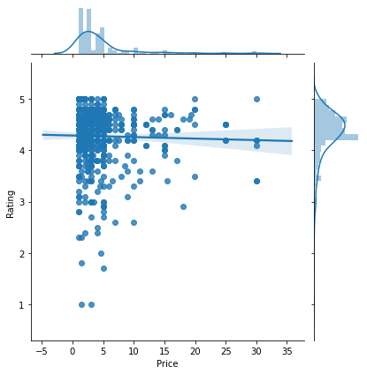
Effect of price on rating
These both graph/jointplots has regression line, which is fig 1 has apps with price 0 and fig 2 has apps without price 0.
There is not much but bit of difference in Rating between fig 1 and 2 but a slight change in regression line.
In fig 1 The regression line is bit increasing order in compare to fig 2 where the regression line is in bit decreasing order.
fig1
fig2

Slide 6
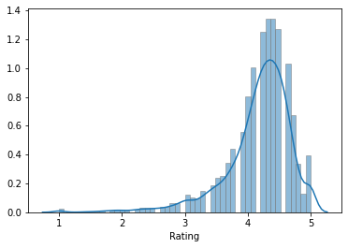
Ratings
Mean of Distribution is 4.170800237107292 & Median of Distribution is 4.3 which is greater than mean
This Distribution Plot shows us the Distribution of Ratings.
Mean of Distribution is 4.170800237107292 & Median of Distribution is 4.3 which is greater than mean
This has skwness of -1

Slide 7
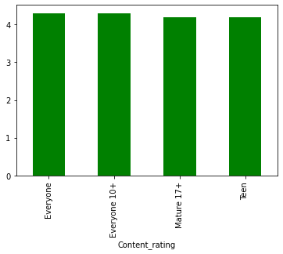
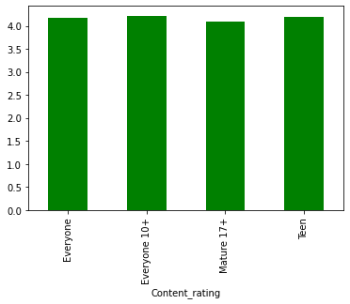
Rating vs Content Rating
We see here that all each categories has Ratings above 4.
Each has a median and mean rating of 4
Median based plot
Mean based plot

Slide 8
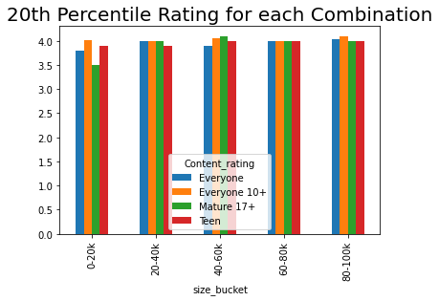
This figure shows us the plot for Apps size with Content Rating and Rating
Rating

Slide 9
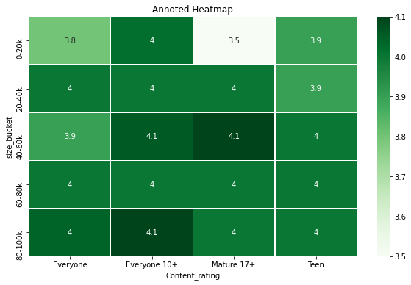
This Annoted Heatmap shows us the co-orealationship between Apps Sizes , Content Rating and Rating.
It shows us the apps in size ranges between 40-60k and 80-100k has the best content Rating .

Slide 10
Conclusion
Price has a high co-orelationship with Installs
Price effects the Rating of the App.
Size effect the Rating of App.
Content Rating also Affects Ratings
Overall the apps with low Price and small size have benefits over all other factors and has much more number of installs.

