Slide 1
My Journey into Graphic & UI/UX Designing
Chintan Parmar
TOPS Technologies

Slide 2
Introduction
Graphic & UI/UX design is a creative journey
From Electrical Engineering → Creative Design Path
Passion for creativity & design
Interest in technology + art
Desire to build user-friendly designs
Turning creativity into a career

Slide 3

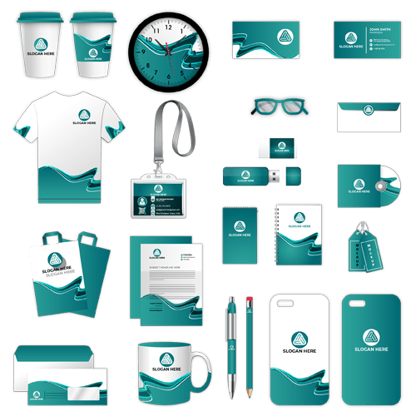
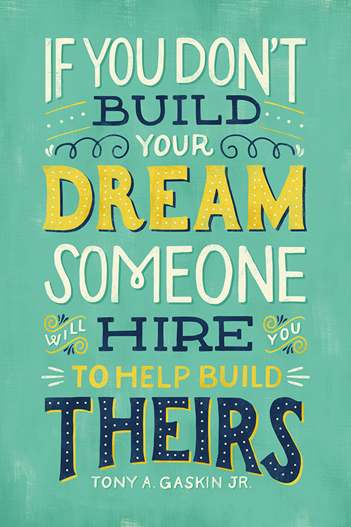
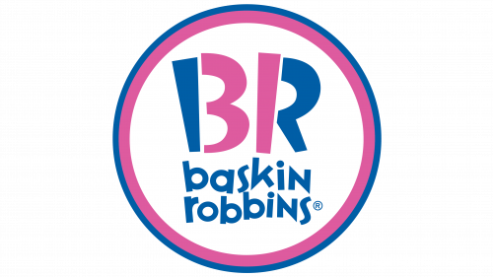
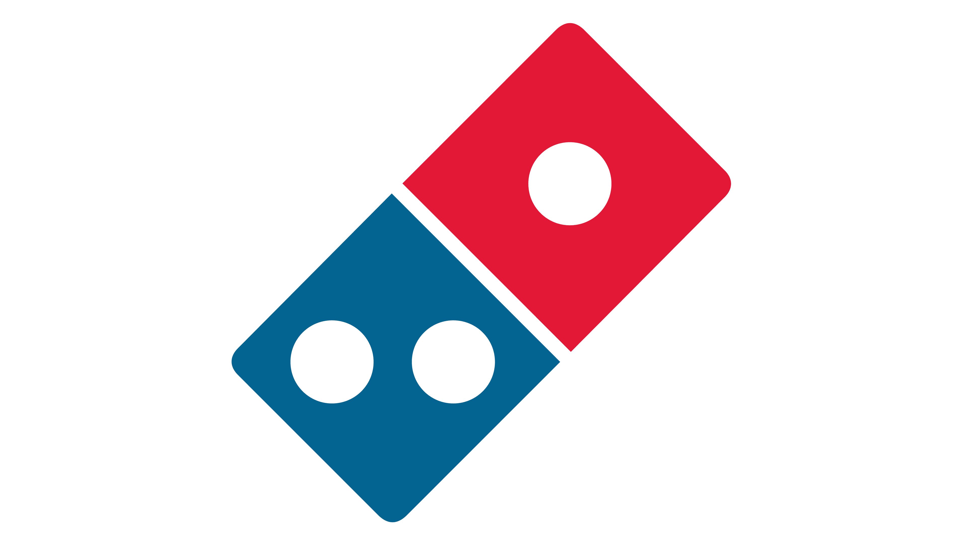
What is Graphic Designing?
The art of visual communication or conveying messages and ideas using typography, color, and images
Creating logos, posters, branding materials
Focus: Aesthetics + Clear message

Slide 4
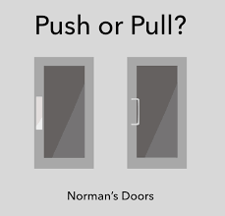
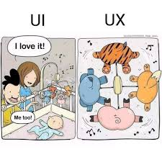
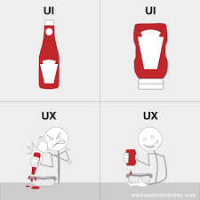
What is UI & UX Designing?
UI (User Interface): Look & feel of digital products (buttons, colors, layout)
UX (User Experience): How users interact & feel while using product (easy, smooth, satisfying)
Together: UI + UX = Great Digital Experience

Slide 5
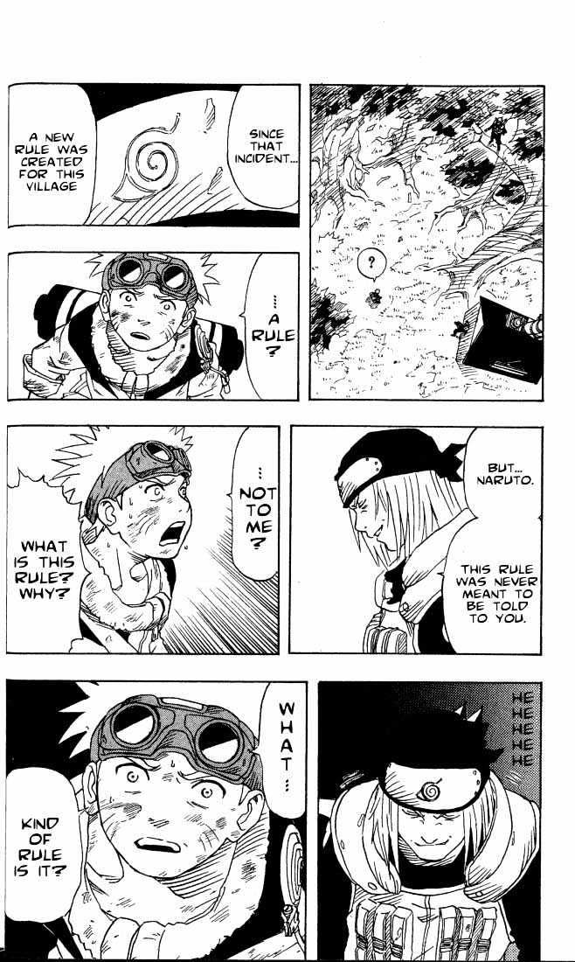
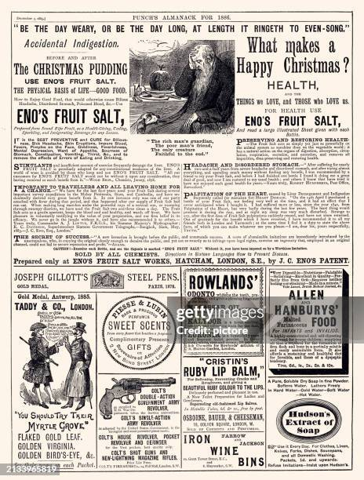
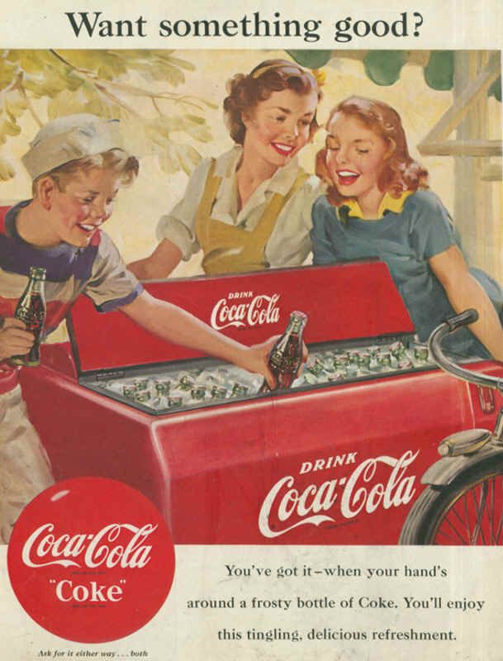
The Evolution of Visual Communication
Traditional design: Posters, print ads, magazines, book covers
Mostly static and one-way communication

Slide 6
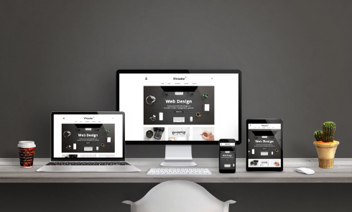
Present of Design
Shift to digital platforms (Illustrator, Figma, Photoshop etc.)
Social media, websites, mobile apps
Interactive & engaging visuals

Slide 7
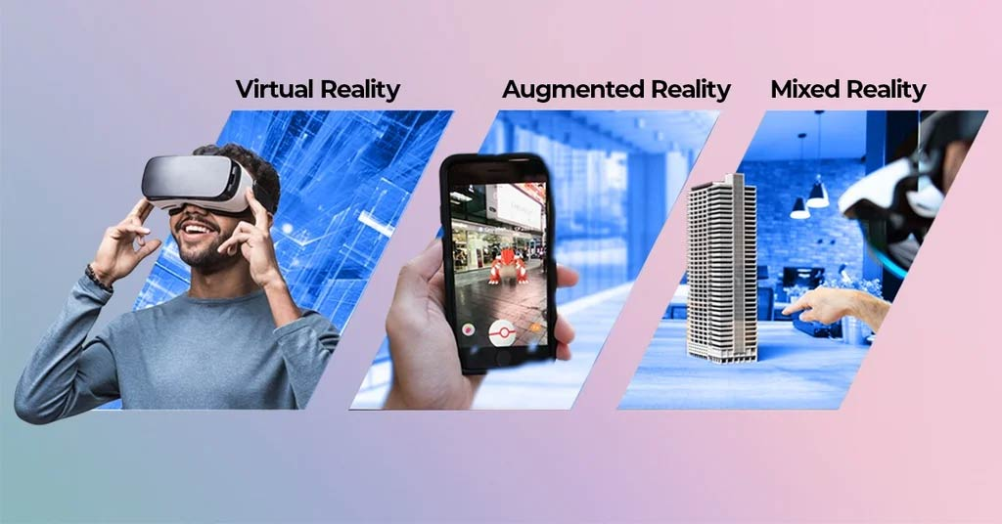
What's Next for Designers?
AR/VR immersive experiences
AI-powered design tools
Global demand for UI/UX experts

Slide 8
Career Opportunities
Graphic Designer: Specialize in branding, marketing, and advertising.
UI Designer: Focus on designing the visual interface for apps and websites.
UX Designer: Conduct user research, create wireframes, and ensure the product is easy to use.
Product Designer: A hybrid role that oversees the entire design process from start to finish.
Other Fields: Motion Graphics, Design Systems

Slide 9
Why This Career Fits Me
Matches my skill of creativity
Freedom to innovate
Exciting, Future-ready career path
Professional & personal growth

Slide 10
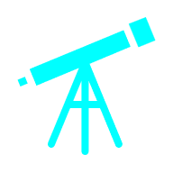

My Vision
To become a skilled UI/UX Designer
Work on impactful projects
Build a global career in design

Slide 11

Thank You

