Slide 1
Name: Ch. Hanuma Pavani Roll no: 2211CS010124(S2) Dataset: 01_District_wise_crimes_committed_IPC_2001_2012(kaggle) Email: hanumapaavani@gmail.com LinkedIn: linkedin.com/in/chintapalli-hanuma-pavani-804aab343
“CRIME ANALYSIS INDIA_2001-2012 USING BIG DATA ANALYTICS”

Slide 2
TABLE OF CONTENTS
Introduction
Initial Analysis of Dataset
Dataset Observations
Graphs
Conclusion

Slide 3
INTRODUCTION
The dataset contains information about district-wise crimes reported in India from 2001 to 2012. It includes details such as the number of crimes under different categories (like murder, theft, robbery, assault, etc.), the year-wise distribution of crimes, and the districts and states where these crimes occurred. It also provides insights into trends over the years, regional crime patterns, and areas with higher crime rates.
In short, this dataset helps us analyze crime trends in India over time, identify regions with higher crime incidents, and understand patterns that could assist in law enforcement and policy-making

Slide 4
INITIAL ANALYSIS OF DATASET
Dataset Size: ~800,000 records covering crimes reported across Indian districts from 2001 to 2012.
Key Columns:
Crime details: Crime Head (e.g., Murder, Robbery, Theft, Assault), Total Cases Reported
Temporal info: Year of crime
Geographic info: District, State
Missing Values: Some missing entries in district names for older records; occasional blanks in crime counts.
Duplicates: No duplicates, as each record corresponds to a unique district-year-crime type combination.
Outliers: Extremely high crime counts in certain urban districts compared to rural districts, e.g., major cities showing unusually high theft or assault numbers.
Basic Statistics:
Years: 2001–2012
Crime Counts: Wide variation from single-digit incidents in small districts to several thousand in large urban districts
Dominant Crime Types: Theft, Assault, Burglary
Regional Patterns: Some states consistently report higher crime numbers across multiple years
Categorical Distributions:
Crime Types: Theft and Assault dominate across most districts
Geography: High crime concentration in metropolitan districts such as Delhi, Mumbai, Bengaluru
Yearly Trends: Gradual increase in reported crimes over the 12-year period, with occasional spikes in specific crime categories

Slide 5
DATASET OBSERVATIONS
Total records: ~800,000 district-wise crime entries.
Main target variable: Crime trends across districts and years (measured by total cases in each crime category).
Key factors influencing crime trends: Crime Type (e.g., Theft, Murder, Assault), Year, and District/State.
Other important columns: District, State, and Total Cases Reported.
Geographical data: Crime incidents are concentrated in metropolitan and highly populated districts such as Delhi, Mumbai, Bengaluru, and Kolkata.
Trends over time: Gradual increase in reported crimes from 2001 to 2012, with occasional spikes in specific crime types in certain regions.
No duplicate records: Each record represents a unique district-year-crime type combination.
Outliers: Extremely high crime counts in urban districts compared to rural districts, particularly in Theft, Assault, and Burglary categories.

Slide 6
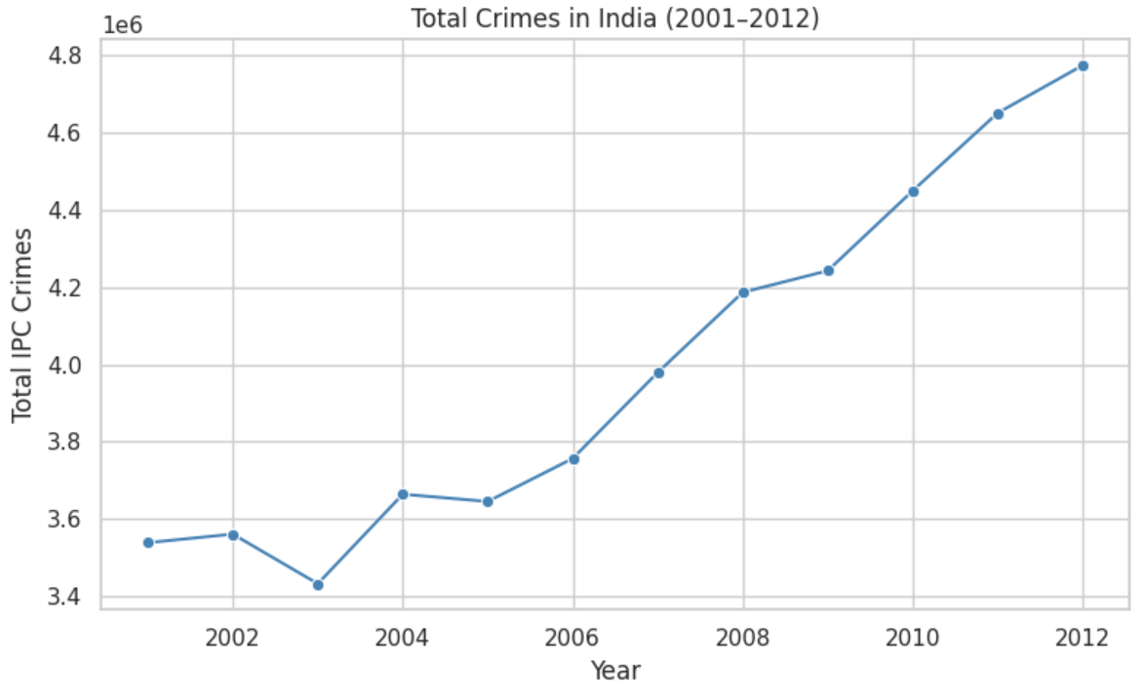
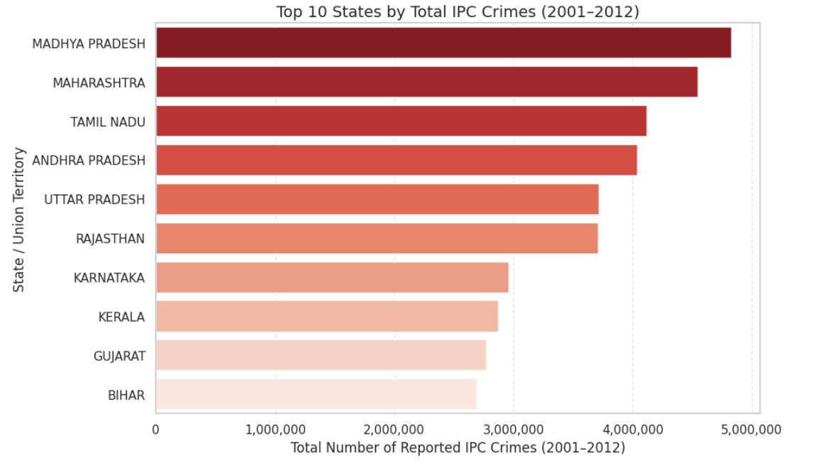
GRAPHS
1.Line Plot: Total Crimes Over Years: This line plot shows the total IPC crimes reported in India from 2001 to 2012. There is a gradual increase in total crimes over the years, with occasional spikes in certain years. It helps visualize overall trends in crime reporting and identify periods with unusually high crime rates.
2. Bar Plot: Top 10 States by Total Crimes This bar plot shows the top 10 states/UTs with the highest total IPC crimes from 2001–2012. States like Uttar Pradesh, Maharashtra, and West Bengal report the highest crimes, highlighting regional crime concentration. The visualization clearly indicates which states have the most significant crime burden over the 12-year period.

Slide 7
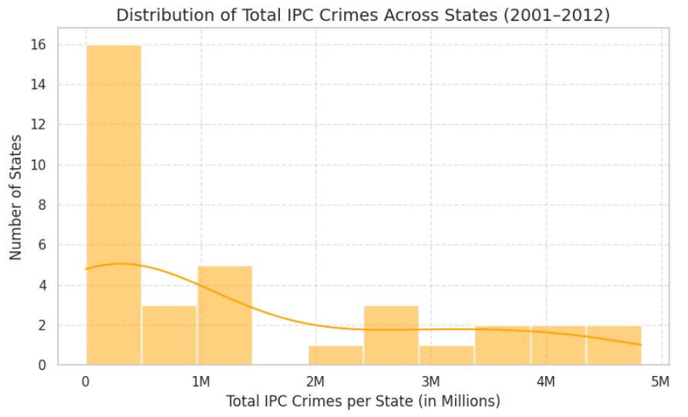
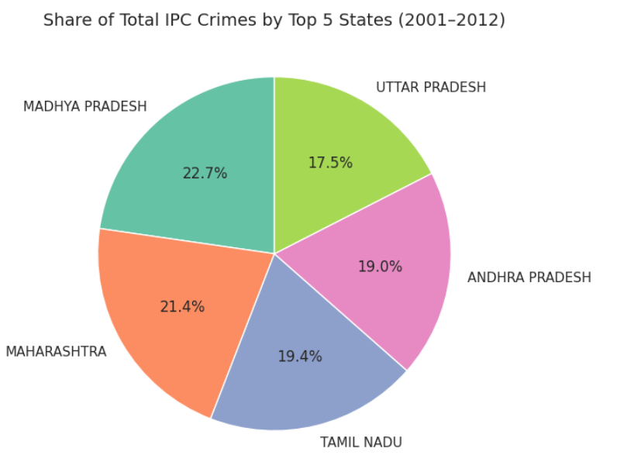
GRAPHS
3. Histogram: Distribution of Total Crimes Across States The histogram shows how total IPC crimes are distributed among all states. Most states have crime counts below 2–3 million, while a few highly populated states have significantly higher totals. The distribution highlights regional disparities in crime numbers and helps understand how crime is concentrated across different states.
4. Pie Chart: Share of Total Crimes by Top 5 States This pie chart represents the proportion of total crimes contributed by the top 5 states. It clearly shows which states dominate in terms of crime reporting and their relative contribution to total IPC crimes in India. This visualization emphasizes the regional imbalance in crime distribution.

Slide 8
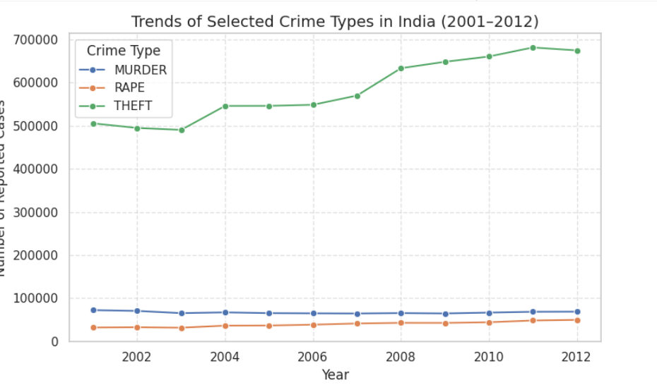
GRAPHS
5. Line Plot: Trends of Selected Crime Types This line plot shows the year-wise trends of selected crime types (Murder, Rape, Theft) in India from 2001–2012. Theft and Assault are consistently higher, while murder remains lower. This visualization helps analyze patterns in different crime categories over time and provides insights into how specific crimes have evolved across the years.

Slide 9
CONCLUSION
Findings:
Reported crimes in India show a gradual increase from 2001 to 2012, indicating both population growth and improved reporting mechanisms.
States such as Uttar Pradesh, Maharashtra, and West Bengal consistently record the highest number of IPC crimes.
Theft, Assault, and Burglary are among the most commonly reported crime types across multiple years and regions.
Metropolitan areas like Delhi, Mumbai, and Bengaluru contribute significantly to overall crime numbers, showing a clear urban concentration.
Regional and year-wise analysis highlights disparities in crime distribution, with some states exhibiting sharp spikes in certain years.
Future Scope:
Apply predictive models (e.g., Time-Series Forecasting, Regression) using PySpark MLlib to estimate future crime trends and identify potential hotspots.
Integrate additional datasets such as population, literacy rate, unemployment, and police strength to explore factors influencing crime rates.
Develop interactive dashboards for dynamic visualization of district-wise and category-wise crime patterns.
Extend the analysis beyond 2012 using updated datasets to study recent trends and policy impacts on crime reduction.

