Slide 1
EMOTION recognition from facial expressions
Aakanksha Reddy Bannuru
Govinda Lahari Jagarlamudi
Srikar Chintha

Slide 2



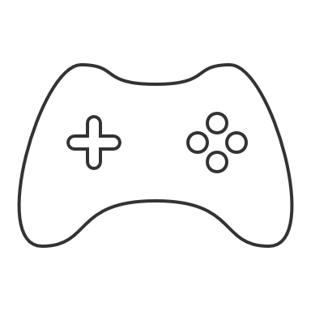
WHY Emotion Detection?
Mental Health
Customer feedback
Marketing and advertisements
Gaming
2

Slide 3







Data Set Description
In our project, we work with the FER2013 dataset, comprising 35,888 grayscale images of faces. These images are standardized to 48x48 pixels and categorized into seven facial expression classes: Angry, Disgust, Fear, Happy, Sad, Surprise, and Neutral. Our analysis focuses on understanding and classifying these emotions accurately.
The image transformations applied involve converting images to grayscale and resizing them to a standard 98x98 pixel resolution. During training, augmentation techniques include random horizontal flipping, rotation (up to 10 degrees), and resized cropping within a scale range of 0.8 to 1.2 times the original size. Finally, images are converted to tensors and normalized to have a mean of 0.5 and a standard deviation of 0.5, ensuring consistent data range and distribution.

Slide 4

Emotion detection using Classifiers
Logistic
May not capture the complex and nonlinear relationships present in facial expressions and emotions.
Inherently a binary classifier and may not perform as well when faced with multi-class emotion classification
Support Vector Machine
Random Forest classifiers tend to overfit noisy or high-dimensional data. This can lead to poor generalization performance on unseen data here.
Random Forest
In the context of facial emotion detection, the challenge lies in extracting meaningful features from raw images.
SVMs are powerful classifiers with strong theoretical foundations, their effectiveness here depends on the careful tuning of hyperparameters.
Interpreting the decision-making process of a Random Forest model in facial emotion detection can be challenging due to its lower level of interpretability.

Slide 5
Transition to Neural Networks
Traditional classifiers like Logistic Regression, SVM, and Random Forest struggled to capture the intricate nuances present in facial expressions, leading to suboptimal performance in emotion detection.
The FER2013 dataset, comprising facial images, necessitates a model that can effectively analyze and interpret these visual patterns to accurately classify emotions, making CNNs the ideal choice for this task.
CNNs, on the other hand, excel in processing image data due to their ability to capture spatial hierarchies, enabling them to understand and extract intricate visual patterns inherent in facial expressions.

Slide 6
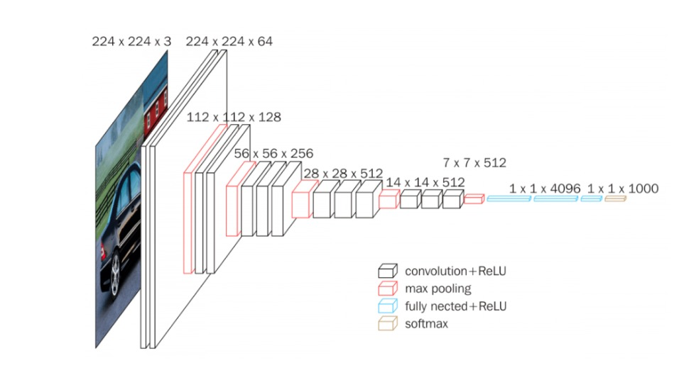
VGG-16
Drawbacks of VGG-16
Vanishing Gradient Problem
Overfitting
Lack of Spatial Attention
Redundancy in Parameters

Slide 7
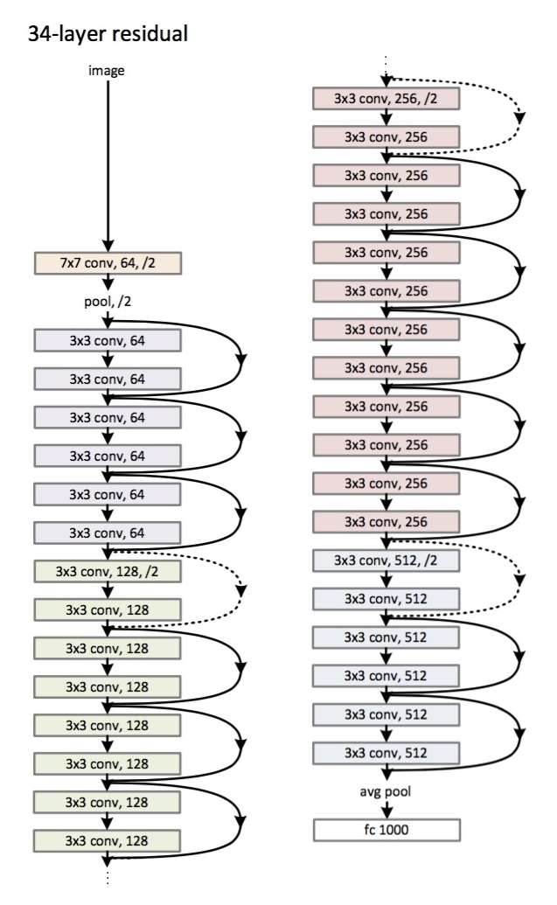
RESNET-34
Drawbacks of RESNET-34

Slide 8
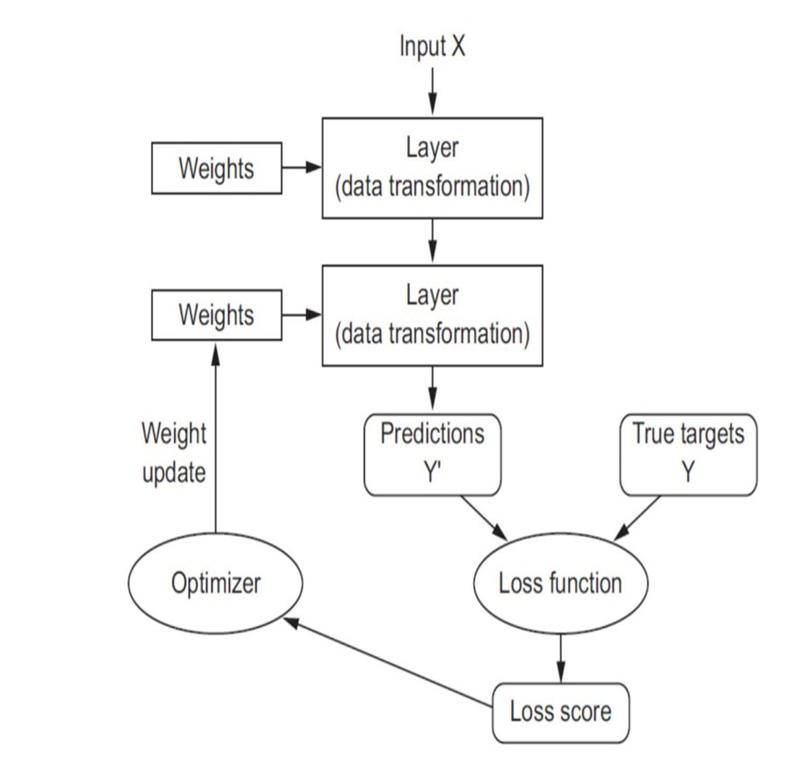
Loss Function
Loss function also known as cost function serves as a metric for evaluating how well a model’s predictions match the actual labels.
It compares the distance between the predicted and target outputs and determine the model’s performance

Slide 9
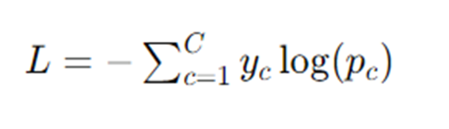
Cross Entropy Loss
It measures the performance of a classification model whose output is a probability value between 0 and 1. Cross-entropy loss increases as the predicted probability diverges from the actual label.
C is the number of classes.
y is a binary indicator (0 or 1) if class label c is the correct classification for the observation.
p is the predicted probability of the class label c.

Slide 10
Seamless Integration of Softmax within cross entropyloss
Performing Softmax internally within CrossEntropyLoss eliminates the need for an additional Softmax layer in the neural network architecture.
This reduces computational overhead and memory usage, resulting in faster training times and improved resource efficiency during model training.
By operating directly on logits, the loss computation maintains numerical precision and stability, leading to more reliable and robust training outcomes.

Slide 11
Focal Loss
Focal Loss is a specialized loss function designed to address class imbalance in classification tasks.
Focal Loss helps mitigate the impact of class imbalance by downweighing the loss assigned to well-classified examples, thereby focusing more on hard-to-classify examples.
Focal Loss introduces a modulating factor that reduces the loss contribution of well-classified examples.

Slide 12
Kullback-Leibler Divergence loss
KL Divergence Loss compares the predicted probability distribution of emotions with the true distribution in emotion detection tasks.
Minimizing this loss encourages the model to assign higher probabilities to the correct emotions, thereby improving overall accuracy
Emotion detection tasks often involve inherent uncertainty and ambiguity, where an input may correspond to multiple emotions with varying degrees of intensity. KL Divergence Loss encourages the model to output probability distributions that capture this uncertainty more accurately.

Slide 13
Optimizer
Optimizers are algorithms or methods employed during the training process of neural networks to adjust attributes such as weights and learning rates in order to minimize the loss function, thereby improving the performance of the model.

Slide 14
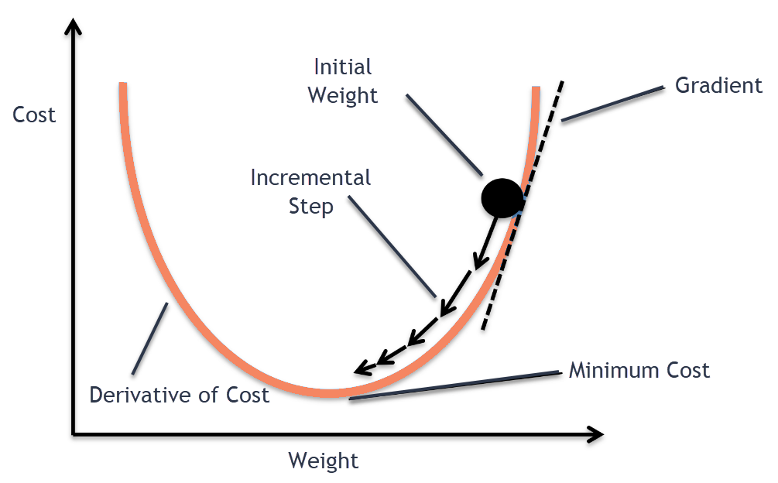
Stochastic Gradient Descent
SGD is an iterative optimization algorithm used to minimize the loss function by updating the model parameters in the direction of the steepest gradient.
It operates by randomly selecting a subset of data (a mini-batch) in each iteration to compute the gradient of the loss function with respect to the model parameters.
The model parameters are then updated using these gradients, scaled by a learning rate, to gradually converge towards a local minimum of the loss function.

Slide 15
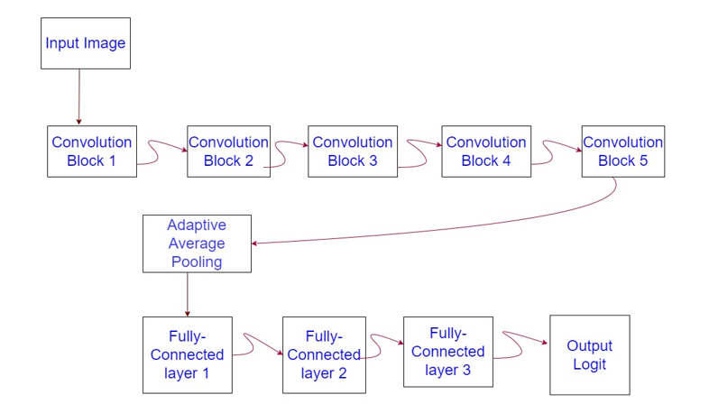
Architecture of the designed model.

Slide 16
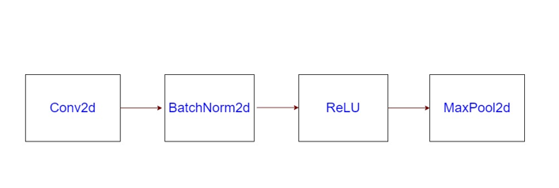
Description of each Convolution Block
.

Slide 17
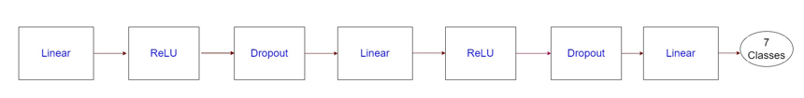
Description of Fully Connected Layers
.

Slide 18
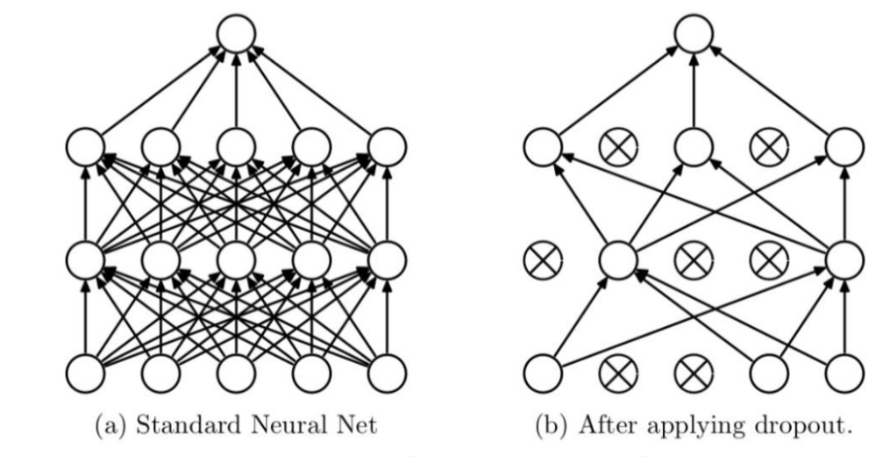
Why Dropout?
Regularization technique
Prevents overfitting.
Used 0.5 parameter which indicates that there is a 50% chance that any given neuron will be dropped.

Slide 19
Why Batch Normalization?
1. Accelerates Training: Batch Normalization allows for the use of higher learning rates, speeding up network convergence by stabilizing the distribution of activations across layers.
2. Enables Deeper Networks: Helps in training deeper neural networks by addressing the vanishing and exploding gradients problem, thus supporting more complex architectures without performance degradation.

Slide 20
Inspiration from VGG
convolution +
max pooling layers +
fully connected layers

Slide 21
Inspiration from Resnet
Use of batch normalization after each convolutional layer
Adaptive average pooling before fully connected layers.

Slide 22
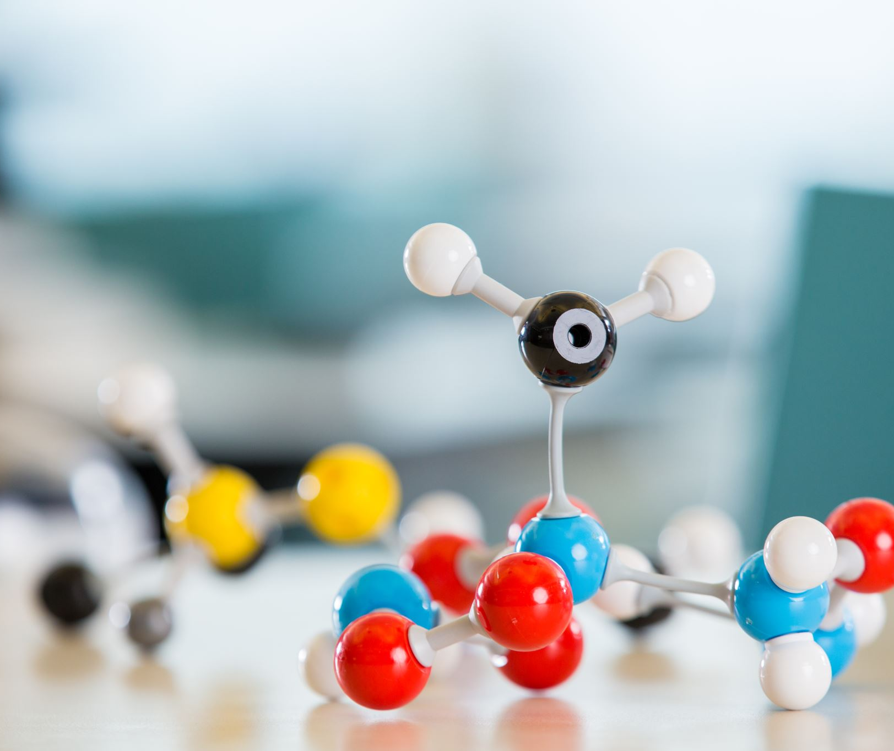
Integration of Webcam to test the model

