Slide 1

Pune Institute of Computer Technology
DEPARTMENT OF COMPUTER ENGINEERING
Vision
Achieve academic excellence through education in computing, to create intellectual manpower to explore professional, higher educational and social opportunities.
Mission
To impart learning by educating students with conceptual knowledge and hands on practices using modern tools, FOSS technologies and competency skills there by igniting the young minds for innovative thinking, professional expertise and research.

Slide 2
Software Engineering & Project Management
Course code: 310243
By: Prof. Yogesh Handge
PICT, Pune

Slide 3
Course Outcomes
310243.1Compare and chose a process model for a software project development
310243.2Analyze and model software requirements of a software system
310243.3Design and Modeling of a software system using open source tools
310243.4Prepare the SRS, Design document, Project plan for a given software system
310243.5Prepare a project management report mitigating risks involved, using soft skills
310243.6Designing automated test cases for a software model
PICT, Pune

Slide 4
Software Requirements Engineering& Analysis
Unit-II
PICT, Pune

Slide 5
Contents
Requirements Engineering:
  User and system requirements
  Functional and non-functional requirements
  Types & Metrics
  A spiral view of the requirements engineering process
Software Requirements Specification (SRS):
  The software requirements Specification document
  The structure of SRS
  Ways of writing a SRS
  Structured & tabular SRS for an insulin pump case study
PICT, Pune

Slide 6
Requirements elicitation & Analysis :
  Process
  Requirements validation
  Requirements management
Case Studies:
An information system-Mental health care patient management system (MHC-PMS).
PICT, Pune

Slide 7
Requirements Engineering
It is a statement that identifies a necessary attribute, capability, characteristic, or quality of a system for it to have value and utility to a customer, organization, internal user, or other stakeholder.
A thing that is needed or wanted.
The broad spectrum of tasks and techniques that lead to an understanding of requirements is called requirements engineering.
Action that begins during the communication activity and continues into the modeling activity.
Requirements engineering tasks include from inception to validation.
PICT, Pune

Slide 8
User & System Requirements
Classification of Requirements:
  User Requirements:
    statements, in a natural language plus diagrams
    what services the system is expected to provide to system users
    the constraints under which it must operate.
  System Requirements:
    more detailed descriptions of the software system’s functions, services, and operational constraints.
    The system requirements document (sometimes called a functional specification) should define exactly what is to be implemented.
    It may be part of the contract between the system buyer and the software developers.
PICT, Pune

Slide 9
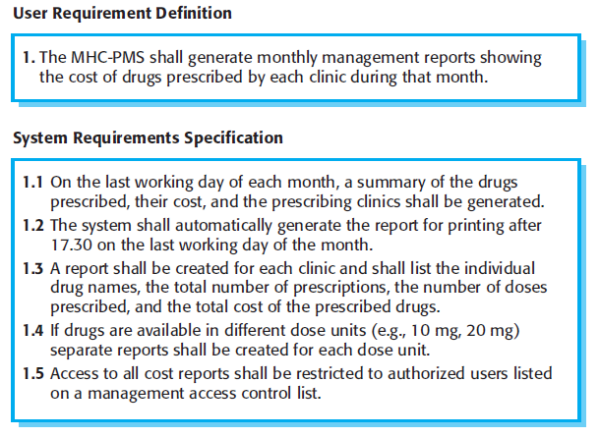
Fig: User and System requirements of MHC-PMS
PICT, Pune

Slide 10
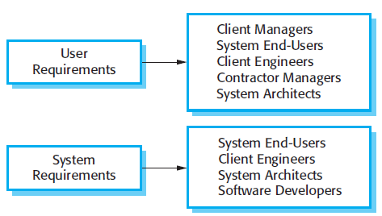
Fig: Readers
of different types
of requirements
specification
High level specification is called user requirement
Detailed specification is called system requirement
PICT, Pune

Slide 11
Functional and non-functional requirements
System Requirements are classified as functional or non-functional requirements.
Functional:
  statements of services the system should provide
  how the system should react to particular inputs
  how the system should behave in particular situations
  may also explicitly state what the system should not do
  Examples from MHC-PMS:
    A user shall be able to search the appointments lists for all clinics.
PICT, Pune

Slide 12
    The system shall generate each day, for each clinic, a list of patients who are expected to attend appointments that day.
    Each staff member using the system shall be uniquely identified by his or her eight-digit employee number
  Functional Requirements should be complete and consistent and unambiguous.
Non-functional:
  constraints on the services or functions offered by the system
  include timing constraints, constraints on the development process, and constraints imposed by standards
  often apply to the system as a whole, rather than individual system features or services.
PICT, Pune

Slide 13
  Non-functional requirements may affect the overall architecture of the system
  A single non-functional requirement can generate multiple related functional requirements.
  They may arise through
    user needs
    budget constraints
    organizational policies
    interoperability constraints
    externals factors such as safety regulations
    privacy legislation
PICT, Pune

Slide 14
Types and Metrics
Types of non-functional requirements:
  Product requirements: specify or constrain the behavior of the system.
    Example: The MHC-PMS shall be available to all clinics during normal working hours (Mon–Fri, 08.30–17.30). Downtime within normal working hours shall not exceed five seconds in any one day.
  Organizational requirements: requirements derived from policies and procedures in the customer’s and developer’s organization.
    Example: Users of the MHC-PMS system shall authenticate themselves using their health authority identity card.
  External requirements: requirements that are derived from factors external to the system and its development process.
    Example: The system shall implement patient privacy provisions as set out in Patient Privacy Protection Act, 2011
PICT, Pune

Slide 15
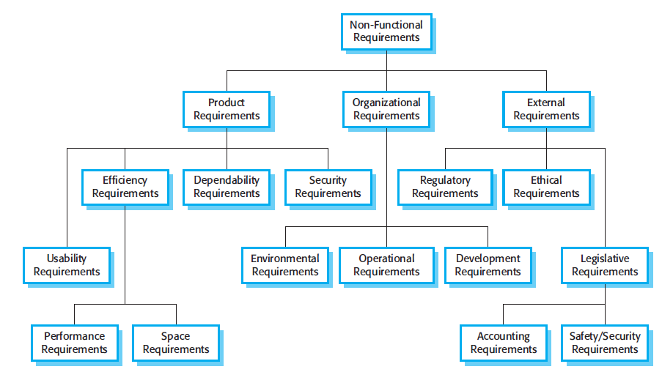
Fig: Types of non-functional requirement
PICT, Pune

Slide 16
Often non-functional requirements are proposed as general goals, such as ease of use, ability of system to recover from failure or rapid user response, etc. by the customer.
But these goals can cause problems fro system developers as they leave scope for interpretation and hence disputes arise subsequently.
Example:
  Manager says “The system should be easy to use by medical staff and should be organized in such a way that user errors are minimized.”
  Meaning: Medical staff shall be able to use all the system functions after four hours of training. After this training, the average number of errors made by experienced users shall not exceed two per hour of system use.
PICT, Pune

Slide 17
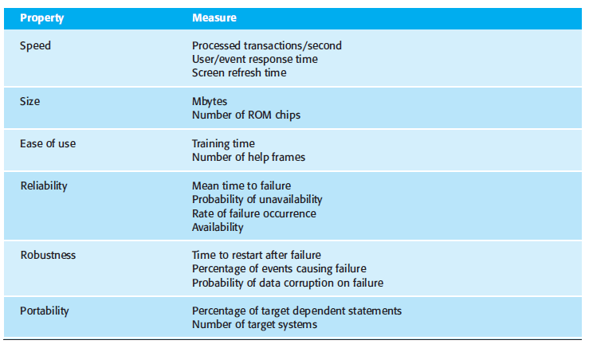
Hence there are few metrics to be measured during the system testing and check whether the system has met the its NFR.
PICT, Pune

Slide 18
The Software requirements specification (SRS) document
Official statement of what the system developers should implement.
Includes both user and system requirements.
Required when outside contractor is developing the software system.
Agile methods argue it is largely wasted as there is rapid changing needs.
At least use of cards with user stories need to be maintained as a document in agile.
Many people use the SRS and why they use it?
PICT, Pune

Slide 19
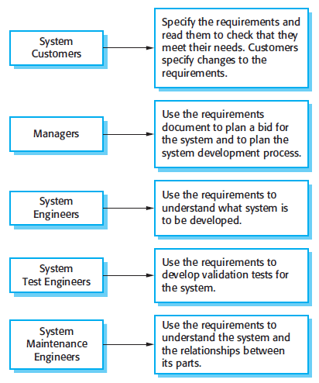
Fig: Who use SRS and why?
PICT, Pune

Slide 20
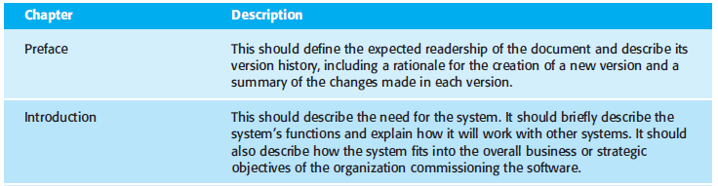
Structure of SRS
Structure of SRS can be different for different software types.
IEEE gave a standard for requirements document in 1998 and is generic.
Structure of SRS:
PICT, Pune

Slide 21
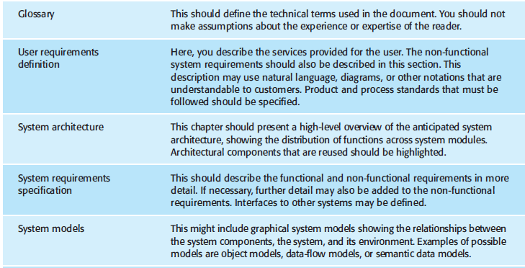
PICT, Pune

Slide 22
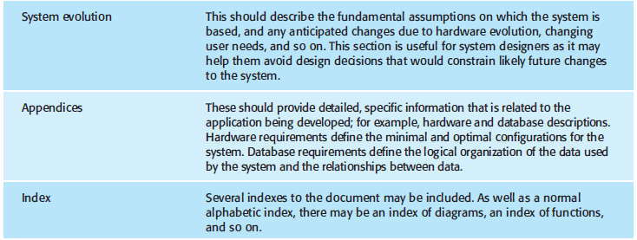
For long documents it is suggested to include comprehensive table of content and document index.
PICT, Pune

Slide 23
Ways of writing SRS
In SRS, User & system requirements should describe the functional and non-functional requirements clearly, consistently, unambiguously and completely.
It should be easily understood by system users with no technical knowledge.
Specify only external behavior.
No detailed specifications
No formal notations
No structured notation
No software jargon
No detailed system architecture and design.
PICT, Pune

Slide 24
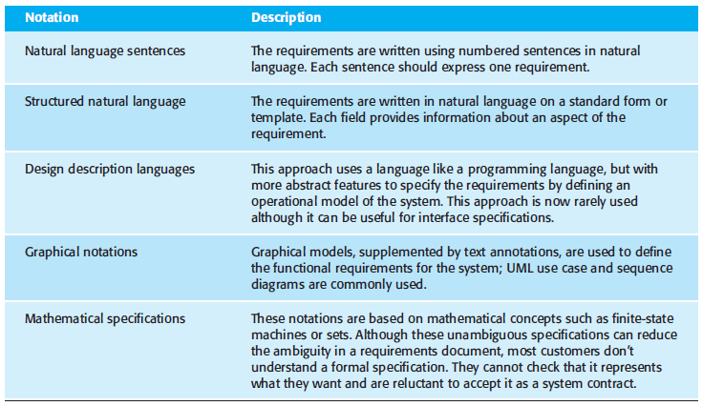
PICT, Pune
Fig: Ways of writing SRS

Slide 25
Case study: Structured & tabular SRS for an insulin pump
Requirement about Insulin pump:
  The system shall measure the blood sugar and deliver insulin, if required, every 10 minutes.
Guidelines for Natural Language:
  Invent a standard format and adhere to it.
  Distinguish between mandatory (Shall) and desirable(Should) requirements.
  Use text highlighting to pick key parts of the requirement.
  Avoid use of jargons, abbreviations and acronyms.
  Try to associate a reason.
PICT, Pune

Slide 26
Structured specification:
  It is a way of writing system requirements using a standard template.
  Information included in standard form:
    Tell about function or entity being specified
    Inform of its inputs and where these come from.
    A description of its outputs and where these go to.
    Information about the information that is needed for the computation or other entities in the system that are used
    A description of the action to be taken.
    Pre-condition and post-condition on functions.
    A description of the side effects (if any) of the operation.
PICT, Pune

Slide 27
Structural requirements for insulin pump:
Insulin Pump/Control Software/SRS/3.3.2
Function | Compute insulin dose: Safe sugar level
Description | Computes the dose of insulin to be delivered when the current measured sugar level is in the safe zone between 3 and 7 units.
Inputs | Current sugar reading (r2), the previous two readings (r0 and r1).
Source | Current sugar reading from sensor. Other readings from memory.
Outputs | CompDose—the dose in insulin to be delivered
Destination | Main control loop.
Action | CompDose is zero if the sugar level is stable or falling or if the level is increasing but the rate of increase is decreasing. If the level is increasing and the rate of increase is increasing, then CompDose is computed by dividing the difference between the current sugar level and the previous level by 4 and rounding the result. If the result, is rounded to zero then CompDose is set to the minimum dose that can be delivered.
Requirements | Two previous readings so that the rate of change of sugar level can be computed.
Pre-condition | The insulin reservoir contains at least the maximum allowed single dose of insulin.
Post-condition | r0 is replaced by r1 then r1 is replaced by r2.
Side effects | None.
PICT, Pune

Slide 28
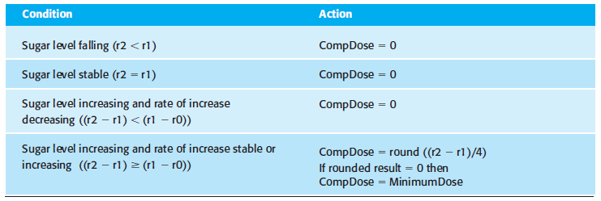
Tabular requirements for insulin pump:
  Using structural specifications, removes some of the problems of natural language specification.
  Reduces variability and organizes them more effectively.
  But, cannot completely take out unambiguity.
  Hence, Tabular description or graphical models are used to add extra info.
PICT, Pune

Slide 29
Requirements engineering process
Requirement engineering process includes four high level activities:
  Feasibility study
  Elicitation and analysis
  Specification
  Validation
It is shown as an iterative process in the form of a spiral with an interleaving.
As the outer rings expand, more clear requirements are obtained.
Output is SRS document.
PICT, Pune

Slide 30
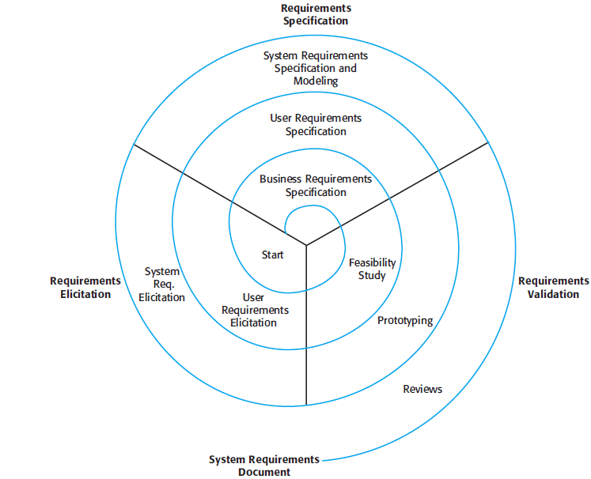
Fig: Spiral view of the requirements engineering process
PICT, Pune

Slide 31
Requirements elicitation & Analysis
Process
It is a next stage after initial feasibility study.
Software engineers work with customers and system end-users to find out about
  The application domain
  What services the system should provide?
  The required performance of the system
  Hardware constraints, etc.
This process may involve a variety of stakeholders.
PICT, Pune

Slide 32
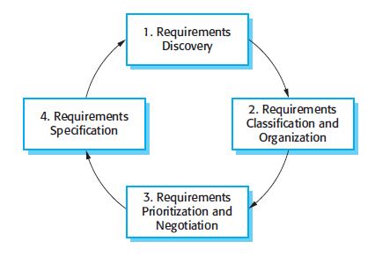
Requirements elicitation and analysis process has four activities which are iterated.
Fig: The requirements elicitation and analysis process
PICT, Pune

Slide 33
Requirements Discovery:
  Process of interacting with stakeholders to discover their requirements (domain requirements).
  Documentation is also discovered.
Requirements classification and organization:
  Takes unstructured collection of requirements, groups related requirements, and organizes them into coherent clusters.
  Model system architecture to identify sub-systems and to associate requirements to each of them.
Requirements prioritization and negotiation:
  Involvement of multiple stakeholders can bring conflicts, wanting them to prioritize.
Requirements specification:
  Requirements are documented whether formal or informal.
PICT, Pune

Slide 34
Eliciting and understanding requirements from system stakeholders is a difficult process.
Why because:
  Stakeholders often don’t know what they want from a computer system except in most general terms.
  They make unrealistic demands because of incomplete knowledge.
  Express requirements in their own terms and requirement engineers wont understand them.
  Different stakeholders have different requirements expressed in different ways with conflicts.
  Political factors may influence.
  Economic and business environment are dynamic.
PICT, Pune

Slide 35
Requirements Discovery:
  It includes documentation, system stakeholders, and specifications of similar systems
  Interact with system stakeholders through interviews and observations.
  Stakeholders for MHC-PMS are:
    Patients
    Doctors
    Nurses
    Medical Receptionists
    IT staff
    A medical ethics manager
    Healthcare manager
    Medical record staff
  Requirements can come from application domain and other interacting systems.
PICT, Pune

Slide 36
Interviews:
  Formal or informal interviews
  Ask questions and get the requirements
  Two types of interviews:
    Closed: with an agenda
    Open: with no agenda
  Difficult to elicit domain requirements for two reasons:
    Specialists use terminology and jargon that are specific to a domain leading to misunderstanding
    Some knowledge is familiar to stakeholders hence ignore them worth discussing.
  Effective interviews have two characteristics:
    Open-minded
    Prompting interviewee to get into discussions
PICT, Pune

Slide 37
Scenarios:
  They add details to an outline requirements description.
  Real-life examples will give more relevance and understanding.
  Generally scenarios include:
    What the system and users expect when the scenario starts
    Normal flow of the events in the scenario
    What can go wrong and how it is handled?
    Other activities going on at the same time.
    System state when the scenario finishes.
Use cases:
  Use cases identify the actors involved in the interaction and names the type of interaction.
PICT, Pune

Slide 38
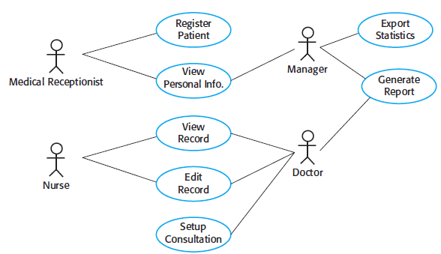
Documented using a high-level use case diagram.
Includes textual description or one or more graphical models.
Fig: Example of Use Cases for MHC-PMS
PICT, Pune

Slide 39
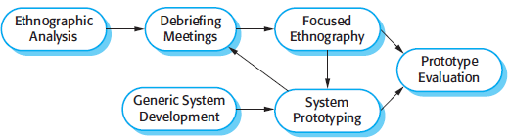
Ethnography:
  It is an observational technique that understands social and organizational requirements.
  Effective in discovering two types of requirements:
    That are derived from the way in which people actually work.
    That are derived from co-operation and awareness of other people’s activities.
  Can be combined with prototyping.
  Fig: Ethnography can be combined with prototyping
PICT, Pune

Slide 40
Requirements Validation
Requirements validation is the process of checking that requirements actually define the system that the customer really wants.
It is concerned with finding problems with the requirements.
Fixing errors during development or after delivery can cost you huge than in requirements.
Change in requirements will change the design or code and wants you to test it again which is the reason for costing.
PICT, Pune

Slide 41
Different checks during validation:
  Validity checks:
    Does the system provides what the user has asked for?
  Consistency checks:
    Requirements in the document should not conflict.
    Should not be contradictory constraints or different descriptions of the same system function.
  Completeness checks:
    Document should include requirements that define all functions and the constraints intended by the system user.
  Realism checks:
    Ensure that they can actually be implemented.
    Should also take account of the budget and schedule for the system development.
  Verifiability:
    Demonstrate that the delivered system meets each specified requirement.
PICT, Pune

Slide 42
There are number of requirement validation techniques.
Used individually or in conjunction with one another.
  Requirements review:
    requirements are analyzed systematically by a team of reviewers who check for errors and inconsistencies.
  Prototyping:
    an executable model of the system in question is demonstrated to end-users and customers.
  Test-case generation:
    requirements should be testable.
    If the test is difficult to design, then this usually means that the requirement will be difficult to implement and should be reconsidered.
PICT, Pune

Slide 43
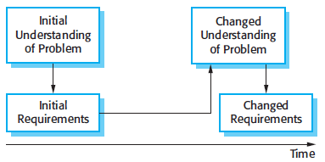
Requirements Management
Requirements keep on changing for large software systems.
Cannot completely define the problems, hence no complete solution.
Fig: Requirements Evolution
PICT, Pune

Slide 44
Changes are inevitable even after installation.
Reasons would be:
  Business and technical environment of the system changes after installation.
  People who pay and people who use the system are different.
  Different people with different conflicting or contradictory priorities.
Requirements management is the process of understanding and controlling changes to system requirements.
Formal process starts after first draft of SRS.
PICT, Pune

Slide 45
Requirements management planning
Planning is the first stage in requirements management.
During management, you have to decide upon:
  Requirement identification: uniquely identified
  A change management process: assess the impact and cost of changes
  Traceability policies: maintain relationships between requirements and also system design
  Tool support: processing of large amount of information using tools
PICT, Pune

Slide 46
Tools should be chosen in planning phase to:
  Requirements Storage: maintained in a secure and managed data storage system.
  Change management: for simplified maintenance of changes using tool.
  Traceability management: related requirements will be discovered.
Requirements change management
Applied to all proposed changes after the SRS is approved.
Advantage:
  All change proposals are treated consistently.
  Changes are made in a controlled way
PICT, Pune

Slide 47

Fig: Requirements change management
Three Stages include:
  Problem analysis and change specification: change proposal is analyzed and fed back to requestor for decision.
  Change analysis and costing: cost of making the change is assessed in all terms for decision making.
  Change implementation: modifications are made to document and system design and implementation as well.
PICT, Pune

Slide 48
Case Studies:
An information system-Mental health care patient management system (MHC-PMS).
To be performed by the students.
Expected outcome: Clear SRS of MHC-PMS
PICT, Pune

Slide 49
END of Unit-II
PICT, Pune

