Slide 1
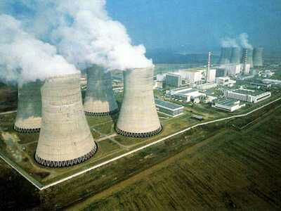
Pune Institute of Computer Technology
NUCLEAR ENERGY
Nuclear power is not a miracle
But a key to the future

Slide 2
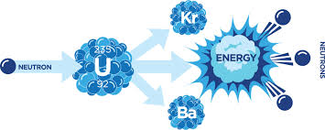
Pune Institute of Computer Technology
What is Nuclear Power???
Nuclear power is the energy contained in atoms. This energy can be released as heat from a chain reaction in a radioactive element such as uranium. Nuclear power stations use this heat to produce steam, which drives turbines to generate electricity.

Slide 3
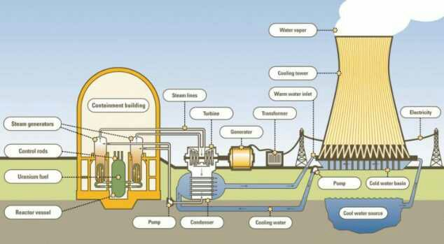
Pune Institute of Computer Technology
Construction
Nuclear Reactor
Turbine
Generator
Condenser
Safety Walls

Slide 4
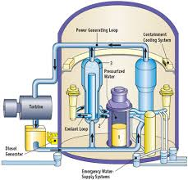
Pune Institute of Computer Technology
Nuclear Reactor
Reactor Vessel
To enclose various parts of the reactor
To provide passage for the coolant to flow
To withstand high pressure
To provide place for control rods

Slide 5
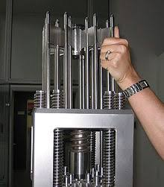
Control Rods
To control the fission reaction rate of uranium and plutonium
Pressurizer
Keeps the primary system under high pressure
Steam Generator
Are heat exchangers used to convert water into steam
Pune Institute of Computer Technology

Slide 6
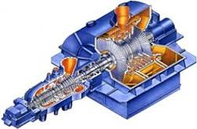
Pune Institute of Computer Technology
Turbine
Function:
To convert the energy from the high pressure steam to mechanical energy in the form of shaft rotation so that the generator will turn.

Slide 7
Pune Institute of Computer Technology
Turbine Support Systems
Functions:
To control the amount of steam admitted to the turbine.
Lubricate the generator.
Keep the steam inside the turbine.
Protect the turbine in the case of a fault (Electrical or Mechanical).

Slide 8
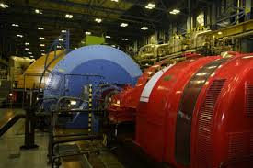
Pune Institute of Computer Technology
Generator
Converts Kinetic energy supplied by the turbine into electrical energy

Slide 9
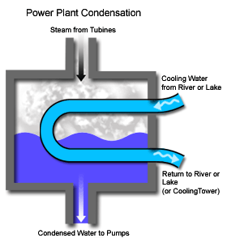
Condenser
Pune Institute of Computer Technology
Condense and recover the steam that passes through the turbine.
Maintain a vacuum to optimize the efficiency of the turbine.

Slide 10
Pune Institute of Computer Technology
Block Diagram
Nuclear Fission in reactor
Control of rate of chain reaction
Heat exchanger
Turbine
Electric Generator
Power Output

Slide 11
Pune Institute of Computer Technology
Advantages
Lower Greenhouse Gas Emissions
Powerful and Efficient
Reliable
Cheap Electricity
Low Fuel Cost
Supply
Easy Transportation

Slide 12
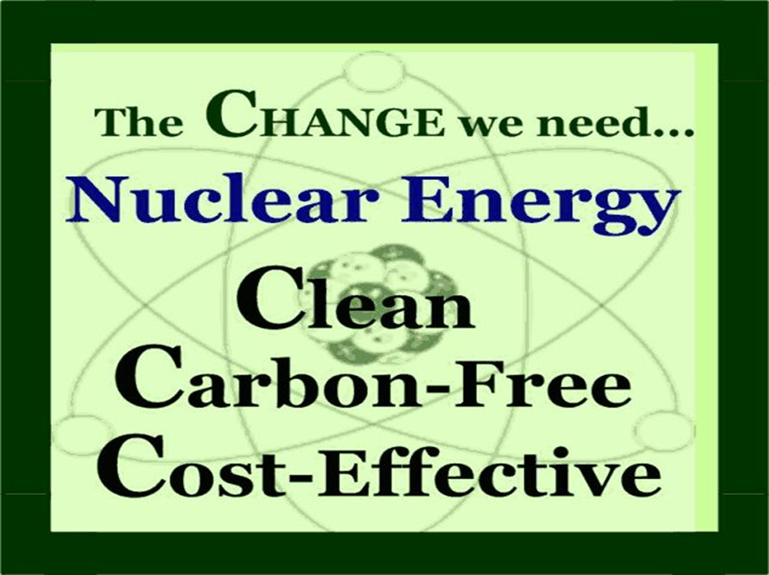

Slide 13
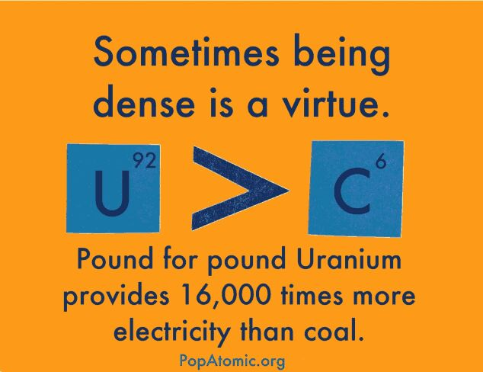

Slide 14
Pune Institute of Computer Technology
Disadvantages
Radioactive Waste
Nuclear Accidents
Nuclear Radiation
High Cost of Installation
National Risk
Impact on Aquatic Life
Fuel Availability
Non-Renewable

Slide 15
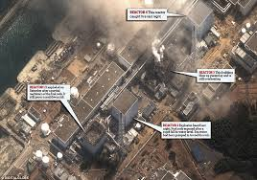
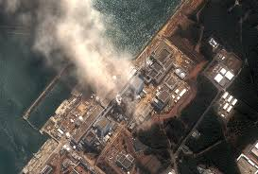
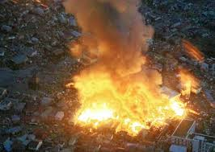


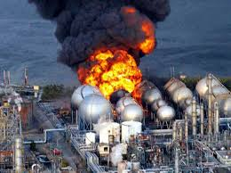

Slide 16
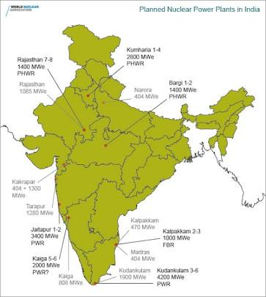
Pune Institute of Computer Technology
Nuclear Energy in India
Fourth largest source of energy.
21 Nuclear Reactors producing a total of over 30000MW of Electricity.
The main Nuclear Power
plants in India are:
Rajasthan
Kaiga
Kakrapar
Koondakulam
Narora
Tarapur
Jaitapur

Slide 17
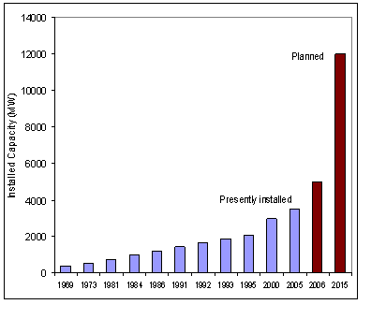
Pune Institute of Computer Technology

Slide 18
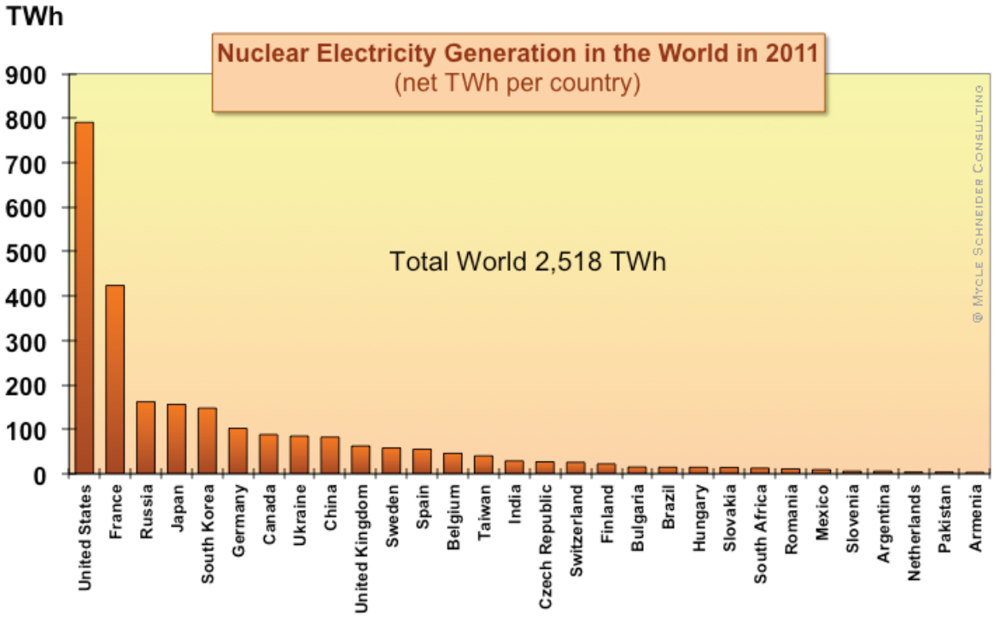
Pune Institute of Computer Technology
India and the World

