Slide 1
Laptop screen – 1080 pixel width

Slide 2
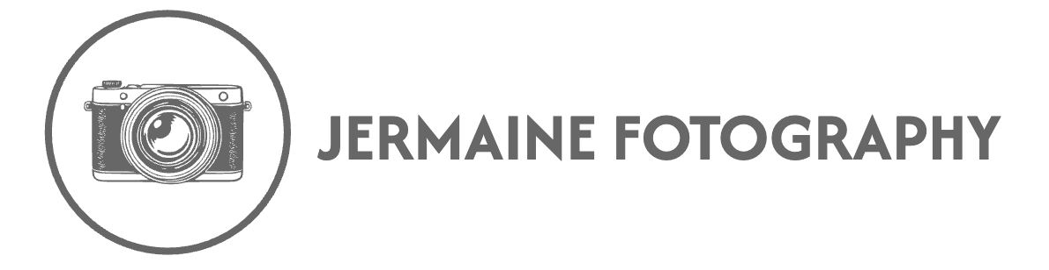
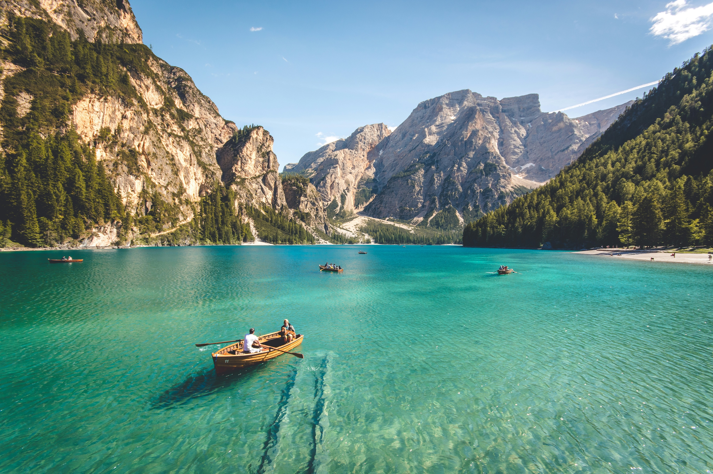
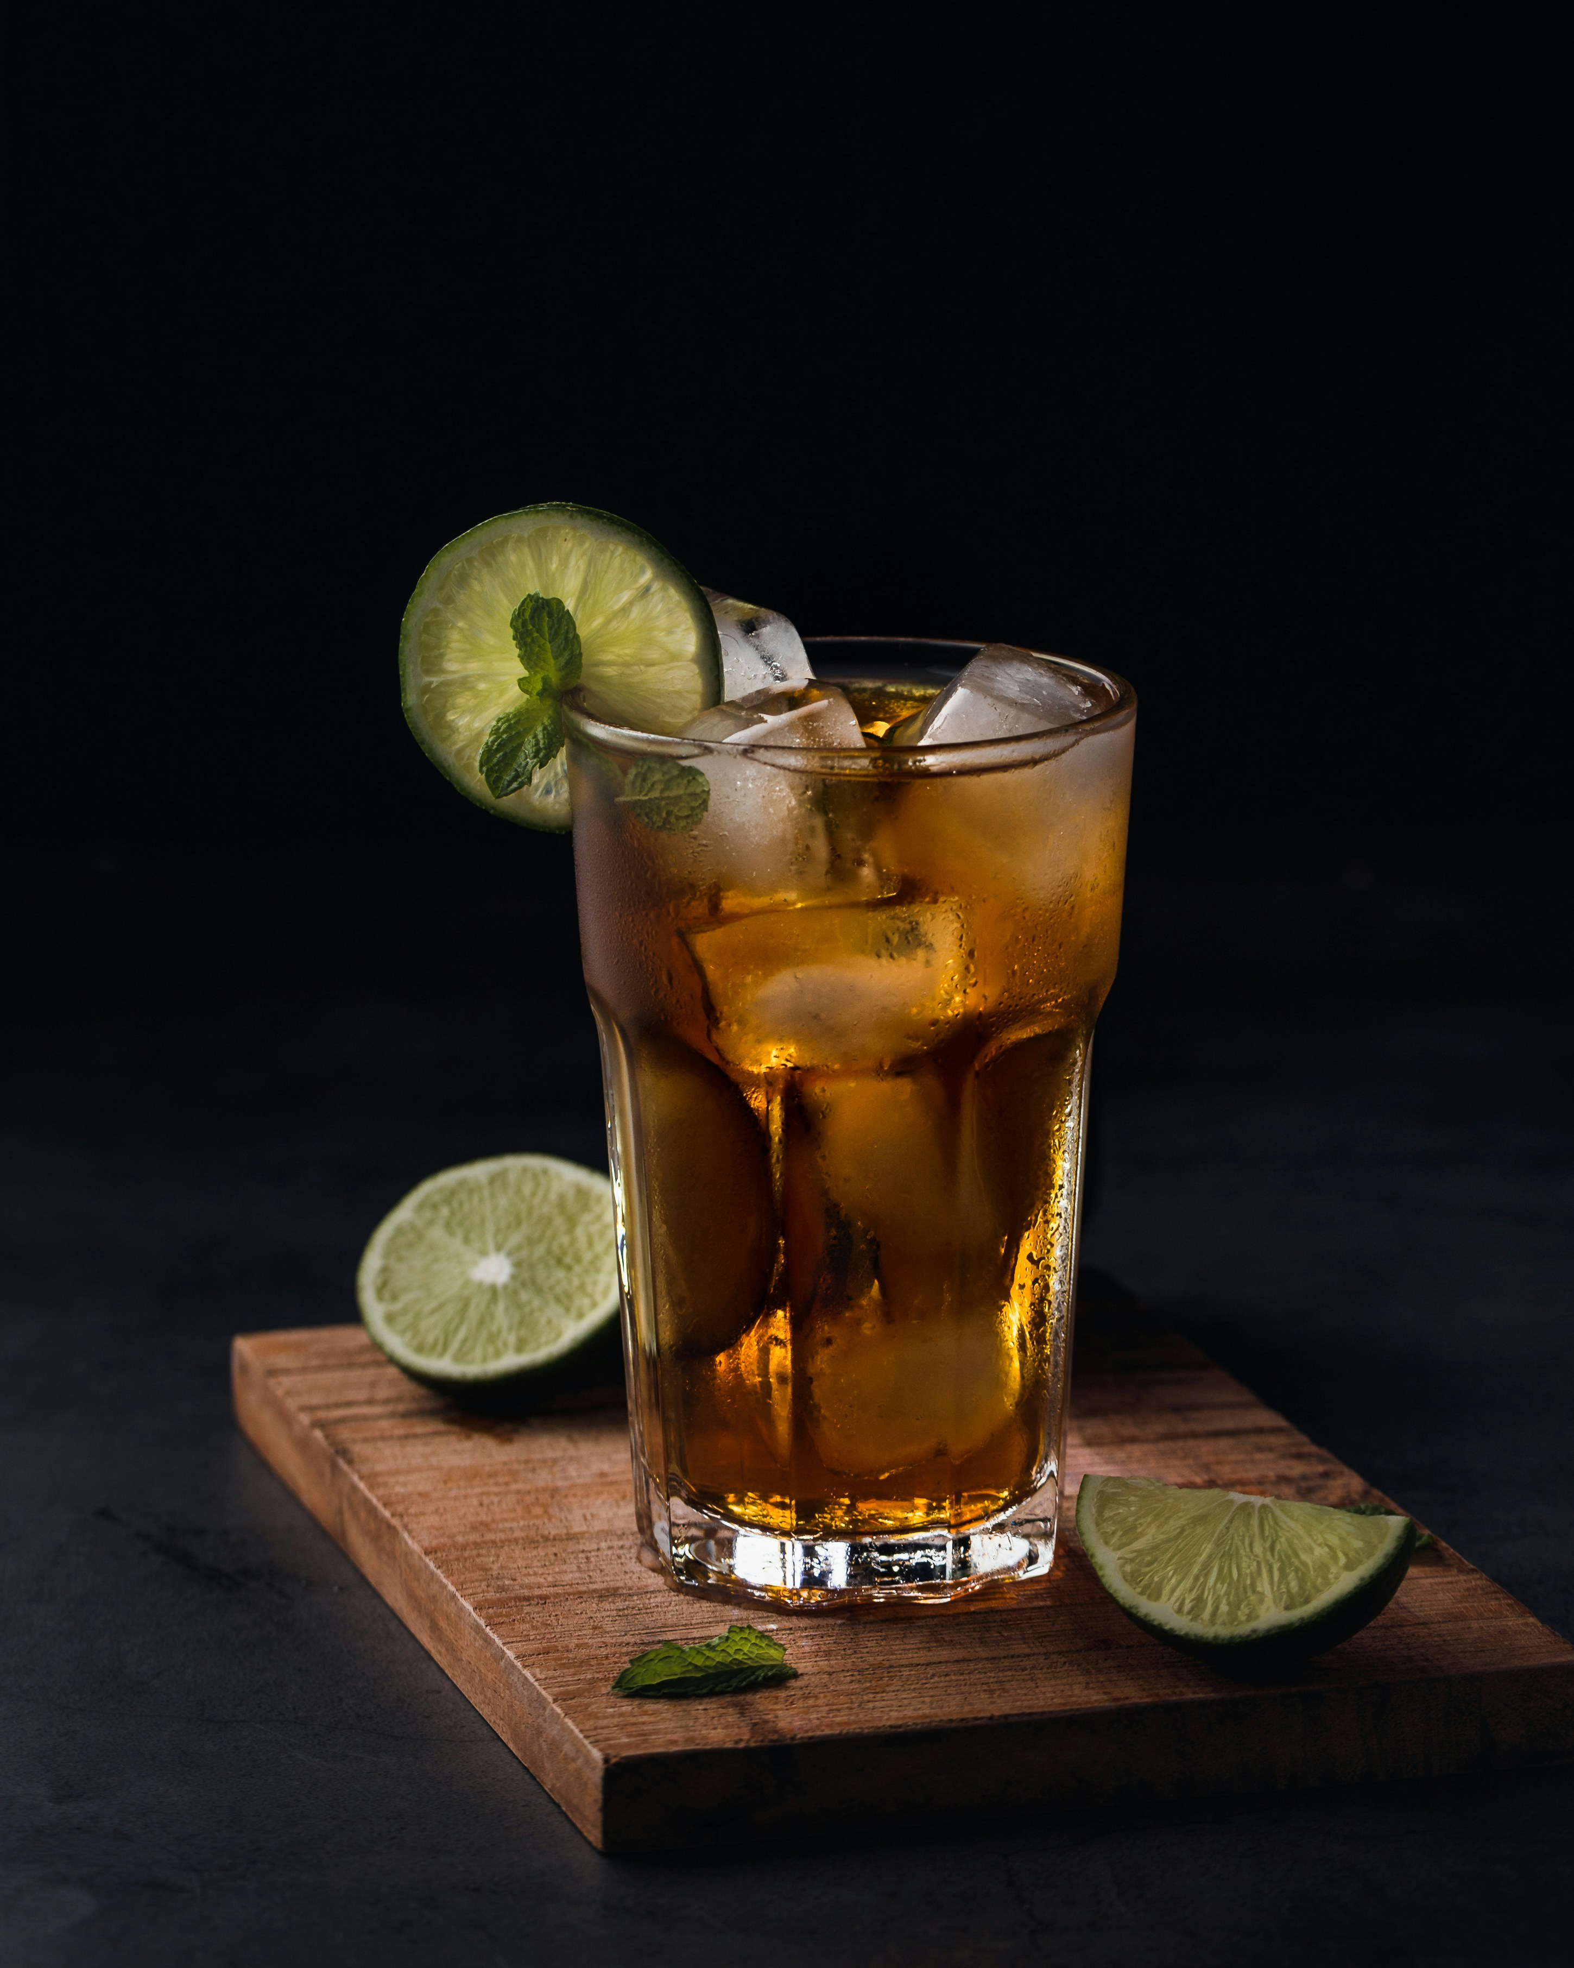
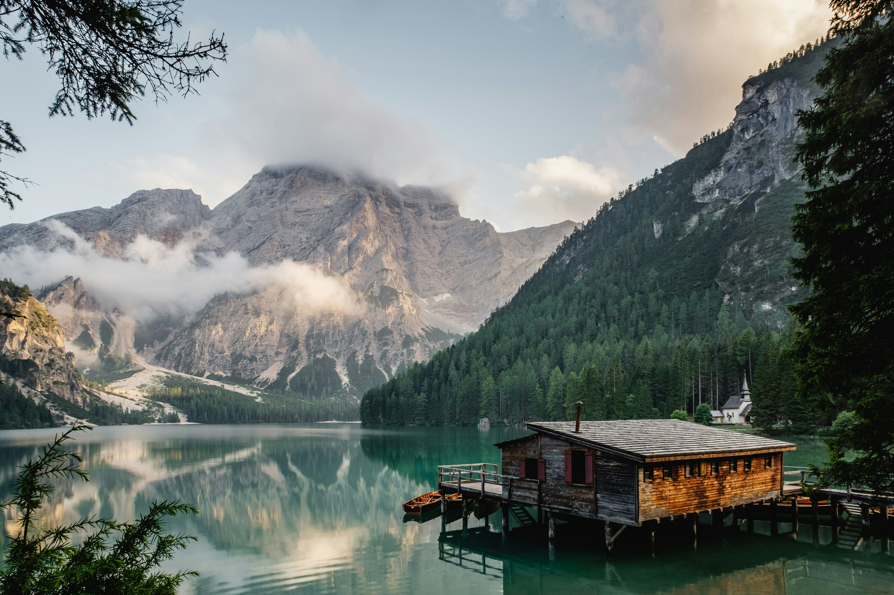
Portfolio ^ About Purchase prints
Landscape
Still life
© 2026 Jermaine Fotography

