Slide 1
Python ApplicationsWeb Development
Game Development
Machine Learning and Artificial Intelligence
Data Science and Data Visualization
Desktop GUI
Web Scraping Applications
Business Applications
Audio and Video Applications
CAD Applications
Embedded Applications

Slide 2
Create Database
mycursor = mydb.cursor() mycursor.execute("CREATE DATABASE Rajeev")

Slide 3
Create table
mycursor = mydb.cursor() mycursor.execute("CREATE TABLE customers (name VARCHAR(255), address VARCHAR(255))")

Slide 4
Data Insert
mycursor = mydb.cursor() sql = "INSERT INTO customers (name, address) VALUES (%s, %s)" val = ("John", "Highway 21") mycursor.execute(sql, val) mydb.commit() # Store data from memory to HDD print(mycursor.rowcount, "record inserted.")

Slide 5
Select From a Table
mycursor = mydb.cursor()
mycursor.execute("SELECT * FROM customers")
myresult = mycursor.fetchall()
for x in myresult:
print(x)

Slide 6
Select With a Filter
mycursor = mydb.cursor() sql = "SELECT * FROM customers WHERE address ='Park Lane 38'" mycursor.execute(sql) myresult = mycursor.fetchall() for x in myresult: print(x)

Slide 7
Delete Record
mycursor = mydb.cursor() sql = "DELETE FROM customers WHERE address = 'Mountain 21'" mycursor.execute(sql) mydb.commit() print(mycursor.rowcount, "record(s) deleted")

Slide 8
Delete a Table
mycursor = mydb.cursor() sql = "DROP TABLE customers" mycursor.execute(sql)

Slide 9
Update Table
mycursor = mydb.cursor() sql = "UPDATE customers SET address = 'Canyon 123' WHERE address = 'Valley 345'" mycursor.execute(sql) mydb.commit() print(mycursor.rowcount, "record(s) affected")

Slide 10
Limit the Result
mycursor = mydb.cursor() mycursor.execute("SELECT * FROM customers LIMIT 5") myresult = mycursor.fetchall() for x in myresult: print(x)

Slide 11
What is Matplotlib?
Matplotlib is a low level graph plotting library in python that serves as a visualization utility.
Matplotlib was created by John D. Hunter.
Matplotlib is open source and we can use it freely.
Matplotlib is mostly written in python, a few segments are written in C, Objective-C and Javascript for Platform compatibility.

Slide 12
Checking Matplotlib Version
import matplotlib
print(matplotlib.__version__)

Slide 13
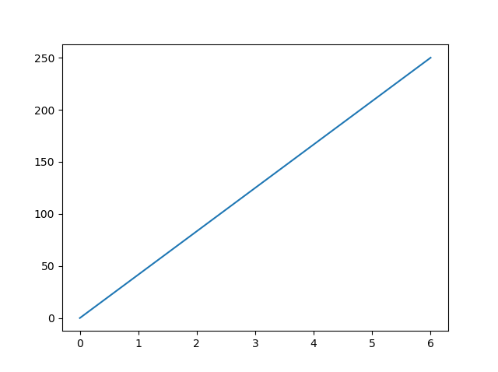
Pyplot
Most of the Matplotlib utilities lies under the pyplot submodule, and are usually imported under the plt alias:
import matplotlib.pyplot as plt
import numpy as np
xpoints = np.array([0, 6])
ypoints = np.array([0, 250])
plt.plot(xpoints, ypoints)
plt.show()

Slide 14

Plotting x and y points
The plot() function is used to draw points (markers) in a diagram.
By default, the plot() function draws a line from point to point.
The function takes parameters for specifying points in the diagram.
Parameter 1 is an array containing the points on the x-axis.
Parameter 2 is an array containing the points on the y-axis.
import matplotlib.pyplot as plt import numpy as np xpoints = np.array([1, 8]) ypoints = np.array([3, 10]) plt.plot(xpoints, ypoints) plt.show()

Slide 15
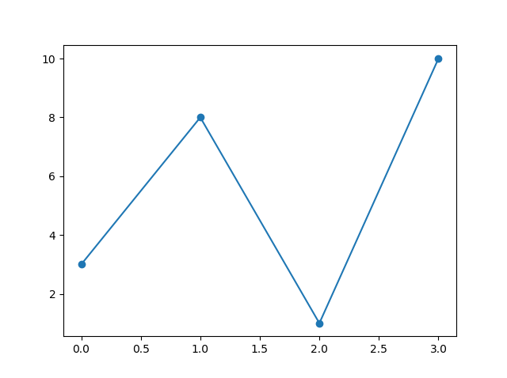
Markers
You can use the keyword argument marker to emphasize each point with a specified marker:
import matplotlib.pyplot as plt
import numpy as np
ypoints = np.array([3, 8, 1, 10])
plt.plot(ypoints, marker = 'o')
plt.show()

Slide 16
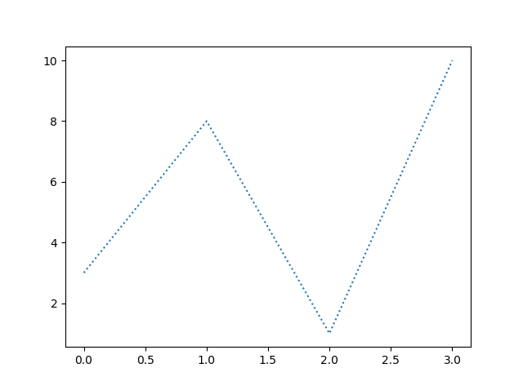
Line
You can use the keyword argument linestyle, or shorter ls, to change the style of the plotted line:
import matplotlib.pyplot as plt
import numpy as np
ypoints = np.array([3, 8, 1, 10])
plt.plot(ypoints, linestyle = 'dotted')
plt.show()

Slide 17
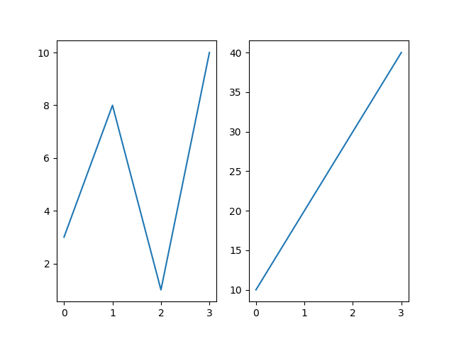
Display Multiple Plots
With the subplots() function you can draw multiple plots in one figure:
import matplotlib.pyplot as plt
import numpy as np
#plot 1:
x = np.array([0, 1, 2, 3])
y = np.array([3, 8, 1, 10])
plt.subplot(1, 2, 1)
plt.plot(x,y)
#plot 2:
x = np.array([0, 1, 4, 3])
y = np.array([3, 10, 6, 10])
plt.subplot(1, 2, 2)
plt.plot(x,y)
plt.show()

Slide 18
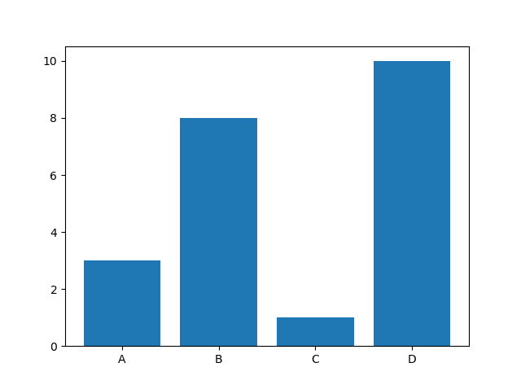
Creating Bars
With Pyplot, you can use the bar() function to draw bar graphs:
import matplotlib.pyplot as plt
import numpy as np
x = np.array(["A", "B", "C", "D"])
y = np.array([3, 8, 1, 10])
plt.bar(x,y)
plt.show()

Slide 19
Marker | Description
'o' | Circle
'*' | Star
'.' | Point
',' | Pixel
'x' | X
'X' | X (filled)
'+' | Plus
'P' | Plus (filled)
's' | Square
'D' | Diamond
'd' | Diamond (thin)
'p' | Pentagon
'H' | Hexagon
'h' | Hexagon
'v' | Triangle Down
'^' | Triangle Up
'<' | Triangle Left
'>' | Triangle Right
'1' | Tri Down
'2' | Tri Up
'3' | Tri Left
'4' | Tri Right
'|' | Vline
'_' | Hline

Slide 20
Line Syntax | Description
'-' | Solid line
':' | Dotted line
'--' | Dashed line
'-.' | Dashed/dotted line

Slide 21
Color Syntax | Description
'r' | Red
'g' | Green
'b' | Blue
'c' | Cyan
'm' | Magenta
'y' | Yellow
'k' | Black
'w' | White

Slide 22
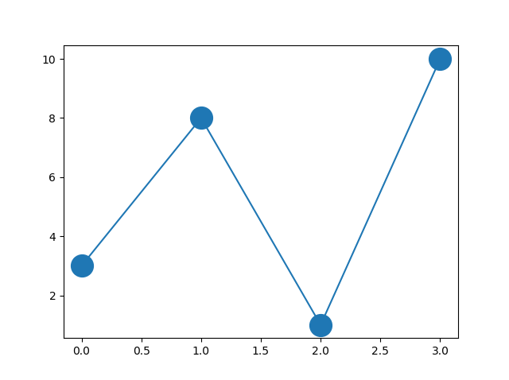
Marker Size
You can use the keyword argument markersize or the shorter version, ms to set the size of the markers:
import matplotlib.pyplot as plt
import numpy as np
ypoints = np.array([3, 8, 1, 10])
plt.plot(ypoints, marker = 'o', ms = 20)
plt.show()

Slide 23
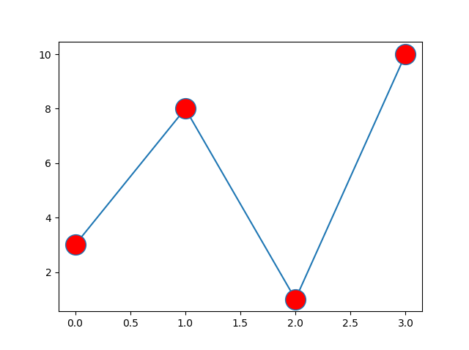
You can use the keyword argument markerfacecolor or the shorter mfc to set the color inside the edge of the markers:
import matplotlib.pyplot as plt
import numpy as np
ypoints = np.array([3, 8, 1, 10])
plt.plot(ypoints, marker='o', ms=20, mfc='r')
plt.show()

Slide 24
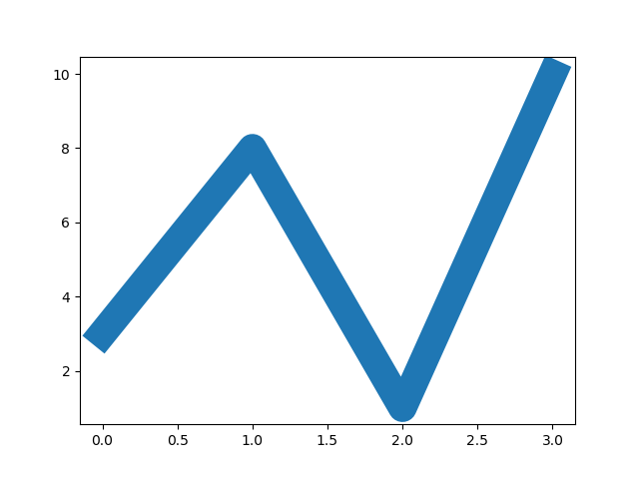
You can use the keyword argument linewidth or the shorter lw to change the width of the line.
The value is a floating number, in points:
import matplotlib.pyplot as plt
import numpy as np
ypoints = np.array([3, 8, 1, 10])
plt.plot(ypoints, marker = 'o', linewidth = '20.5')
plt.show()

Slide 25
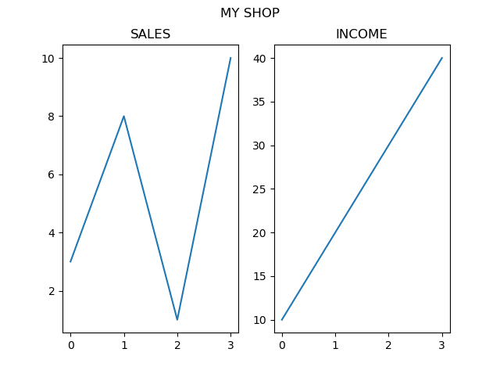
You can add a title to the entire figure with the suptitle() function:
import matplotlib.pyplot as plt
import numpy as np
#plot 1:
x = np.array([0, 1, 2, 3])
y = np.array([3, 8, 1, 10])
plt.subplot(1, 2, 1)
plt.plot(x,y)
plt.title("SALES")
#plot 2:
x = np.array([0, 1, 4, 3])
y = np.array([3, 10, 6, 10])
plt.subplot(1, 2, 2)
plt.plot(x,y)
plt.title("INCOME")
plt.suptitle("MY SHOP")
plt.show()

Slide 26
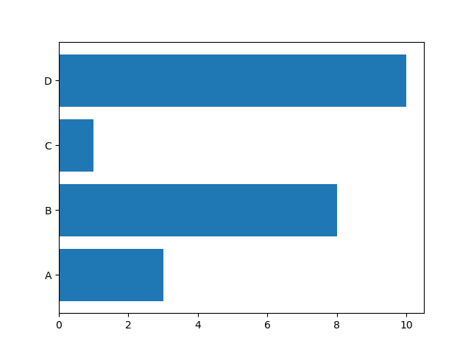
Draw 4 horizontal bars:
import matplotlib.pyplot as plt
import numpy as np
x = np.array(["A", "B", "C", "D"])
y = np.array([3, 8, 1, 10])
plt.barh(x,y)
plt.show()

Slide 27
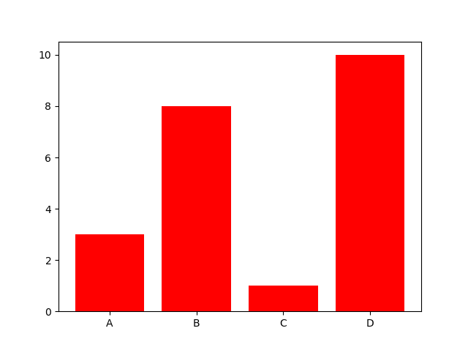
The bar() and barh() takes the keyword argument color to set the color of the bars:
import matplotlib.pyplot as plt import numpy as np x = np.array(["A", "B", "C", "D"]) y = np.array([3, 8, 1, 10]) plt.bar(x, y, color = "red") plt.show()

Slide 28
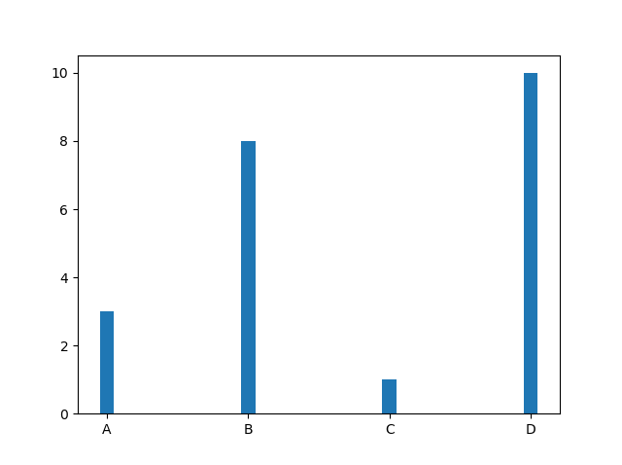
The bar() and barh() takes the keyword argument width to set the width of the bars
import matplotlib.pyplot as plt import numpy as np x = np.array(["A", "B", "C", "D"]) y = np.array([3, 8, 1, 10]) plt.bar(x, y, width = 0.1) plt.show()

Slide 29
Create Histogram
In Matplotlib, we use the hist() function to create histograms.
The hist() function will use an array of numbers to create a histogram, the array is sent into the function as an argument
import numpy as np x = np.random.normal(170, 10, 250) print(x)

Slide 30
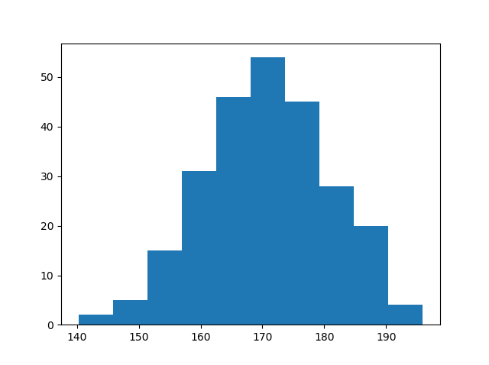
import matplotlib.pyplot as plt import numpy as np x = np.random.normal(170, 10, 250) plt.hist(x) plt.show()

Slide 31
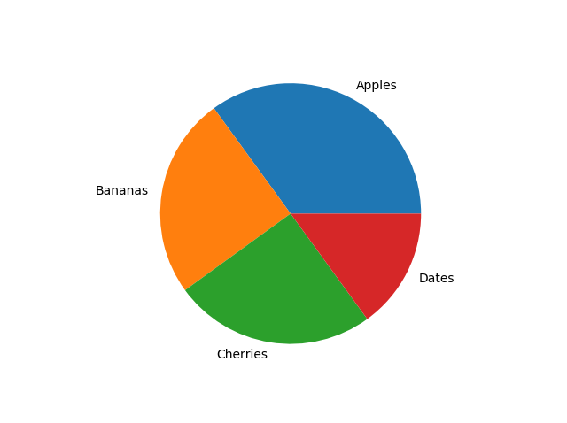
import matplotlib.pyplot as plt
import numpy as np
y = np.array([35, 25, 25, 15])
mylabels = ["Apples", "Bananas", "Cherries", "Dates"]
plt.pie(y, labels = mylabels)
plt.show()

Slide 32
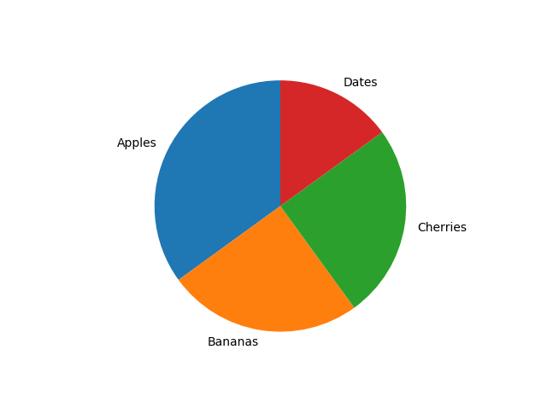
Start the first wedge at 90 degrees
import matplotlib.pyplot as plt
import numpy as np
y = np.array([35, 25, 25, 15])
mylabels = ["Apples", "Bananas", "Cherries", "Dates"]
plt.pie(y, labels = mylabels, startangle = 90)
plt.show()

Slide 33
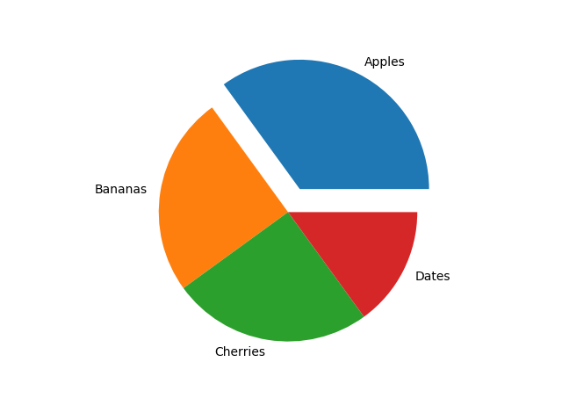
Pull the "Apples" wedge 0.2 from the center of the pie:
import matplotlib.pyplot as plt import numpy as np y = np.array([35, 25, 25, 15]) mylabels = ["Apples", "Bananas", "Cherries", "Dates"] myexplode = [0.2, 0, 0, 0] plt.pie(y, lables = mylabels, explode = myexplode) plt.show()

Slide 34
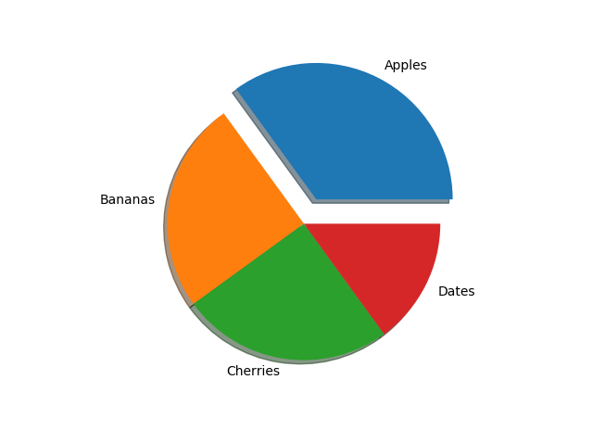
import matplotlib.pyplot as plt import numpy as np y = np.array([35, 25, 25, 15]) mylabels = ["Apples", "Bananas", "Cherries", "Dates"] myexplode = [0.2, 0, 0, 0] plt.pie(y, lables = mylabels, explode = myexplode, shadow = True) plt.show()

Slide 35
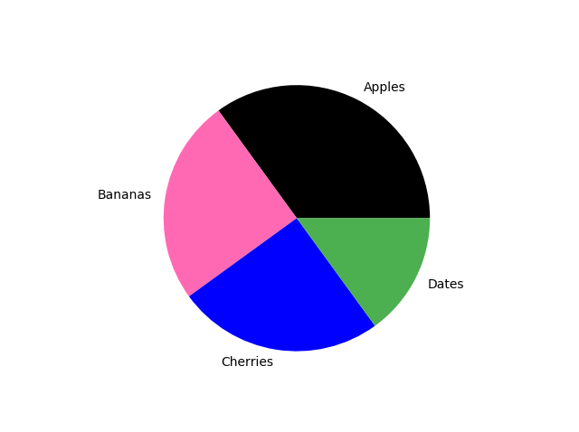
Specify a new color for each wedge
import matplotlib.pyplot as plt import numpy as np y = np.array([35, 25, 25, 15]) mylabels = ["Apples", "Bananas", "Cherries", "Dates"] mycolors = ["black", "hotpink", "b", "#4CAF50"] plt.pie(y, labels = mylabels, colors = mycolors) plt.show()

Slide 36
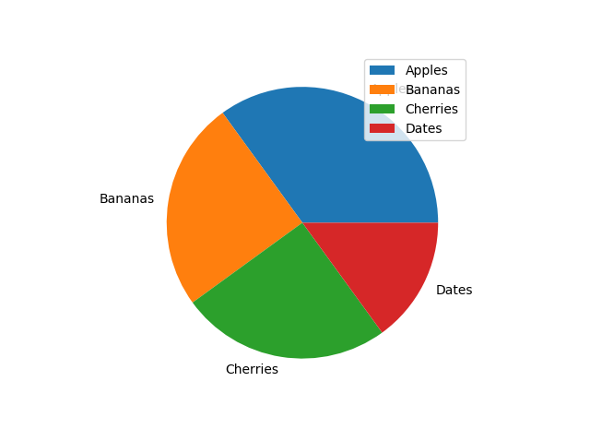
To add a list of explanation for each wedge, use the legend() function
import matplotlib.pyplot as plt import numpy as np y = np.array([35, 25, 25, 15]) mylabels = ["Apples", "Bananas", "Cherries", "Dates"] plt.pie(y, labels = mylabels) plt.legend() plt.show()

Slide 37
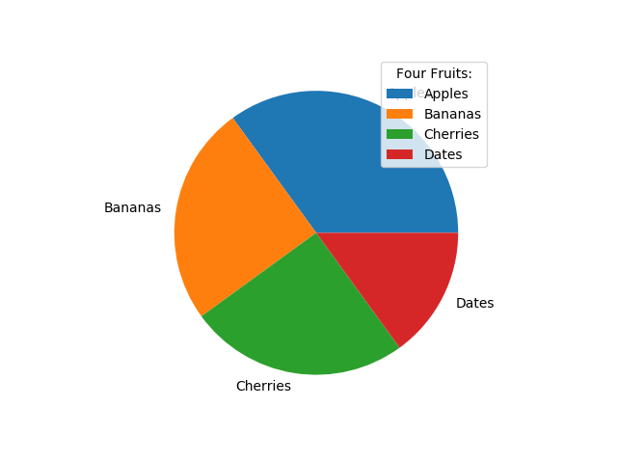
import matplotlib.pyplot as plt import numpy as np y = np.array([35, 25, 25, 15]) mylabels = ["Apples", "Bananas", "Cherries", "Dates"] plt.pie(y, labels = mylabels) plt.legend(title = "Four Fruits:") plt.show()

