Slide 1
Cyber Risk Quantification
Executive briefing for the CISO and CFO: SecureBank mobile banking platform
Chioma Ameh | C11/26/CGRCE/17567 | GRC103 Lab 3B | 29 October 2026

Slide 2
We are exposed to about $35.0M a year
Risk | One incident | Chance per year | Expected loss / year | Priority
Database Injection | $125,000,000 | 25% | $31,250,000 | High
Session Hijacking | $7,500,000 | 40% | $3,000,000 | High
API Authentication Bypass | $5,000,000 | 15% | $750,000 | Medium
Database injection alone is 89% of the exposure: one incident costs $125M and we expect one about every four years.

Slide 3
Three controls remove 77% of that exposure
$35.00M to $8.04M
yearly exposure before and after controls
$26,962,500 a year
risk removed ($26,857,500 after running costs)

Slide 4
The return is large, and the WAF leads
WAF
MFA
API Gateway
13,293%
1,139%
69%
Year-1 ROI
Year-1 ROI
Year-1 ROI
2.3 days
25.9 days
6.7 months
payback | cost $150,000 + $25,000/yr
payback | cost $200,000 + $30,000/yr
payback | cost $350,000 + $50,000/yr
Whole programme: $700,000 up front, Year-1 ROI 3,249%, paid back in about 9.5 days.

Slide 5
If the budget is capped, buy WAF + MFA first
Budget limit | Best selection | Risk removed / year | Share of maximum
$150,000 | WAF only | $23,437,500 | 86.9%
$200,000 | WAF only | $23,437,500 | 86.9%
$350,000 | WAF + MFA | $26,287,500 | 97.5%
$500,000 | WAF + MFA | $26,287,500 | 97.5%
$550,000 | WAF + MFA | $26,287,500 | 97.5%
$700,000 | All three controls | $26,962,500 | 100.0%
At $350,000 WAF + MFA already removes 97.5% of what all three controls achieve. The API gateway adds $675,000 a year but only fits once the budget reaches $700,000, so it can wait until Year 2.

Slide 6
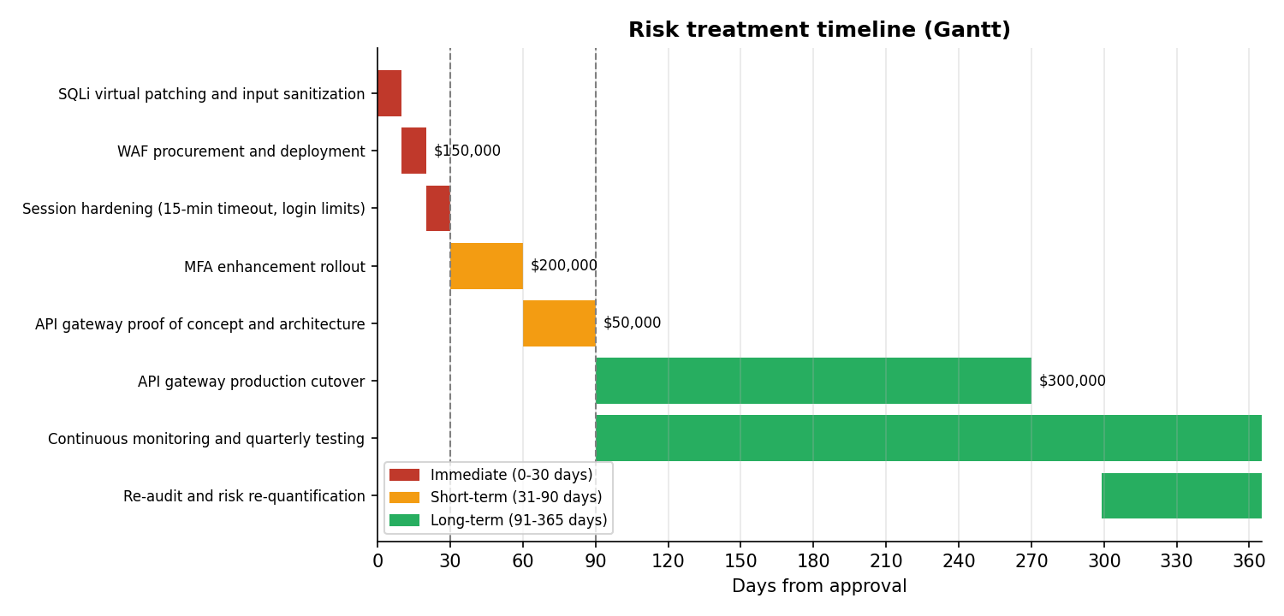
Roadmap: 30 days, 90 days, one year

Slide 7
Decision requested
Approve $700,000 capital and $105,000 a year for WAF, MFA and the API gateway, funded in that order.
If spending is capped at $500,000, approve WAF + MFA now ($350,000) and revisit the API gateway in Year 2.
Name an owner for each Priority 1 action in the first 30 days.
Re-test and re-quantify after 12 months to confirm the controls work as assumed.
Read as estimates: probability is treated as a yearly rate, loss and effectiveness figures come from the lab sheet, and MFA's 95% may be optimistic for stolen sessions. Full assumptions are in the report.

