Slide 1
Final Project Presentation
Group 13 – Gift Ajayi, Moyosore Akinola And Chioma Ulom.
CMPT 2091: Data Management Systems
Elizabeth Rutaroh
April 22, 2024

Slide 2
Introduction
This project is centered around gathering data from Kijiji and RentFaster rental listings in Alberta to identify restaurants in close proximity to these listings and the quality of said restaurants.

Slide 3
Objectives
To understand how to extract data from websites
Extract top and bottom listings from rental sites - Kijiji and Rentfaster
To extract data from Yelp to identify restaurants close to listings above.
- To Perform data exploration to form insights

Slide 4
Data Collection
Datasets were gotten with Web Scraping from Kijiji and Rentfaster and saved in 4 CSV files
Alberta locations selected were Edmonton, Red-Deer, Lethbridge, Spruce-Grove, St-Albert and Grande-Prairie for Rentfaster
Three(3) ranges of 4 pages each were selected from Kijiji

Slide 5
Issues faced while acquiring the data
Web scraping errors with some URLs not loading and
having to restart the process
Time spent​ during the web scraping process

Slide 6
Data Transformation
Converted CSV files to Pyspark Dataframes.
Imported request from Yelp Fusion API
Extracted top and bottom 50 listings from Kijiji and Rentfaster.
Combined top and bottom listings and collected addresses.
Data cleaning performed by eliminating duplicate addresses.

Slide 7
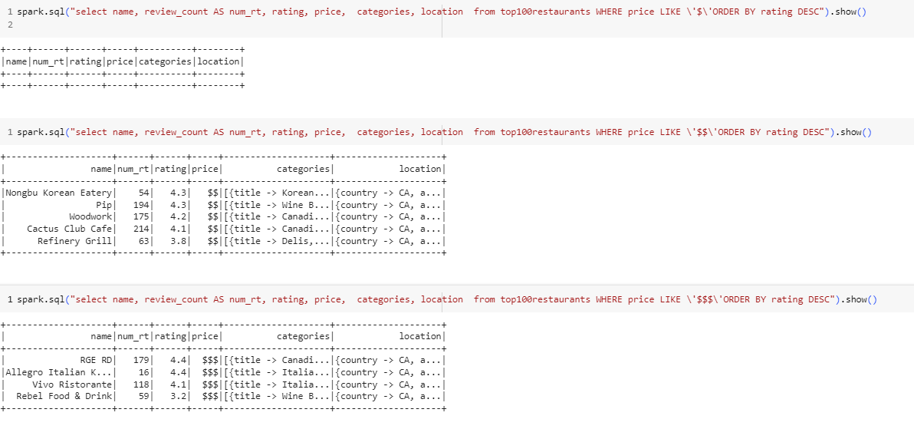
Findings
Figure 1: Results showing query for restaurants close to top listings where price is like $, $$ and $$$ respectively

Slide 8
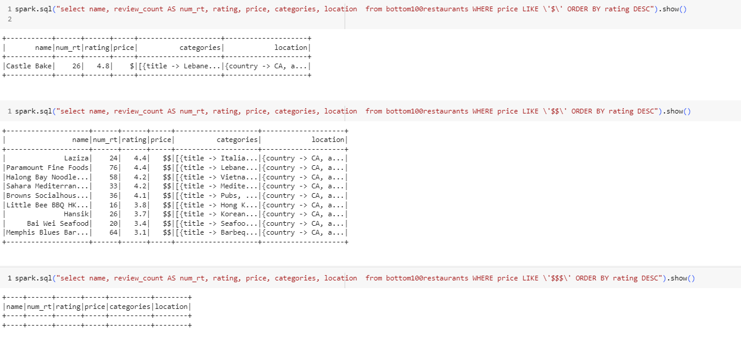
Findings
Figure 2: Results showing query for restaurants close to bottom listings where price is like $, $$ and $$$ respectively

Slide 9
Is there a correlation between the rental price vs the quality/price on restaurants nearby?
Yes.
From figures 1 and 2:
There were no restaurants with prices ($$$) in close proximity to the bottom listings.
There are more number of ratings and presumably, more visits to the restaurants near the top listings compared to the bottom listings.
The restaurants near the top listings included fine dining categories such as steak houses, and wine bars compared to those near the bottom listings such as pubs, fast foods e.t.c.

Slide 10
Is the data coming from Yelp of enough quality to drive insights?
Yes. We were able to draw comparisons between the prices and quality of restaurants close to top listings and bottom listings.

Slide 11
What you would do better or different to arrive to a more conclusive analysis?
- Increase the number of listings i.e. sample size
- Eliminate the restaurants with null values for prices
- Compare only the restaurants with available prices

Slide 12
What are your next steps?
Expand our range for Kijiji to acquire more data
Add more cities to Rentfaster to acquire more data
Increase our limit to acquire more listings

Slide 13
Is this data pipeline you built enough to scale for big data?
Yes.
Apache Spark efficiently distributes workloads across clusters,
ensuring processing time remains consistent even as data volume expands.

Slide 14
Thank you

