Slide 1
Java Bootcamp

Slide 2
Agenda
Goal of the course
About this course
Preconditions
Result of the course

Slide 3
Goal
Goal of the course is to give theoretical knowledge and practical experience in Java language and Object-Oriented Programming (OOP):
  Using Eclipse development environment
  Using SVN and Git version control systems
  Give chance to develop applications in Java EE web, database frameworks, and Android Dalvik/ART development environment
  Familiarize new IT workers with work in a team
  Introduce new IT workers in software engineering project life cycle

Slide 4
About this course
Courses are performed in 4 weeks, 5 days in week, 8 hours in a day in regular "Nine-to-five" manner
Course length is 160 astronomical hours, of which:
  Lunch time is included (we do "Brownbag seminars")
  First two weeks (80 hours) are spent for theoretical lectures and practical exercises about different Java technologies
    During this part of course regular knowledge checks are performed
    Practical exercises need to be completed, including main tasks and extra tasks
  Last two weeks (80 hours) students compete each within separate teams to develop some Java-based solution

Slide 5
Preconditions
To pass this course, required knowledge is:
  Good English
  Good skills of workstation usage (i.e. "poweruser")
  General understanding of operating systems and programming languages
Optional knowledge, which would help, is:
  General understanding of Object Oriented principles
  Practical experience in some kind of programming language
  General understanding of networking and databases
  Knowledge of some kind of Linux workstation

Slide 6
Result of the course
At the end of the course (successful) students:
  Should be able to develop new or extend existing Java programs, compile, debug and integrate them
  Can write and execute Unit tests
  Can use Eclipse development environment, knows about other Java IDEs
  Understand different roles of software engineering and their responsibilities
  Understand life cycle of software development project
  Can help his colleagues to solve problems
  Can switch to other programming languages

Slide 7
Speed of the course
Course is planned to be intensive, and tasks can be described as "Hard but doable"
It is planned, that most of students will complete most of the tasks
  That means, some students will not be able to complete some of tasks
All tasks have deadlines
  Tasks, which are completed after deadline, are not rated
You can work extra time on your tasks at home
  This is neither prohibited nor encouraged

Slide 8
Course schedule
All students have to work on the same schedule
Do not rush ahead of planned schedule!
  But it doesn't mean you should be bored
If you have completed current task, you have to do extra task
  There are already prepared extra tasks in ..extra.. package, complete them in their order
  You can always ask for another extra task
  Completed extra tasks will be also rated

Slide 9
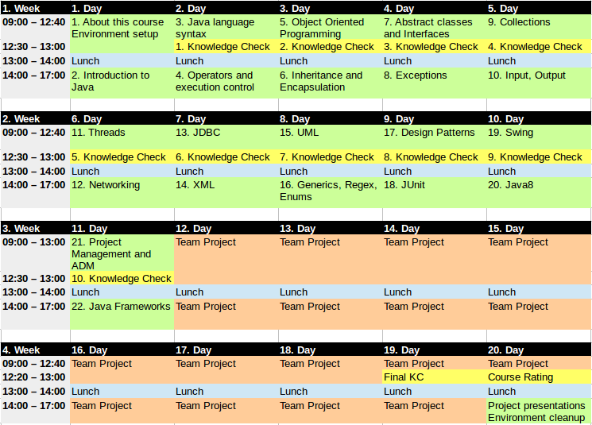
Course Map

Slide 10
Support levels
You are working in material rich environment and can use anything you can find
  In course materials and presentations
  In the sample project
  In the Internet
When dealing with problem use following approach:
  Help yourself looking at solutions on the web
  Ask your teammate close to you
  Ask competing team
  Ask teacher

Slide 11
Priority of information sources
As in any information rich course, different information sources can contradict
In this case priority of information in ascending order is:
  Internet (particularly, web)
  Course materials in Latvian
  Course materials in English
  What teacher says
(It doesn't mean, you cannot oppose to teacher, but it means you need to convince him, that other particular source is correct)

Slide 12
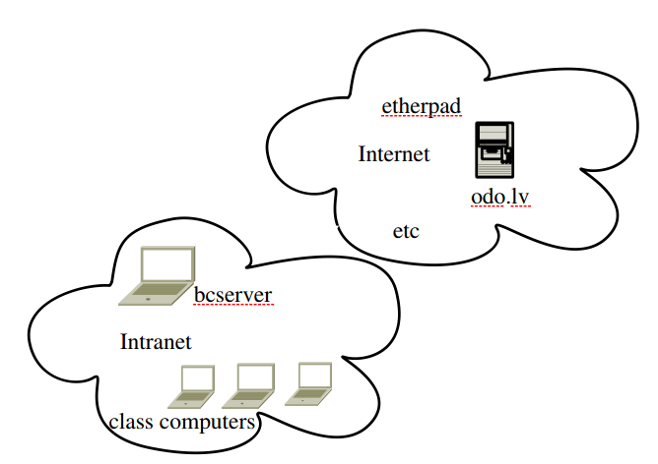

Class resources

Slide 13


Creation vs Consumption
How it is consumed and how it is prepared:
Users use Microsoft Windows and Office
Developers use Linux and Open Source
(GNU tools, Java, MySQL, Tomcat, etc.)

Slide 14
First task — prepare Linux workstation
In the course Linux workstations are used, because:
  Java development environment is fully open (including standards and source code), therefore it is easier to use open-sourced operating system to develop in Java
  In last years Unix-like operating systems (Linux, BSD, Mac OSX, iOS, Android) become more popular in IT solutions than VMS-like (Windows) systems, therefore it is important to know these systems
Students have to set-up their operating system themselves, because this is only way how IT professional can control his main working tool himself

Slide 15
Introduce yourself to the class
Please tell to the class:
  Your name and surname
  Your relation to Accenture
  Your self-assessed knowledge in programming:
    I'm here by accident (e.g. wrong door)
    I'm not a programmer, but have IT related/non-related experience in ...
    I'm a programmer (in which language, how long)
    I'm/I'm not familiar with Object-Oriented Programming (OOP)
    I have/don't have experience in Java OOP (how long)
    I have finished … course in … school
Your expectations to this course
  Learn something new
  Learn some particular technology, approach, etc.
Tell something interesting about yourself
(what would enjoy us and could help to remember you)

