Slide 1
Design patterns

Slide 2
Agenda
What are software design patterns
Creational patterns
Structural patterns
Behavioral patterns
Concurrency patterns
  Mentioned for full set, but will not be reviewed

Slide 3
Software design patterns
A software design pattern is a general reusable design to common software problem
There are different kinds of software design patterns:
  Algorithm strategy patterns
  address application algorithmic characteristics on a computing platform
  Computational design patterns
  address computational identification
  Execution patterns patterns
  address lower-level application execution
  Implementation strategy patterns
  address source implementation and support — program organization and common data structures
  Structural design patterns
  address global structures of applications being developed

Slide 4
Why design patterns
Solve "real", frequently occurring problems
Makes software design process faster and easier
Allow to reuse code fragments
Shows "best practices" in particular software development area
Create common understanding and vocabulary about particular software development area
Besides already created solution, also has well known design weaknesses and limitations

Slide 5
Creational patterns
Abstract factory
Factory method
Builder
Lazy initialization
Prototype
Singleton

Slide 6

Factory method
Factory method pattern is a creational pattern, which uses factory methods to deal with the problem of creating objects without specifying the exact class of object that will be created.

Slide 7
Builder
The builder pattern is an object creation pattern where complex objects is constructed in several steps (usually starting with "nullified" object, and then filling in its structures).
Builder pattern is used when creation of complex object leads to an exponential list of constructors (which is anti-pattern)
CarBuilder carBuilder = new CarBuilder();
carBuilder.setSeats(2);
carBuilder.setSportsCar();
carBuilder.setTripComputer();
carBuilder.unsetGPS();
Car car = carBuilder.getResult();

Slide 8
Lazy initialization
Lazy initialization is delaying of creation of an object (especially large static objects) until the first time it is needed
class LazyDemo {
static Object megaObject;
public Object getMegaObject() {
if (megaObject == null) { // not thread safe!
megaObject = new MegaObject();
}
return megaObject;
}
}
For thread safe construction synchronized methods/blocks of code should be used, look also at Singleton pattern

Slide 9

Singleton
Ensure a class has only one instance, and provide a global point of access to it.
Can create, using:
  Lazy initialization
  Eager initialization
  Static block initialization
  Etc.
See more at https://en.wikipedia.org/wiki/Singleton_pattern

Slide 10
Structural patterns
Adapter
Composite
Decorator
Facade
Proxy

Slide 11

Adapter (Wrapper)
Convert the interface of a class into another interface clients expect.

Slide 12
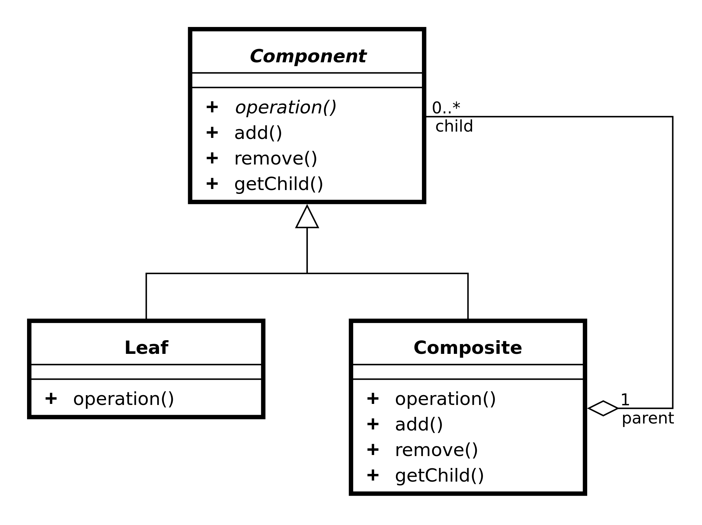
Composite
Compose objects into tree structures to represent part-whole hierarchies. Composite lets clients treat individual objects and compositions of objects in the same way.

Slide 13
Behavioral patterns
Iterator
Strategy
Observer

Slide 14
Iterator
Provide a way to access the elements of an aggregate object sequentially without exposing its underlying representation.
Java has Iterator and Iterable interfaces for this
Can be traversed using the enhanced for loop syntax
The Collection interface from the Java collections framework extends Iterable.

Slide 15

Strategy
Joint name for inheritance hierarchy and polymorphism
Define a family of algorithms, encapsulate each one, and make them interchangeable.
Strategy lets the algorithm vary independently from clients that use it.

Slide 16

Observer
Also called publish/subscribe
One-to-many dependency between objects where change in one object results changes in all dependent objects
  Avoids "Busy waiting" in distributed systems
  Do not confuse with simple shared structure

Slide 17
Concurrency patterns
Active object
Double-checked locking
Monitor object
Reactor
Thread-specific storage
Etc.

Slide 18
Design pattern weaknesses
Without good understanding of problem, incorrect design pattern can be chosen
Too much of pattern usage may unnecessarily increase complexity
The design patterns can be a sign of missing features in given programming language
  Too much patterns in code is anti-pattern, why not to develop some kind of DSL language for this problem?
  Much of what looks like "pattern" is actually "anti-pattern"
See more at: https://en.wikipedia.org/wiki/Anti-pattern#Software_engineering

