Slide 1
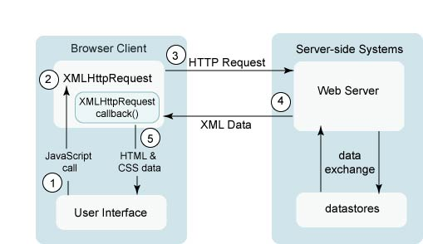
AJAX ==== A GENERAL SEQUENCE

