Slide 1

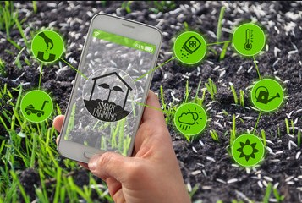
ROBO-FARM
BY MUKWE DICKSON ESAMAI AND DAVID NZAI (CO-INNOVATOR)
MACHAKOS UNIVERSITY

Slide 2
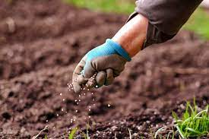
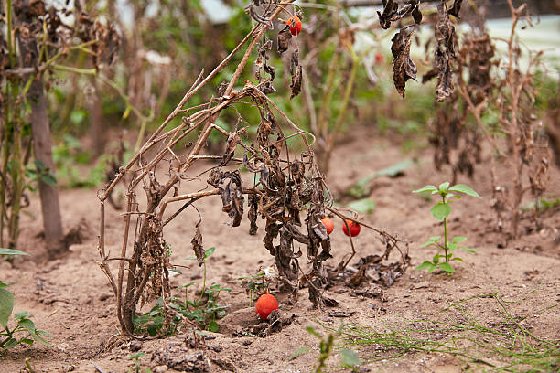
PROBLEM STATEMENT
The problem Robo-Farm addresses are farmers' limited ability to accurately monitor and manage crucial farm parameters.
Traditional farming practices lack real-time data on temperature, moisture, humidity, rain, and light, resulting in inefficient resource management and suboptimal crop production. Human senses alone are inadequate for precise measurements. This leads to excessive water usage, crop failure, and increased costs. The lack of data-driven insights hinders sustainable farming practices and compromises food security.

Slide 3
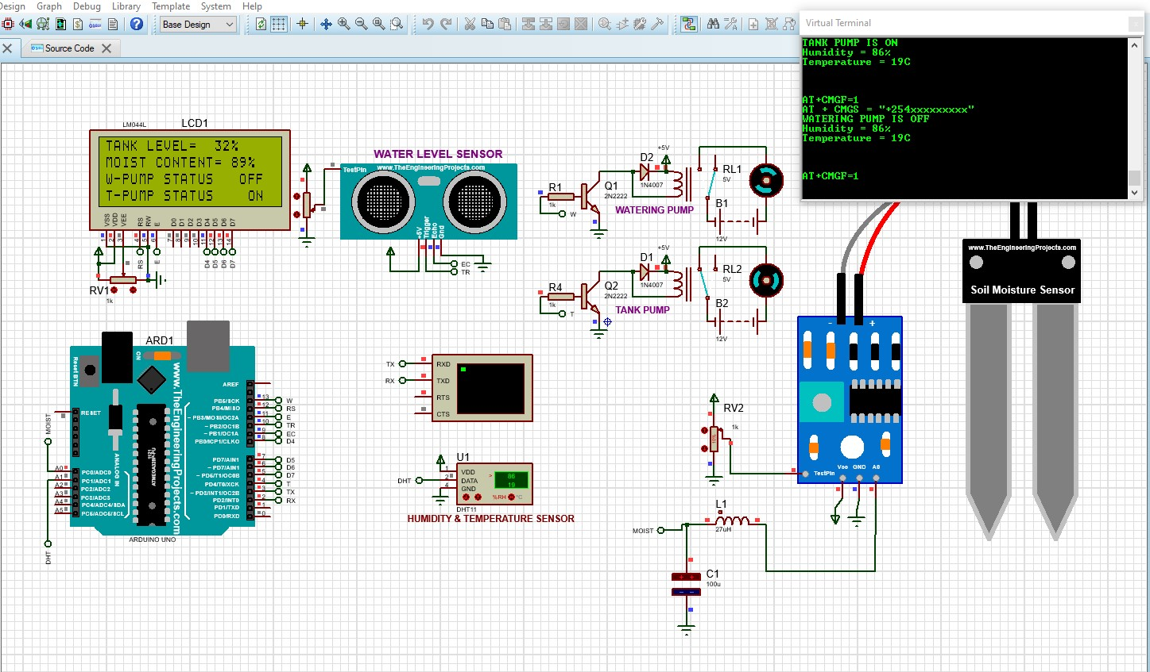
SOLUTION
The solution provided by Robo-Farm is an IoT-based platform that revolutionizes farming practices.
It enables farmers to accurately monitor and control crucial farm parameters such as temperature, moisture (Remote control of irrigation system), humidity, rain, and light in real-time
This data is collected by solar-powered sensors deployed strategically across the farm and transmitted to an online database.
Farmers can access this data through a mobile or web application, empowering them to make informed decisions about irrigation, resource allocation, and crop management.

Slide 4
TARGET MARKET
The target market for Robo-Farm includes small to large-scale farmers across various agricultural sectors, such as crop farming, horticulture, and greenhouse cultivation.
It caters to farmers who are seeking to optimize their crop production, improve resource management, and enhance sustainability practices. The solution is designed for farmers who recognize the importance of data-driven insights in making informed decisions about irrigation, fertilization, and overall farm management.
Additionally, agricultural research institutions, consultants, and governmental bodies involved in the agricultural industry can benefit from the platform's data analytics and knowledge-sharing capabilities. By providing accessible and scalable technology, Robo-Farm aims to empower farmers globally, enabling them to leverage advanced monitoring and control systems for efficient and sustainable farming practices.

Slide 5
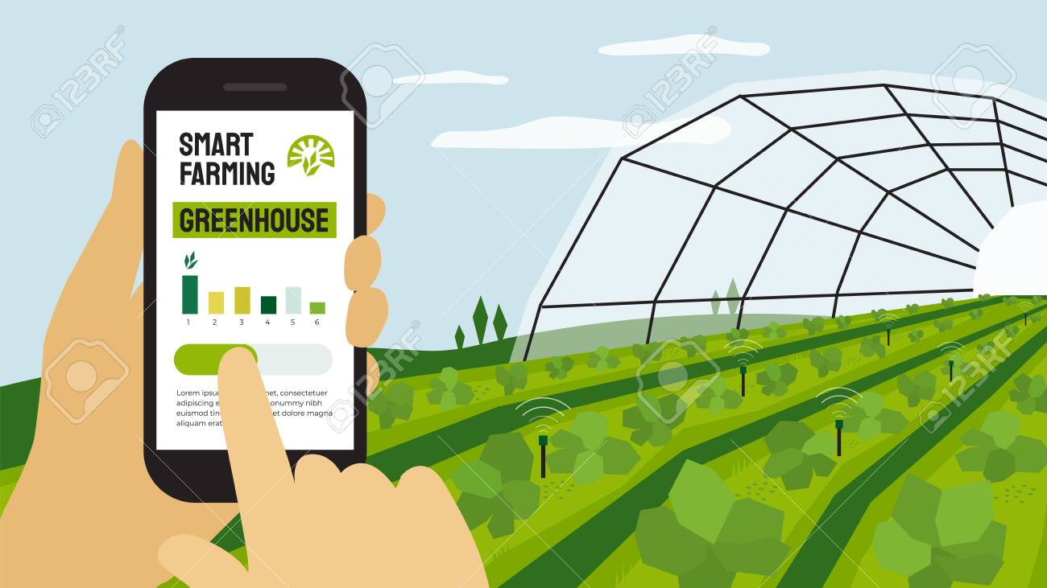
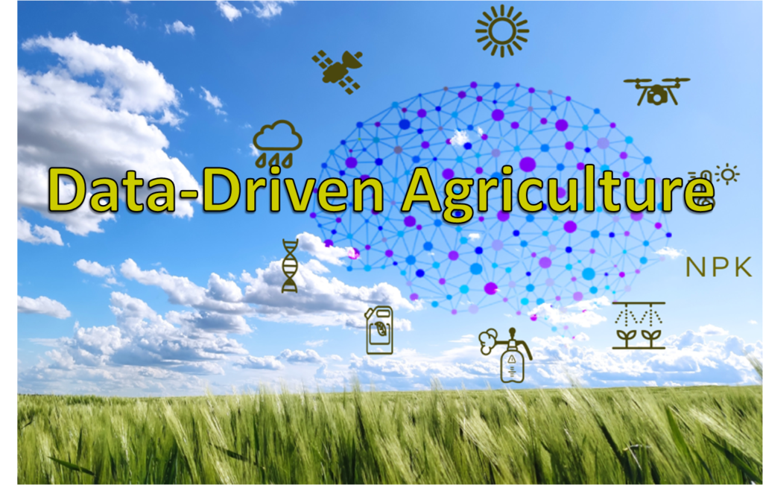
UNIQUE FEATURES
1. Comprehensive Monitoring: Monitors temperature, moisture, humidity, rain, and light in real time.
2. Remote Control: Allows farmers to control the irrigation system remotely.
3. Data-Driven Insights: Provides valuable recommendations based on advanced data analytics.
4. Knowledge Sharing: Facilitates collaboration and learning among farmers.
5. Scalable and Customizable: Adaptable to farms of different sizes and types.

Slide 6
BUSINESS MODEL & PARTNERSHIPS
Business Model:
- Subscription-based revenue model
- Data analysis services
- Licensing agreements with Agri-tech companies
Possible Partners:
1. Agricultural Input Providers: Integration of Robo-Farm with irrigation systems, fertilizers, etc.
2. Research Institutions: Collaboration for data analysis and innovation.
3. Government Agricultural Departments: Funding, support, and market access.
4. Agricultural Technology Companies: Enhancing Robo-Farm's capabilities.
5. Farming Cooperatives: Scaling deployment for collective benefits.
6. Agricultural Consultants: Expert advice on crop management and sustainability.
7. Financing Institutions: Affordable financing for adoption.

Slide 7
PRODUCT OVERVIEW & STATUS
Product Overview:
Robo-Farm is an IoT-based agricultural solution that revolutionizes farming practices. It enables comprehensive monitoring of farm parameters such as temperature, moisture, humidity, rain, and light. The system offers remote control of the irrigation system and generates data-driven insights for optimized crop production. It also provides a knowledge-sharing platform for collaboration among farmers.
Status:
Robo-Farm is currently in the under development stage and is expected to be launched commercially in the near future.
Robo-Farm's innovative features and advanced stage of development position it as a game-changer in the agricultural industry, empowering farmers with data-driven insights and sustainable farming practices.

Slide 8
ASK/REQUIREMENTS
1. Funding: Seeking investment to support further development, production, and commercialization.
2. Partnerships: Collaborating with input providers, research institutions, technology companies, and farming cooperatives.
3. Regulatory Support: Seeking government backing for market access and navigating regulations.
4. Pilot Farms: Partnering with farms for real-world testing and data validation.
5. User Feedback: Gather insights from farmers and experts for continuous improvement.
6. Market Adoption: Promoting awareness and adoption through targeted marketing and education.
7. Scaling Operations: Building a scalable infrastructure to meet growing demand.
Join us in revolutionizing agriculture with Robo-Farm. Together, let's drive sustainable farming practices and enhance food production.

Slide 9
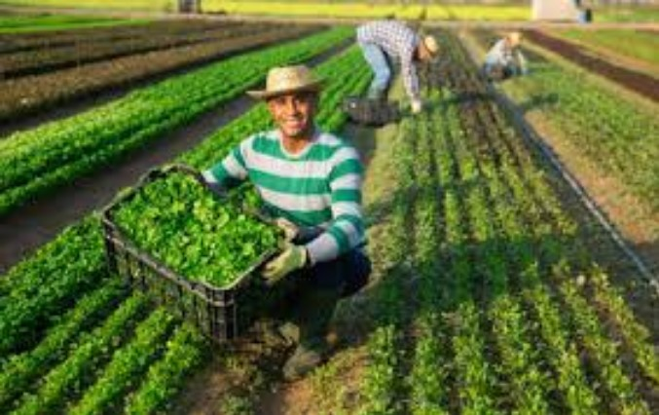

CONCLUSION:
Embracing the Future of Farming with Robo-Farm for sustainable agriculture and food security.
Join us on the journey to a smarter and greener future.

Slide 10
THANK YOU!

