Slide 1
AI Driven Bank Customer
Complaint Ticket Classifier
Simplifying and Streamlining Customer Support with AI
Introduction:
I specialize in developing AI solutions that address real-world problems. With a focus on innovation, I leverage cutting-edge technologies to optimize processes, enhance efficiency, and deliver impactful results. This project exemplifies my commitment to creating intelligent systems that make complex tasks simpler and more user-friendly.
Presented by: Chiraag P V

Slide 2
CUSTOMER COMPLAINT TICKET PROCESS
Understanding the Challenges in Ticket
Current Ticket Submission Process
Customers must select a category, sub-category and priority or many other options when raising tickets, making the process complex and time-consuming.
Customer Pain Point
Customers face difficulty in finding appropriate categories and sub-categories, leading to frustration due to prolonged complaint resolution times.
Frustration due to unclear priorities.

Slide 3
AI MODEL DEVELOPMENT: OVERVIEW
Key Aspects of AI Model Objectives and Training
Al Model Objectives
The primary goal is to reduce the time and complexity involved in the complaint ticket process.
Dataset Utilized
The model focuses on three main categories for initial training: 'Credit card or prepaid card’, ‘Checking or savings account’, and ‘Mortgage’.
Training Process
The training involves categorization based on customer issue descriptions and emphasizes the requirement of a comprehensive dataset for effective model training.

Slide 4
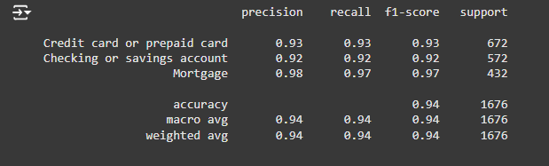
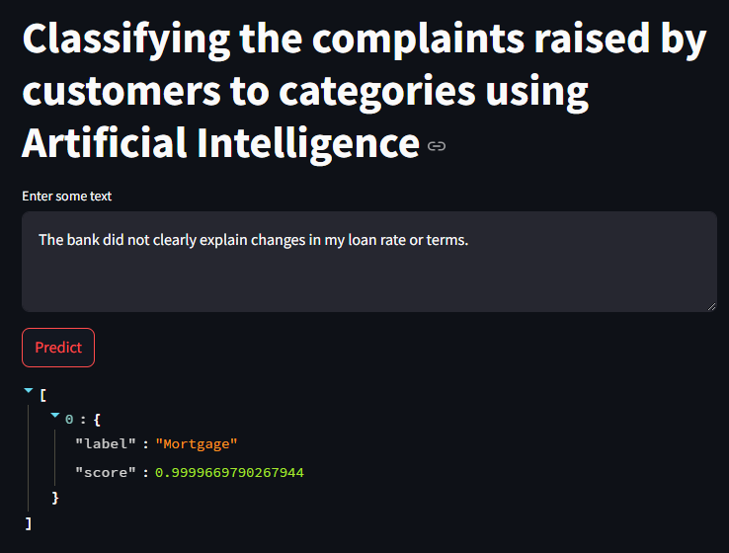
CLASSIFIER MODEL PERFORMANCE AND CAPABILITIES
APPROACH
Extracts insights from issue descriptions to classify into relevant categories.
MODEL DEVELOPMENT
Creation of a Fine-tuned Classifier model
CURRENT CAPABILITIES
Model can predict categories from descriptions, streamlining the complaint submission process
PERFORMANCE METRICS
Achieved and impressive accuracy of 94%

Slide 5
IMPORTANCE OF SOLUTION
For Customers
For Banks
Faster ticket creation with minimal effort.
User-friendly and intuitive experience.
Streamlined complaint routing for quicker resolution.
Data-driven insights into common complaint areas.
Scalable for more complex classification in the future.

Slide 6
FUTURE ENHANCEMENTS
AND
POTENTIAL APPLICAITONS
Expansion of Classification Capabilities
Potential to classify into additional categories, sub-categories, and priorities.
Continuous Improvement
Vision to continuously improve Al solutions to adapt to evolving customer needs
Broader Applications
Implementation across various banking sectors and beyond to enhance customer service.

