Slide 1
BUILDING CHATBOTS
WITH OPENAI
CHIRAAG P V

Slide 2
Contents
01
02
03
04
05
Introduction to RAG Applications
OpenAI API and Chat Models
OpenAI Embeddings
OpenAI Vector Store
LangChain Framework

Slide 3
INTRODUCTION TO RAG APPLICATIONS

Slide 4

Overview of Retrieval-Augmented Generation
01
Definition of RAG
Retrieval-Augmented Generation (RAG) is a hybrid approach that combines retrieval-based mechanisms with generative models. This enables chat systems to pull relevant information from external knowledge sources, thus enhancing response accuracy and contextuality during user interactions.
02
Importance in AI Applications
RAG applications are critical in bridging the gap between large language models and specific datasets. They enhance the ability of chatbots to provide contextually rich responses by referencing up-to-date information, resulting in improved user engagement and satisfaction.
03
Key Components of RAG
Key components of a RAG system include a retrieval mechanism that fetches relevant data, generative models that create coherent responses, and embeddings that facilitate semantic understanding between queries and information sources.

Slide 5
OPEN AI API AND CHAT MODELS

Slide 6


Introduction to OpenAI API
Features of OpenAI API
Use Cases in Chat Models
The OpenAI API provides robust functionalities including natural language understanding, generation, and the ability to interact with external knowledge bases. Its flexibility allows for the creation of customized chat models tailored to specific user needs.
Use cases for the OpenAI API in chat models include personalized customer support bots, educational tutoring systems, and interactive entertainment experiences, showcasing its versatility across various industries.

Slide 7
OPEN AI EMBEDDINGS

Slide 8
Understanding Embeddings
What are Embeddings?
Embeddings are numerical representations of words or phrases that capture semantic meaning. They allow models to understand relationships and similarities between different pieces of information, which is essential for effective retrieval in RAG applications.
How Embeddings Work
Through methods like Word2Vec or BERT, embeddings transform language into a vector space where semantically similar items are positioned closer together. This enables chat models to quickly identify relevant data during the retrieval process.

Slide 9
OPEN AI VECTOR STORE

Slide 10
Introduction to Vector Store
Definition and Purpose
How Vector Store Works
A vector store is a database system designed to store and manage embeddings. It enables efficient similarity searches and retrieval of relevant embeddings that correspond to user queries, forming a backbone of RAG architectures.
Vector stores utilize indexing techniques like FAISS to quickly retrieve embeddings based on vector proximity, allowing for rapid response generation in chat applications that require up-to-date information from external data sources.

Slide 11
LANGCHAIN FRAMEWORK

Slide 12


Overview of LangChain
What is LangChain?
Key Features of LangChain
LangChain is an open-source framework designed to simplify the development of applications using language models. It helps developers integrate various processes required for building complex chat systems, streamlining workflows.
Key features include the ability to manage chats, handle user interactions, and integrate with external APIs and knowledge bases seamlessly, making it a powerful tool for building context-aware chatbots.

Slide 13
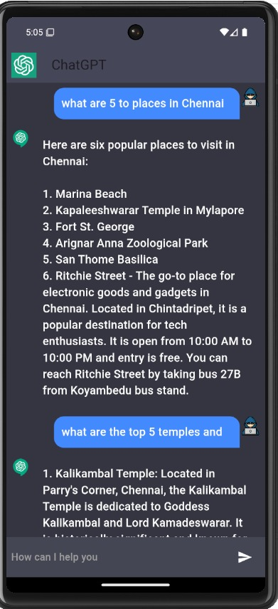
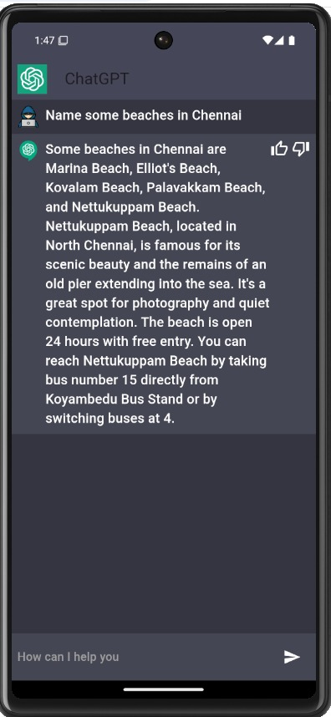
PHOTOSHOTS

Slide 14
THANKS
CHIRAAG PV

