Slide 1



Slide 1
Python for Data Science 3150713
Malicious URL Detection
COMPUTER SCIENCE & ENGINEERING SEM 5
Bellani Chirag P. 200050131180
Gajera Nand D. 200050131049

Slide 2
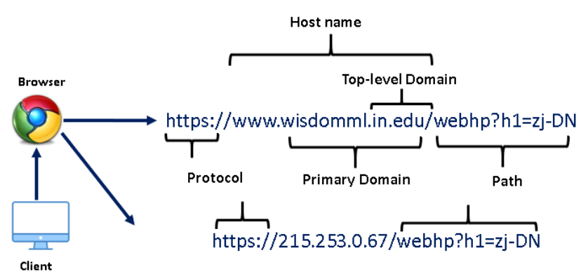
Slide 2
The Uniform Resource Locator (URL) is the well-defined structured format unique address for accessing
websites over World Wide Web (WWW).
i.) Protocol: It is basically an identifier that determines what protocol to use e.g., HTTP, HTTPS, etc.
ii) Hostname: Also known as the resource name. It contains the IP address or the domain name where the actual resource is located.
iii) Path: It specifies the actual path where the
resource is located
What is URL?
2

Slide 3
Slide 4
What is Malicious URL?
Modified or compromised URLs employed for cyber attacks are known as malicious URLs.
A malicious URL or website generally contains different types of trojans, malware, unsolicited content in the form of phishing, drive-by-download, spams.
The main objective of the malicious website is to fraud or steal the personal or financial details of unsuspecting users. Due to the ongoing COVID-19 pandemic the incidents of cybercrime increased manifold. According to Symantec Internet Security Threat Report (ISTR) 2019, malicious URLs are a highly used technique in cyber crimes.
In this article, we address the detection of malicious URLs as a multi-class classification problem by classifying the raw URLs into different class types such as benign or safe URLs, phishing URLs, malware URLs, or defacement URLs.
4

Slide 4

Slide 7
Problem statement
25
In this case study, we address the detection of malicious URLs as a multi-class classification problem. In this case study, we classify the raw URLs into different class types such as benign or safe URLs, phishing URLs, malware URLs, or defacement URLs.

Slide 5
Slide 4
Dataset description
In this case study, we will be using a Malicious URLS dataset of 6,51,191 URLs, out of which 4,28,103 benign or safe URLs, 96,457 defacement URLs, 94,111 phishing URLs, and 32,520 malware URLs.
Now, let’s discuss different types of URLs in our dataset i.e., Benign, Malware, Phishing, and Defacement URLs.
4

Slide 6
Slide 4
Dataset description
Benign URLs: These are safe to browse URLs. Some of the examples of benign URLs are as follows:
mp3raid.com/music/krizz_kaliko.html
infinitysw.com
google.co.in
myspace.com.
Malware URLs: These type of URLs inject malware into the victim’s system once he/she visit such URLs. Some of the examples of malware URLs are as follows:
proplast.co.nz
http://103.112.226.142:36308/Mozi.m
microencapsulation.readmyweather.com
xo3fhvm5lcvzy92q.download
4

Slide 7
Slide 4
Dataset description
Defacement URLs: Defacement URLs are generally created by hackers with the intention of breaking into a web server and replacing the hosted website with one of their own, using techniques such as code injection, cross-site scripting, etc. Common targets of defacement URLs are religious websites, government websites, bank websites, and corporate websites. Some of the examples of defacement URLs are as follows:
http://www.vnic.co/khach-hang.html
http://www.raci.it/component/user/reset.html
http://www.approvi.com.br/ck.htm
http://www.juventudelirica.com.br/index.html
Phishing URLs: By creating phishing URLs, hackers try to steal sensitive personal or financial information such as login credentials, credit card numbers, internet banking details, etc. Some of the examples of phishing URLs are shown below:
roverslands.net
corporacionrossenditotours.com
http://drive-google-com.fanalav.com/6a7ec96d6a
citiprepaid-salarysea-at.tk
4

Slide 8


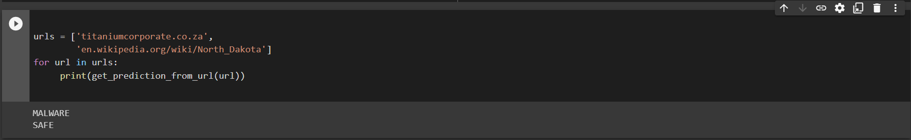
Slide 10
Result
In this final step, we will predict malicious URLs using our best-performed model.
10

Slide 9
Slide 4
Conclusion
In this article, we have demonstrated a machine learning approach to detect
Malicious URLs. We have created 22 lexical features from raw URLs and trained
three machine learning models XG Boost, Light GBM, and Random forest.
Further, we have compared the performance of the 3 machine learning models
and found that Random forest outperformed others by attaining the highest
accuracy of 96.6%. By plotting the feature importance of Random forest we found that hostname_length, count_dir, count-www, fd_length, and url_length are
the top 5 features for detecting the malicious URLs. At last, we have coded the
prediction function for classifying any raw URL using our saved model i.e., Random
Forest.
4

Slide 10

Slide 11
THANK YOU

