Slide 1
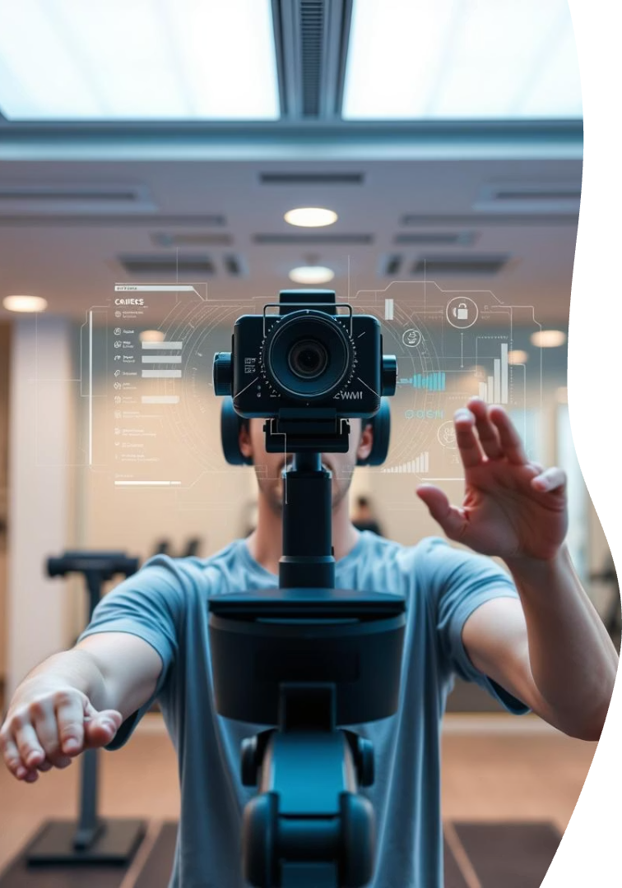

TNT: Webcam-Based Exercise Rep Tracker
TNT Tracker uses webcam video and AI to count exercise reps in real time. It supports squats, pushups, and bicep curls, providing instant feedback on form.
by Chirag Khola

Slide 2
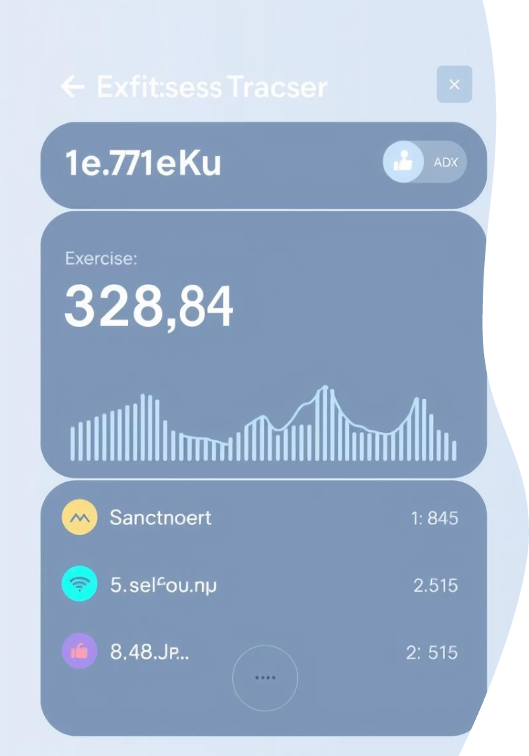
Key Features of TNT Tracker
Rep Counting
Tracks squats, pushups, and bicep curls live via webcam.
Web-Based UI
Runs in browsers with no installation required, built with HTML/CSS/JS.
Form Feedback
Provides real-time guidance to improve exercise technique.
Backend Powered by Python
Uses Flask, OpenCV, and MediaPipe for processing and analysis.

Slide 3
System Architecture Overview
Frontend
Backend
JavaScript app captures webcam frames, displays live video, sends data to backend.
Flask server processes frames with MediaPipe Pose, runs rep-counting logic, returns feedback.

Slide 4
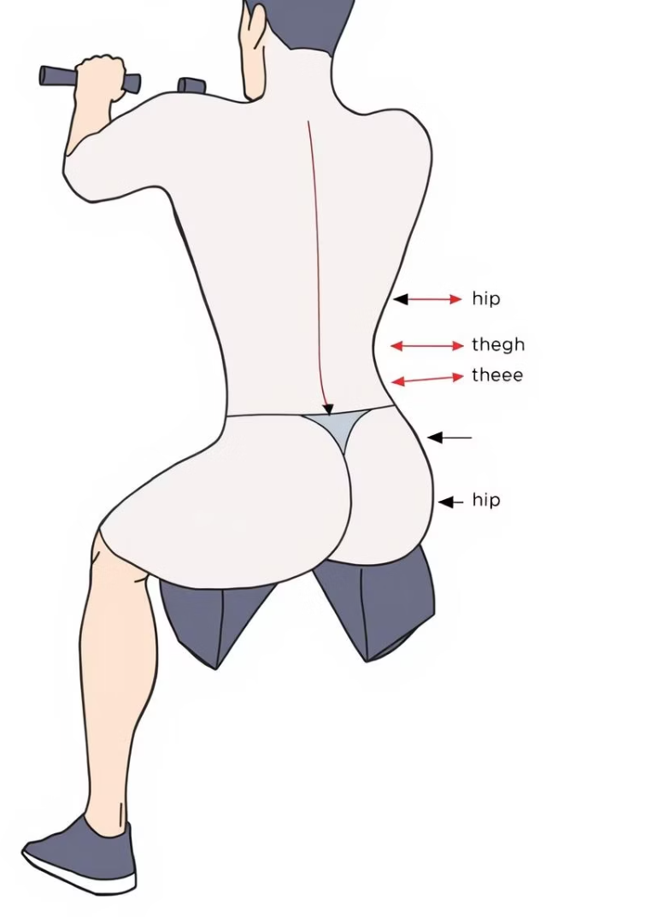




Rep Counting Logic Explained
Calculate Joint Angles
Use vector math to find angles between key body points.
State Machine
Track whether user is in “up” or “down” position during reps.
Increment Count
Count a rep when angle transitions meet defined thresholds.
Example: Pushups
Count reps when elbow angle goes from >160° to <90° and back.

Slide 5
Accuracy & Limitations
Pose Detection
Rep Counting
Best Practices
High accuracy on benchmarks, but sensitive to lighting and camera angles.
Rule-based logic robust but can miscount fast or inconsistent movements.
Use bright, uniform lighting and ensure full body visibility for optimal results.

Slide 6

References and Resources
MediaPipe Pose Documentation
OpenCV Documentation
Flask Documentation

Slide 7

Team & Future Outlook
Developed by Chirag Khola
Next Steps
Community
Expand exercise types, enhance form feedback, integrate wearable sensors.
Open for collaborations to improve robustness and real-world applicability.
Project completed in 2025 with a focus on accuracy and usability.

