Slide 1
Smart MRF
INDUSTRIAL AI & DIGITAL TWIN · PROBLEM STATEMENT 06 · SMART RECYCLING ASSISTANT
The affordable intelligence layer for modern Material Recovery Facilities.
Camera Feed (Eye)
→
LLM Controller (Brain)
→
Digital Twin (Actuator)
THE TEAM
CS
DSATM
Project lead
NM
BIT
CB
BMS
GR
BIT
Chirag S Reddy
Nikshay MS
Chetan B
Gurusmaran Raghavan
github.com/Chirag-S-Reddy/Smart-MRF
Computer Vision · Digital Twin · Generative AI

Slide 2
Inefficient manual sorting and a lack of actionable disposal guidance hinder effective waste management and circular economy adoption. This project develops an integrated system combining Computer Vision for automated material classification, a Digital Twin for real-time lifecycle tracking, and Generative AI for personalized recycling recommendations.
PROBLEM STATEMENT

Slide 3
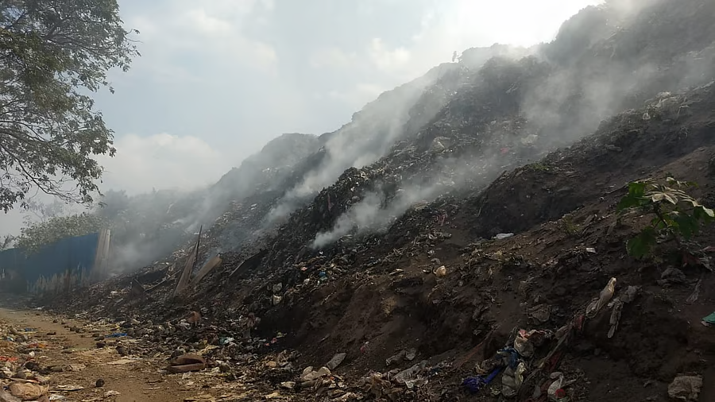
Hidden Battery & Aerosol Fires
PROBLEM 1 · FIRE
37
50+ h
~95%
fire incidents at Delhi landfills in 2019 (fire department data) src ↗
to douse the Ghazipur landfill fire, March 2022 src ↗
of Indian Li-ion batteries believed to end up in rubbish tips (estimate) src ↗
INDIA · CHENNAI
UK · LONDON MRF
Baling-centre blaze
Aerosols exploded in the baler
About 60 firefighters worked 2 hours. Around 100 tons of flammable refuse-derived fuel was stored on site. Heat was suspected as the cause.
Two fires since 2016, then a baler explosion. The first fire closed the MRF for over two weeks. In the US and Canada: 448 fires and about $2.5B damage in 2025.
Read article ↗
Read council report ↗
SMART MRF RESPONSE
Spot battery and aerosol upstream of the baler and raise CRITICAL before they are crushed.
Notes:
Sources: Deccan Herald/PTI on Delhi landfill fires (37 incidents in 2019); Outlook India on Ghazipur 2022; Outlook Business (95% battery estimate, no official figures); DT Next (Chennai); WRWA (London); Fogelman 9th Annual Waste and Recycling Facility Fires Report (US/Canada 2025). Delhi landfill fires are landfill fires, not MRF baler fires. Illustrations are not photos of incidents.

Slide 4
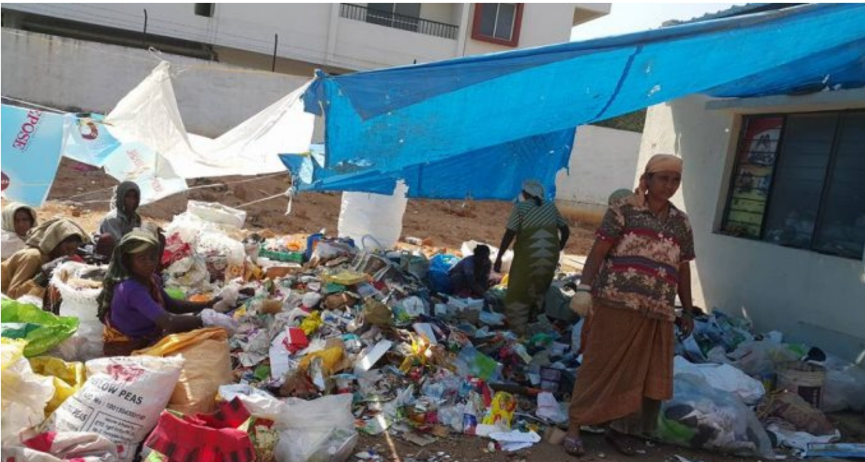
Plastic Film Wraps the Machinery
PROBLEM 2 · JAMS
35%
3.8M
82%
of India’s plastic waste is multi-layered, hard to recycle (CSE) src ↗
tons of multi-layered packaging waste a year (CSE) src ↗
low-value dry waste at Bengaluru dry waste centres src ↗
INDIA · WHY IT MATTERS
US · MINNESOTA
Film has little resale value
Film wraps the screens
Carry bags, multi-layer packs and films fetch low prices in India’s recycling market, and only about 46% of plastic waste was recycled in 2019-20. No Indian jam-time figures found.
Eureka Recycling shuts down about 2 hours a day to cut bags out; film was 29–38% of screen contaminants. One Chicago MRF spends $9,500 a month on untangling labour.
Read testimony ↗
Read MoEFCC reply ↗
SMART MRF RESPONSE
Track the plastic_bag share on the belt and warn operators before a surge reaches the screens.
Notes:
Sources: CSE via Down To Earth (35% multi-layered, 3.8 million tons); Citizen Matters (Bengaluru, 82%); MoEFCC Rajya Sabha reply (34.69 lakh tons generated, about 15.8 lakh tons recycled, 2019-20); Innovation Norway deck on low prices for carry bags, multi-layer packs and films; Eureka Recycling testimony; ISRI on Chicago. The India figures are national context, not machine-jam data.

Slide 5
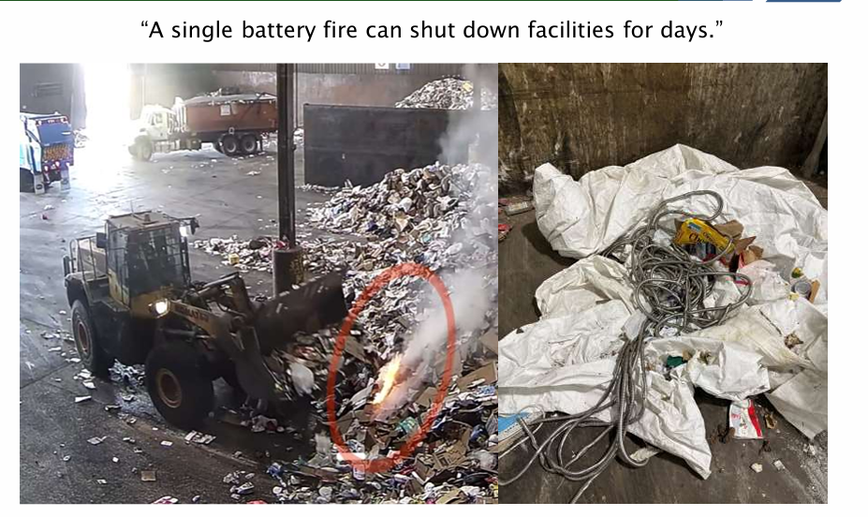
Purity Is Measured Too Late
PROBLEM 3 · PURITY
30–35%
57%
~50%
of India’s municipal waste is scientifically segregated (CPCB) src ↗
average source segregation in Delhi’s MCD areas (2023) src ↗
of municipal waste processed: 79,956 of 160,039 tons a day (CPCB 2022) src ↗
INDIA · CONTEXT
US · HOUSTON
Contamination, little digitisation
Contamination above 42%
Contamination, uneven flow and lack of digitisation are listed as core MRF challenges. No Indian bale-rejection data found.
A 2026 city presentation puts Houston above 42%, against 15–25% nationally. In Wigan, UK, 14 rejected loads cost about £25,000 in two months (2015).
Read article ↗
Read report ↗
Illustration of the failure mode
SMART MRF RESPONSE
Show live per-class counts and bin totals while the material is still on the belt.
Notes:
Sources: CPCB via Impri India (30-35%); Delhi DPCC SWMC minutes (57% MCD average, 2023); IIT BHU thesis citing CPCB 2022; Outlook Business; Houston city presentation (May 2026); Lets Recycle on Wigan (2015). Low segregation is context for contamination, not a measured MRF purity rate.

Slide 6
Augmenting Facilities, Not Replacing Workers
THE PARADIGM
166
0.5–4.5
15 lakh
functional dry waste centres in Bengaluru (198 sanctioned) src ↗
tons a day: capacity of each Bengaluru centre src ↗
waste pickers in India (older estimate) src ↗
ROBOTIC SORTING ARMS
SMART MRF SOFTWARE LAYER
Capital-heavy, per station
Watches the whole belt
$200K
per robot unit before install (BHS MAX-AI)
1
camera over the existing conveyor
+$169K
install, freight, electrical at one US site
0
conveyor rebuilds or teardown
40–60
picks a minute per arm (Dallas MRF)
2
hazard classes watched live
Robot figures: Resource Recycling (robot costs, Dallas MRF). Smart MRF hardware cost: [to be added].
Notes:
Indian figures: Citizen Matters (Bengaluru dry waste centres) and an Innovation Norway deck (waste pickers, older estimate). Robot costs are reported figures excluding software licences and maintenance. Smart MRF cost to be filled in.

Slide 7
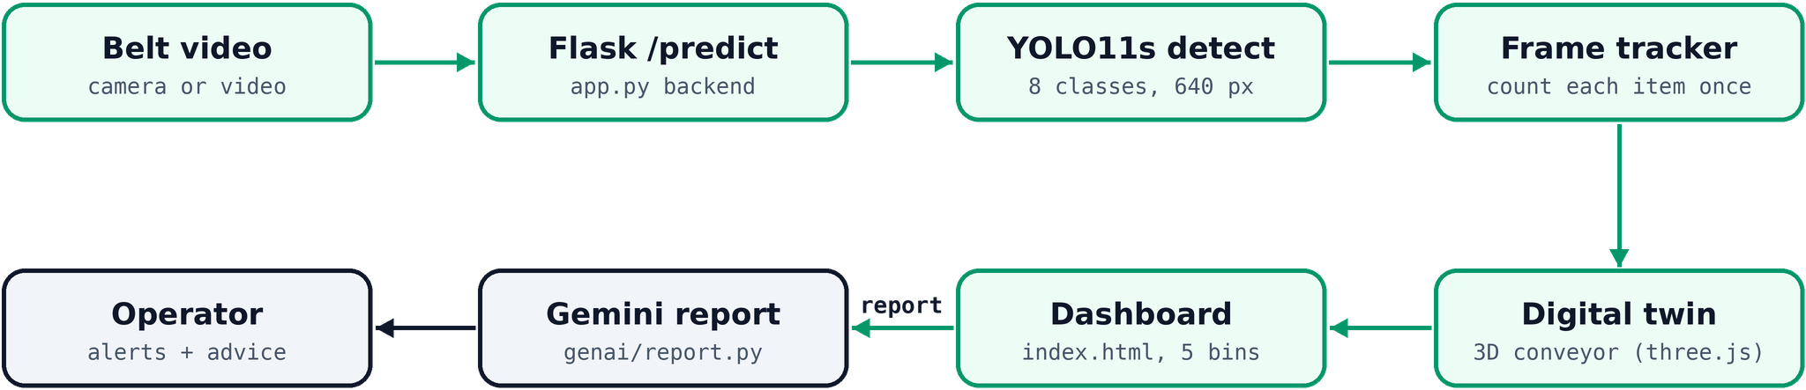
From Belt Video to Operator Advice
ARCHITECTURE
YOLO11s · 640 px · 94 epochs
Frame tracker: persistent IDs
battery · aerosol → CRITICAL
offline summary if no Gemini key

Slide 8






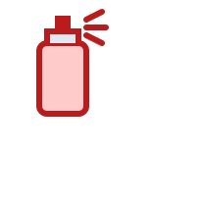
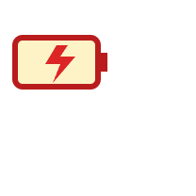

8-Class Computer Vision on the Belt
DEEP DIVE · THE EYE
paper
cardboard
plastic
[SAFE: RECYCLE]
[SAFE: RECYCLE]
[SAFE: RECYCLE]
glass
metal
plastic_bag
[SAFE: RECYCLE]
[SAFE: RECYCLE]
[WARN: FILM JAM]
aerosol
battery
[CRITICAL: HAZARD]
[CRITICAL: HAZARD]
Notes:
Classes shown are illustrations of the 8 classes in the repo README.

Slide 9
A Gemini Report on Demand
DEEP DIVE · THE BRAIN
1
→
2
→
3
→
4
Scans run
Every item scanned
Twin logs it
Gemini report
Material moves along the belt
The model sees what passes the machinery
Counts, bins, hazards, fill
On the AI Summary button
THE REPORT COVERS
AI SUMMARY · EXAMPLE FORMAT
Every item that passed the machinery and was scanned
Counts per class, including film and hazards
When hazards were flagged
Bin status and fill levels
Recommendations (offline if no key)
Scans: [N] · Avg confidence: [x]
Plastic [n] · Paper [n] · Hazards [n]
battery [n] · aerosol [n]
Fullest bin: [name] [x]%
Advice: [Gemini recommendation]

Slide 10
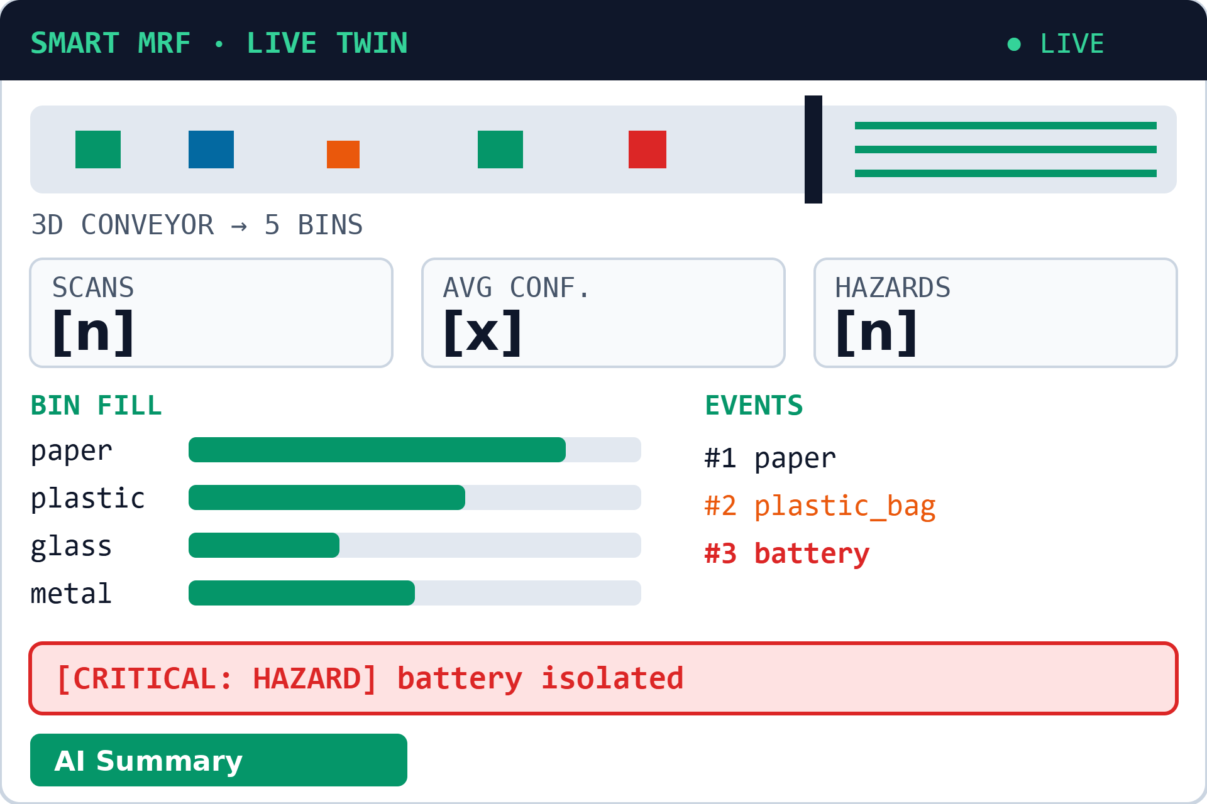
Real-Time Digital Twin Dashboard
DEEP DIVE · THE ACTUATOR
Belt mirror: events become live counts per material
Conveyor view: 3D belt drops items into five bins
Bin fill: level bars per bin
HUD: scans, per-class counts, average confidence
Hazard alerts: hazard banner and recent-detections log
AI Summary: Gemini report on demand, PDF export
Notes:
Wireframe with placeholder values. The repo dashboard is a Flask backend with a three.js 3D twin (templates/index.html).

Slide 11
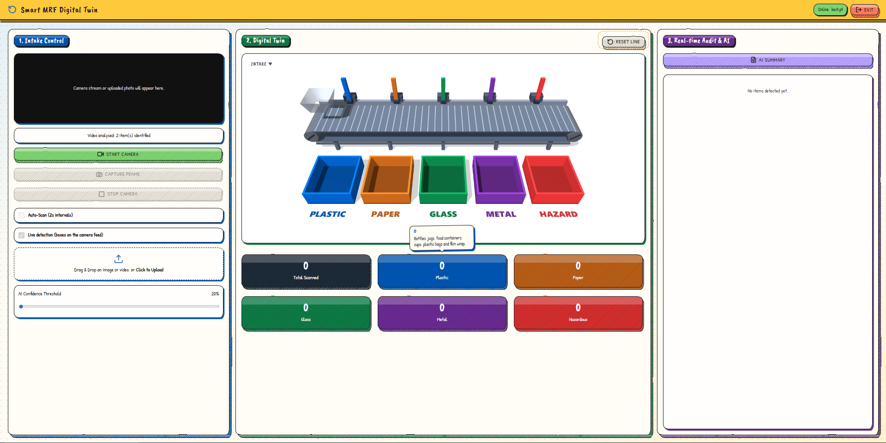
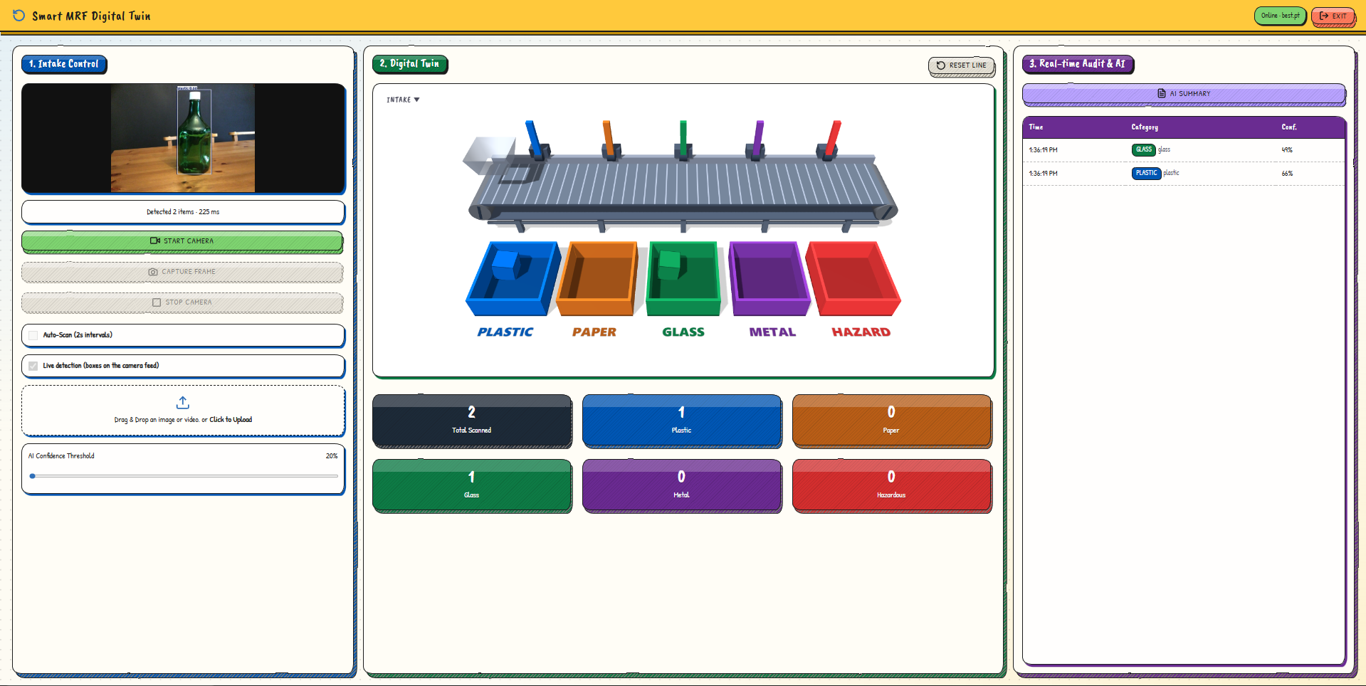
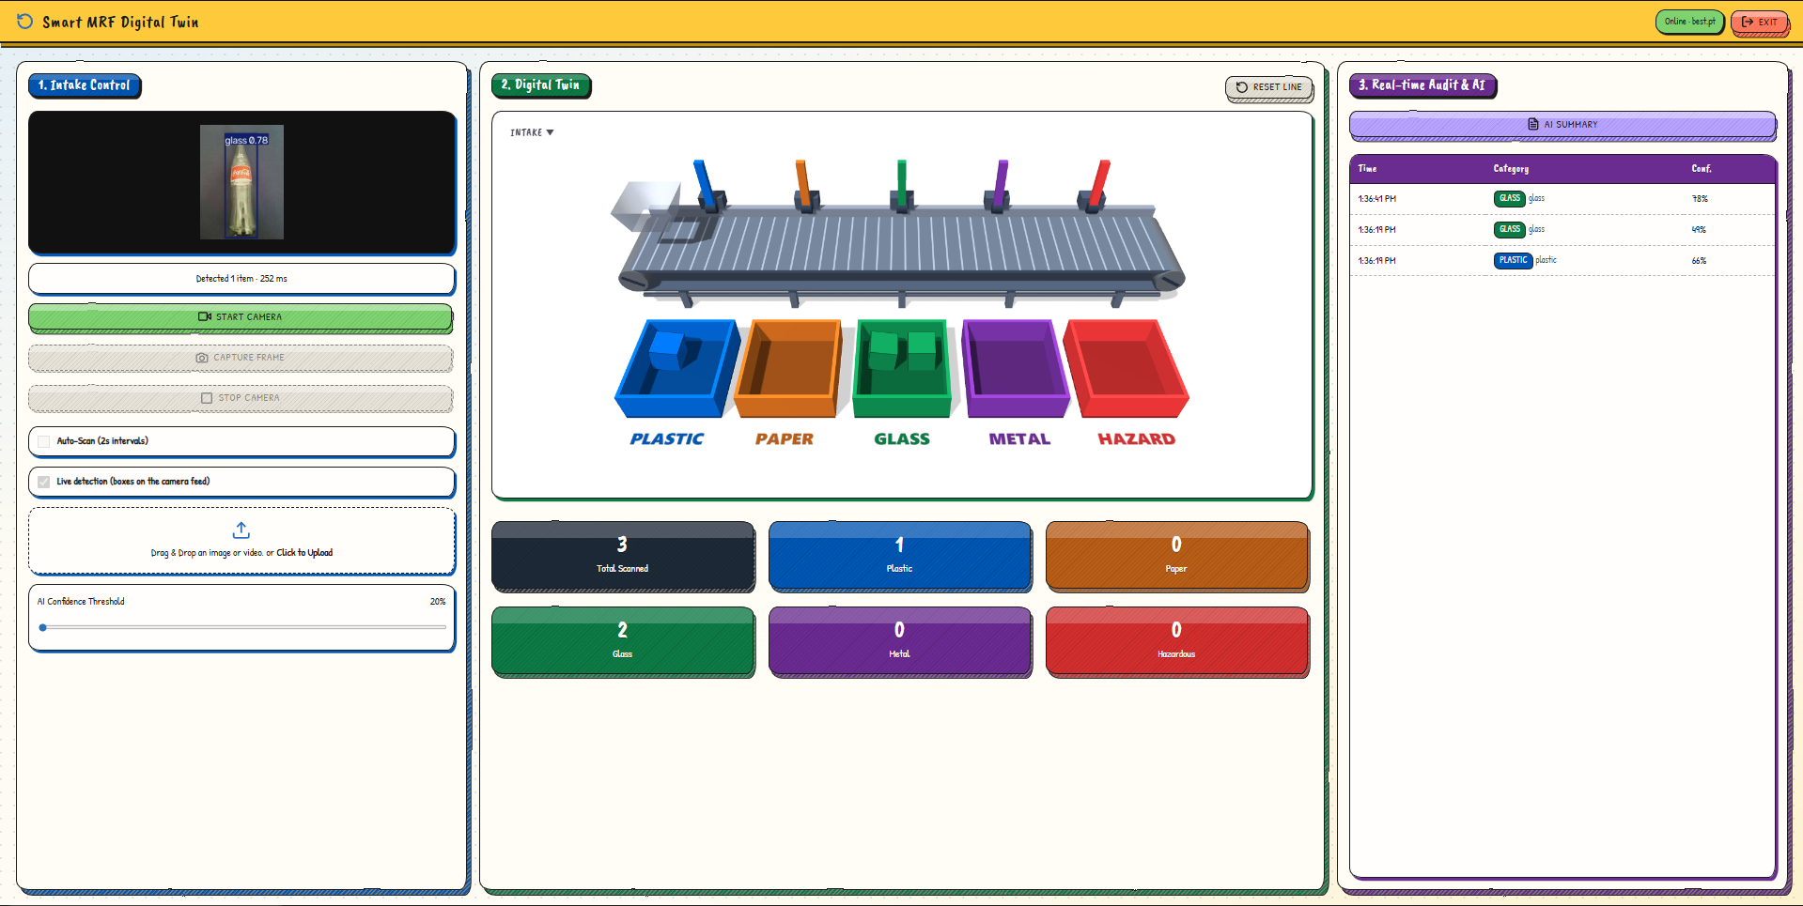
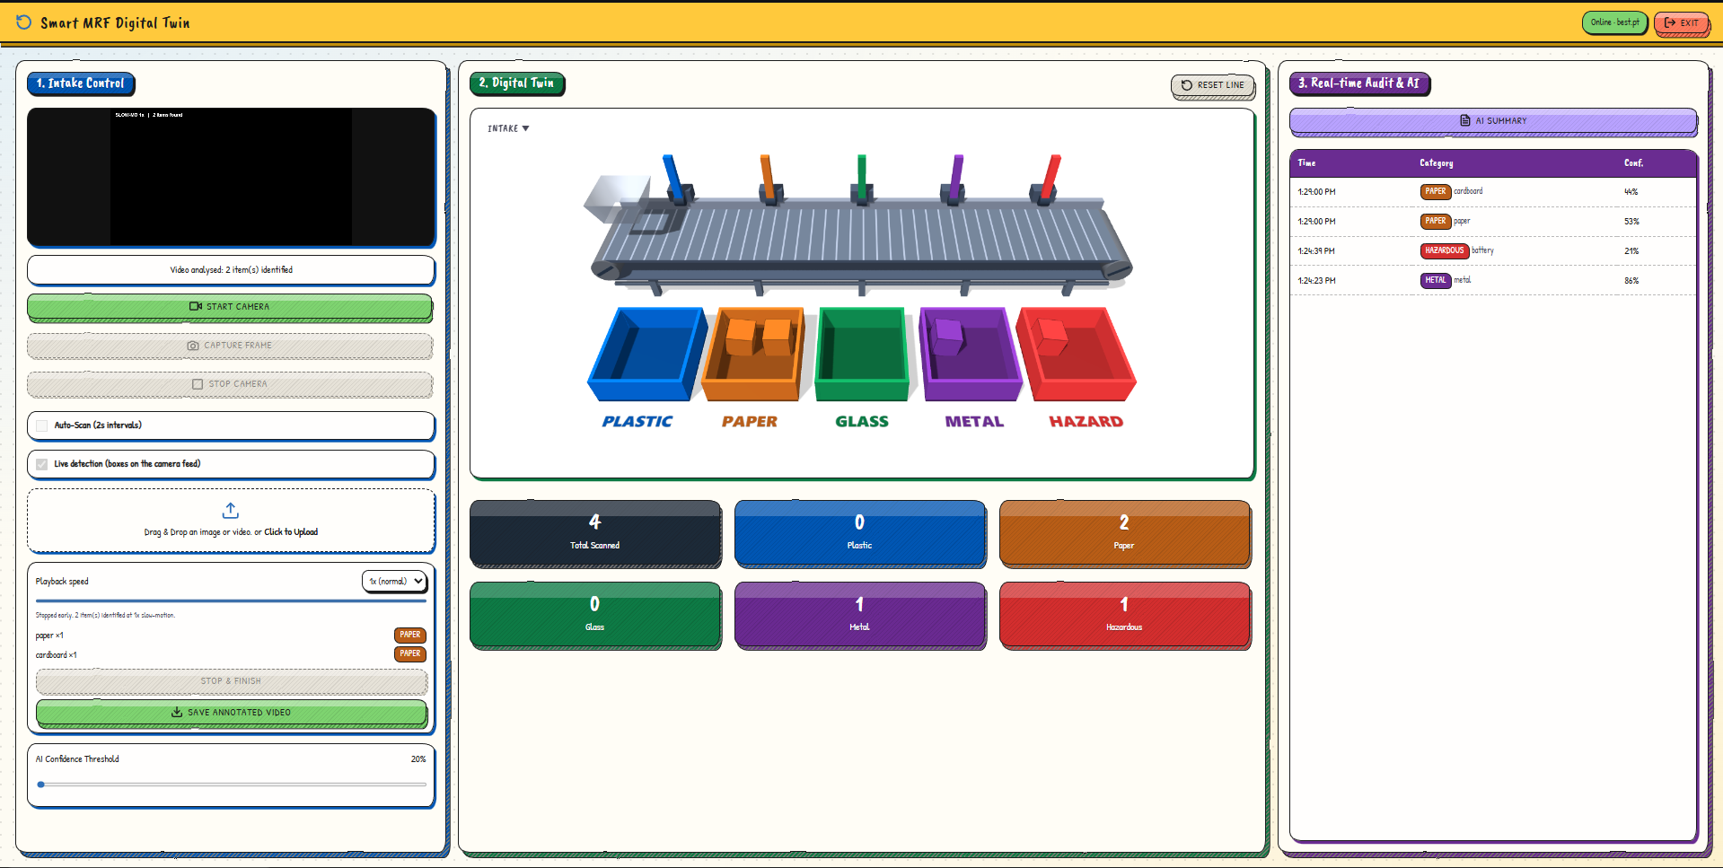
The Dashboard in Action
LIVE DEMO · SCREENSHOTS
1 · Ready state: empty twin, five bins, hover tips
2 · Live camera: boxes on the feed, 225 ms
3 · Glass bottle detected at 0.78, binned as glass
4 · Video upload: 4 items sorted, battery to hazard

Slide 12
The Model Working, End to End
LIVE DEMO · VIDEO
WHAT TO WATCH FOR
Camera feed: a box and class label on every item
Digital twin: each item lands in its bin
Audit log: time, category and confidence per item
Hazards: batteries go to the hazard bin
[Demo video to be added]
Insert › Video › This Device, then drop it over this frame

Slide 13
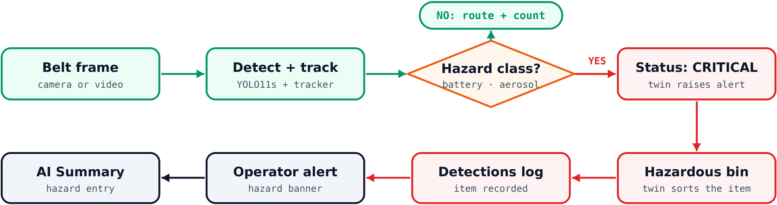
Hazard Isolation Before the Crusher
HAZARD PROTOCOL
Bin sorting is simulated in the twin today. Physical actuation is Phase 2 (PLC/Modbus).

Slide 14
Why Our Model Fits This Use Case
WHY THIS MODEL
Many items in one frame
→
Box detection finds each one
Counts must not double
→
The tracker gives each item a persistent ID
Hazards and film matter most
→
2 hazard classes + plastic_bag, not just material
Must run on a shop-floor PC
→
YOLO11s, a small, fast model
No budget for a rebuild
→
One camera over the existing belt
ACCURACY: mAP50 0.66 and mAP50-95 0.47 on the validation split after 94 epochs. Hazard classes still need more data.
Notes:
Trained on three merged Roboflow Universe datasets (CC BY 4.0), box annotations only, Colab T4. Final model YOLO11s (94 epochs); the results slides show the initial YOLO11n run (40 epochs).

Slide 15
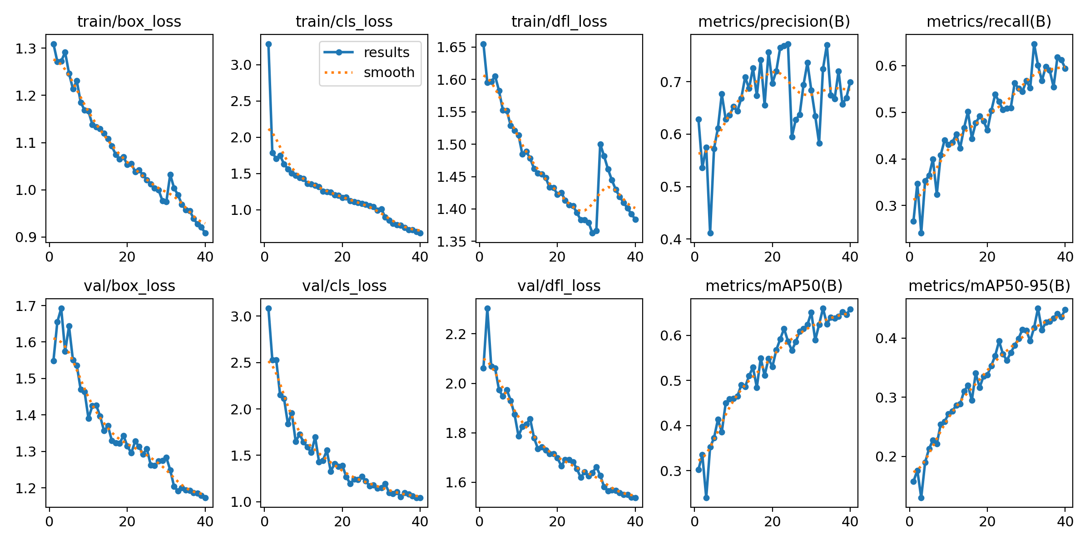
Initial Run: 40 Epochs, Still Improving
MODEL RESULTS · TRAINING
0.659
0.448
mAP50
mAP50-95
0.700
0.594
Precision
Recall
YOLO11n initial run: loss and metric curves over 40 epochs
Smoothed mAP50 and recall were still trending up at epoch 40, and the losses were still falling. Final YOLO11s, 94 epochs: mAP50 0.664, mAP50-95 0.466.

Slide 16
Metal and Cardboard Lead, Aerosol Lags
MODEL RESULTS · PER CLASS (INITIAL RUN)
Best: cardboard 0.857 and metal 0.848.
Mid-range: plastic 0.715, glass 0.635, plastic_bag 0.625 and paper 0.609.
Weakest: aerosol 0.335, a hazard class with only 13 labelled boxes.
Not scored: battery does not appear in the validation results.

Slide 17
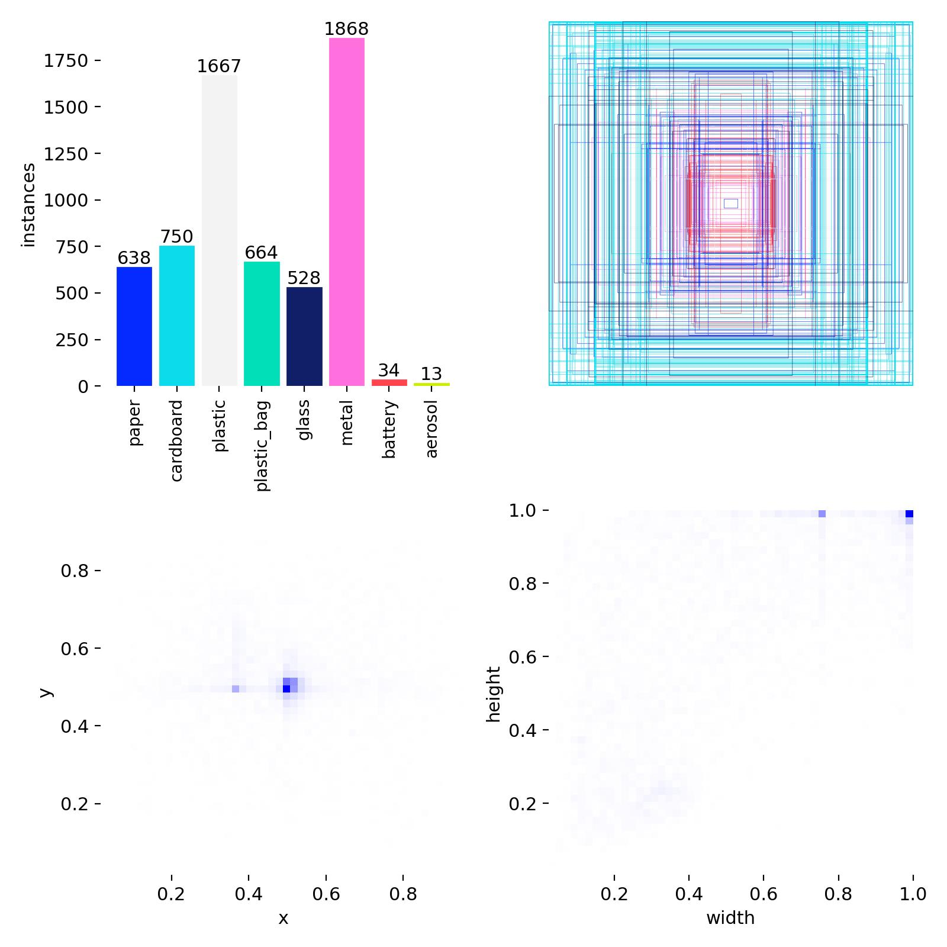
Hazard Classes Are Rare in the Data
MODEL RESULTS · DATASET
6,162
34
13
labelled boxes, 8 classes
battery boxes
aerosol boxes
Most data: metal 1,868 and plastic 1,667 boxes.
Least data: battery 34 and aerosol 13, the classes that trigger CRITICAL alerts.
Box sizes: mostly small to medium and centred in the frame, with some filling the whole image.
Next step: label more battery and aerosol images to strengthen the hazard classes.

Slide 18
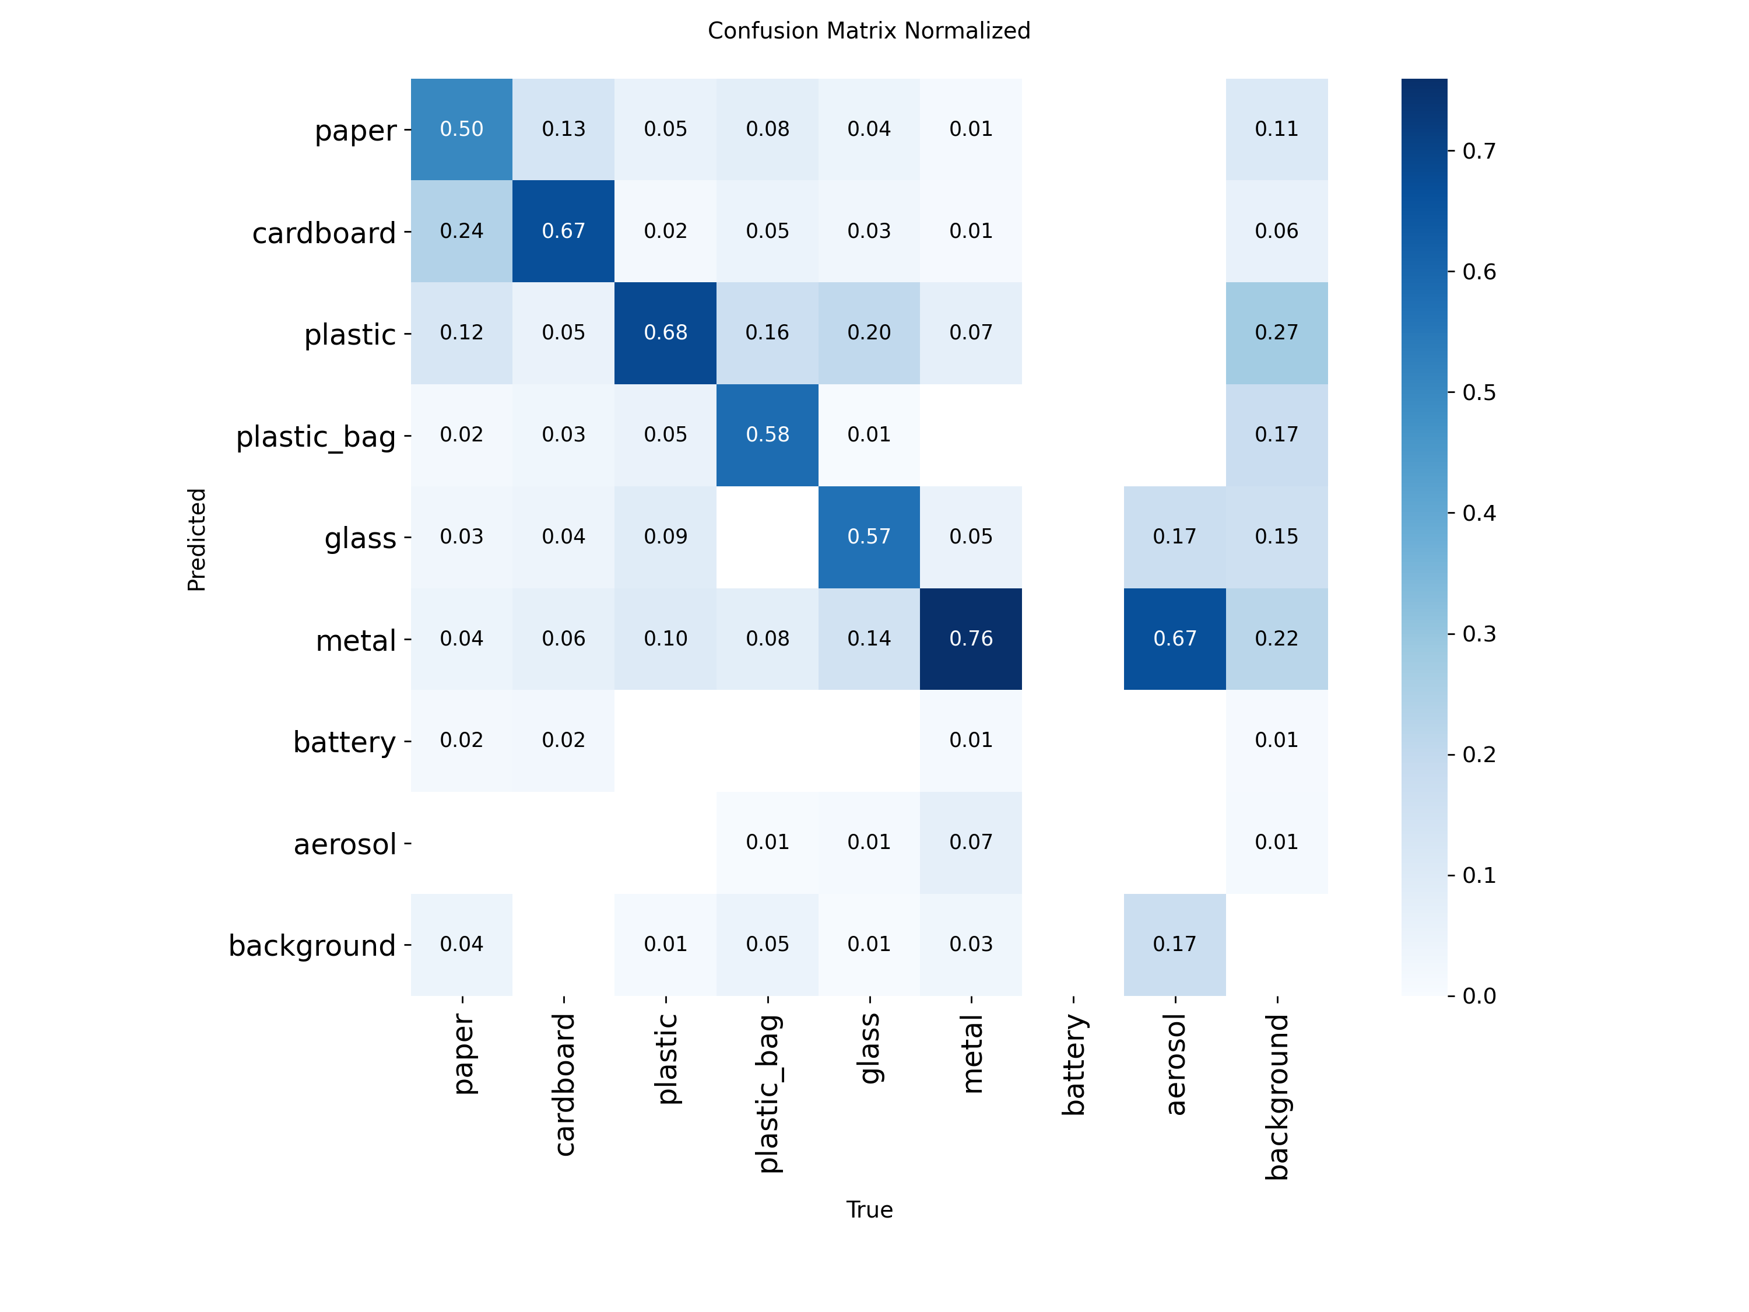
Where the Model Gets Confused
MODEL RESULTS · CONFUSION MATRIX (INITIAL RUN)
Correct: metal 0.76, plastic 0.68 and cardboard 0.67 of true items.
Paper: only 0.50 correct, and 0.24 of paper is called cardboard.
Glass: 0.20 of glass is called plastic.
Aerosol: 0.67 of aerosol is called metal.
Columns are the true class, rows are the prediction.

Slide 19
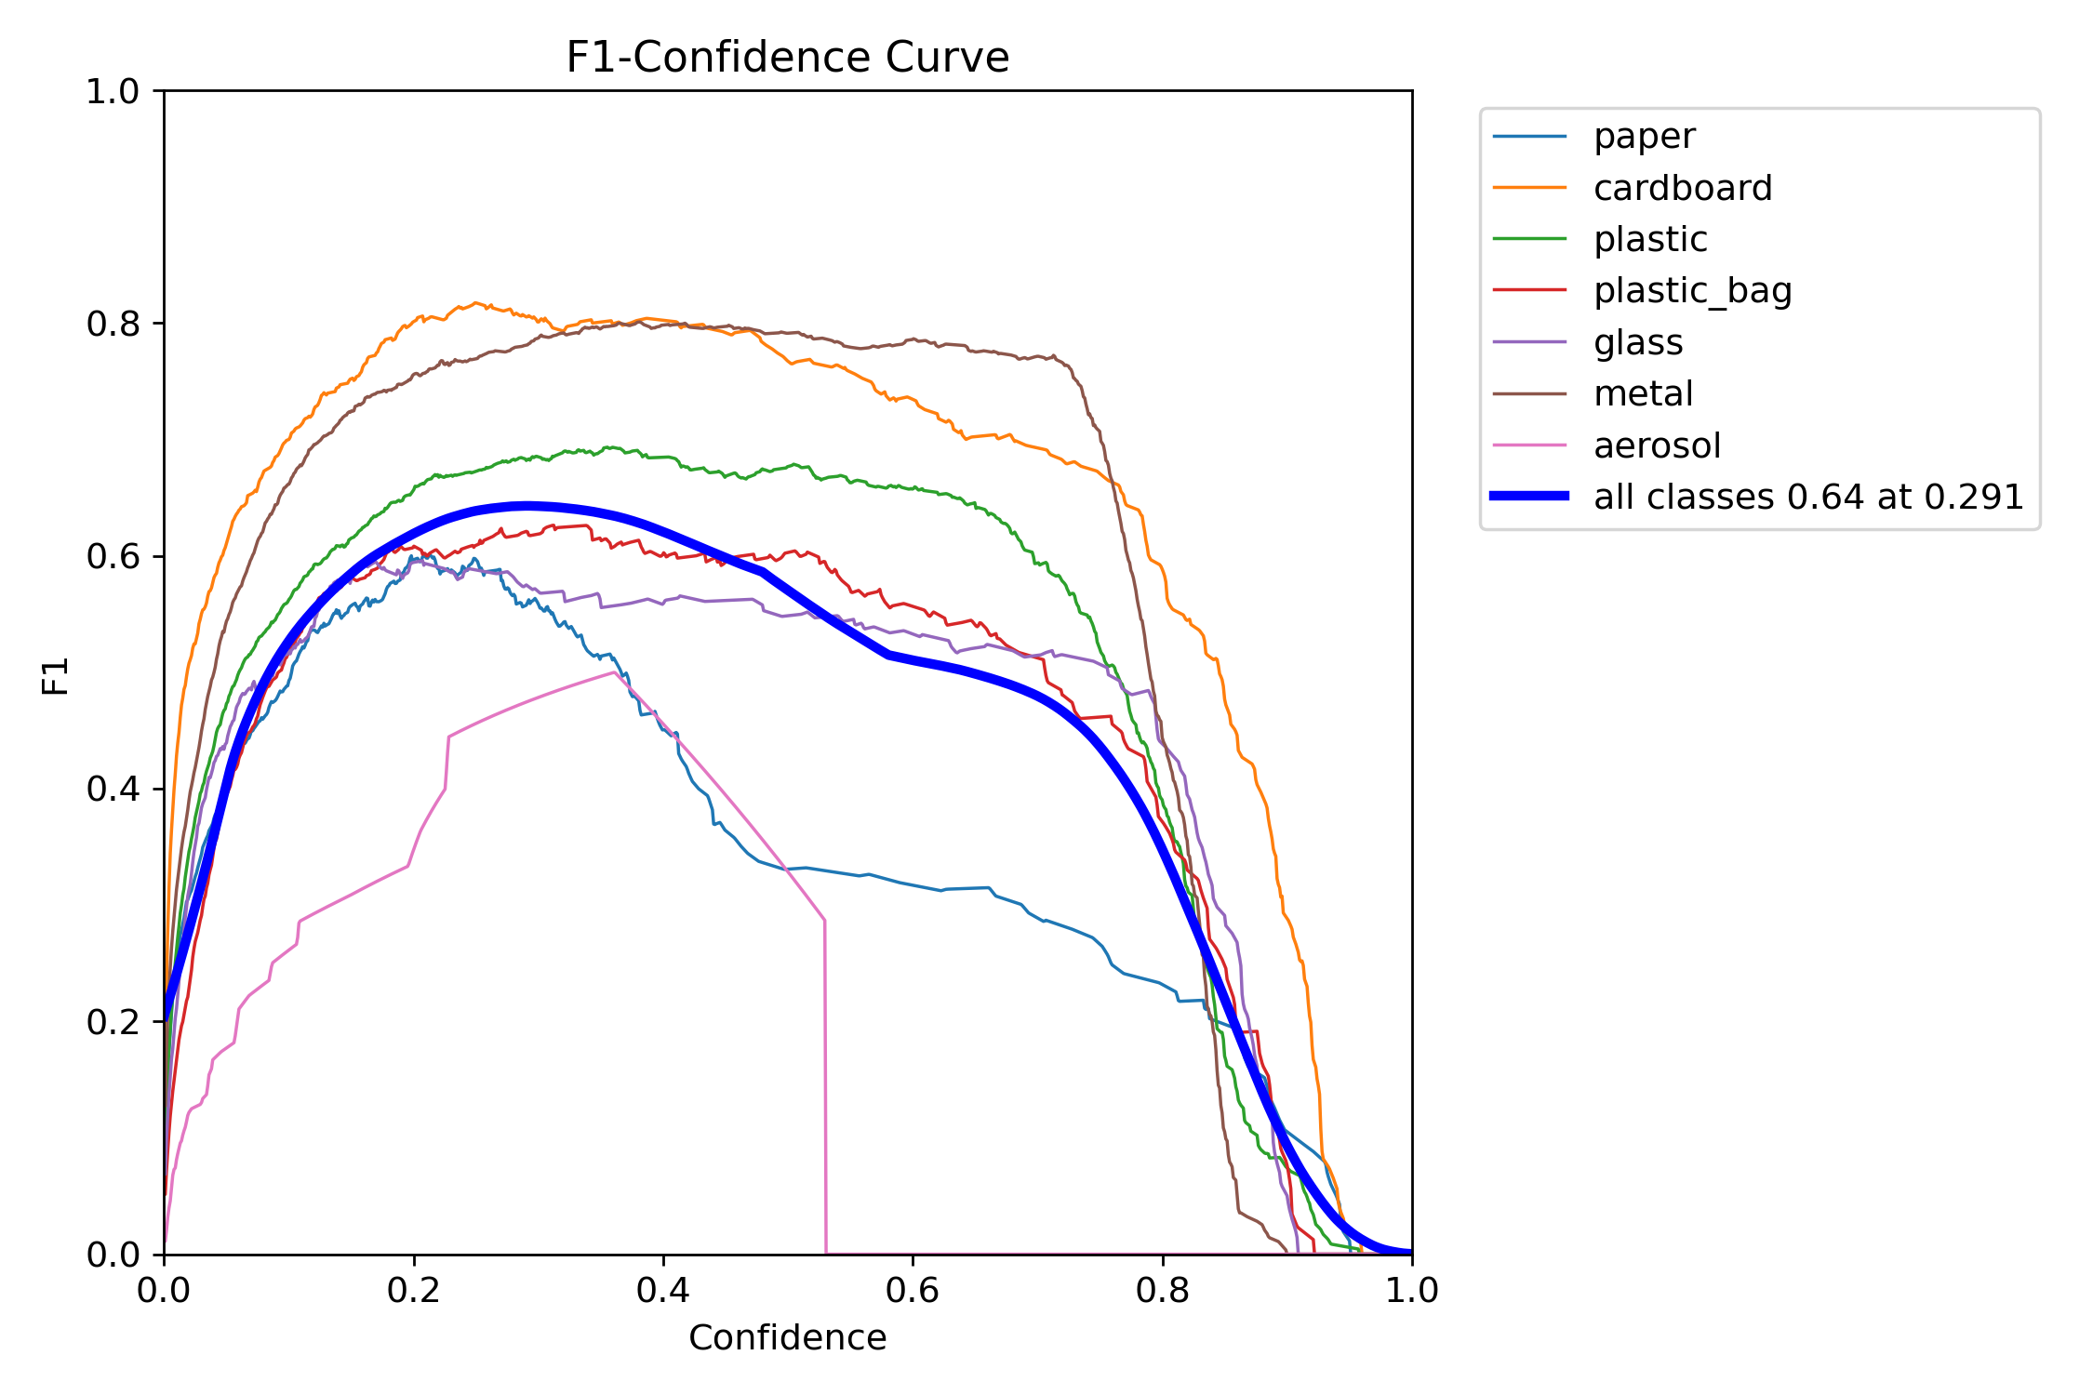
Choosing the Confidence Threshold
MODEL RESULTS · THRESHOLD (INITIAL RUN)
0.64
40%
best F1, all classes, at 0.29 confidence
dashboard default today
F1 peaks near 0.29. The 40% default (adjustable) sits above it, which favours fewer false alarms over catching every item.
Precision reaches 1.00 only at 0.963 confidence.
Hazard classes can run a lower threshold than the rest, so a battery is not missed.

Slide 20
Scaling the Smart MRF Ecosystem
ROADMAP
PHASE 1
PHASE 2
PHASE 3
NOW · IN PROGRESS
NEXT
LATER
Vision + Twin + AI
Hardware Bridge
Facility Mesh
Train YOLO11s, build twin and dashboard, Gemini report.
PLC/Modbus to drive air-jets and diverters.
Cloud bale-purity certification and predictive maintenance.

Slide 21
See the GitHub Repo for the Full Explanation
MORE DETAIL
The README covers setup, the API, training, results, and the demo screenshots and videos.
github.com/Chirag-S-Reddy/Smart-MRF

Slide 22
A Smarter Nervous System for Recycling
LIVE DEMO
Turning standard conveyor belts into self-protecting, AI-orchestrated recovery lines.
github.com/Chirag-S-Reddy/Smart-MRF

