Slide 1
Uber Supply And Demand Case Study
By: Chirag Veldandi

Slide 2
Problem Statement:
We are facing problem with trip cancellation and no cars available From and to Airport causing loss in revenue.
Objective:
To identify the root cause of supply-demand gap to and fro Airport.

Slide 3
METHODOLOGY
Data collection and cleaning
Data exploration and analysis
Outcome and recommendations
Import the data.
Identifying the data
Analyze different variables.
Visualizing the problems.
Presenting the
quality issues.
Clean the data.
Format in uniform date and time variables.
Extracting new variables for analysis.
Analyze variables across various time slots .
Identifying the types of requests, locations and the time slots that constitutes the demand supply gap.
observations.
Recommendations for solving the problems.

Slide 4

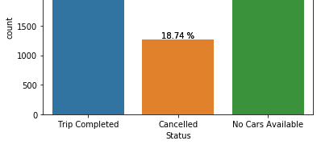
Problem
Trip Status Chart
Observations
Only 42% trips completed per day.
Almost 40%, there is no cabs available for an request.
19% of the requests are cancelled by drivers.
Here is trip counts:
Trips Cancelled No Cabs Completed
2831 1264 2650

Slide 5
Analysis: Driver count
Now lets look at the driver count and trip requests per day:
No. of Drivers
Average trip request per day
Average trip completed per day
So, the average trip requests for a driver is ap
prox. 5 out of which
300 1349
Total count details:
Count of Total Trip Requested 6745 Count of Completed Trip 2831 Percent of Completed Trip 42.02
Count of Trip that did not happened 3914 Percent of Trip that did not happened 58.02
566.2
only 2 trips get completed.

Slide 6
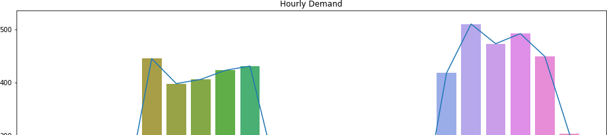
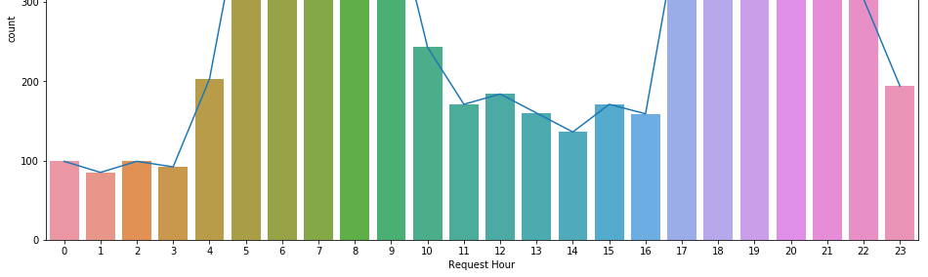
Hourly Demand
From the graph, we can observe that:
The peak hour for the demand
From morning 4am to 10 am
From evening 5pm to 10pm.

Slide 7
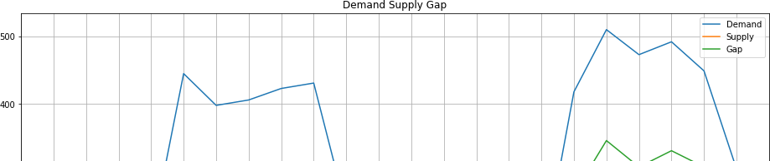
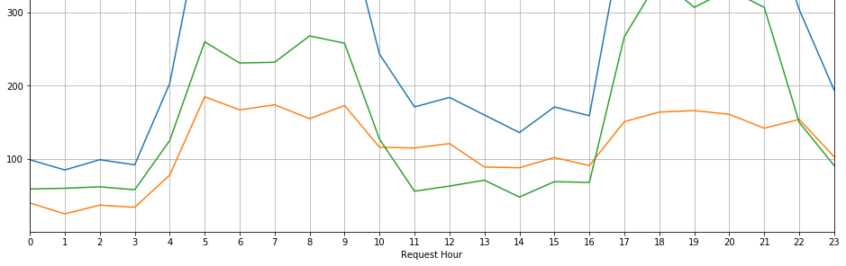
Demand-Supply Gap
This graph shows the hourly demand, supply and gap variation through out the day. With demand the gap increases but supply remains constant.

Slide 8
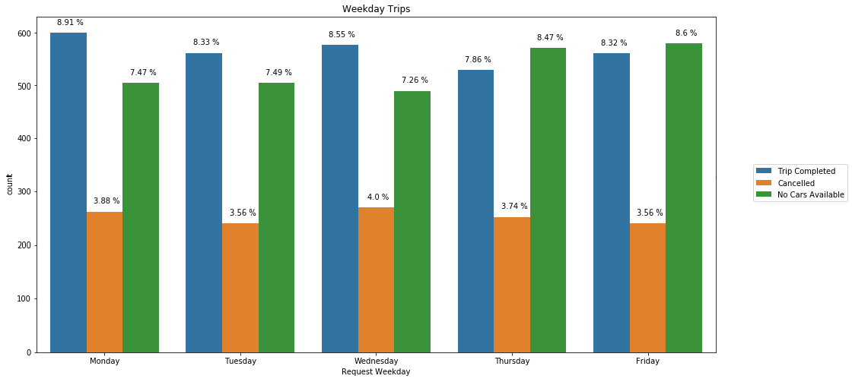
Weekday Analysis
Daily Trip analysis
From graph we can observe:
On Monday highest trip completed whereas on Thursday, the least trip completed.
No of non availability of cab is higher on Friday.
On Wednesday highest trips are cancelled.

Slide 9
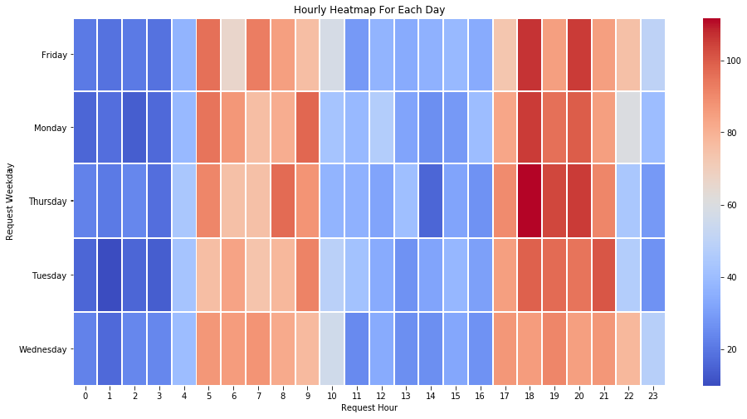
Heatmap
Heatmap showing hourly demand of each day.
The heatmap shows the high demands are from morning 4am to 10am and from evening 5pm to 10pm.

Slide 10
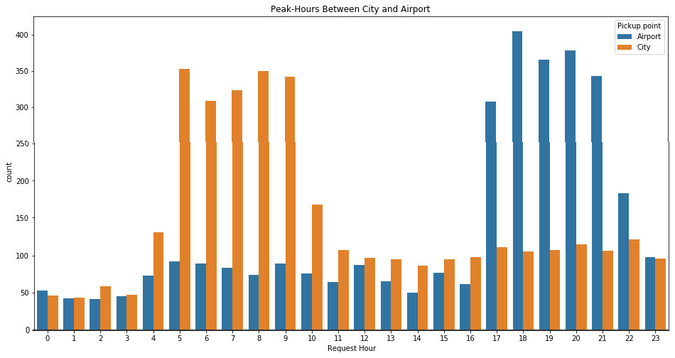
Pickup point analysis
From the graph it is clearly seen that demands are high in morning from 4am to 10am in city and high for Airport is in the evening throughout the night between 5pm to 11pm.

Slide 11
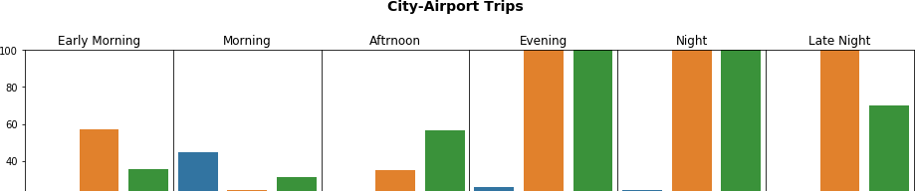

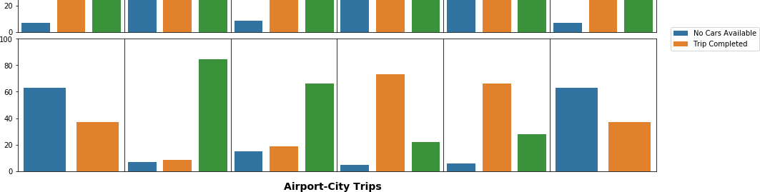
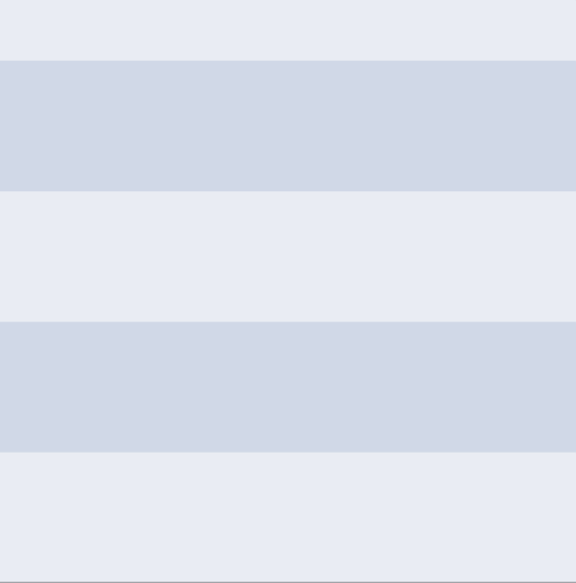
Time slot analysis
Time Slot Name
Time Interval
Early Morning
04:00 to 06:00
Morning
06:00 to 12:00
Afternoon
12:00 to 17:00
Evening
17:00 to 20:00
Night
20:00 to 00:00
Late Night
00:00 to 04:00

Slide 12
Inference: Based on pickup point and time slot
Inferences
Early Morning Afternoon Evening Night Late Night Morning
City to Airport
For high cancellation the demand supply gap
Though a good no trips are completed but there is
Higher no of trips are cancelled although good of trip
Higher no of trip cancellation as well as trip
Same issue like evening.
High no of trip get completed but there is some issue
is high.
a large no cancellation
.
completed.
completed.
with cancellation
Airport to City
No cabs available issue.
No cabs available issue
Higher no of cancellation
.
Higher no of trip completed then lesser no of trip cancelled.
Though there is cancellation issues but a good amount of trip completed.
There is either no car or trips are cancelled.

Slide 13
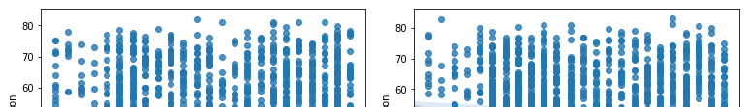
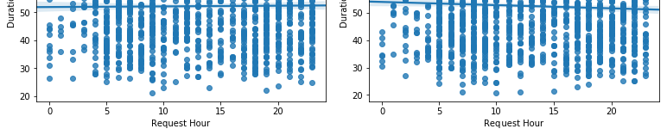
Traffic congestion
Traffic congestion from Airport
Traffic congestion from City
Ride duration is not much fluctuating for various slots and various rides either from airport to city or from city to airport, that means traffic congestion is not an issue causing factor.

Slide 14
Observations
The ratio of demand to car is less.
The main problem observed throughout the analysis is that almost 40% of trips not completed due to non-availability of cars.
Cars non-availability is the main issue between 5 to 10 pm time slot in Airport to City trip requests for the high supply-demand gap. Out of 1800 requests, 73.9% is due to non-availability of cars.
In the evening, there is high demand for cabs from airport to city but the return trip is not easily available. Hence 'no cars available' in the airport is the highest in the evening.
In the Morning, there is a high demand for cars from city to airport but the return trip is not available. Hence the driver tends to 'cancel' the request as getting a return trip from airport to city would be tough.

Slide 15
Solutions and recommendations
There should be a limit of cancellation and impose some penalties for any cancellation.
Promote some new schemes for attracting new cars get collaborated with Uber.
Flight schedules should be handy to every drivers so that they can go to airport or nearby location when there is flight.
There should be some weekly bonus systems to the drivers who doesn’t cancel any trip and maximum trips.
Give some incentives for airport trips specially for peak hours.

