Slide 1
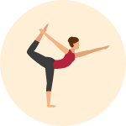
Classifying Yoga Poses

