Slide 1
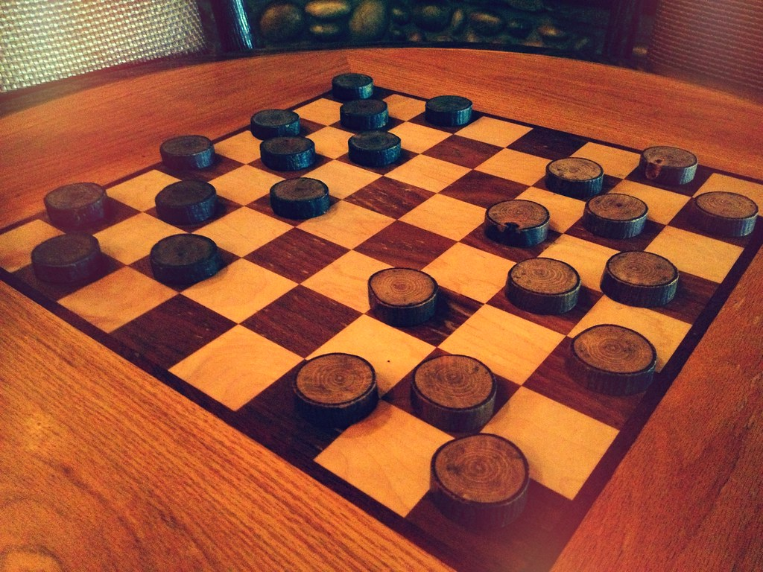
Checkers Game
Team INCOGNITO
Chirag(20CBS1049)
Mohit(21BCS10085)
Ayush(20BCS3868)
Shruti Sharma(20BCS3639)
Vani Gupta (20BCS4068)

Slide 2
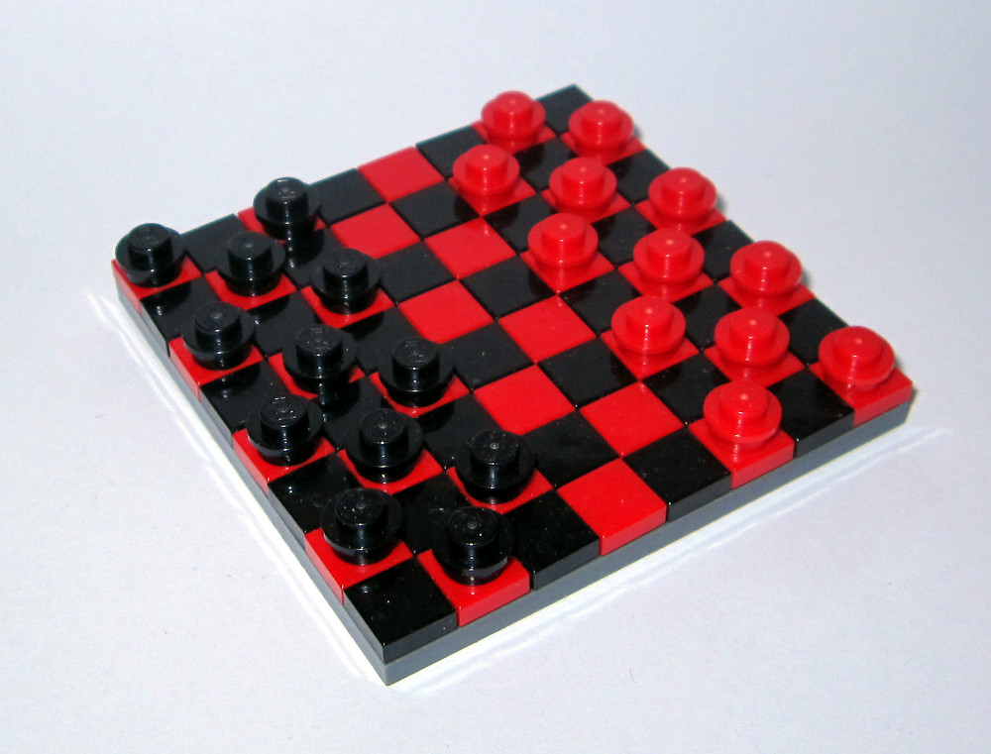
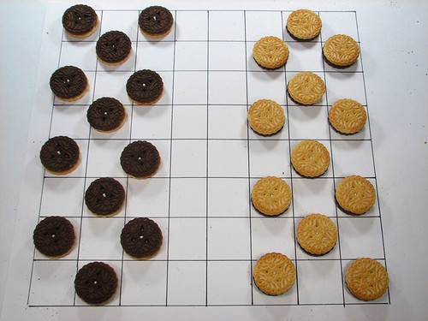
Introduction
Checkers, also called draughts, board game, one of the world’s oldest games. Checkers is played by two persons who oppose each other across a board of 64 light and dark squares, the same as a chessboard.
The 24 playing pieces are disk-shaped and of contrasting colours (whatever their colours, they are identified as black and white).
At the start of the game, each contestant has 12 pieces arranged on the board. While the actual playing is always done on the dark squares, the board is often shown in reverse for clarity.
Product Scope:
It is intended to be played by users of all age groups, no matter user is children, teenager, adult or old.
This Photo by Unknown Author is licensed under CC BY
This Photo by Unknown Author is licensed under CC BY

Slide 3
Objectives
The game’s main objective is to capture every opponent’s piece.

Slide 4
MOVING:
Moves are always diagonal, towards the opponent, and via dark squares only.
You can only jump one square at a time unless capturing a piece, in which case two squares will be jumped.
You cannot jump over two consecutively positioned pieces. ---Players will alternate turns to move.

Slide 5

CAPTURING
You may only capture one piece per jump.
If a single capture is available, it must be taken.
If multiple captures are available, the player can decide which one to take, but still, a capture must be taken.
Captured pieces are eliminated from the board.
At last, King will be decided!

Slide 6
CROWNING A KING
“
A piece reaching the furthest row from the player in control is crowned king by placing on a captured piece on top of that piece, doubling its height.
Pieces crowned king can move backward and forward, but only in a diagonal direction.
”

Slide 7
What our Project includes!
We are planning to design a game in which 2 users can play checkers on their laptops and computer systems.
This will take the help of computer OS in detecting a valid move. It will make sure that user will move only in the diagonal direction.
Theme can be changed in the game while playing the matches but all the game is needed to be played within the given time period only.
At last, based on the pieces on the board, computer will detect about the winner and will declare the user as king.
At most, it will have the facility that if you are playing some last game, it will be kept saved in your respective systems.
Rules to play game can be checked while playing the game or even when you are not playing the game.

Slide 8
Requirements
System Requirements
RAM Specifications
Do not disturb
System is designed to work in windows operating systems with the windows version 7 or higher!
Ram Required: 2GB (minimum)
Need to remove notifications as user is playing game for relaxations, so no more notifications needed!

Slide 9
Basic Libraries Included!
1
2
3
4
5
NumPy
Pygame
Random
Sys
Combinations

Slide 10
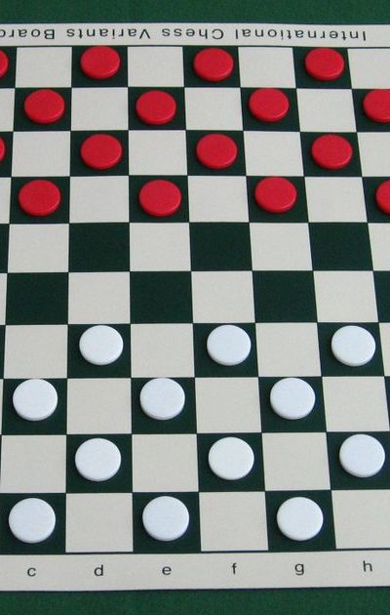
Further Extensions
The major improvements to be done in the projects:
Addition of network system to game: Using server client connections, we may further extend this project to multi-system game. This will help people to play game in online mode with people on different systems.
Chatbot: This is the second improvement that we have decided to make further, as it will make people feel that they are really playing games in real – time mode.
Addition of
This Photo by Unknown Author is licensed under CC BY-NC-ND

Slide 11

Meet our team
CHIRAG
Ayush Paliwal
Mohit Choudhary
Shruti Sharma
Vani Gupta
20CBS1049
20BCS3868
21BCS10085
20BCS3639
20BCS4069

Slide 12
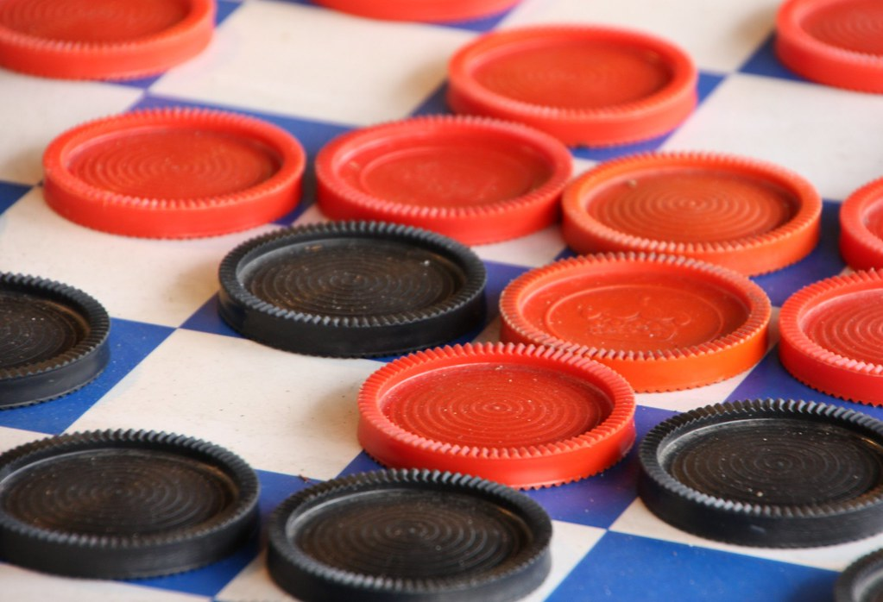
Thank you
Regards
Team INCOGNITO

