Slide 1
Creating a system for detecting and preventing phishing attacks.
Domain: cyber security

Slide 2
PARTICIPANT DETAILS
CHIRAG
SAHIL SACHDEVA
TASHU CHUGH
UID: 20CBS1049
UNIVERSITY: CHANDIGARH UNIVERSITY, GHARUAN, PUNJAB (140413)
BRANCH: COMPUTER SCIENCE AND BUSINESS SYSTEMS
YEAR OF GRADUATION: 2024
UID: 20CBS1046
UNIVERSITY: CHANDIGARH UNIVERSITY, GHARUAN, PUNJAB (140413)
BRANCH: COMPUTER SCIENCE AND BUSINESS SYSTEMS
YEAR OF GRADUATION: 2024
UID: 20CBS1058
UNIVERSITY: CHANDIGARH UNIVERSITY, GHARUAN, PUNJAB (140413)
BRANCH: COMPUTER SCIENCE AND BUSINESS SYSTEMS
YEAR OF GRADUATION: 2024

Slide 3
PROBLEM STATEMENT
Develop a system which is capable of detecting and preventing phishing attacks.
The solution should be able to detect user actions which may result in phishing of user information, intimating them and preventing such actions.

Slide 4
Abstract of the problem:
Phishing emails are a routine occurrence for anyone with email in the Internet age. Masking themselves as reputable companies such as Paypal, using devious means such as the use of company logos and standards, malicious actors, again and again, attempt to lure in individuals from a wide range of technical shades.
In the project, we outline to design a model for phishing learning and detection model using machine learning.
This is done to protect and inform user about this increasing security concern.

Slide 5
Continued…
As part of the first part of project, the intention of this work is to design system with a focus on user interaction.
In this, algorithms for analyzing URLs were developed and evaluated by experts in the field.
The completed system was evaluated and found to be usable.
This completes the implementation of the decision-making aspects of the tool and forms the basis for further work to determine the efficiency and accuracy of the system.

Slide 6
MOTIVATION
In the Internet age, phishing emails are commonplace for anyone with email.
Malicious attackers will repeatedly attempt to entice people of all technical persuasion by posing as legitimate companies such as Paytm, Google and using deceptive means such as using company logos and standards. Phishing is very sophisticated. From mass-produced, misspelled requests that ask for overly specific details, to sophisticated spear-hit phishing attacks that focus on personal details. The ability of phishing attacks to harmlessly steal personal credentials can expose you relentlessly in a data-intensive world. It is enough for a user to make a serious mistake by clicking on a single malicious link. A simple mistake can put your users and their data at risk for everything from drive-by downloads and cross-site scripting attacks to data harvesting in harmless web forms.

Slide 7
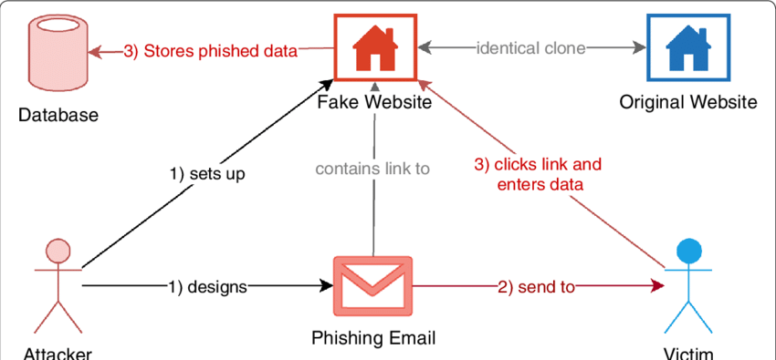
Source: Researchgate

Slide 8
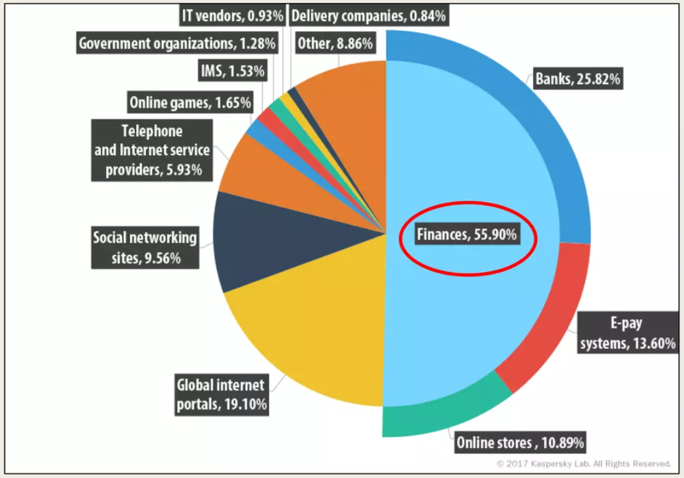
Phishing attacks (2017)

Slide 9
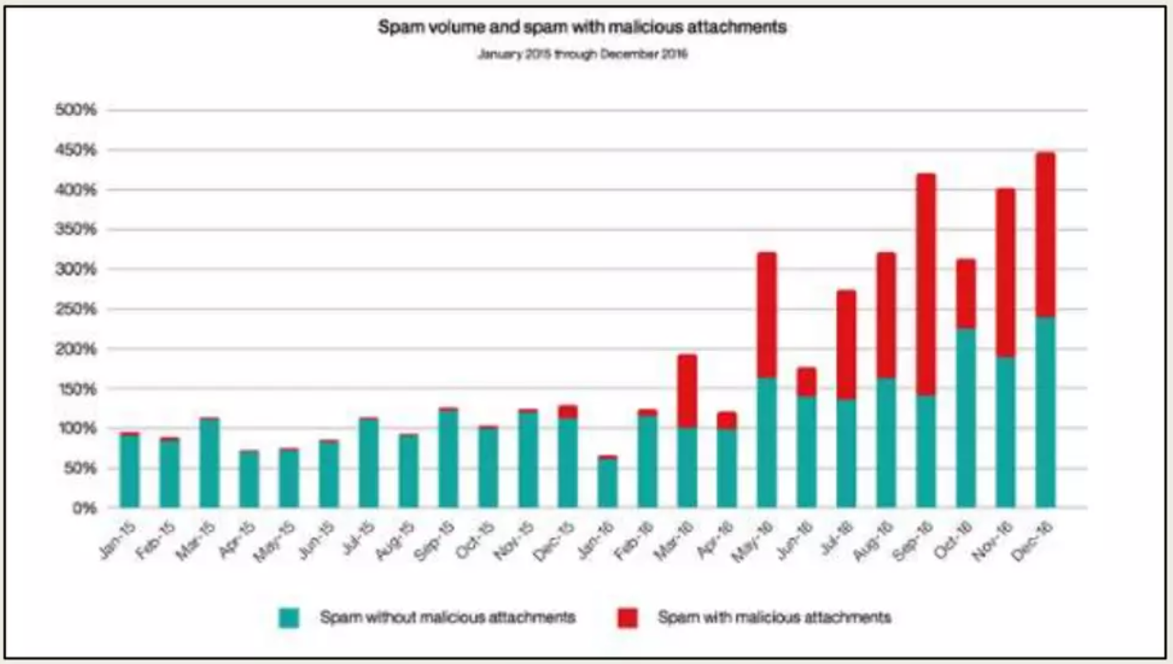
SPAM MAILS VS MALICIOUS ACTIVITES (2015 - 2016)

Slide 10
Purpose of phishing
Using fake emails or fake websites to steal personal or sensitive user data such as personal, banking or credit information.
cause financial loss to users
lock users out of their accounts
steal trade secrets
proliferate botnets and DDoS agents
lose productivity
consume excessive resources on corporate networks (bandwidth, busy state e-mail system, etc.).
Attack Propagation: Compromise hosts and install botnets for future attacks.
Attacker exploits vulnerabilities in client software (email user agents and her web browsers) and designs vulnerabilities in her target website applications.

Slide 11
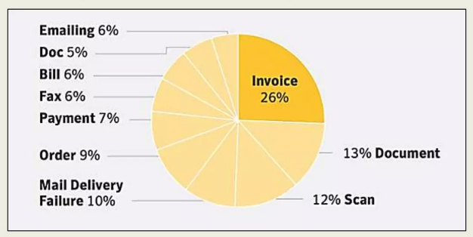
Ways of phishing mails (2017 - data)

Slide 12
Phases of phishing attacks
1. Potential victim gets a phish.
2. Victim taking suggestion in message or banner.
3. Go to fake website or send sensitive information or download malware.
4. Criminalizing the information stolen.

Slide 13
OBJECTIVE OF PROJECT
The objective of this project includes:
To give knowledge to the user about the phishing mails i.e. spam mails containing malicious information.
To classify the mail as spam or not.

Slide 14
SCOPE OF THE PROJECT
The scope of project includes:
Company users –
This may also harm as it may leak their confidential documents, strategies and other important information.
This may also give them strategic disadvantage in terms of projects and other start-ups.
Normal users –
These users are most prone to these attacks as this emails take away their personal information, account details and many more.
This can also lead to financial loss to the users.

Slide 15
INNOVATIVE SOLUTION APPROACH
FIRST PHASE OF MODEL:
To solve this problem, I developed a user-centric tool. This tool attempts to intercept offending URLs before they reach the full malicious potential. A tool I developed at is a phishing learning and detection tool.
It increases security and council.
It reduces IT administrative council.
It considers a complete message instead of single words.

Slide 16
Objective
A phishing website is a common social engineering method that mimics trustful uniform resource locators (URLs) and webpages. The objective of this project is to train machine learning models and deep neural nets on the dataset created to predict phishing websites. Both phishing and benign URLs of websites are gathered to form a dataset and from them required URL and website content-based features are extracted. The performance level of each model is measures and compared.

Slide 17
Collection of data
The set of phishing URLs are collected from opensource service called PhishTank. This service provide a set of phishing URLs in multiple formats like csv, json etc. that gets updated hourly. To download the data: https://www.phishtank.com/developer_info.php. The legitimate URLs are obtained from the open datasets of the University of New Brunswick, https://www.unb.ca/cic/datasets/url-2016.html.
This dataset has a collection of benign, spam, phishing, malware & defacement URLs. Out of all these types, the benign url dataset is considered for this project. From this dataset, 5000 random legitimate URLs are collected to train the ML models.

Slide 18
Model and Trainings
Before stating the ML model training, the data is split into 80-20 i.e., 8000 training samples & 2000 testing samples. From the dataset, it is clear that this is a supervised machine learning task. There are two major types of supervised machine learning problems, called classification and regression.
This data set comes under classification problem, as the input URL is classified as phishing (1) or legitimate (0).

Slide 19
The supervised machine learning models (classification) considered to train the dataset in this project are:
Decision Tree
Random Forest
Support Vector Machines

Slide 20
Expected End results
From the obtained results of the above models, XGBoost Classifier has model performance of 80%(approx).

Slide 21
Conclusion
Using this detection tool, we are able to classify the emails as spam or not.
This will help the mail to be safe from malicious activities and fraud and remain safe from hackers.

Slide 22
References
https://www.slideshare.net/nabinsjamkatel/final-spamemaildetection
https://www.slideshare.net/shvick/phishing-incident-response-playbook-126954763
IBM Dataset and reports – 2017
https://project-archive.inf.ed.ac.uk/ug4/20191528/ug4_proj.pdf

