Slide 1
CS 410 Final Project College Events
Chirag Rastogi

Slide 2
01.
Collecting Events based on Time

Slide 3
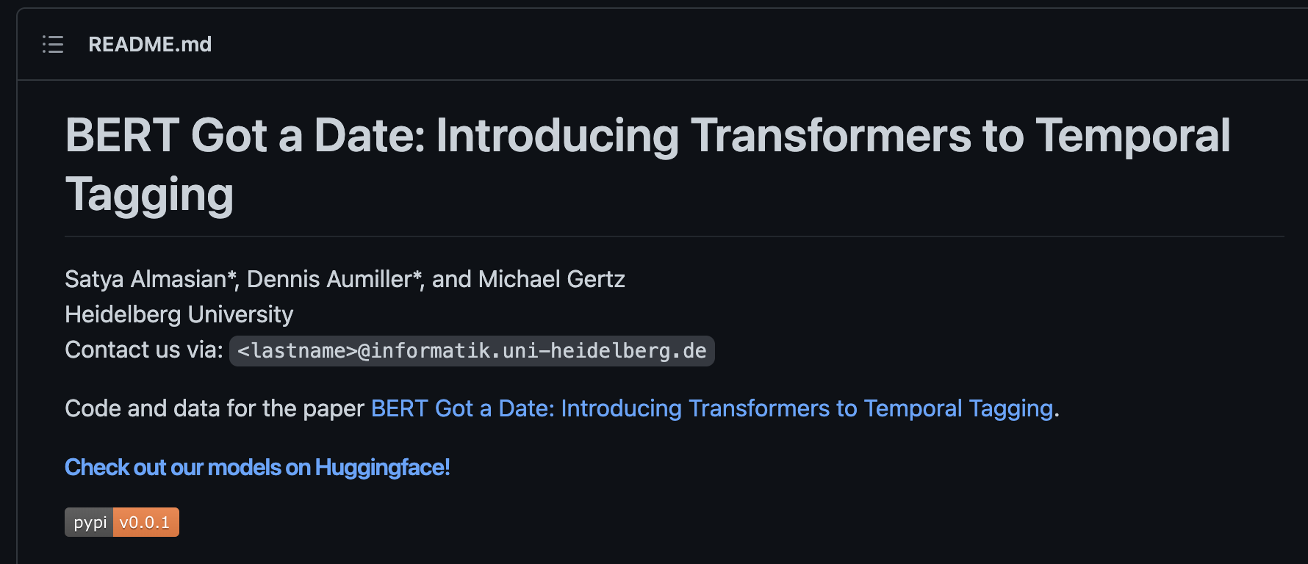
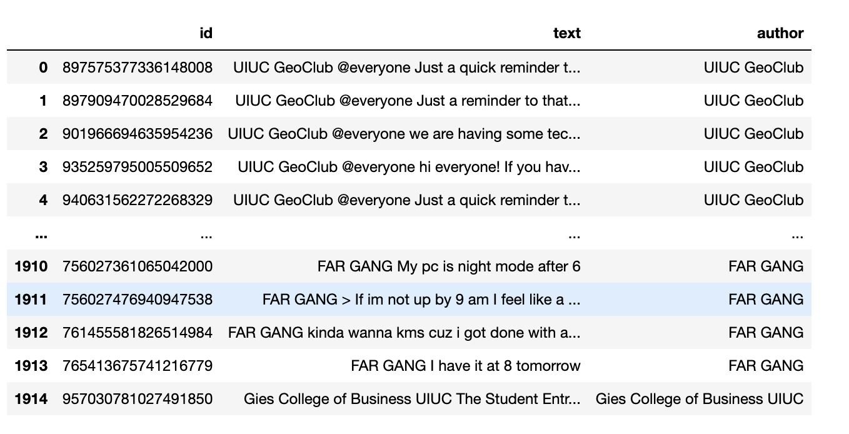
Collecting Events based on Time
Data was collected from multiple uiuc discord servers and from multiple instagram accounts. Next, Bert Temporal Tagging was implemented to collect messages with time or date.

Slide 4
02.
Stopword removal, Lemmatization, and Stemming

Slide 5
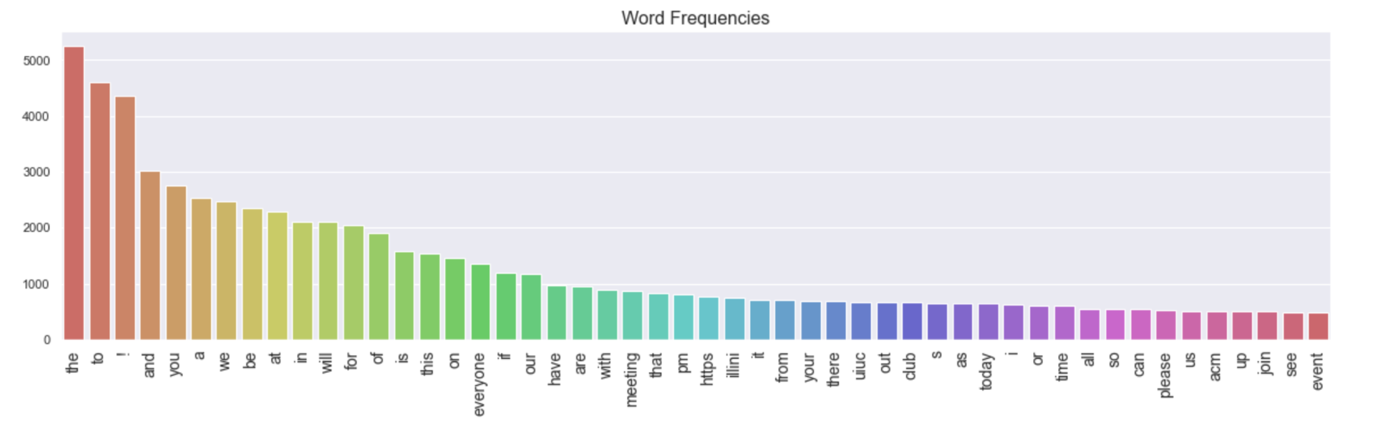
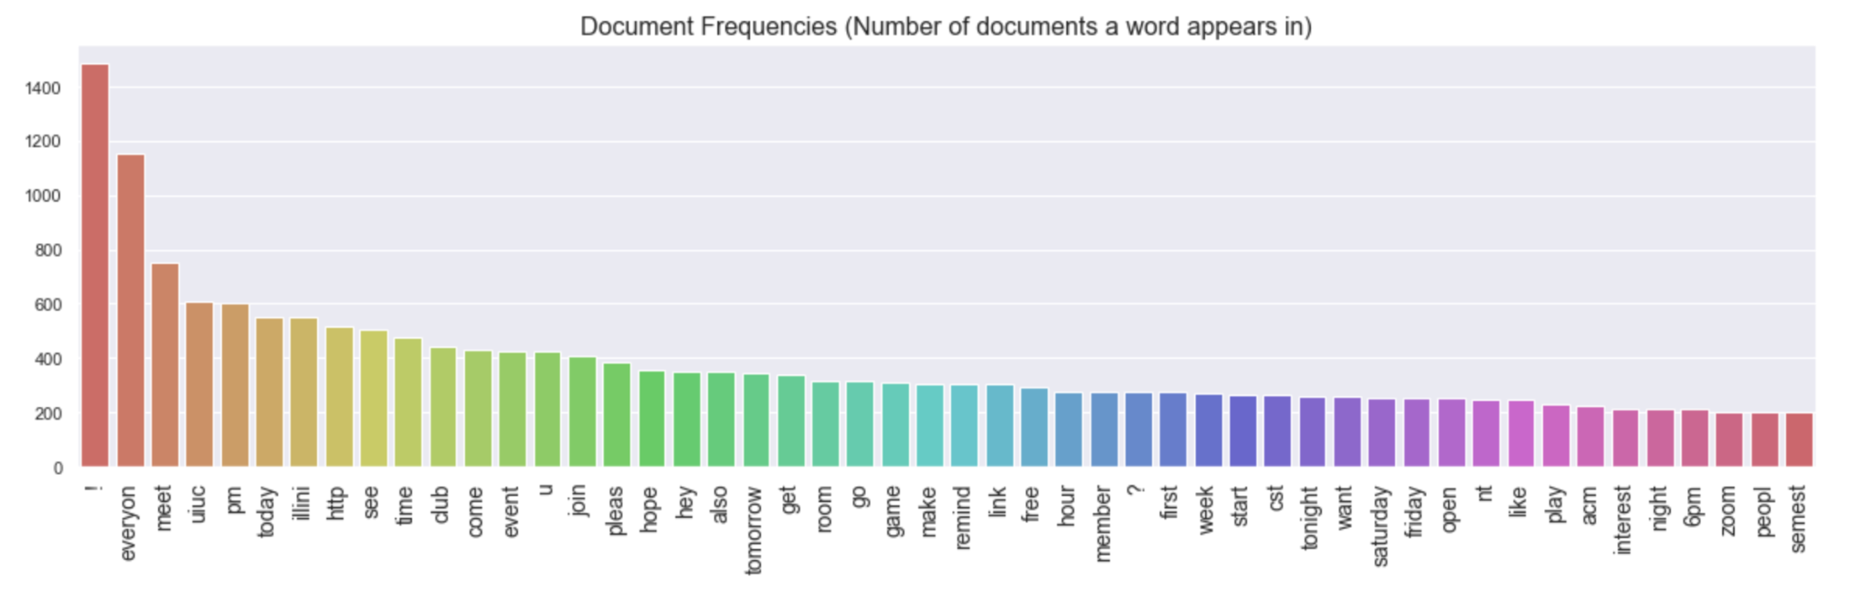
Stopword removal, Lemmatization, and Stemming
We can see the before and after Frequency Graphs for the messages. For example words such as the, and have been removed.
Before
After

Slide 6
03.
LDA

Slide 7
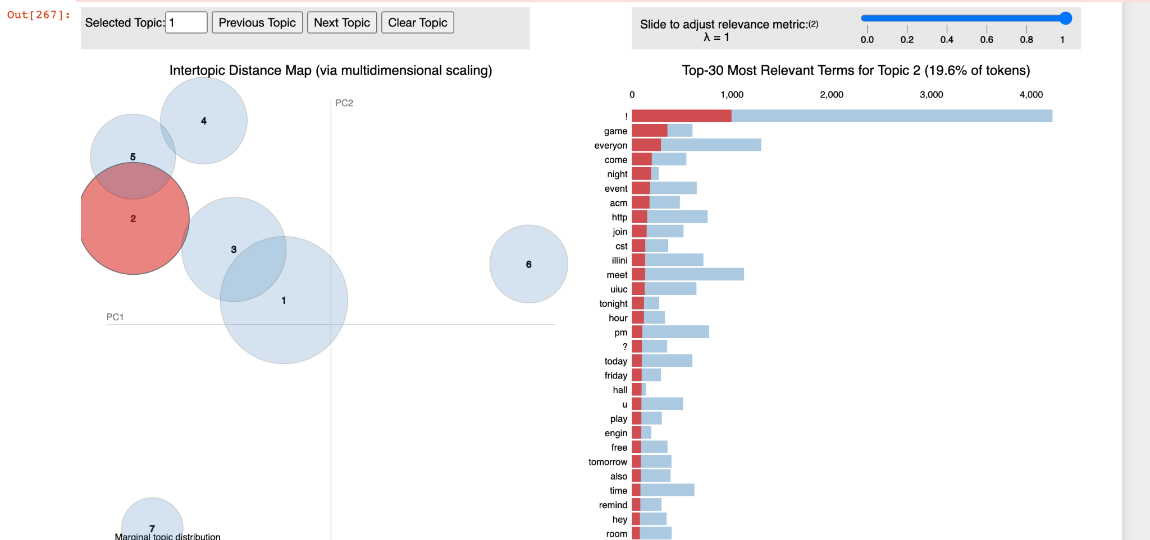
LDA
Clusters created based using LDA. I created 7 clusters for the documents to get 7 different topics.

Slide 8
Thanks!

