Slide 1

Presented By:
Chirag Talreja
Diamond Price Prediction

Slide 2





Chirag Talreja
Aspiring Data Scientist
Education
Skills
Contact
Post-Graduation in Data Analytics and Machine Learning Imarticus Learning (2022-Present)
Bachelor of Technology MIT-WPU (2018-2022)
Python
NumPy
Pandas
Statistics
Data Visualization
Machine Learning
Time Series
Deep Learning
Pune, Maharashtra
:+91-7620748392
Work Experience
chiragtalreja76@gmail.com
Internship Trainee (Nov 2021 - Mar 2022)
https://github.com/Chirag7120
Forbes Marshall
https://www.linkedin.com/in/chirag-talreja-89a605206/
Understood the working of boiler and its sub-parts. Implemented all basic thermal engineering knowledge gained with a practical and industrial viewpoint..
Projects
Hobbies
Languages
Diamond Price Prediction : The purpose of this project is to predict price of diamond based on certain parameters. Investigate which parameters are most important to achieve the best results from the data.
Regression Analysis
Datasets: Melbourne Housing Price Prediction,Boston House Price Prediction
Classification Analysis
Dataset:Diabetes
The objective is to predict based on diagnostic measurements whether a patient has diabetes.
English
Hindi
Video
Music
Travelling
Marathi

Slide 3
Agenda
Problem Statement
Data Visualization
Feature Selection
Model Building & Predictions
Model Deployment
Comparison of Algorithms
Predict target using original and new inputs
Conclusion

Slide 4
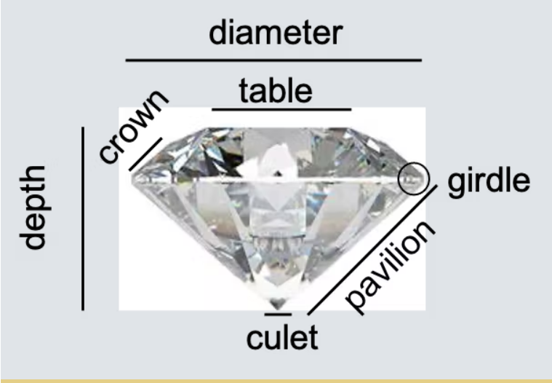
Problem Statement
The Given dataset contains the prices and other attributes of diamond. There are 10 attributes included in the dataset including the target ie. Price Perform Regression Analysis to predict the price of diamond.
Price : price in US Dollars($326-$18,823)
Carat : Weight of Diamond(0.2-5.01)
Cut: Quality of Cut.(Fair,Good,Very Good,Premium,Ideal)
Color: Diamond Color,from J(worst) to D(Best)
Clarity:A measurement of how clean the diamond is.(I1(best),IF(worst)).
X: Length in mm(0-10.74)
Y: Wight in mm(0 - 58.9)
Z: Depth in mm(0-31.80)
Depth: Total Depth Percentage = Z/ mean(x,y) = 2*Z/(X+Y)
Table: Width of top top of Diamond relative to widest point(43 – 95)

Slide 5
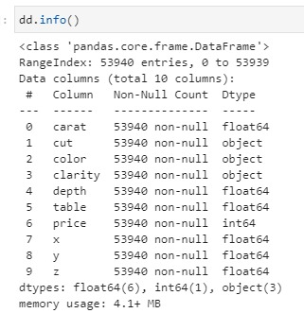
Basic Information:
Shape:(53940,11)
Size:593340

Slide 6
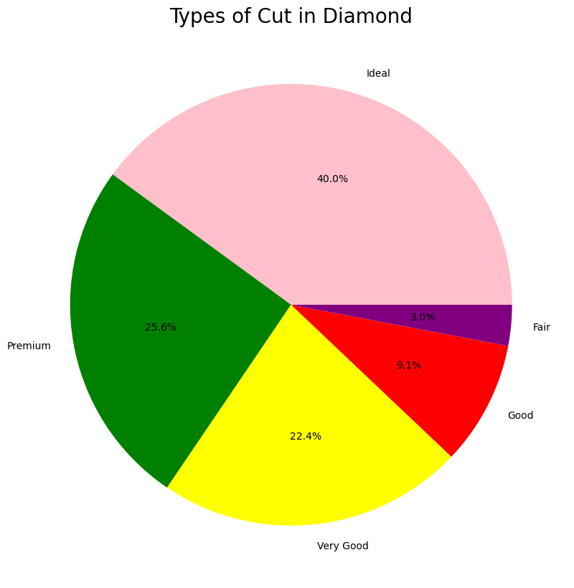
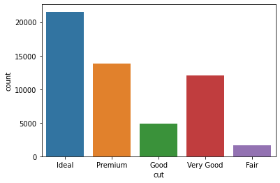
Visualization:-Univariate Analysis
Visualization of categorical Attributes

Slide 7
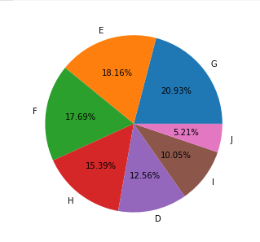
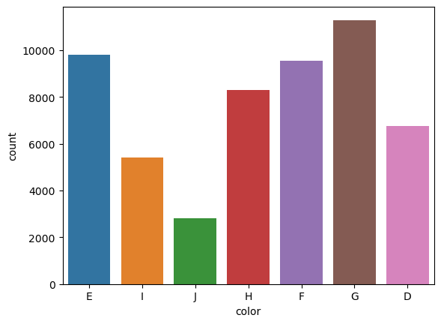

Slide 8
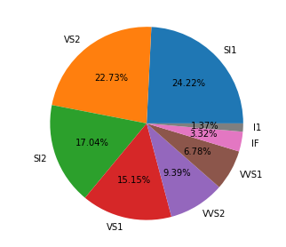
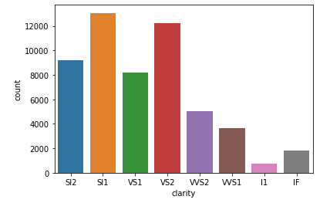

Slide 9
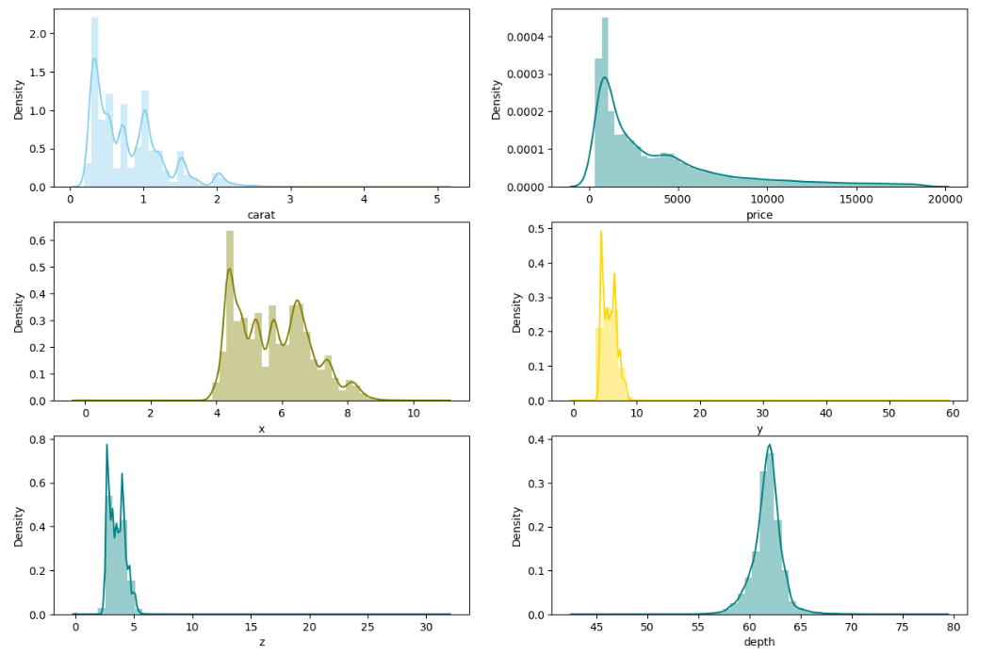

Slide 10
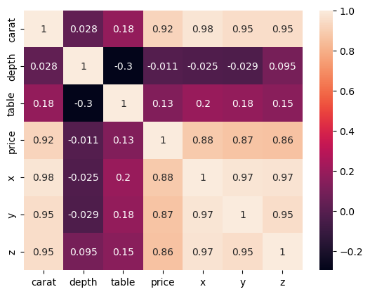
Visualization:-Multivariate Analysis

Slide 11
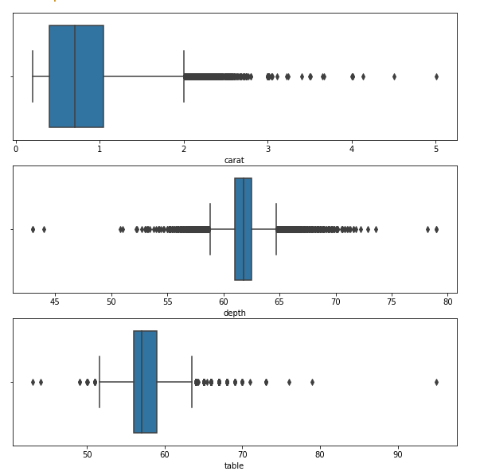
Outlier Handling

Slide 12
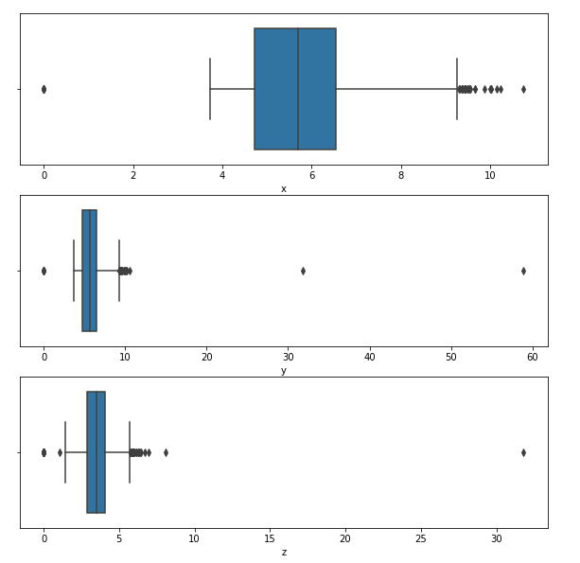

Slide 13
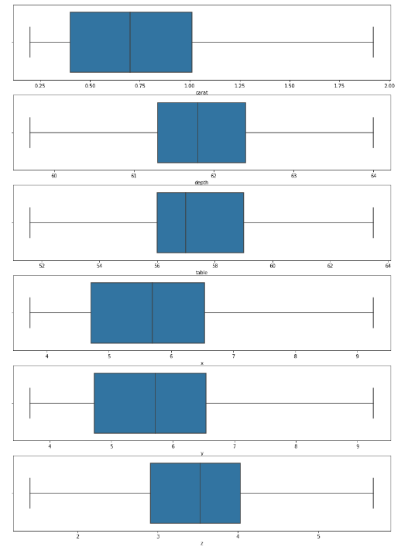
Features After Outlier Handling:

Slide 14
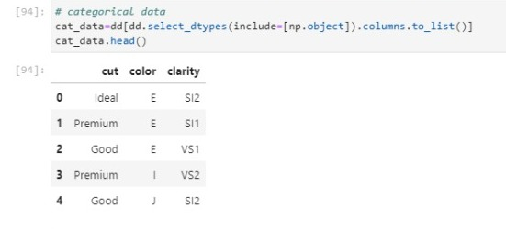
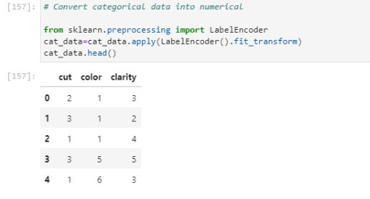
Categorical Data Conversion

Slide 15
Model Building & prediction
We have implemented various machine learning algorithms such as Linear Regression, Decision Tree ,Random Forest and Adaptive Boosting and Voting Regressor in order to identify the most optimal model.
For each of these models R2_Score,MSE,RMSE,MAE were calculated.
Further we found importance and results based on the models we have used.

Slide 16
Simple Linear Regression
Independent Variable: Carat
Dependent Variable: Price
Train & Test size/shape
Train R2_score: 0.5254
Test R2_score : 0.5169
Train Size: 43152
Train Shape:(43152,1)
Test Size: 10788
Test Shape:(10788,1)
After Cross Validation
Train R2_score: 0.56
Test R2_score: 0.54

Slide 17
Multiple Linear Regression
Independent Variables: Carat,X,Y,Z,depth,table,cut, color, clarity
Dependent Variable: Price
Train & Test Size & shape
Train Size: 388368
Train Shape:(43152,9)
Test Size: 97092
Test Shape:(10788,9)
Train R2_score: 0.8197
Test R2_score : 0.8190
After Cross Validation
Train R2_score: 0.8150
Test R2_score: 0.8146

Slide 18

Decision Tree Regressor
Decision Tree Regressor algorithm builds a model in the form of tree structure
In the final prediction is the average of the value of the dependent variable in that particular child node
Train R2_score: 0.9672
Test R2_score: 0.9619
After Cross Validation
Train R2_score: 0.9617
Test R2_score: 0.9580

Slide 19
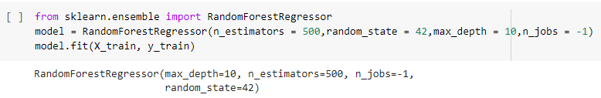
Random Forest Regressor
Random forest is developed version of decision tree regressor
Random forest works on multiple decision tree model which is trained over the same data & averaging the result of each model ultimately finds more powerful predictive result
Train R2_score:0.9835
Test R2_score:0.9774
After Cross Validation
Train R2_score: 0.9771
Test R2_score: 0.9721

Slide 20
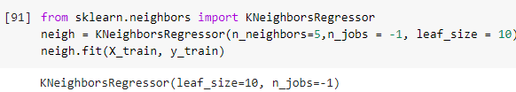
K-Nearest Neighbors Regressor
It is non-parametric method
Averaging the observation in the same nearest neighbourhood
Train R2_score: 0.9706
Test R2_score: 0.9505
After Cross Validation
Train R2_score: 0.9511
Test R2_score: 0.9327

Slide 21

Support Vector Regressor
Train R2_score:0.7063
Test R2_score:0.7086
After Cross Validation
Train R2_score: 0.7047
Test R2_score: 0.6802

Slide 22
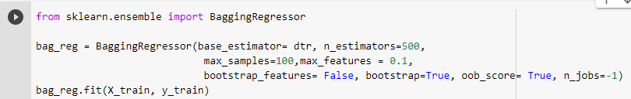
Ensemble Technique
Bagging:
Train R2_score:0.9094
Test R2_score:0.9093

Slide 23
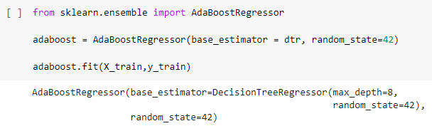
Boosting
Adaptive Boosting
Train R2_score:0.9808
Test R2_score:0.9746
After Cross Validation
Train R2_score: 0.9738
Test R2_score: 0.9714

Slide 24

2. Gradient Boosting
Train R2_score:0.9709
Test R2_score:0.9704
After Cross Validation
Train R2_score: 0.9687
Test R2_score: 0.9682

Slide 25
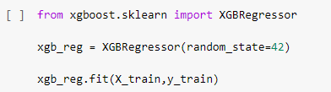
3. Xtreme Gradient Boosting
Train R2_score:0.9711
Test R2_score:0.9709
After Cross Validation
Train R2_score: 0.9686
Test R2_score: 0.9683

Slide 26
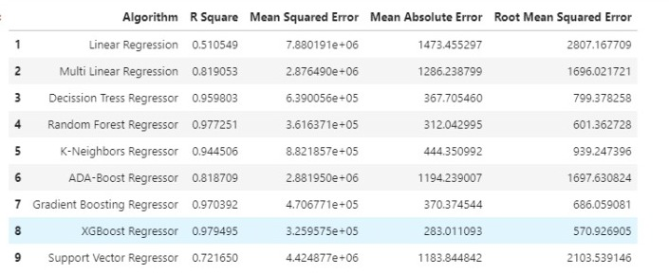
Comparison of Algorithm

Slide 27
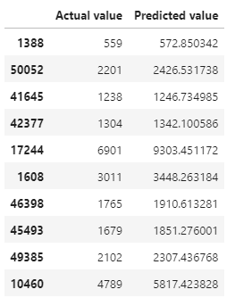
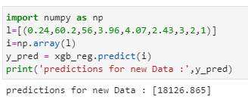
Predict target using original and new inputs

Slide 28
Conclusion
After analyzing all the models we can conclude that predictors X,Y,Z & Carat did played a major role for Diamond Price Prediction
Comparing all the models, XGboost is the best among all the regression models

Slide 29
Thankyou

