Slide 1

DATA MANAGEMENT PROJECT REPORT
(Project Semester: August-December 2020)
Shoes Companies Data Analysis
Name: Chirag Agarwal
Roll no: A12
Section: RKM073
Registration No: 11804188
Date of Submission: 22/12/2020

Slide 2
DECLARATION
I, Chirag Agarwal, student of B.Tech CSE under CSE/IT Discipline at, Lovely Professional University, Punjab, hereby declare that all the information furnished in this project report is based on my own intensive work and is genuine.
Date: 22 December 2020
Registration No.: 11804188 Chirag Agarwal

Slide 3
Acknowledgement
I would like to express my special thanks of gratitude to my teacher Miss. Ashu who gave me the golden opportunity to do this wonderful project of analysis of the data of a Shoes Companies in India which also helped me in doing a lot of research and I came to know about so many new things. I am thankful to them. Secondly, I would also like to thank my parents and friends who helped me a lot in finalizing this project within the limited time frame.

Slide 4
CONTENTS OF THE REPORT
Introduction
Objectives/Scope of the Analysis
Source of dataset
ETL process
Analysis on dataset (for each analysis)
Introduction
General Description
Specific Requirements, functions and formulas
Analysis results
Visualization
List of Analysis with results
References
Bibliography

Slide 5
INTRODUCTION
Data Analysis is a process of inspecting, cleansing, transforming, and modeling data with the goal of discovering useful information, informing conclusions, and supporting decision making. Data analysis has multiple facets and approaches, encompassing diverse techniques under a variety of names, while being used in different business, science, and social science domains.
The Companies would love to check their performance through data analysis of each and every month, year leading to a well-organized and fruitful information. My analysis contains data on Companies which produce and sell Shoes all over the India and are most successful.

Slide 6
Insights of data:
Shoes Companies in India contains the following data fields: -
Company : In this data field the name of top shoes companies in India
State : In this data field the name of state from where the shoes are buyied.
Units : In this data field the number of shoes sold.
Price: In this data field the price of shoes is provided.
Total revenue: In this data field the total revenue of the company is provided.
Offline/Online shopping: In this data field how buyers are buying the shoes i.e. through online mode or offline mode.
Payment Mode: In this data field by which mode of payment the customer had purchased the Shoes.
Month: In this data field the month in which the units are sold by each company are provided.
Year: In this data field the year in which the units are sold by each company are provided.

Slide 7
SCOPE OF ANALYSIS
This project on Shoes companies in India provides the overall Statistics details of the units sold, state, revenue generated of Different companies from the year 2012 to 2016.
Objectives of this project:
To good hand on excel.
To use different feature and get friendly with the excel.
How to use pivot table and pivot chart.
Learn to make dashboard in excel.
To make different type of graphs in excel.
Aim of this project is to answer the above objectives in the form of visualization by creating a dashboard to convey the answers effectively and efficiently.

Slide 8
SOURCE OF DATASET
The data is being taken from the Kaggle .Kaggle is an AirBnBfor Data Scientists –this is where they spend their nights and weekends. It’s a crowd-sourced platform to attract, nurture, train and challenge data scientists from all around the world to solve data science, machine learning and predictive analytics problems. It has over 536,000 active members from 194 countries and it receives close to 150,000 submissions per month. Started from Melbourne, Australia Kaggle moved to Silicon Valley in 2011, raised some 11 million dollars from the likes of Hal Varian (Chief Economist at Google), Max Levchin (Paypal), Index and Khosla Ventures and then ultimately been acquired by the Google in March of 2017. Kaggle is the number one stop for data science enthusiasts all around the world who compete for prizes and boost theirKaggle rankings. There are only 94 Kaggle Grandmasters in the world to this date.

Slide 9
ETL PROCESS
In computing, extract, transform, load (ETL) is a process in database usage to prepare data for analysis, especially in data warehousing. Data extraction involves extracting data from homogeneous or heterogeneous sources, while data transformation processes data by transforming them into a proper storage format/structure for the purposes of querying and analysis; finally, data loading describes the insertion of data into the final target database such as an operational data store, a data mart, or a data warehouse. A properly designed ETL system extracts data from the source systems, enforces data quality and consistency standards, confirms data so that separate sources can be used together, and finally delivers data in a presentation-ready format so that application developers can build applications and end users can make decisions.

Slide 10
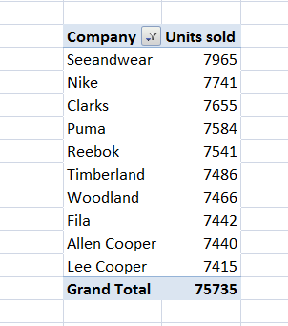
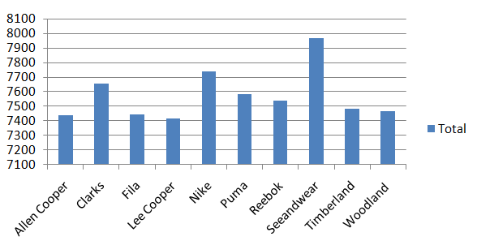
ANALYSIS OF DATASET
Companies which have highest number of unit Sold:
According to the analysis the units sold by the Seeandwear is the highest with total of 7965 unit from 2012 to 2016.

Slide 11
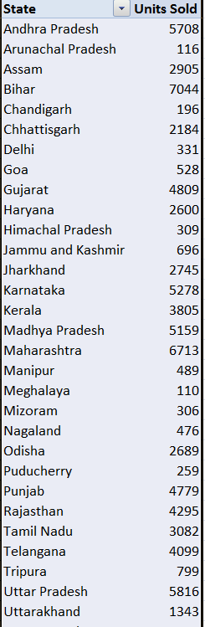
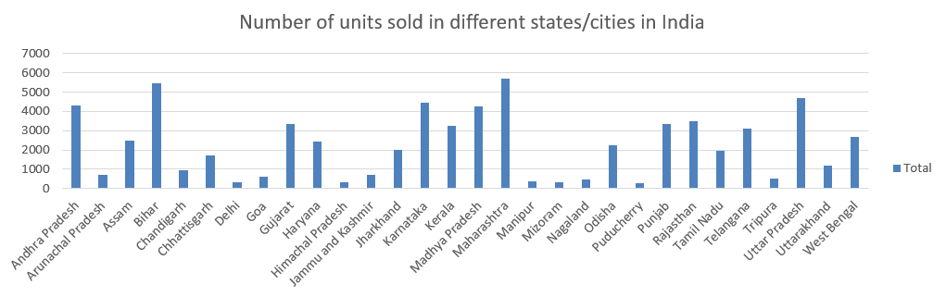

2. States where people purchase highest number of units shoes In India during 2012 and 2016.

Slide 12

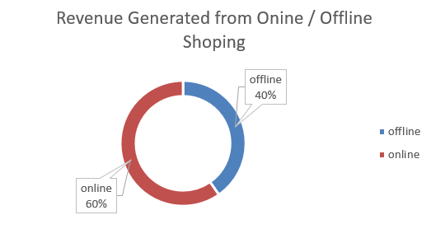
3. Revenue generated through online/offline shopping

Slide 13
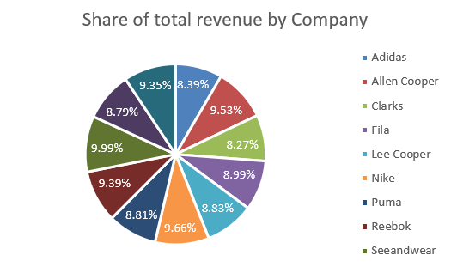
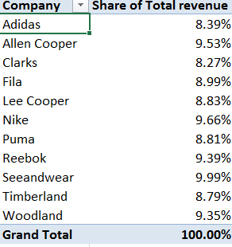
4. Share of revenue generated by companies from 2012-2016 in percent

Slide 14
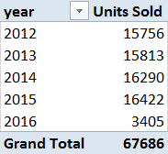
5. Unit sold by the companies by year;

Slide 15
List of analysis with results
In India the top 5 companies which sold maximum shoes are :
1.seeandwear with 6557 Units sold during 2012-2016
2. Reebok with 6284 Units sold
3. Woodland with 6278 units sold
4. alien cooper with 6187 units sold
5. Clarks with 6181 units sold
Company | Units Sold
Seeandwear | 6557
Reebok | 6284
Woodland | 6278
Allen Cooper | 6187
Clarks | 6181
Grand Total | 31487

Slide 16
Pair of shoes sold between 2012-2016
During 2015 the number of shoes sold is maximum with total selling of 16422 while least in 2016 with total sell 3405.
Now the list of shoes sold in different year in India
2012 - 15756
2013 – 15813
2014 – 16290
2015 – 16422
2016 – 3405 (till march)
year | Units Sold
2012 | 15756
2013 | 15813
2014 | 16290
2015 | 16422
2016 | 3405
Grand Total | 67686

Slide 17
Shopping done using online/offline shopping
The total revenue generated with online shopping is 1225070 while 827379 by offline shopping
Onliine / Offline Shoping | Revenue Generated
Offline | 827379
Online | 1225070
Grand Total | 2052449

Slide 18
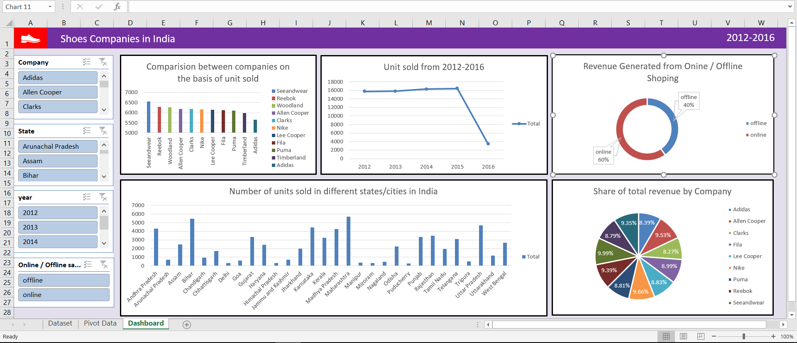
Final Dashboard

Slide 19
Future Scope
In India Shoes Industries is one of the fastest growing industries. In India the majority of people like to buy new shoes every month as the taste changes. So to meet the quality and the taste of Indian shoes consumers, many companies comes up with their products. The price is also the one of the major factor which affects the consumer. The main thing which consumer need is good quality in budget.
And coming to the future, it has great scope and potential and companies taking care of it so well it does not seem the company is going lose any shine in near future.

Slide 20
Reference and Bibliography
Youtube
Kaggle
Google.com

