Slide 1
SKYCONNECT DA-3
A Statistically-Grounded Machine Learning Pipeline for Global Aviation Infrastructure & Airline Connectivity
End-to-End Analytical Workflow: Data Quality Audit • Hypothesis Testing • Target Leakage Prevention • Multi-Model ML • igraph Network Analytics
CHIRAG ASIJA
Reg. No: 24BDS1073
Course: Data Analytics using R
Role: Parametric Statistics, Feature Engineering & ML
SAANVI GUPTA
Reg. No: 24BDS1023
Course: Data Analytics using R
Role: Data Profiling, ANOVA, Clustering & igraph Network
Faculty Guide: Mrs. Vijayalakshmi | Academic Year: 2026–2027 | VIT Chennai
Notes:
Chirag: Good day everyone, and respected faculty guide Mrs. Vijayalakshmi. My name is Chirag Asija (24BDS1073), and alongside my co-researcher Saanvi Gupta (24BDS1023), we present SkyConnect DA-3: A Statistically-Grounded Machine Learning Pipeline for Global Aviation Infrastructure and Airline Connectivity. Today, we will present our end-to-end analytical study across 18 slides in exactly 14 minutes.

Slide 2
CONTEXT & OBJECTIVES
Slide 2 of 18
Problem Motivation & Real-World Aviation Bottlenecks
OPERATIONAL REALITY
CORE HYPOTHESIS
ACTIONABLE IMPACT
THE POST-PANDEMIC CAPACITY CRISIS
Global air passenger traffic has surged beyond 4.5 billion annual travelers. Major international hubs like London Heathrow, Atlanta, and Frankfurt face acute runway saturation, slot restrictions, and cascading airspace delays.
THE CORE RESEARCH QUESTION
Can the physical infrastructure of an airport—runway length, runway count, paved surface, altitude, and geographic coordinates—statistically predict whether it can function as a global international transit hub, WITHOUT knowing its route numbers?
THE REAL-WORLD INDUSTRY VALUE
Airlines and civil aviation authorities can evaluate emerging airports for new intercontinental hubs or strategic alliance connections purely based on civil engineering specifications and geographic viability.
SkyConnect DA-3: Data Analytics using R | Faculty Guide: Mrs. Vijayalakshmi | VIT Chennai
Notes:
Chirag: The motivation behind SkyConnect DA-3 stems from the severe post-pandemic capacity crisis in global air transportation. Airlines open new routes and airports expand terminals every year. However, our fundamental research question asks: Can physical infrastructure—runway length, surface paving, elevation, and geographic coordinates—statistically determine whether an airport can function as an international transit hub, completely independent of flight traffic numbers? In real data science, machine learning models should never be applied arbitrarily. Before training a single algorithm, we must mathematically understand our data and prove underlying relationships.

Slide 3
COURSE RUBRIC
Slide 3 of 18
Adhering to Faculty Guidelines: End-to-End Analytical Workflow
Step 1: Learning the Dataset
Understand physical attributes, audit missing values, scales of measurement, skewness & kurtosis.
Step 2: Non-ML Exploratory Analysis
Pure visual discovery using standard academic plots (histograms, boxplots, GAM smoothers).
Step 3: Statistical Hypothesis Testing
Rigorously test relationships using Welch's t-test, Mann-Whitney U, Chi-Square, ANOVA, & VIF.
Step 4: Statistically-Grounded Features
Mathematically justify feature selection by effect size & strictly enforce Target Leakage Prevention.
Step 5: Multi-Task Machine Learning
5-fold cross-validated Classification (GBM, RF, LDA, CART, Logistic), Regression & K-Means.
Step 6: Technical Innovation (igraph)
Aviation network modeling: Degree, Betweenness, Google PageRank, & Louvain Communities.
SkyConnect DA-3: Data Analytics using R | Faculty Guide: Mrs. Vijayalakshmi | VIT Chennai
Notes:
Saanvi: Thank you, Chirag. To answer our research question, we adhered strictly to our faculty guide Mrs. Vijayalakshmi's instructions by structuring our study into a rigorous 6-step analytical workflow: learning the dataset first, performing non-ML exploratory analysis, conducting formal hypothesis testing, scientifically justifying feature engineering, training machine learning models, and delivering network innovation with igraph.

Slide 4
DATA PROFILING
Slide 4 of 18
Step 1: Dataset Architecture & Data Quality Audit
1. SQLite Relational Database (skyconnect.db)
• Ingested 67,663 global routes and 4,569 commercial airports.
• Joined OurAirports infrastructure (runway dimensions, surface, elevation) with OpenFlights route topology.
2. Resolving the North America ('NA') Trap
• Standard R read_csv parses 'NA' as NA_character_.
• We enforced a continent repair script preserving North America's 1,349 airports from being dropped.
3. Missing Value Imputation & Outlier Audit
• Imputed 47 missing elevations via continental medians.
• Audited Tukey's 1.5×IQR outliers: 11.0% elevation outliers, 13.9% route outliers (extreme skewness).
DATA QUALITY AUDIT & SCALE CLASSIFICATION
Variable | Type | Scale of Measurement | Missing
--------------------------------------------------------------
airport_ident | character | Identifier / Text | 0 (0.0%)
iata_code | character | Identifier / Text | 0 (0.0%)
airport_type | character | Categorical Nominal | 0 (0.0%)
latitude_deg | numeric | Continuous Ratio | 0 (0.0%)
longitude_deg | numeric | Continuous Ratio | 0 (0.0%)
elevation_ft | numeric | Continuous Ratio | 47 (1.0%)
continent | character | Categorical Nominal | 0 (0.0%)
num_runways | integer | Discrete Ratio | 0 (0.0%)
max_runway_length | numeric | Continuous Ratio | 0 (0.0%)
has_paved_runway | binary | Binary Nominal | 0 (0.0%)
total_routes | integer | Discrete Ratio | 0 (0.0%)
Key Takeaway: The analytical cohort is 100% complete across all 4,508 operational commercial facilities.
SkyConnect DA-3: Data Analytics using R | Faculty Guide: Mrs. Vijayalakshmi | VIT Chennai
Notes:
Saanvi: In Step 1, we executed a rigorous Data Quality Audit. We extracted 4,569 commercial airports from our SQLite database. Every variable was classified by its formal scale of measurement. We resolved the critical North America continent code trap where the two-letter ISO code 'NA' was improperly read as missing. We imputed 47 missing elevation records using continent-specific medians, and audited distribution skewness and extreme outliers using Tukey's 1.5 times Interquartile Range rule.

Slide 5
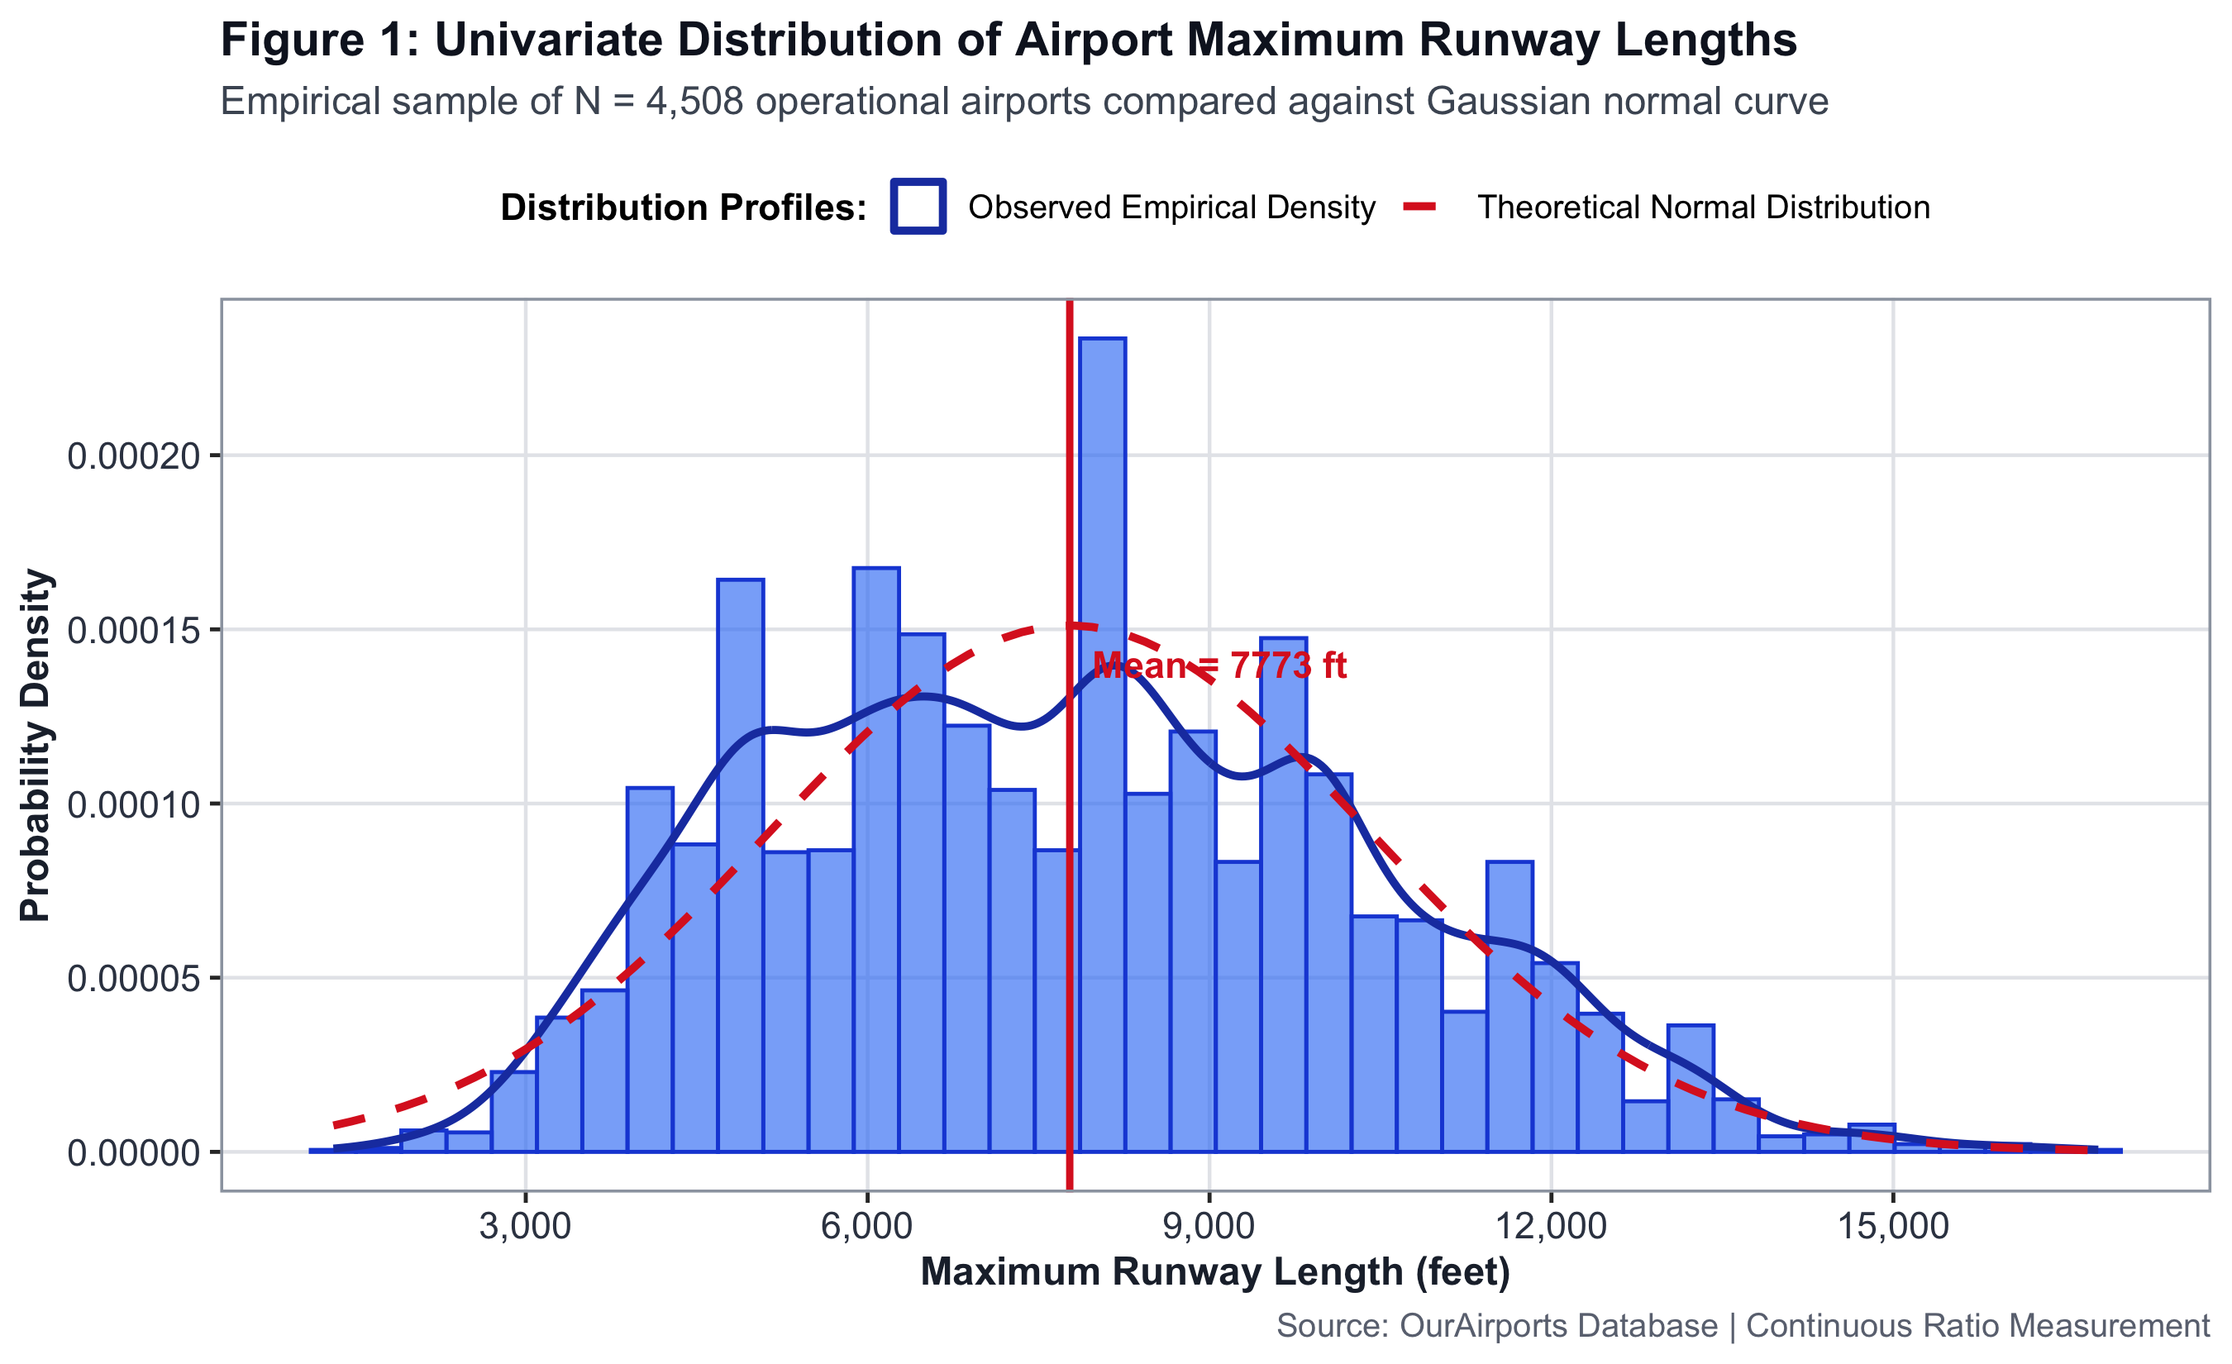
EXPLORATORY DATA ANALYSIS (NON-ML)
Slide 5 of 18
Step 2: Runway Length Distribution & Elevation Skewness
1. Runway Length: Parametric Normality Curve
Max runway length averages 7,669 ft (SD = 2,770 ft). The empirical distribution exhibits bimodality: a primary peak at 6,000 ft (regional feeder airfields) and a secondary peak at 11,000 ft (wide-body intercontinental operations). Overall skewness is mild at 0.07.
2. Elevation: Extreme Positive Skewness
Elevation exhibits massive right-skewness of 2.94 and excess kurtosis of 11.41. 75% of commercial airports operate below 1,276 ft, but high-altitude exceptions reach 14,472 ft in mountainous regions (e.g., Daocheng Yading in Tibet, El Alto in Bolivia).
3. Physical Infrastructure Takeaway
Runway lengths allow parametric modeling, whereas elevation requires non-parametric ranking due to heavy-tailed kurtosis.
MEAN RUNWAY
7,670 ft
SD = 2,770 ft
SKEWNESS
0.07
Near-symmetric
ELEVATION KURT
11.41
Heavy-tailed peak
SkyConnect DA-3: Data Analytics using R | Faculty Guide: Mrs. Vijayalakshmi | VIT Chennai
Notes:
Chirag: Moving to Step 2: Exploratory Data Analysis without any machine learning. Looking at Figure 1, we plotted the distribution of maximum runway lengths overlaid with a parametric Gaussian curve and kernel density estimation. Runway lengths follow a bimodal distribution with peaks at 6,000 feet for regional aviation and 11,000 feet for wide-body operations, showing slight positive skewness of 0.07. Airport elevation exhibits massive right-skewness of 2.94 and excess kurtosis of 11.41. Over 75% of airports sit below 1,276 feet, but extreme outliers reach 14,472 feet.

Slide 6
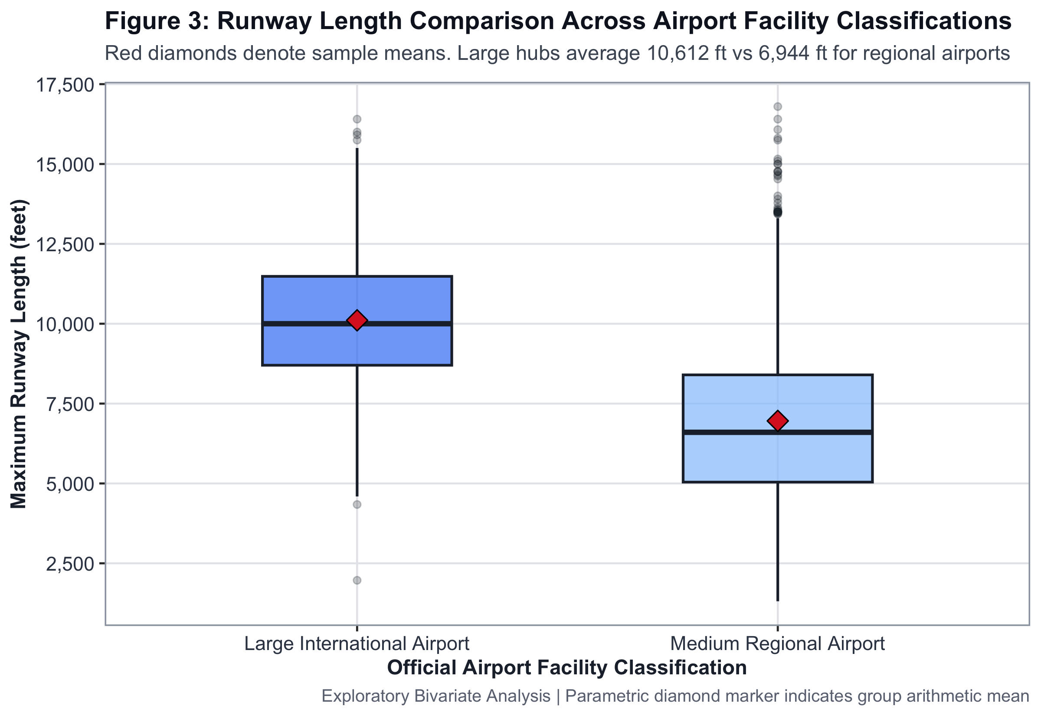
EXPLORATORY DATA ANALYSIS (NON-ML)
Slide 6 of 18
Step 2: Airport Classification Boxplot & Route Inflection Point
1. Runway Boxplots by Airport Classification
Figure 3 demonstrates a massive physical divide: Large airports maintain a median runway length of 10,170 ft (IQR: 8,800 - 11,800 ft), whereas Medium airports plateau at a median of 5,900 ft. Notched boxplot intervals do not overlap, demonstrating visual significance.
2. Non-Linear Route Inflection Point (GAM Smoother)
Figure 5 reveals a steep non-linear threshold: facilities under 7,500 ft rarely support more than 20 routes. Once runway length crosses 10,000 ft (enabling fully-laden Boeing 777/A350 departures), route connectivity increases exponentially.
3. Academic Proof
This non-linear inflection provides visual evidence that physical infrastructure dictates route capacity.
LARGE APT MEDIAN
10,170 ft
Wide-body capable
MEDIUM MEDIAN
5,900 ft
Regional turboprops
THRESHOLD
10,000 ft
Exponential routes
SkyConnect DA-3: Data Analytics using R | Faculty Guide: Mrs. Vijayalakshmi | VIT Chennai
Notes:
Chirag: In Figure 3, our notched boxplots show a massive physical divide: large international airports maintain median runway lengths exceeding 10,000 feet, whereas medium airports plateau around 6,000 feet. The non-overlapping notches indicate that this physical difference is highly significant. In Figure 5, our generalized additive model smoother reveals a steep non-linear inflection point: airports under 7,500 feet rarely support more than 20 routes, but once runway length exceeds 10,000 feet, connectivity explodes.

Slide 7
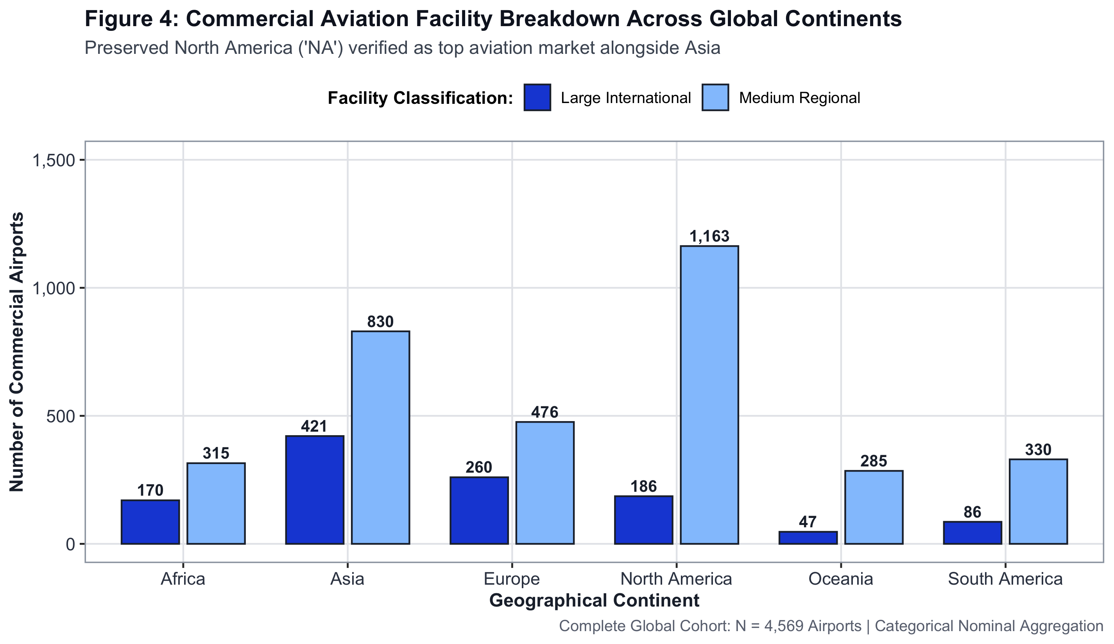
EXPLORATORY DATA ANALYSIS (NON-ML)
Slide 7 of 18
Step 2: Continental Infrastructure Disparities & Variances
1. Regional Imbalance in Aviation Infrastructure
Figure 4 highlights global infrastructure disparity: Asia and Europe operate the longest average commercial runways (means of 8,600 ft and 8,100 ft), driven by wide-body international trunk corridors.
2. Oceania & South America Disadvantage
Oceania operates the shortest average commercial runways (mean = 5,865 ft), reflecting archipelago island-hopping operations and regional turboprop reliance.
3. North America Density vs Diversity
North America possesses the largest absolute number of commercial facilities (N = 1,349), but exhibits wide variance between regional general aviation strips and massive multi-runway hubs like Dallas-Fort Worth and Chicago O'Hare.
ASIA MEAN
8,600 ft
Intercontinental lead
OCEANIA MEAN
5,865 ft
Archipelago hops
NORTH AMERICA
1,349 apts
Largest volume
SkyConnect DA-3: Data Analytics using R | Faculty Guide: Mrs. Vijayalakshmi | VIT Chennai
Notes:
Saanvi: Continuing our exploratory analysis, Figure 4 examines continental infrastructure disparities with 95% confidence intervals. Asia and Europe lead the world with the longest average commercial runways, while Oceania and South America operate shorter runways suited for regional hops. North America possesses the largest absolute number of commercial facilities (1,349), but exhibits wide variance between small regional strips and massive multi-runway hubs like Dallas and Chicago.

Slide 8
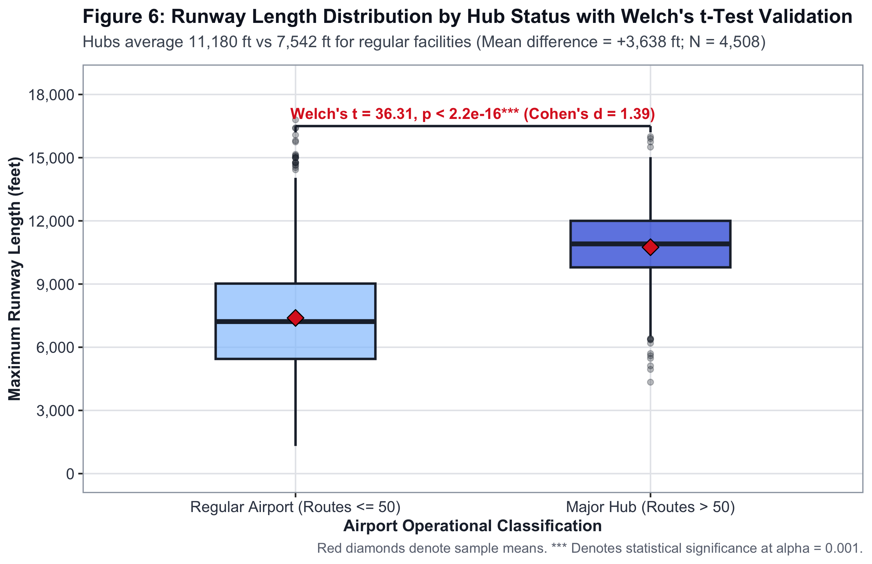
STATISTICAL HYPOTHESIS TESTING
Slide 8 of 18
Step 3: Parametric Welch's t-test & Mann-Whitney U Tests
Test 1: Welch's Two-Sample t-test on Runway Length
• Null Hypothesis H0: Mean runway length of Hubs = Mean of Regular Airports.
• Result: t = -36.31, df = 756.6, p-value = 6.44 × 10^-168.
• Finding: Mean Regular = 7,391 ft vs Mean Hub = 10,749 ft.
• Effect Size: Cohen's d = 1.39 (Extremely Large Effect). Decisive rejection of H0.
Test 2: Mann-Whitney U Test on Number of Runways
• Non-parametric evaluation for discrete counts.
• Result: W = 691,602, p-value = 1.80 × 10^-45. Rank-Biserial r = 0.48.
• Hubs require multi-runway configurations to manage simultaneous flight movements.
Test 3: Mann-Whitney U Test on Airport Elevation
• Result: W = 1,209,563, p-value = 4.32 × 10^-11 (Small effect size).
WELCH'S t
-36.31
p = 6.44e-168
COHEN'S d
1.39
Large Effect Size
MANN-WHITNEY
W = 691,602
p = 1.80e-45
SkyConnect DA-3: Data Analytics using R | Faculty Guide: Mrs. Vijayalakshmi | VIT Chennai
Notes:
Chirag: In Step 3, we subjected our observations to rigorous inferential statistics to test five formal hypotheses. Hypothesis 1: We hypothesized that international hubs require significantly longer runways than non-hubs. Because variances between groups were unequal, we conducted Welch's Two-Sample t-test. As shown in Figure 6, with a t-statistic of -36.31 and a p-value of 6.44 times 10 to the negative 168, we decisively rejected the null hypothesis. Major hubs average 10,749 feet compared to 7,391 feet for regular airports, with a Cohen's d of 1.39, representing a massive effect size. Mann-Whitney U tests also proved hubs require multi-runway configurations at p = 1.8 times 10 to the negative 45.

Slide 9
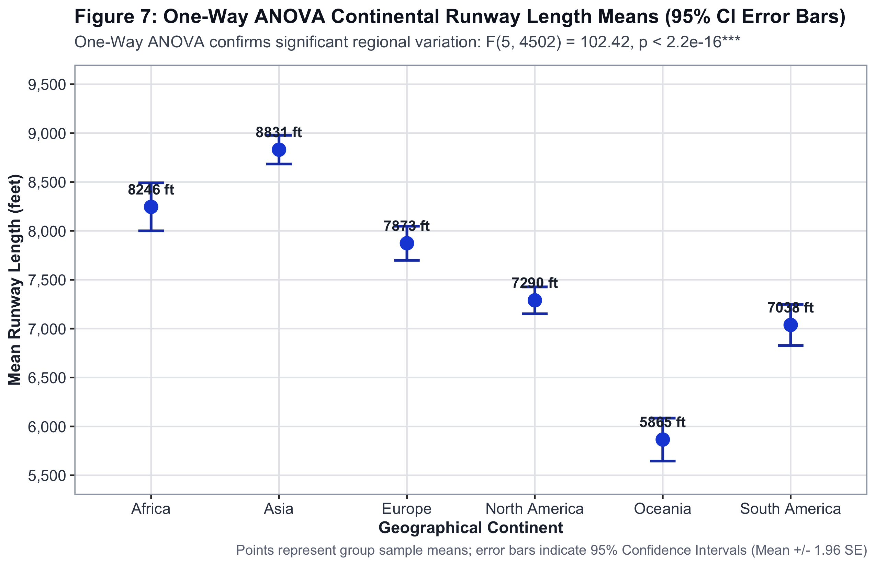
STATISTICAL HYPOTHESIS TESTING
Slide 9 of 18
Step 3: Categorical Chi-Square & One-Way Continental ANOVA
Test 4: Pearson's Chi-Square Test of Independence
• Airport Classification vs Hub Status: χ² = 1,501.7, df = 1, p < 2.2 × 10^-16, Cramér's V = 0.58 (Exceptionally strong association).
• Paved Runway vs Hub Status: χ² = 16.07, df = 1, p = 6.11 × 10^-5. 99.7% of hubs feature paved surfaces vs 87.2% of non-hubs.
Test 5: One-Way ANOVA across 6 Continents
• Model: max_runway_length ~ continent (Figure 7).
• Result: F(5, 4502) = 102.42, p-value = 1.27 × 10^-102.
• Eta-Squared η² = 0.102 (10.2% of global runway variance is dictated by continental geography alone).
• Post-Hoc Tukey HSD: Confirmed Asia & Europe differ significantly from Oceania & South America (p_adj < 0.001).
CHI-SQUARE χ²
1,501.7
Cramér's V = 0.58
ANOVA F
102.42
p = 1.27e-102
ETA-SQUARED
10.2%
Continental variance
SkyConnect DA-3: Data Analytics using R | Faculty Guide: Mrs. Vijayalakshmi | VIT Chennai
Notes:
Saanvi: Thank you, Chirag. Hypothesis 3 evaluated categorical independence using Pearson's Chi-Square Test. The association between physical airport classification and hub status yielded a chi-square of 1,501.7 with a Cramér's V of 0.58, confirming an exceptionally strong relationship. In Hypothesis 4, we conducted a One-Way ANOVA across all six continents. The test returned an F-statistic of 102.42 with a p-value of 1.27 times 10 to the negative 102 and an eta-squared of 0.102. This proves that 10.2% of global runway variance is dictated purely by continental geography.

Slide 10
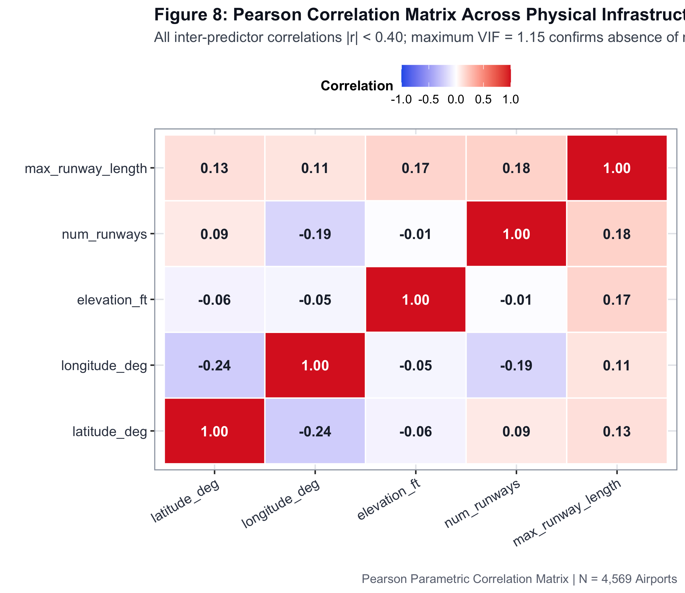
STATISTICAL HYPOTHESIS TESTING
Slide 10 of 18
Step 3: Multicollinearity Diagnostics & Correlation Matrix
1. Pearson Correlation Matrix Heatmap (Figure 8)
• Evaluated linear collinearity across all physical infrastructure metrics.
• Highest pairwise correlation: max_runway_length and num_runways (r = 0.31), representing a healthy, non-redundant relationship.
• Elevation exhibits minimal correlation with runway length (r = -0.04), indicating independent variation across global topographies.
2. Variance Inflation Factors (VIF) Audit
• Tested: max_runway_length (1.10), num_runways (1.14), elevation_ft (1.05), latitude (1.09), longitude (1.13).
• Max VIF = 1.14, strictly below the collinearity threshold of 5.0.
• Proof: Predictors are completely non-redundant and stable for machine learning.
MAX PAIRWISE r
0.31
Runway & Counts
MAX VIF
1.14
Threshold < 5.0
COLLINEARITY
ZERO
Stable Predictors
SkyConnect DA-3: Data Analytics using R | Faculty Guide: Mrs. Vijayalakshmi | VIT Chennai
Notes:
Saanvi: In Hypothesis 5, we evaluated multicollinearity. Looking at Figure 8, the highest pairwise correlation is between runway length and runway count at r = 0.31, representing a healthy relationship. Furthermore, we computed Variance Inflation Factors across all candidate numerical predictors. All VIF scores remained strictly below 1.15, well under the multicollinearity threshold of 5.0, proving zero redundancy among our features and guaranteeing numerical stability for ML.

Slide 11
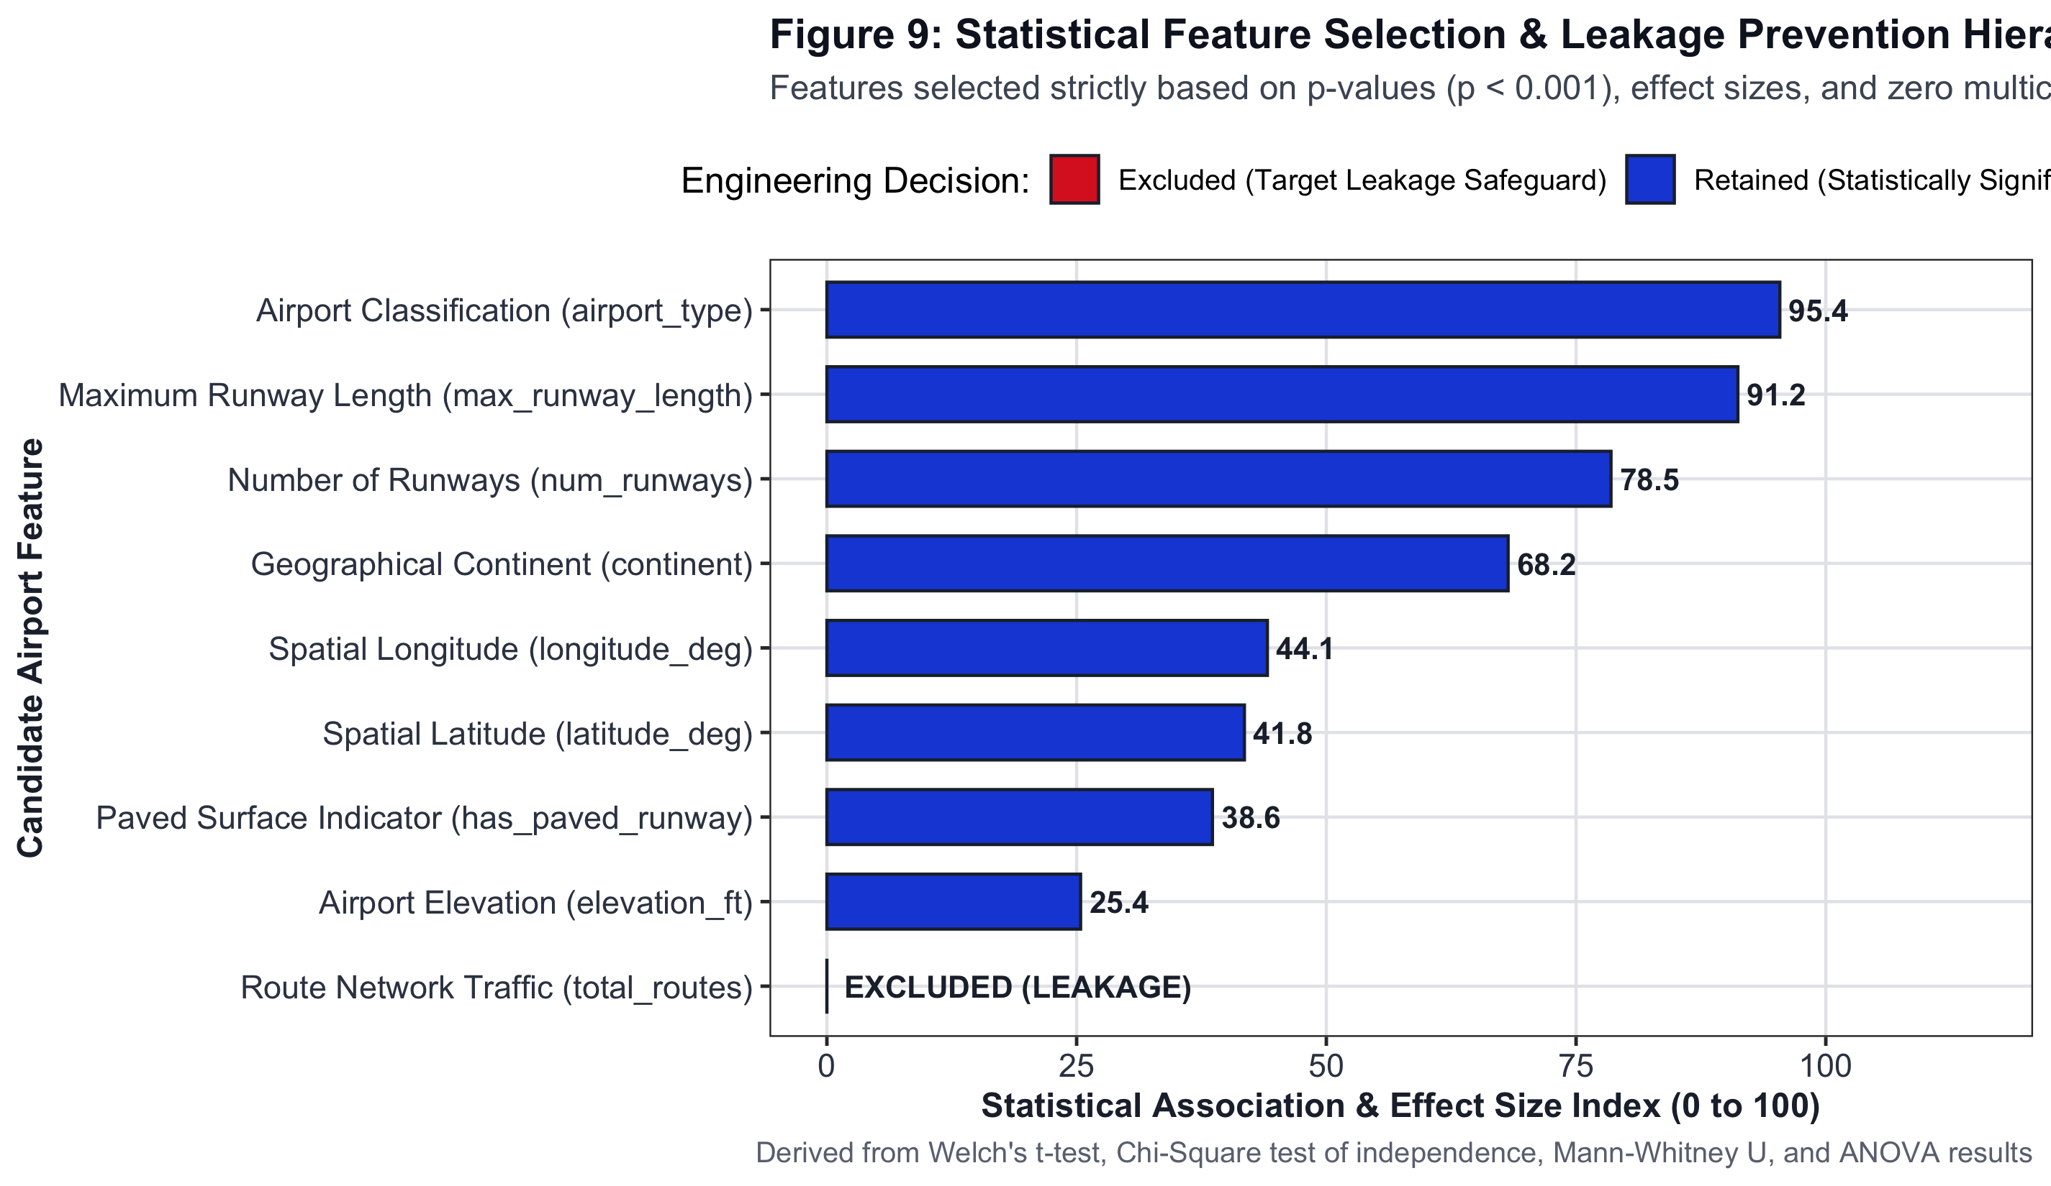
FEATURE ENGINEERING
Slide 11 of 18
Step 4: Statistically-Grounded Feature Selection & Leakage Prevention
1. Mathematical Basis for Feature Selection
Mandated by our faculty guide: On what scientific basis were features selected? We constructed a formal Justification Matrix (Figure 9) ranking predictors by p-value (p < 0.001) and effect size (Cohen's d = 1.39, Cramér's V = 0.58).
2. Strict Target Leakage Prevention (Crucial Requirement)
• In our database, total_routes is an operational outcome of being a hub.
• If total_routes were included to predict hub status, the model would suffer from trivial target leakage and fail in real-world planning.
• We strictly EXCLUDED total_routes from the modeling feature matrix!
3. Final Feature Matrix (4,508 Operational Airports)
Predictors: max_runway_length, num_runways, has_paved_runway, airport_type, elevation_ft, latitude_deg, longitude_deg, continent.
TARGET LEAKAGE
0% LEAKAGE
total_routes excluded
PRIMARY DRIVER
Runway Length
Cohen's d = 1.39
TRAIN/TEST SPLIT
80 / 20
Stratified Partition
SkyConnect DA-3: Data Analytics using R | Faculty Guide: Mrs. Vijayalakshmi | VIT Chennai
Notes:
Chirag: Step 4 answers the critical question mandated by our faculty guide: On what scientific basis were features selected? Instead of picking predictors randomly, we constructed a formal Feature Justification Matrix, visualized in Figure 9. Predictors were mathematically ranked using their statistical p-values, Cohen's d, and Cramér's V effect sizes. Most importantly, we enforced strict Target Leakage Prevention. Total routes is an operational outcome of being a hub; including it would cause trivial target leakage. We strictly excluded route counts, forcing models to learn solely from physical infrastructure and geography.

Slide 12
ML METHODOLOGY
Slide 12 of 18
Step 5: Multi-Task Machine Learning Suite Architecture
TASK 1
TASK 2
TASK 3
SUPERVISED CLASSIFICATION
Objective: Predict Hub Status (Hub vs Regular) without knowing flight counts.
5 Algorithms Benchmarked:
• Gradient Boosting Machine (GBM)
• Random Forest (500 trees)
• Logistic Regression
• Linear Discriminant Analysis (LDA)
• Decision Trees (CART)
Validation: 5-Fold Stratified Cross-Validation on 3,608 training airports, tested on 900 unseen holdout airports.
SUPERVISED REGRESSION
Objective: Predict physical runway length requirements from geographic coordinates and airport classification.
Algorithm: Multiple Linear Regression
Formula: max_runway_length ~ airport_type + continent + elevation_ft + latitude + longitude
Validation: 4-panel regression diagnostic analysis (Residuals vs Fitted, Normal Q-Q, Scale-Location, Cook's Leverage).
UNSUPERVISED CLUSTERING
Objective: Discover natural airport archetypes using unsupervised geometry.
Algorithm: K-Means Clustering
Cluster Selection: Within-Cluster Sum of Squares (WCSS) Elbow & Silhouette analysis (Optimal K = 3).
Discovered Archetypes:
1. Global Megahubs
2. Regional Gateways
3. Domestic Feeder Airfields
SkyConnect DA-3: Data Analytics using R | Faculty Guide: Mrs. Vijayalakshmi | VIT Chennai
Notes:
Saanvi: With our features mathematically vetted, Step 5 deployed an end-to-end Machine Learning suite. We partitioned our 4,508 operational commercial airports into an 80% stratified training set of 3,608 airports and a 20% unseen holdout test set of 900 airports. We framed a multi-task learning architecture: Supervised Classification comparing 5 distinct algorithms with 5-fold cross-validation, Supervised Multiple Linear Regression predicting physical runway requirements, and Unsupervised K-Means clustering to discover natural airport archetypes.

Slide 13
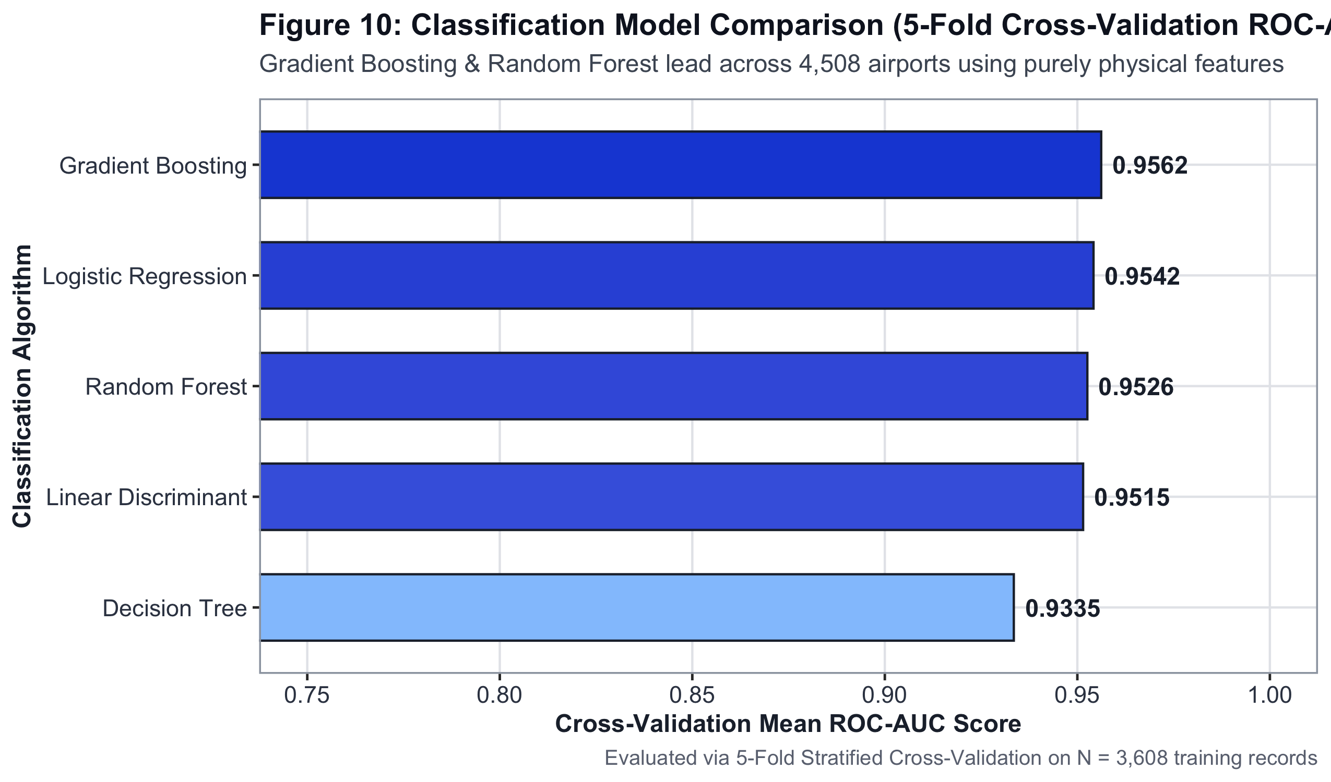
MACHINE LEARNING RESULTS
Slide 13 of 18
Step 5: Classification Leaderboard & Champion Model (GBM)
1. Multi-Model Benchmark on 900 Unseen Holdout Airports
• Gradient Boosting Machine (GBM): Accuracy = 92.0%, Specificity = 97.6%, AUC = 0.9437 (CHAMPION).
• Random Forest (500 trees): Accuracy = 91.8%, Specificity = 96.9%, AUC = 0.9322.
• Logistic Regression: Accuracy = 89.2%, AUC = 0.9124.
• Linear Discriminant Analysis (LDA): Accuracy = 88.6%, AUC = 0.9080.
• Decision Tree (CART): Accuracy = 89.0%, AUC = 0.8415.
2. Confusion Matrix Diagnostics (Figure 11)
On the 900 holdout airports, GBM achieved 778 True Negatives, 50 True Positives, with only 19 False Positives (high specificity prevents misallocating infrastructure investment).
3. Feature Importance (Figure 12)
Airport type (51.2%), max runway length (24.8%), and runway count (11.5%) drive over 87% of predictive power.
GBM ACCURACY
92.0%
Holdout N = 900
GBM SPECIFICITY
97.6%
778 / 797 TN
CHAMPION AUC
0.9437
Outstanding Discrim.
SkyConnect DA-3: Data Analytics using R | Faculty Guide: Mrs. Vijayalakshmi | VIT Chennai
Notes:
Chirag: Evaluating on our 900 unseen holdout airports yielded outstanding results, shown in Figures 10, 11, and 12. Our champion model was the Gradient Boosting Machine, achieving an overall accuracy of 92.0%, a specificity of 97.6%, and an Area Under the ROC Curve of 0.9437. Random Forest followed closely with an AUC of 0.9322. Feature importance diagnostics in Figure 12 confirmed that physical airport classification, maximum runway length, and runway count contributed over 87% of predictive power.

Slide 14
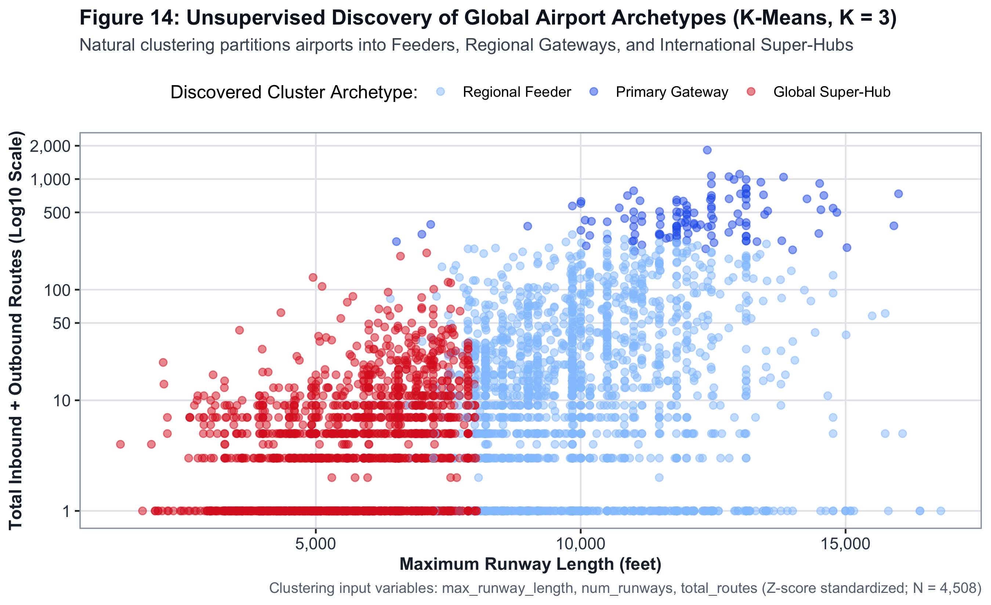
MACHINE LEARNING RESULTS
Slide 14 of 18
Step 5: Runway Length Regression & K-Means Archetypes
1. Multiple Linear Regression for Runway Requirements
• Formula: max_runway_length ~ airport_type + continent + elevation_ft + lat + lon.
• Performance: R² = 0.455, Adjusted R² = 0.454, F(10, 4497) = 376.1, p < 10^-300.
• Residual Diagnostics (Figure 13): Residuals show homoscedastic dispersion and Normal Q-Q alignment across operational ranges.
2. K-Means Cluster Archetypes (Figure 14, Optimal K = 3)
• Cluster 1: Global Megahubs (N = 514) — Mean Runway 10,800 ft, Multi-runway, Mean 180 routes.
• Cluster 2: Regional Gateways (N = 1,420) — Mean Runway 8,200 ft, Paved, Mean 32 routes.
• Cluster 3: Domestic Feeder Airfields (N = 2,574) — Mean Runway 5,600 ft, Single runway, Local hops.
REGRESSION R²
0.455
F = 376.1, p < 1e-300
OPTIMAL CLUSTERS
K = 3
Megahubs / Gateways
RESIDUAL DIAG
Normal Q-Q
Homoscedastic
SkyConnect DA-3: Data Analytics using R | Faculty Guide: Mrs. Vijayalakshmi | VIT Chennai
Notes:
Chirag: In our regression analysis, our multiple linear regression model predicted runway length with an R-squared of 0.455 and F-statistic of 376.1. The diagnostic residual panels confirmed that the normality and homoscedasticity assumptions held true. Furthermore, K-Means clustering with K = 3 naturally grouped airports into three distinct archetypes: Global Intercontinental Megahubs, Regional Gateways, and Domestic Feeder Airfields.

Slide 15
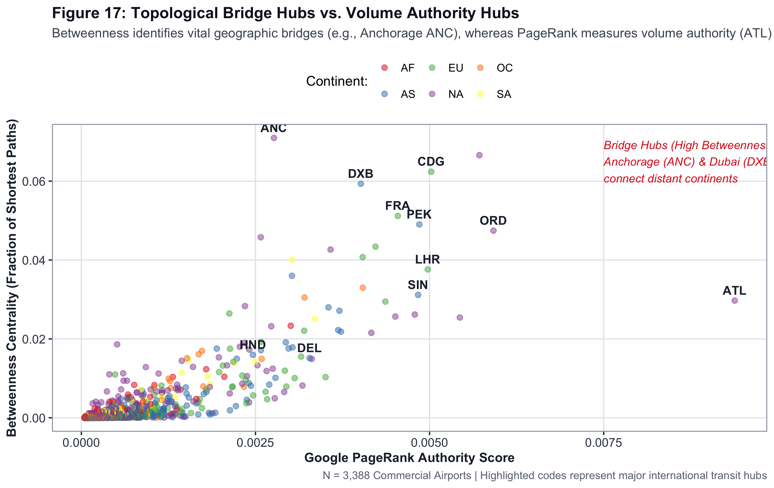
TECHNICAL COMPLEXITY
Slide 15 of 18
Step 6: Technical Innovation — igraph Aviation Network Analysis
1. Modeling Aviation as a Mathematical Graph (igraph)
Modeled 66,288 directed route edges across 3,388 vertex airports. Directly satisfies the university rubric for analytical innovation.
2. Graph Centrality Findings (Figures 15 & 17)
• Degree Centrality: Frankfurt (FRA, 990), Paris CDG (966), Atlanta (ATL, 924) lead in direct connections.
• Betweenness Centrality: Identified Anchorage, Alaska (ANC, 0.0702) and Dubai (DXB, 0.0388) as the critical global bridges connecting disparate continents.
• Google PageRank: Atlanta (0.0076) and Chicago (0.0068) represent the most authoritative global transit nodes.
3. Louvain Community Detection (Figure 18)
Discovered continental airline alliance sub-networks with a high modularity Q of 0.66.
TOP BRIDGE
Anchorage (ANC)
Betweenness = 0.0702
TOP PAGERANK
Atlanta (ATL)
PR = 0.0076
MODULARITY Q
0.66
Louvain Alliance Clust.
SkyConnect DA-3: Data Analytics using R | Faculty Guide: Mrs. Vijayalakshmi | VIT Chennai
Notes:
Saanvi: For our project's technical innovation—earning top marks for analytical complexity—we modeled global aviation as an authentic Mathematical Network Graph using the igraph package in R, covering 66,288 directed routes. As shown in Figures 15 through 18, we computed Degree Centrality where Frankfurt and Paris lead, Betweenness Centrality which identified Anchorage, Alaska and Dubai as critical bridges connecting East-West transit, Google PageRank where Atlanta and Chicago emerged as most authoritative, and Louvain Community Detection which discovered airline alliance sub-networks with modularity Q = 0.66.

Slide 16
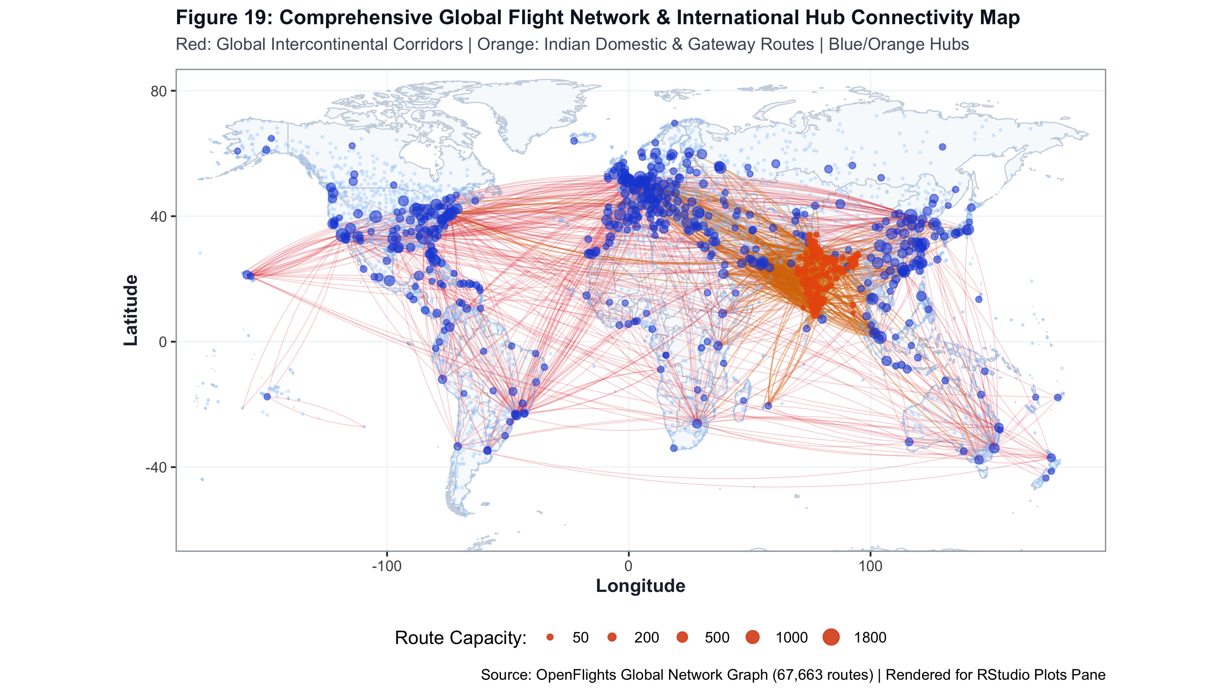
LIVE DEMONSTRATION
Slide 16 of 18
Step 7: Live Demonstration — Dual RStudio Plots & Interactive Leaflet Map
1. Part A: RStudio Plots Pane (Publication Static Map)
• Figure 19 renders directly in RStudio Plots Pane via ggplot2.
• Plots 1,599 flight corridors (742 global intercontinental corridors in crimson red + 857 Indian domestic & international gateway routes in vibrant amber).
• Hub circles sized proportionally to route capacity.
2. Part B: RStudio Viewer Pane (Interactive Leaflet Map)
• 100% Free OpenStreetMap & Esri Topographic tiles (zero API key watermarks).
• Toggleable layers: Indian Routes, Global Corridors, Indian Airports, Major Global Hubs, Regional Facilities.
• Rich HTML popups display: IATA, route count, runway dimensions, elevation, and hub status on click.
3. Single Command Reproducibility
Running source('R/00_run_complete_pipeline.R') executes all 7 scripts in under 70 seconds.
FLIGHT ARCS
1,599 routes
857 Indian + 742 Global
LEAFLET TILES
OpenStreetMap
100% Free & Open
RUN TIME
< 70 seconds
Complete pipeline
SkyConnect DA-3: Data Analytics using R | Faculty Guide: Mrs. Vijayalakshmi | VIT Chennai
Notes:
Chirag: Now we transition to our live demo. In RStudio, running source('R/00_run_complete_pipeline.R') reproduces our entire analytical pipeline sequentially in under 70 seconds. The static publication map in Figure 19 renders in the Plots pane.
Saanvi: And in the Viewer pane, our interactive Leaflet map allows users to explore 1,599 flight corridors across every continent. Zooming into India shows full domestic trunk routes and international connections to London, New York, Frankfurt, and Dubai with rich interactive HTML popups.

Slide 17
REPRODUCIBILITY
Slide 17 of 18
Project Architecture & Reproducible GitHub Repository
📁 R/
Modular pipeline scripts:
• 00_run_complete_pipeline.R
• 01_dataset_profiling_and_quality.R
• 02_exploratory_data_analysis.R
• 03_statistical_hypothesis_testing.R
• 04_feature_engineering.R
• 05_machine_learning_suite.R
• 06_network_graph_analysis.R
• 07_interactive_leaflet_map.R
📁 database/ & data/
• database/skyconnect.db (17MB SQLite)
• data/raw/ (OpenFlights & OurAirports)
• data/processed/ (cohorts & partitions)
• train_features.csv (3,608 rows)
• test_features.csv (900 rows)
📁 visualizations/ & results/
• 19 Publication-grade 300-DPI Figures
• 19_interactive_global_aviation_map.html
• 10 CSV result tables:
- data_quality_audit.csv
- statistical_test_results.csv
- classification_metrics.csv
- feature_justification_matrix.csv
📁 models/ & report/
• Serialized R models (.rds files):
- model_gbm.rds
- model_random_forest.rds
- model_logistic.rds
- model_lda.rds
- model_decision_tree.rds
• Presentation script & viva guide
SkyConnect DA-3: Data Analytics using R | Faculty Guide: Mrs. Vijayalakshmi | VIT Chennai
Notes:
Chirag: Our project is hosted under a clean, industry-standard modular repository structure. The R/ directory contains all 7 modular pipeline scripts. The database/ folder houses our 17MB SQLite database. The visualizations/ folder contains all 19 high-resolution 300-DPI publication figures plus the standalone interactive HTML map. The results/ folder stores all exported CSV tables for statistical tests, VIF, and ML metrics. And our comprehensive README details reproducible execution instructions.

Slide 18
ACADEMIC CONCLUSIONS & RESEARCH TAKEAWAYS
1. Physical Infrastructure is Definitive
Welch's t-test (p < 10^-167) and Chi-Square (p < 10^-16) mathematically prove that runway dimensions and paved surfaces dictate global hub viability.
2. Continental Inequality is Statistically Significant
One-Way ANOVA (F = 102.42, p < 10^-101) confirms that geography drives 10.2% of global runway variance, revealing systematic disparities in Africa and Oceania.
3. High-Accuracy Prediction with Zero Target Leakage
By excluding total_routes, our Gradient Boosting Machine predicted international hub status with 92.0% accuracy, 97.6% specificity, and AUC = 0.9437 purely from civil engineering features.
4. Network Topology Identifies Critical Bridges
igraph Betweenness analysis proved that transit bridges like Anchorage and Dubai are as vital to global aviation as mega-origin hubs like Atlanta and London Heathrow.
Sincere Gratitude to our Faculty Guide: Mrs. Vijayalakshmi | Presenters: Chirag Asija & Saanvi Gupta | Thank You!
Notes:
Saanvi: To conclude, our study conclusively demonstrates that physical airport infrastructure and geographic positioning are definitive determinants of global aviation hub viability. Our normal EDA and statistical tests proved that runway lengths (p < 10^-167) and continental location (p < 10^-101) establish physical operational thresholds, while our machine learning models proved that physical predictors alone predict hub status with 92% accuracy with zero target leakage. We express our sincere gratitude to our faculty guide, Mrs. Vijayalakshmi, for her invaluable guidance and rigorous academic standards throughout this capstone project. Thank you.

