Slide 1

Book-Shop Automation Software
Group 11
Chirag Gajana – 20JE0296
Chirag Gupta – 20JE0297
Srinivas – 20JE0299
Keshav Reddy – 20JE0300

Slide 2
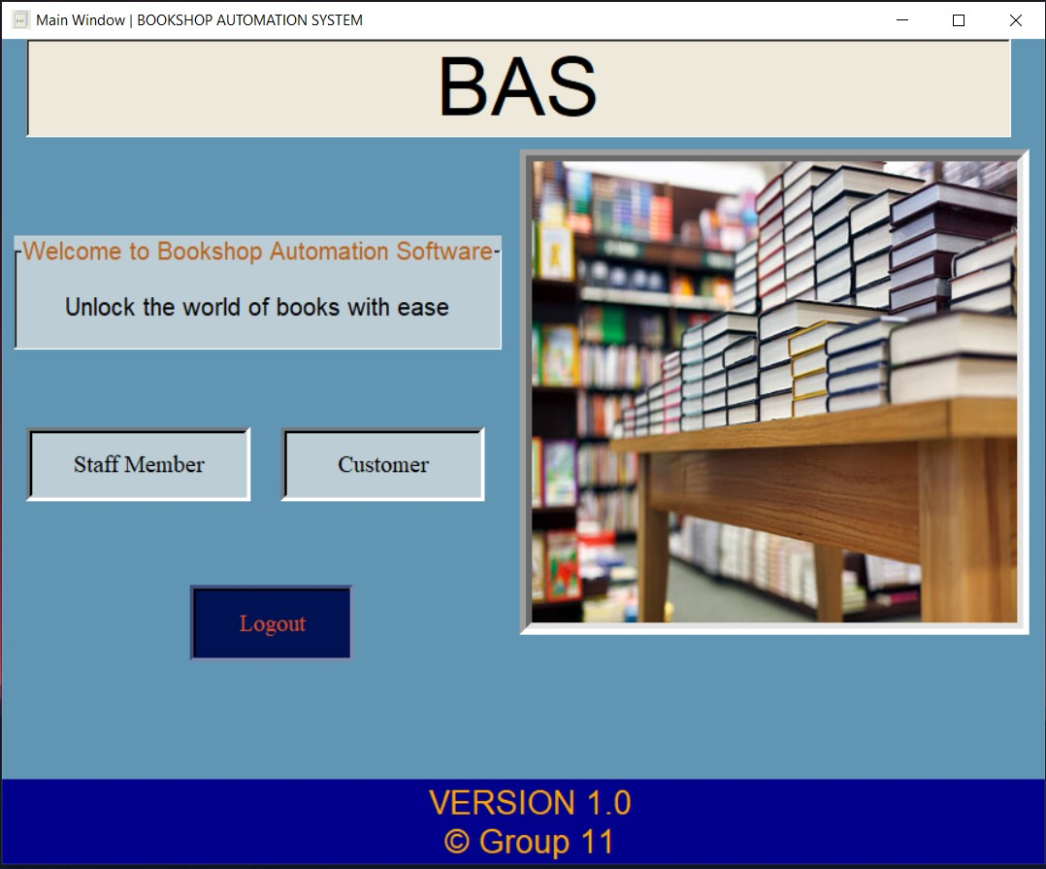
Main Window

Slide 3
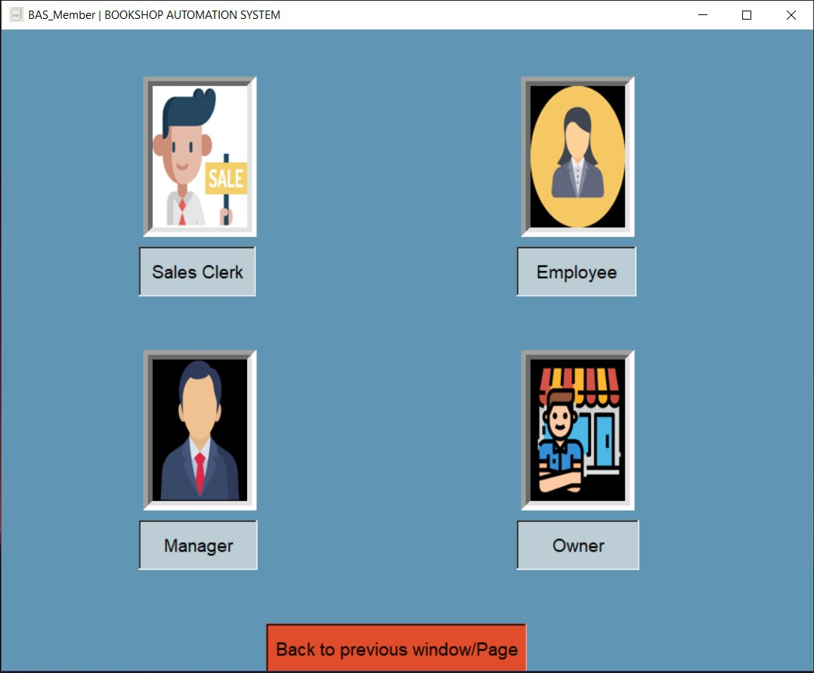
BAS Member Window

Slide 4
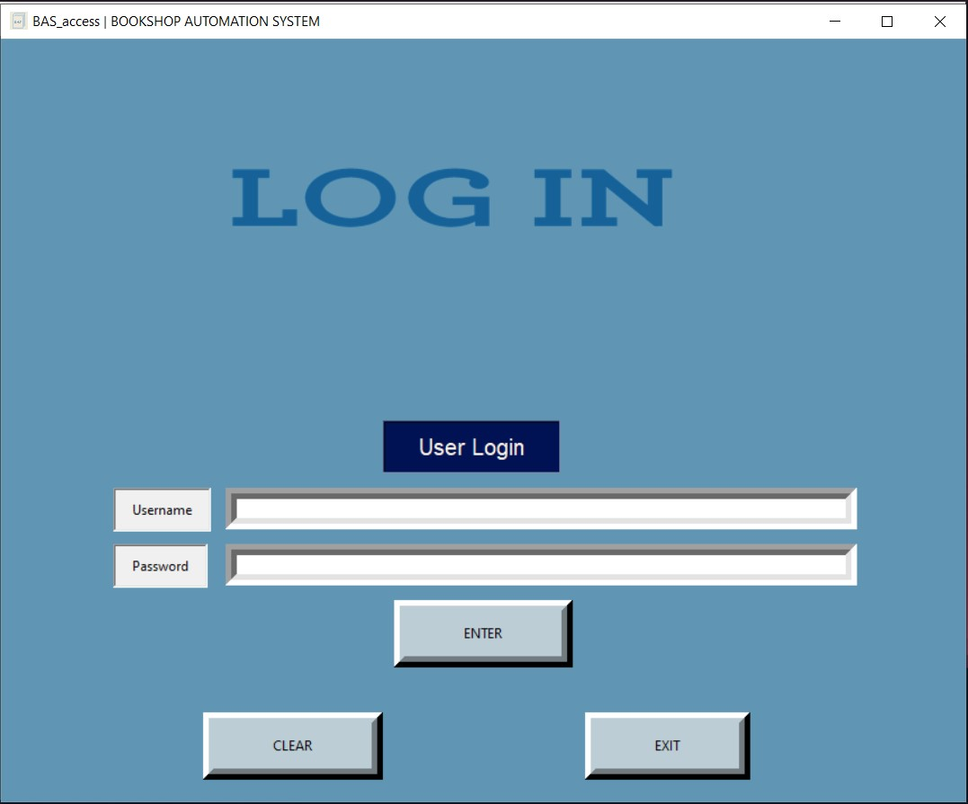
Login Window

Slide 5
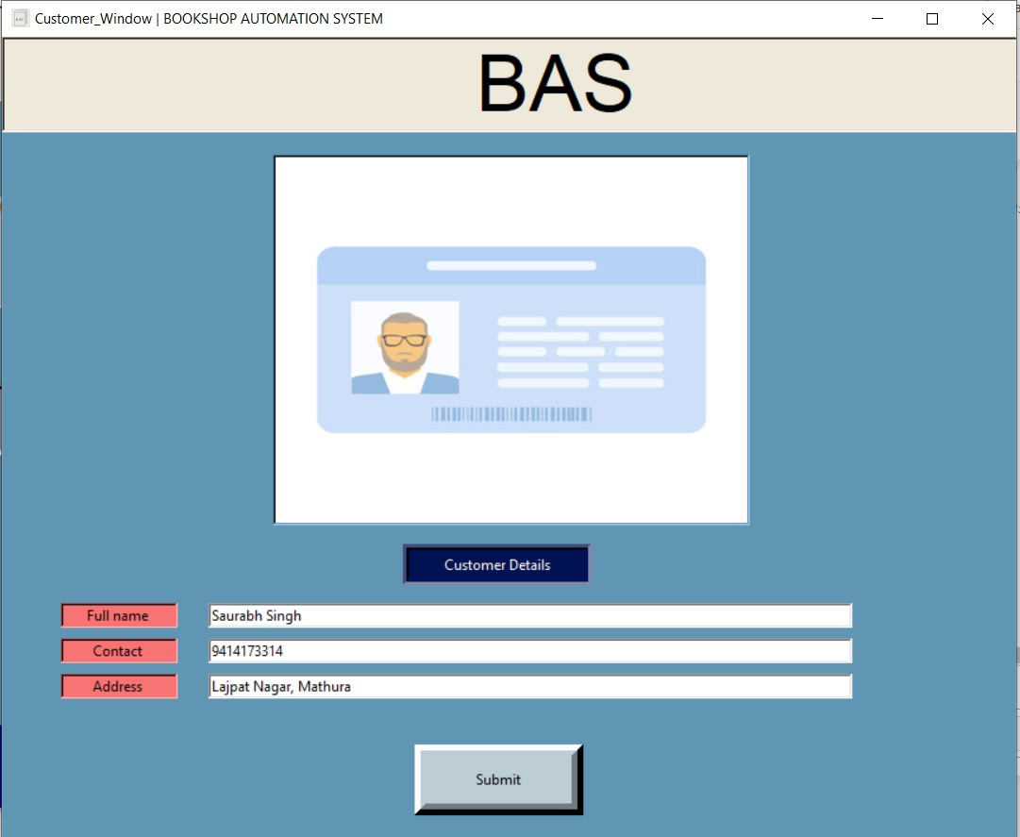
Customer Window

Slide 6
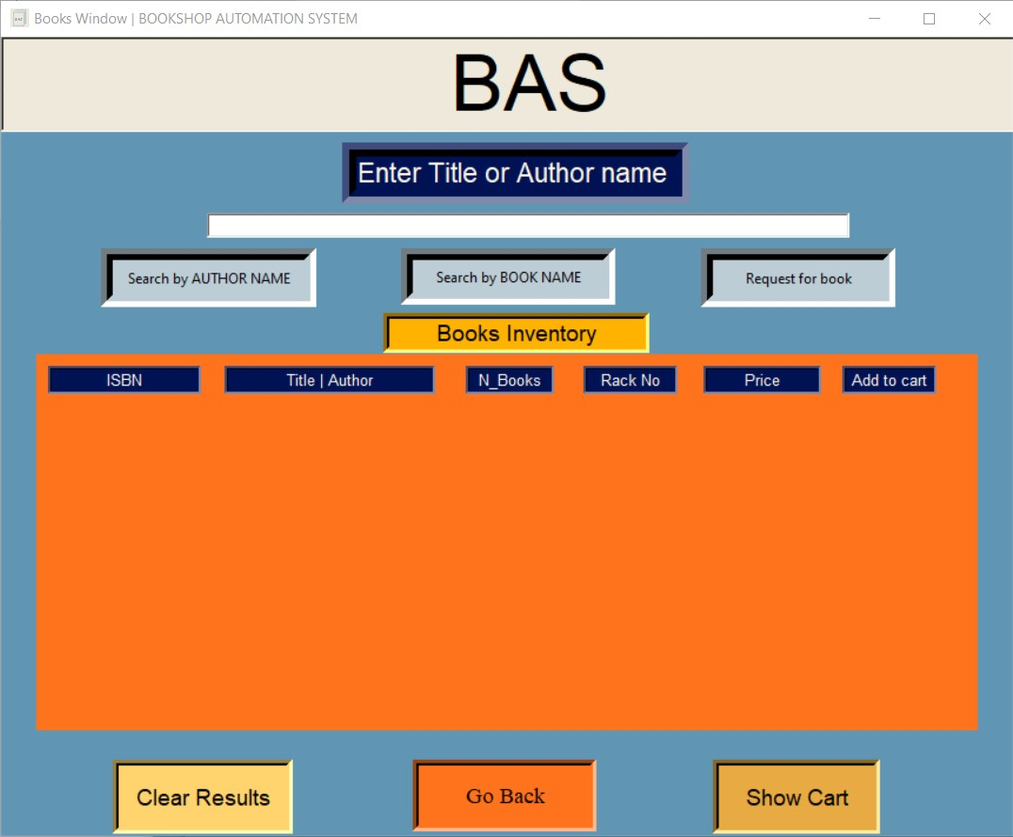
Search Window

Slide 7
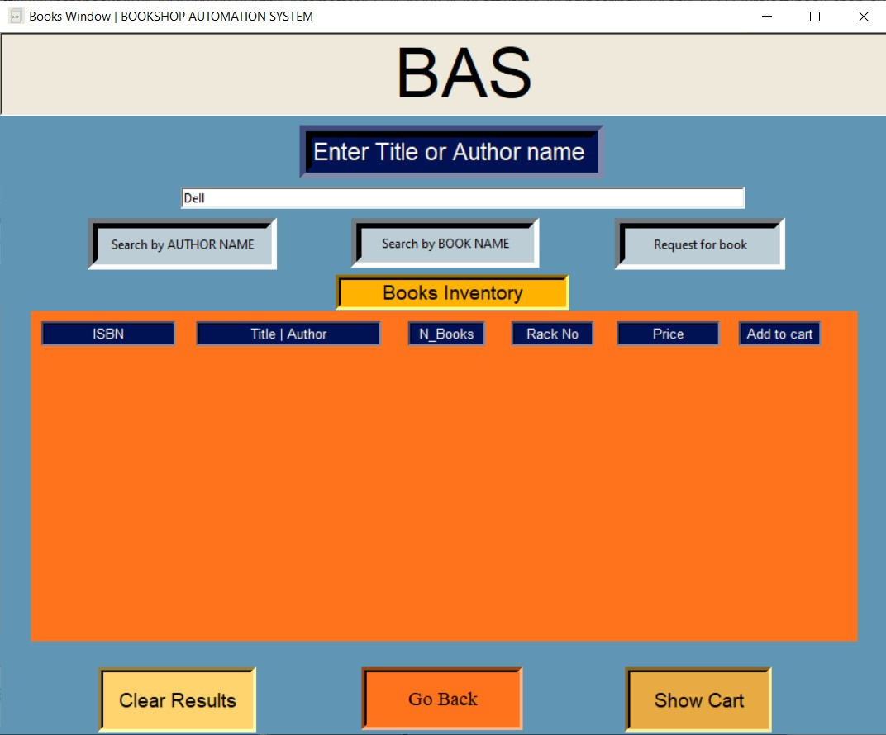
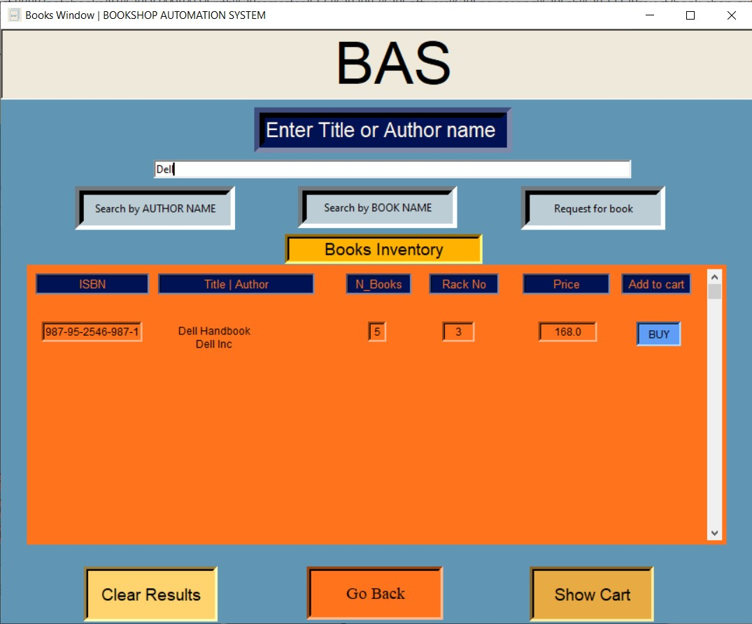
Using Book Title

Slide 8
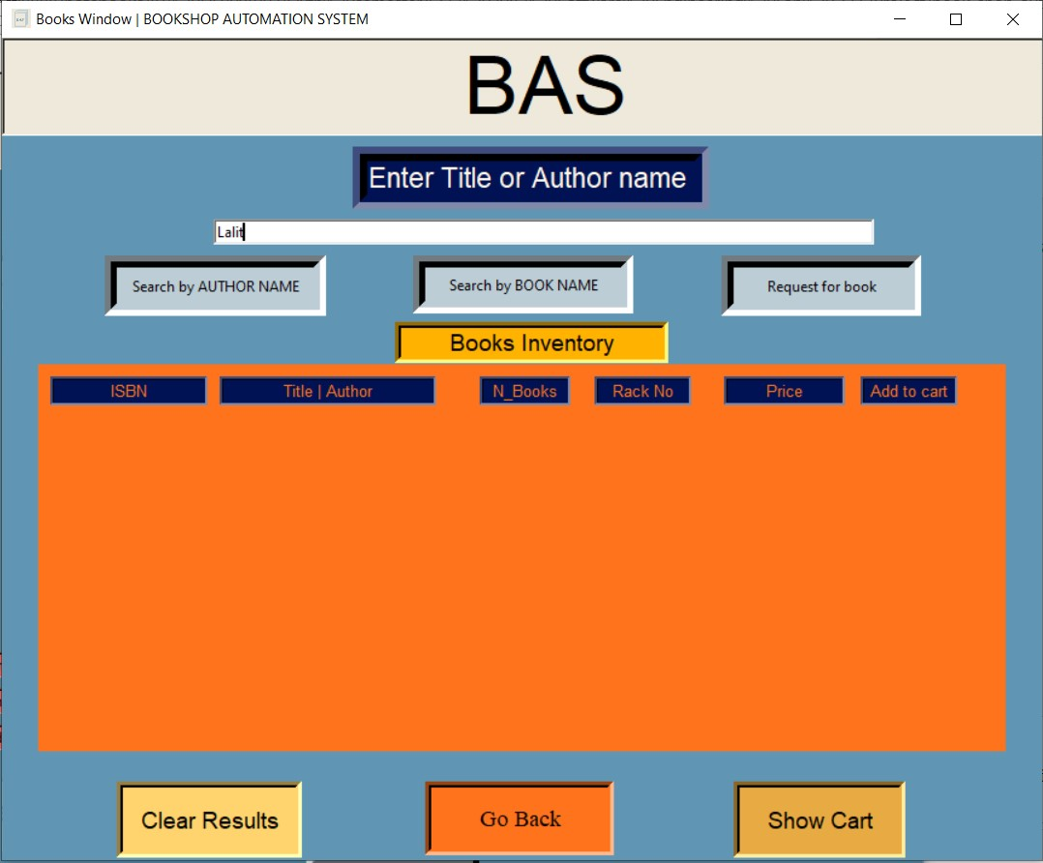

Using Author Name

Slide 9
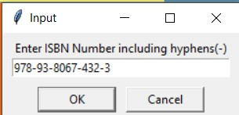
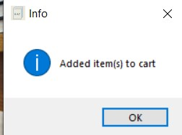
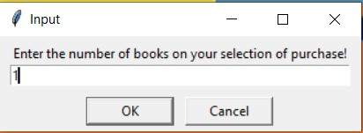
Buy Product
Step - 2
Step - 1
Step - 3

Slide 10
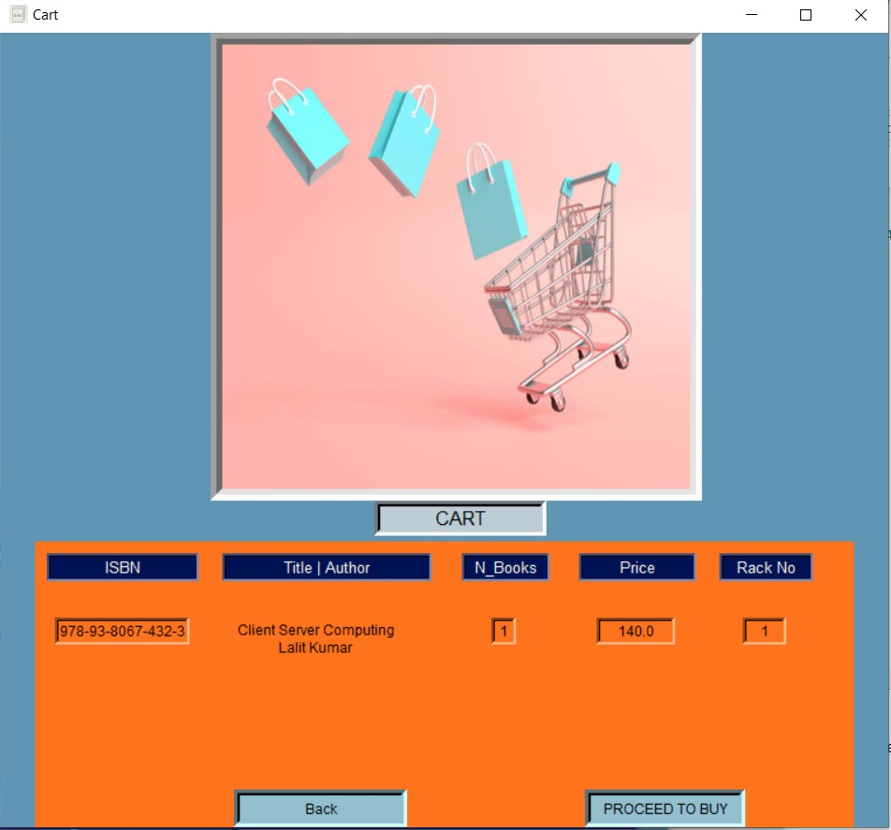
Cart Window

Slide 11
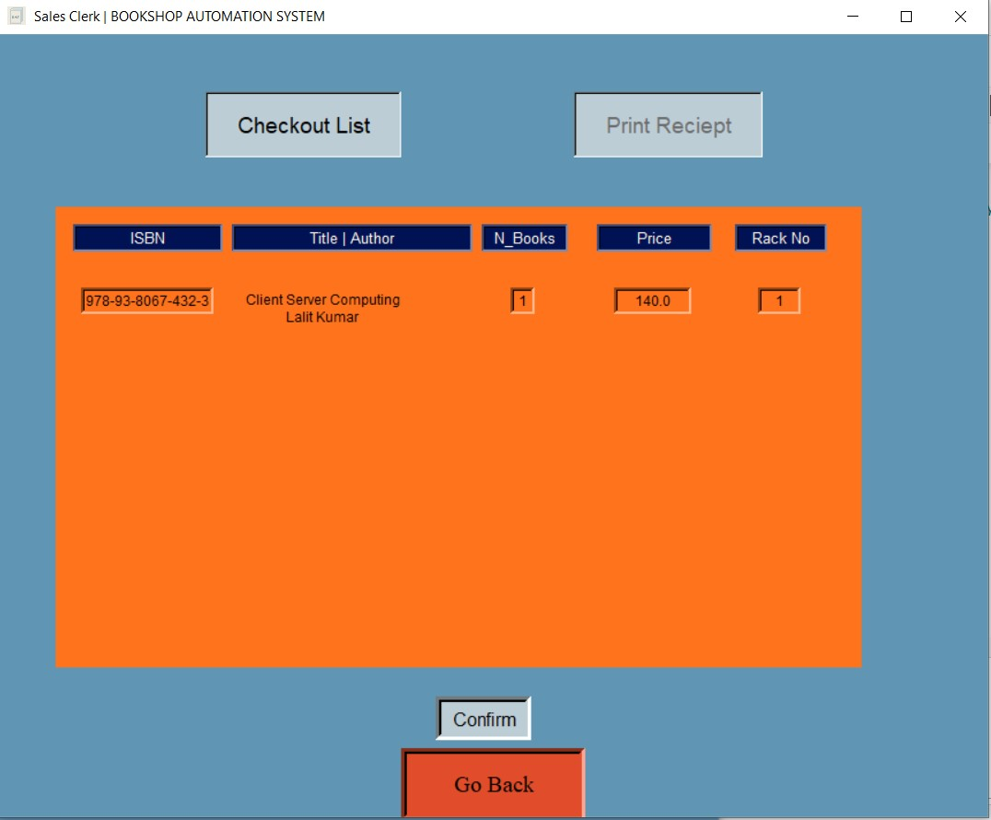
Sales Clerk and Checkout Window

Slide 12
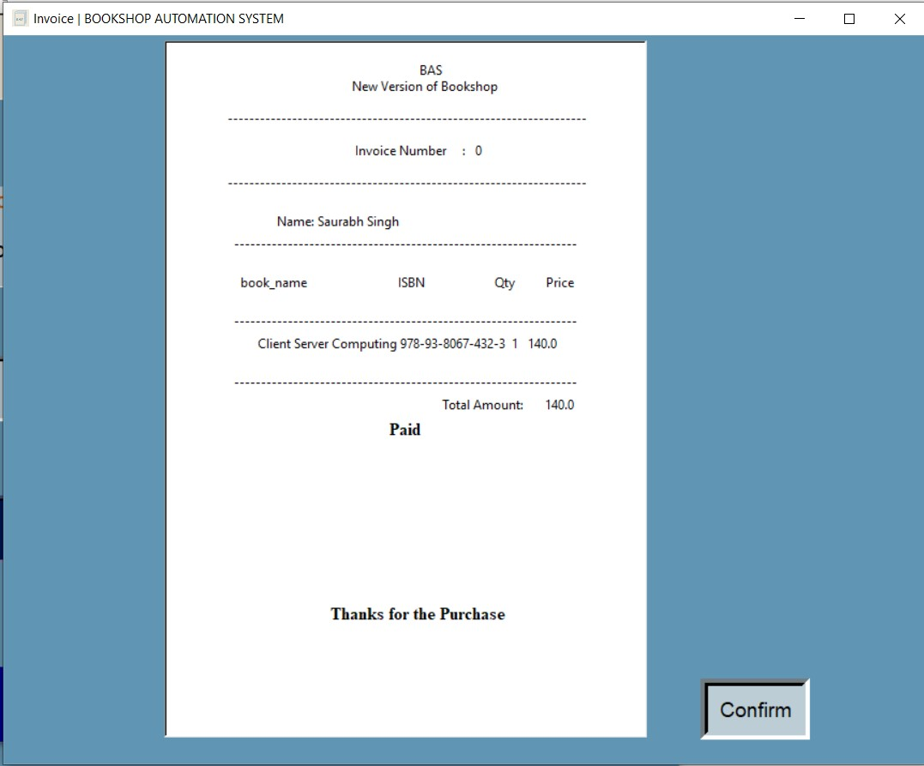
Invoice Window

Slide 13
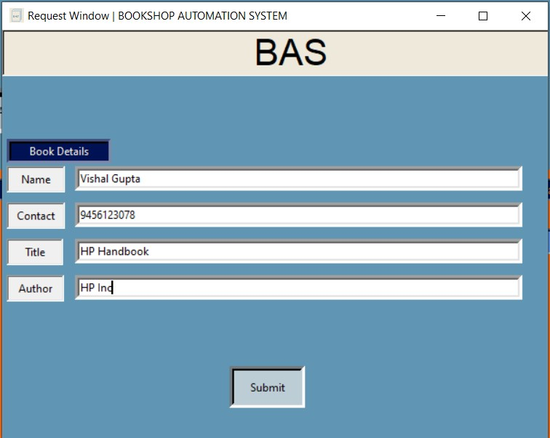
Request Window

Slide 14
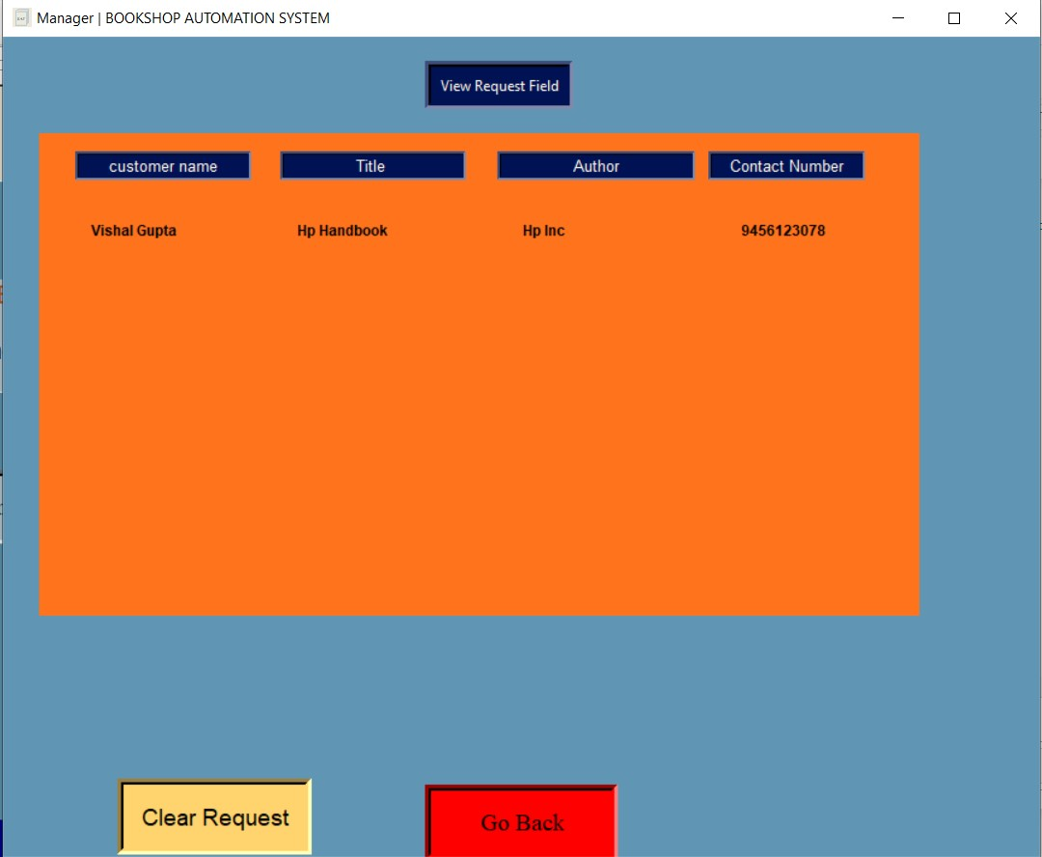
Manager Window

Slide 15
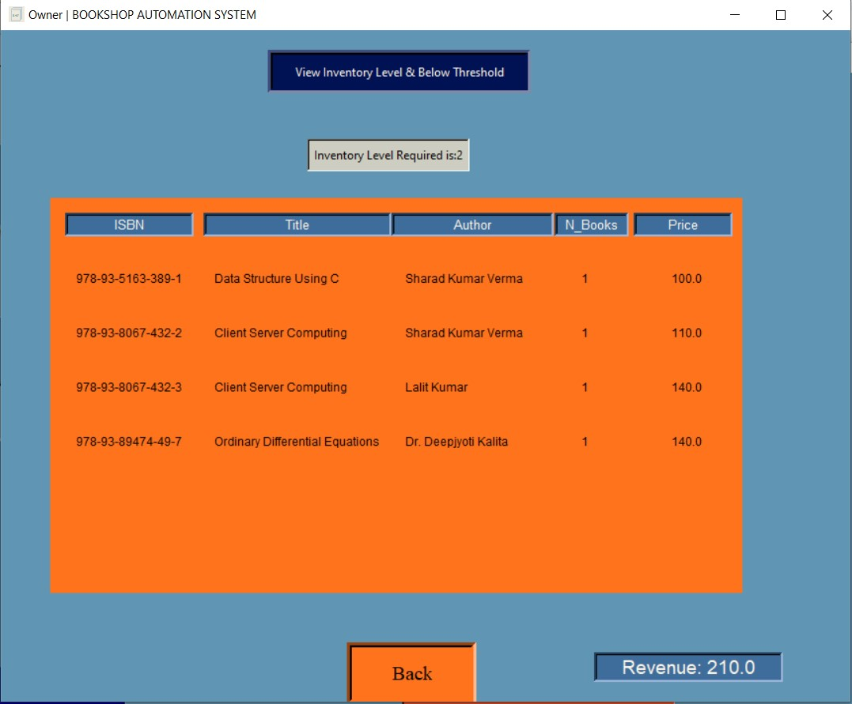
Owner Window

Slide 16
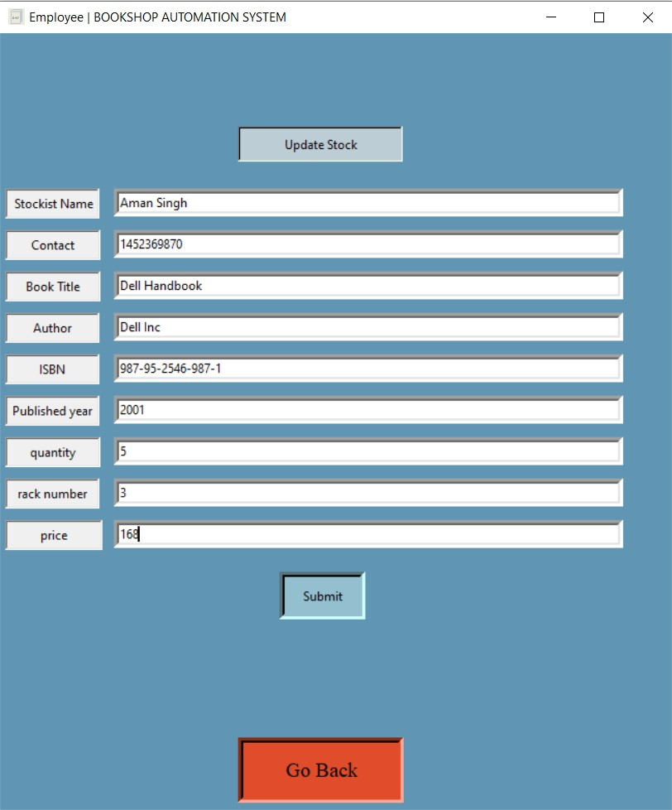
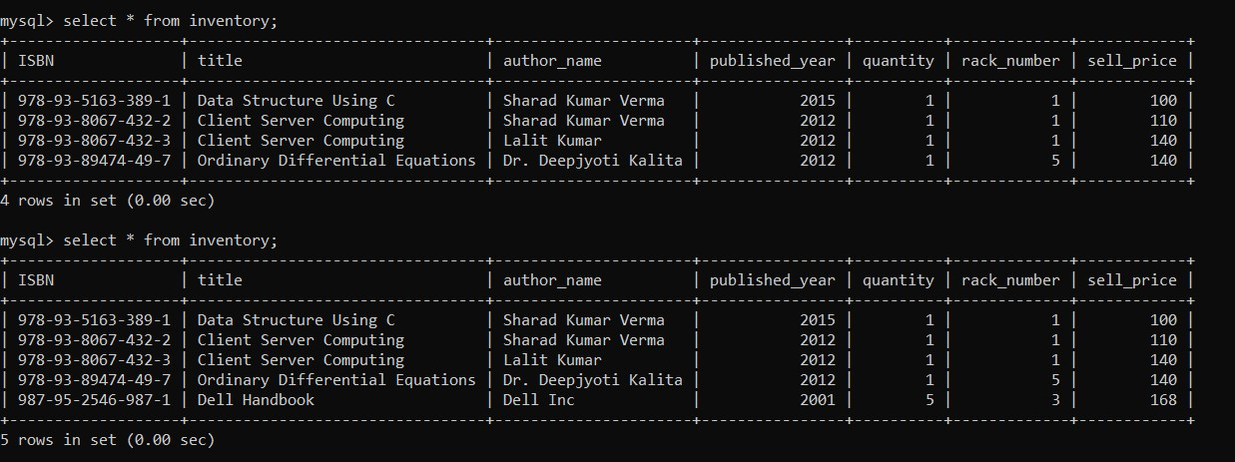
Employee Window

Slide 17
Thank You For Your Attention
Group - 11

