Slide 1



SMART INDIA HACKATHON 2026
Velocity-Enhanced Clustering for Transactional Outlier Recognition
V.E.C.T.O.R
Problem Statement ID - SIH26146
Problem Statement Title - AI-Powered Monitoring & Analysis of Bitcoin Transaction Traffic
Theme - Blockchain & Cybersecurity
PS Category- Software
Team ID - 122958
Team Name - PROMETHEUSS

Slide 2






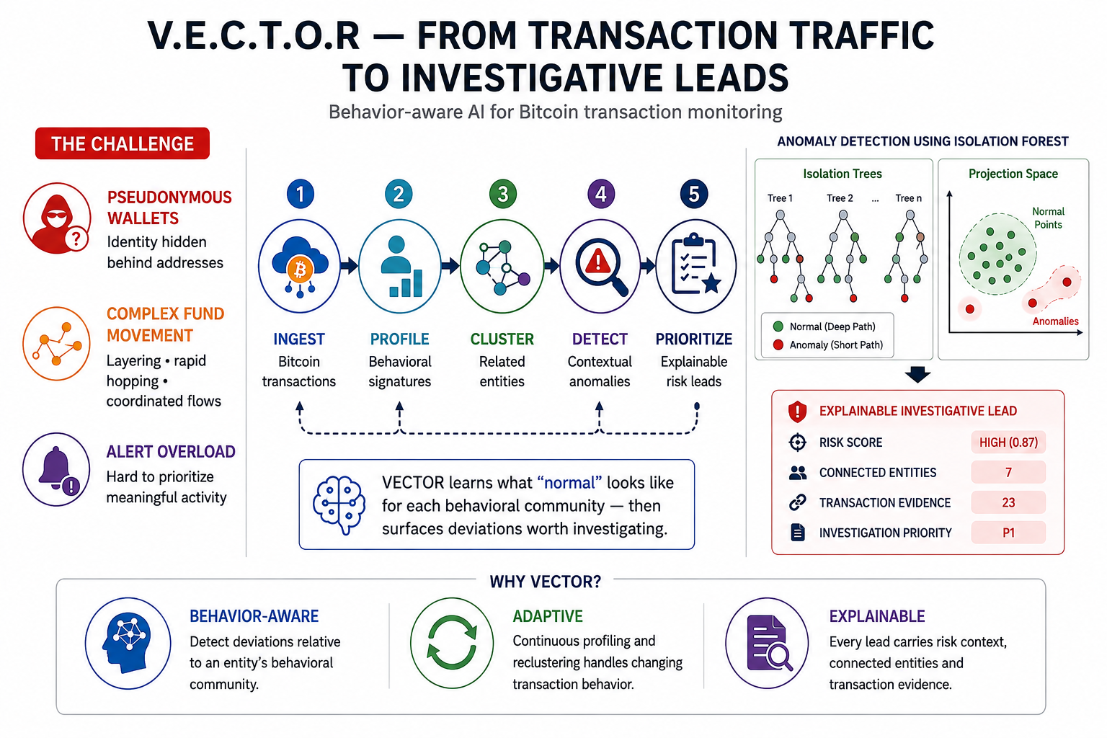






FROM TRANSACTION TRAFFIC TO INVESTIGATIVE LEADS
ANOMALY DETECTION
USING ISOLATION FOREST
INGEST
PROFILE
CLUSTER
DETECT
PRIORITIZE
Bitcoin transactions
Behavioral signatures
Related entities
Contextual anomalies
Explainable risk leads
VECTOR learns what "normal" looks like for each behavioral community - then surfaces deviations worth investigating.
● Anomaly — isolates in fewer splits
● Normal — requires deeper paths
THE CHALLENGE
Pseudonymous Wallets
Complex Fund Movement
Alert Overload
Identity hidden behind addresses
Layering, rapid hopping, coordinated flows
Hard to prioritize meaningful activity
EXPLAINABLE INVESTIGATIVE LEAD
Risk Score
HIGH (0.87)
Behavior-Aware
Adaptive
Explainable
Detects deviations relative to an entity’s behavioral community.
Every lead carries risk context, connected entities and evidence.
Connected Entities
7
Continuous profiling and reclustering handles changing behavior.
Transaction Evidence
23
Investigation Priority
P1

Slide 3
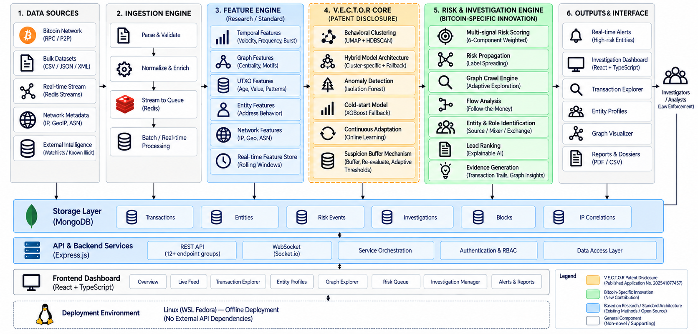




TECHNICAL APPROACH
Source Code
Full Report
Explainer

Slide 4
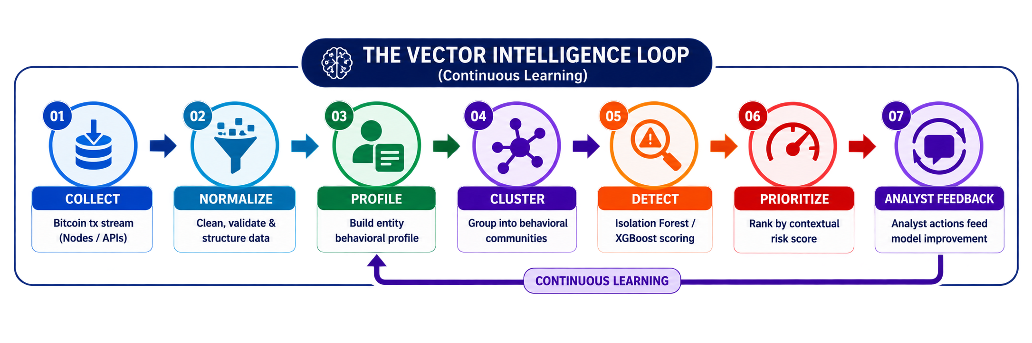
FEASIBILITY AND VIABILITY
1
EXISTING VECTOR CORE
2
BITCOIN ADAPTATION
3
NTRO DEPLOYMENT
CHALLENGES & MITIGATION
Continuous monitoring
ingest, analyze & learn 24/7
Challenge | Mitigation
Sparse / new entities | XGBoost cold-start model
Evolving behavior | Dynamic reclustering
False positives | Contextual cluster-specific detection
Analyst overload | Risk-based prioritization
Model opacity | Evidence-backed lead generation
Real-time streaming
Redis Streams pipeline
UTXO & transaction features
value, time, I/O, fees
ML scoring engine
behavioral feature scoring
Address / entity profiling
behavioral profile per entity
Prioritized anomalies
contextual risk scoring
Dynamic clustering
UMAP + HDBSCAN
Behavioral communities
clusters addresses by behavior
Evidence-backed leads
transactions, entities, patterns
Isolation Forest
cluster-specific detection
Transaction-flow patterns
inflow/outflow, hops, chains
Analyst investigation
deep dive with full context
XGBoost fallback
cold-start / sparse entities
Temporal modeling
velocity, frequency, periodicity
Live dashboard
real-time analytics & alerts
Entity clustering & updating
reclusters as behavior evolves
Actionable intelligence
supports strategic decisions

Slide 5
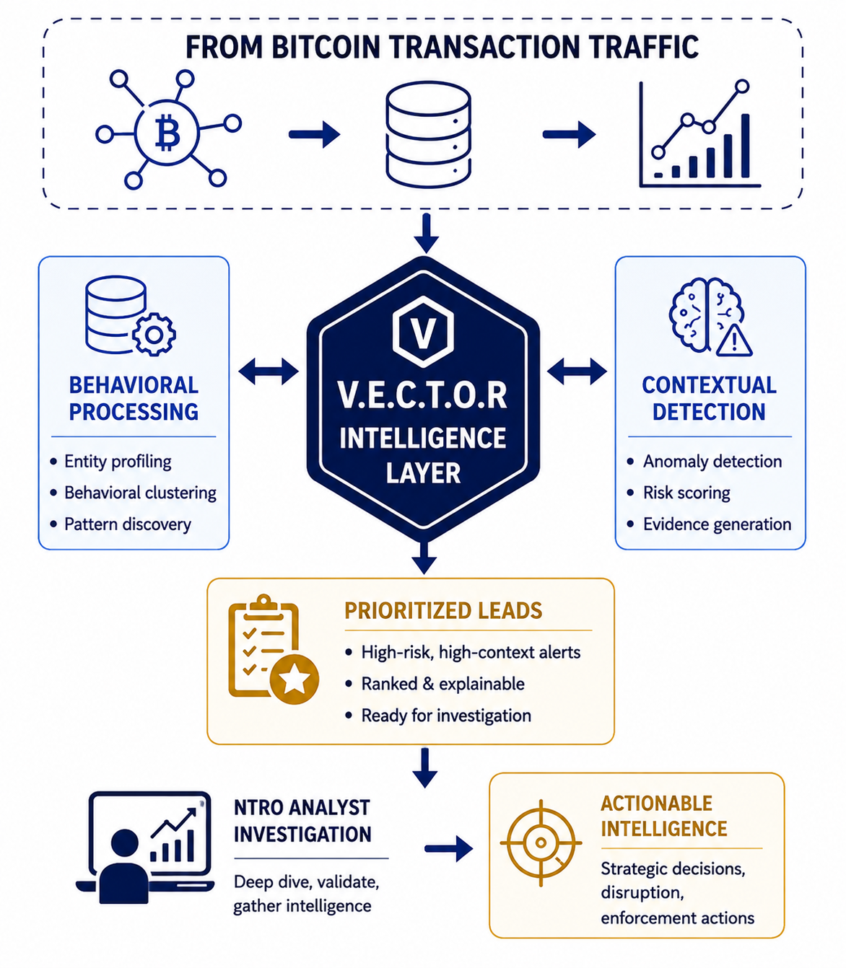
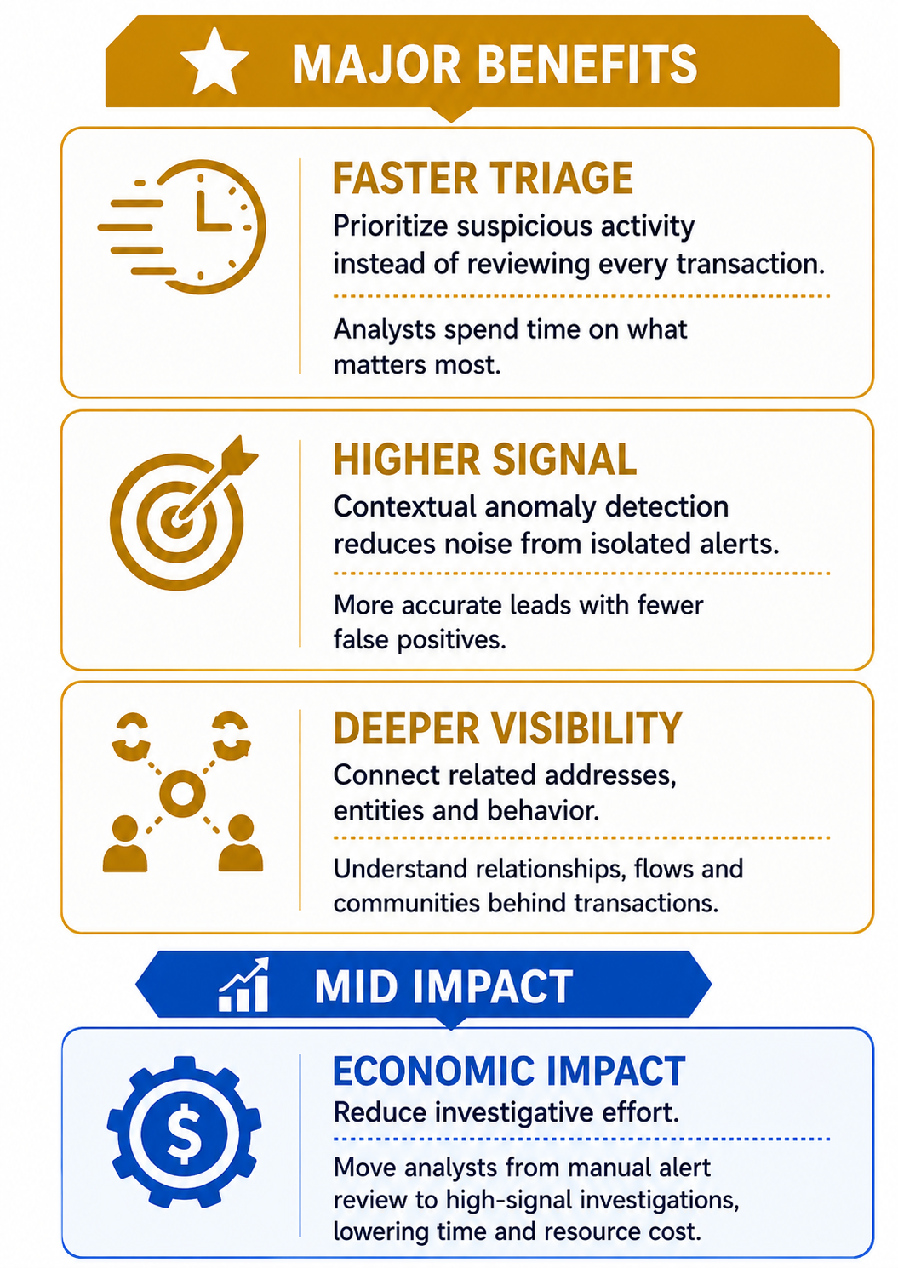
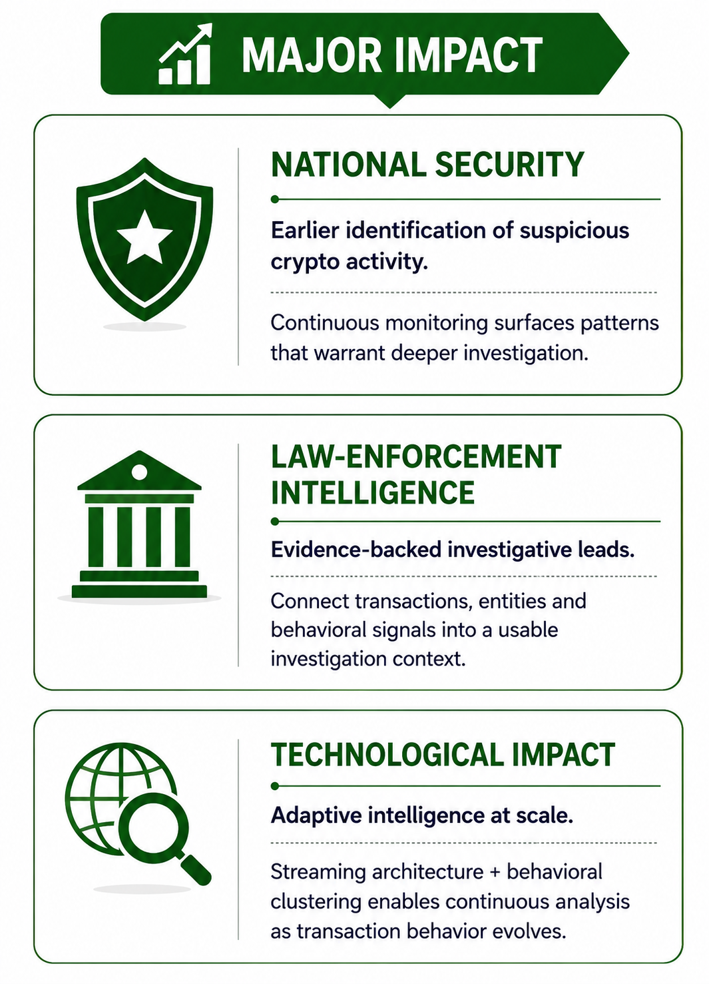
IMPACT AND BENEFITS

Slide 6
RESEARCH AND REFERENCES
1
Anomaly Detection in Bitcoin Network Using Unsupervised Learning Methods - Pham & Lee (2016)
6
Clustering Algorithms for User & Entity Behavior Analytics — Artioli, Maci & Magrì (2024)
Applied k-means, Mahalanobis distance and one-class SVM to Bitcoin transaction graphs, surfacing known theft/loss cases without labeled data - validates unsupervised clustering as a base for VECTOR.
Benchmarked fifteen clustering algorithms for behavior analytics; HDBSCAN performed strongly on density-based behavioral grouping — validates VECTOR’s clustering choice.
2
Anti-Money Laundering in Bitcoin: Graph Convolutional Networks - Weber et al. (2019)
7
Assessing Heuristic-Based Address Clustering for Bitcoin — Schnoering, Porthaux & Vazirgiannis (2024)
Introduced the benchmark labeled Elliptic transaction graph and compared GCNs with random forests for illicit-transaction classification - informs VECTOR’s feature design and evaluation.
Evaluated heuristics for grouping Bitcoin addresses into real-world entities and introduced a clustering-ratio metric — informs VECTOR’s entity-profiling step.
3
Real-Time Credit Card Fraud Detection using Streaming Analytics - Rajeshwari & Sathish Babu (2016)
8
Isolation Forest — Liu, Ting & Zhou (2008)
Streaming analytics combined with Hidden Markov Models achieved 75–85% detection accuracy supports VECTOR’s real-time behavioral scoring pipeline.
Introduced isolation-based anomaly detection, isolating anomalies through random partitioning instead of profiling normal points — the foundation of VECTOR’s detection layer.
4
Credit Card Fraud Detection using State-of-the-Art ML & DL - Alarfaj et al. (2022)
9
XGBoost: A Scalable Tree Boosting System — Chen & Guestrin (2016)
Found false positives a key limitation of existing models; gradient boosting emerged as the strongest ML approach - guided VECTOR’s choice of XGBoost.
Proposed a sparsity-aware, highly scalable gradient boosting framework — the basis for VECTOR’s cold-start fallback model.
5
Detecting Anomalies in Blockchain Transactions using ML Classifiers & Explainability - ScienceDirect (2024)
10
Real-Time Fraud Detection in Digital Banking: Event Streaming Architecture — Mula (2025)
Ensemble classifiers combined with SHAP explainability improved both accuracy and analyst trust — directly supports VECTOR’s explainable investigative leads.
Combined Kafka, Redis and embedding-based anomaly detection for millisecond-level risk scoring — mirrors VECTOR’s real-time streaming pipeline design.

Slide 7
Implementation Status - 10 October 2026
This deck is an SIH proposal/submission artifact. Earlier capability and impact claims describe proposed work, not verification results.
Current repository scope: React/TypeScript dashboard, Express REST and Socket.IO server, MongoDB persistence, and Python Bitcoin analytics.
Seeded records are synthetic and tagged SIMULATION. No live Bitcoin Core connection or cloud deployment is verified.
Fresh Python 3.12.14 environment installed requirements.txt; pip check passed. Backend/bitcoin tests: 60 passed, 7 subtests. One upstream XGBoost serialized-model compatibility warning remains; scikit-learn artifacts are pinned to 1.7.1.
Frontend clean npm ci passed with zero reported vulnerabilities; five Node security tests passed. Lint has zero errors and three React Fast Refresh warnings. Production build passes; largest JS chunk is 304.36 kB (100.37 kB gzip) after route/tab splitting.
Local safe HTTP smoke passed six checks on an app backed by temporary in-memory MongoDB 8.2.6. A guarded integration smoke passed one synthetic transaction through Express and Python analysis, MongoDB retrieval by txid, and the matching Socket.IO event.
Not verified: durable/managed MongoDB restart recovery, Docker/Compose startup, hosting, live Bitcoin Core connectivity, representative performance, or detection quality on an independent labeled set. Current verdict: NO-GO. See AUDIT/GO_NO_GO.md and AUDIT/VALIDATION_RESULTS.md.

