Slide 1
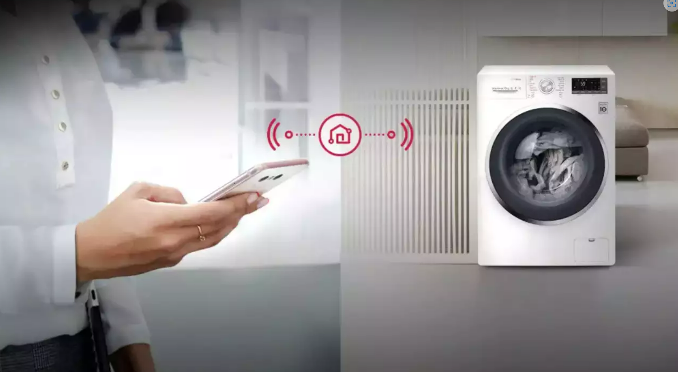
INNOVATIVE LAUNDARY SERVICE

Slide 2

Title and Content
Executive summary
problems
Solutions
Qualifications
Pricing option
Summary

Slide 3

Executive summary
It’s tricky for students to make time out of their busy college schedule and wait for their turn to wash their clothes
Here we are to present a simple IOT based solution where washing machine can be controlled by app connecting server with firebase .
User books a slot on the mobile application, using the authentication key, the user who booked the slot can only access the washing machine and wash their clothes

Slide 4

Problems
Power and water wastage
a lot of time is wasted waiting in the queue to wash the clothes
Excessive maintenance requirements due to erratic usage by students, which costs a lot to institute.
Students face difficulties due to Poor maintenance of the machines.

Slide 5

Solutions
Innovative washing service so that users can book a slot convenient to them at any time
controlling rough uses of the machine by the user
saves power and water, environment friendly
help in reducing the maintenance charge
Affordable solution to student

Slide 6
Work-flow of the system
User books a slot on the mobile application, also the type of washing required for their clothes
Cloud contacts to the IOT device when the booked slot is near
Using the authentication key, the user who booked the slot can only access the washing machine and wash their clothes, but if the user doesn't show up in time, the slot becomes available again.
5 minutes before washing, the user gets a notification regarding the same, and once washing is done, the machine becomes available for the next person who booked the slot.
This data is stored in the cloud, and it allots the user to a washing machine from the available pool of washing machines

Slide 7
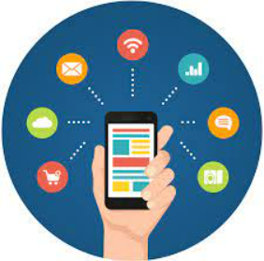
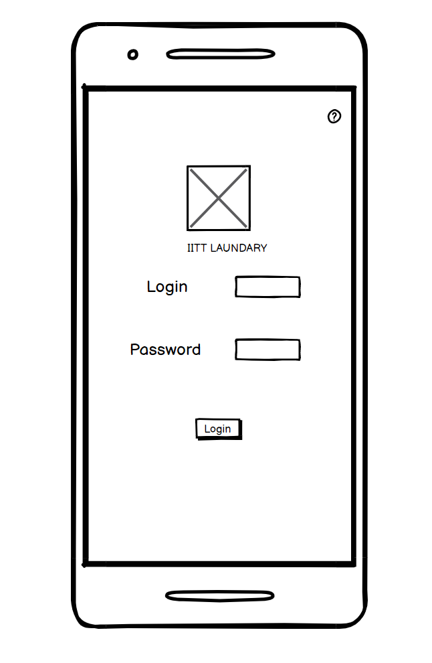
App Wireframe
A user-friendly secure app developed on DART, which will allow slot bookings

Slide 8
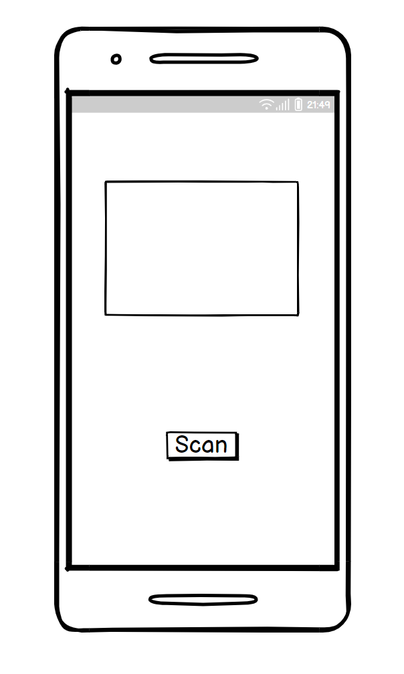
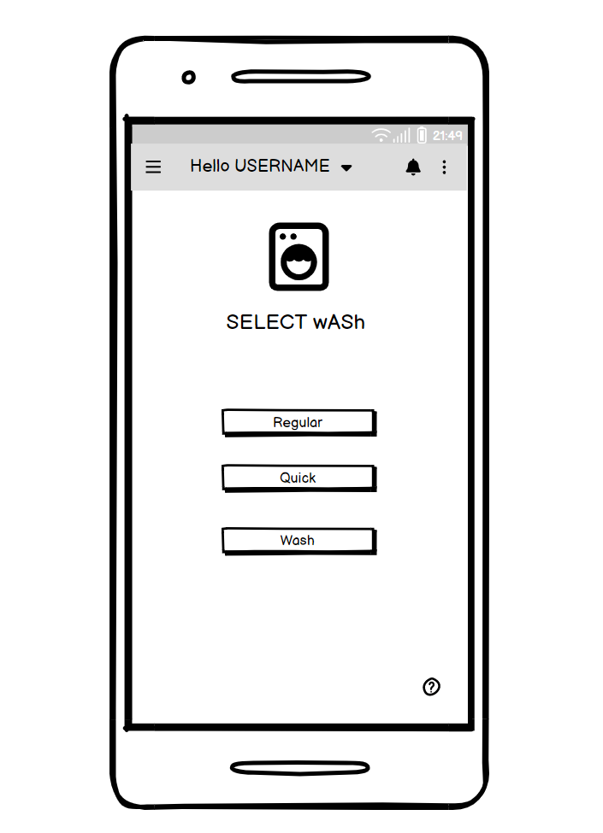

Slide 9
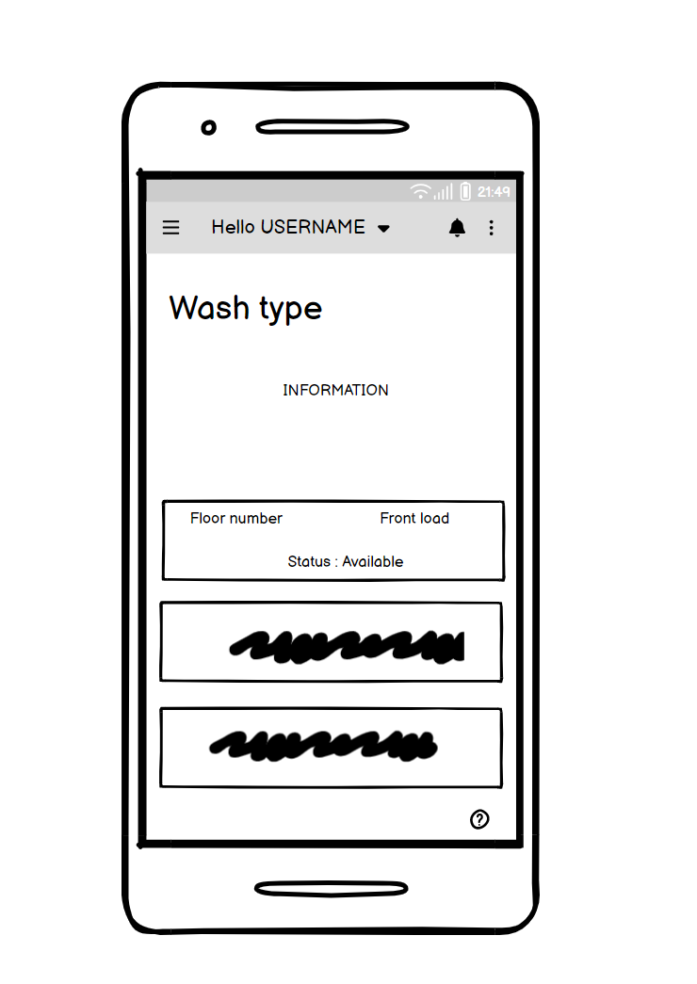
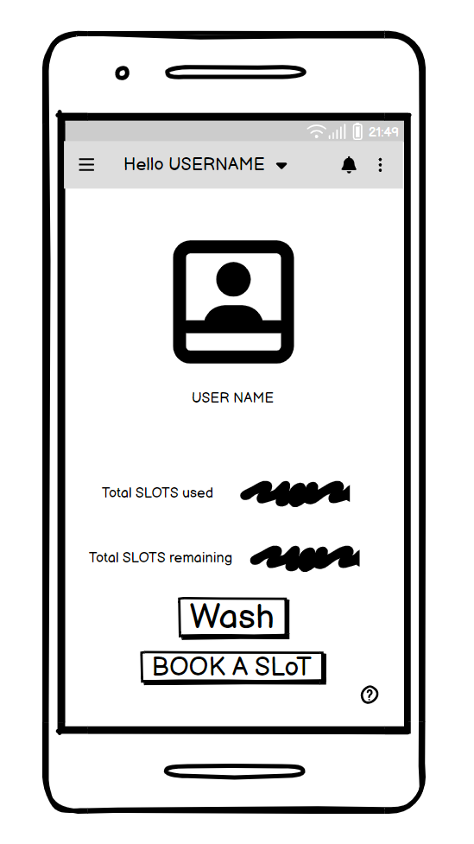

Slide 10
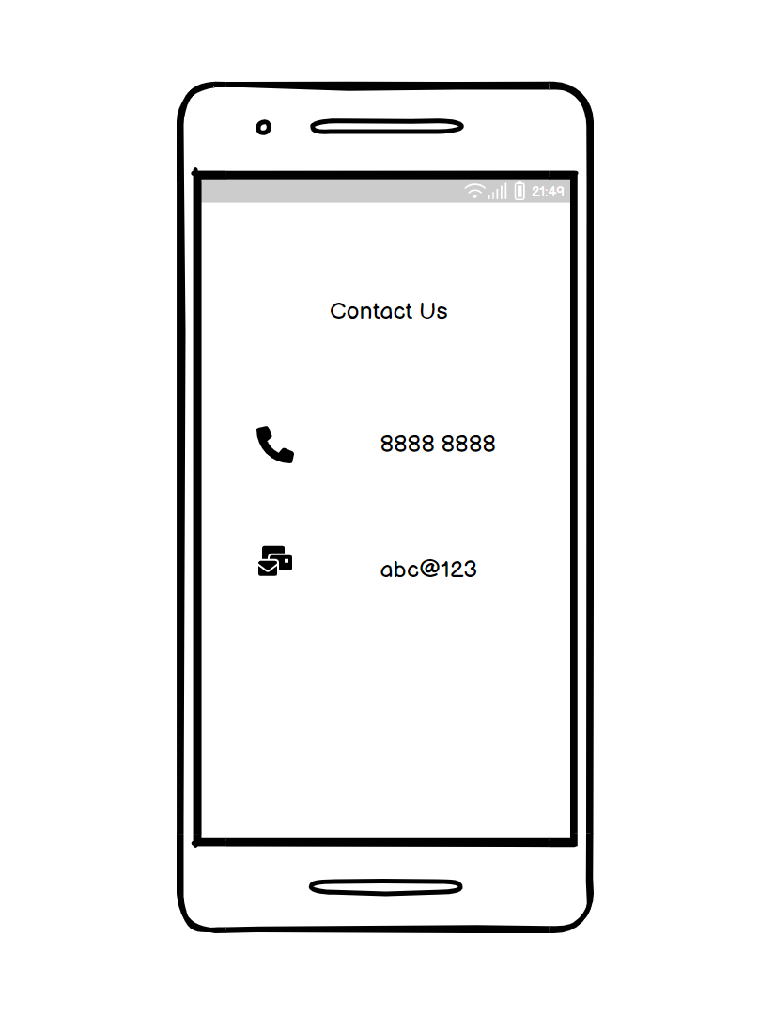
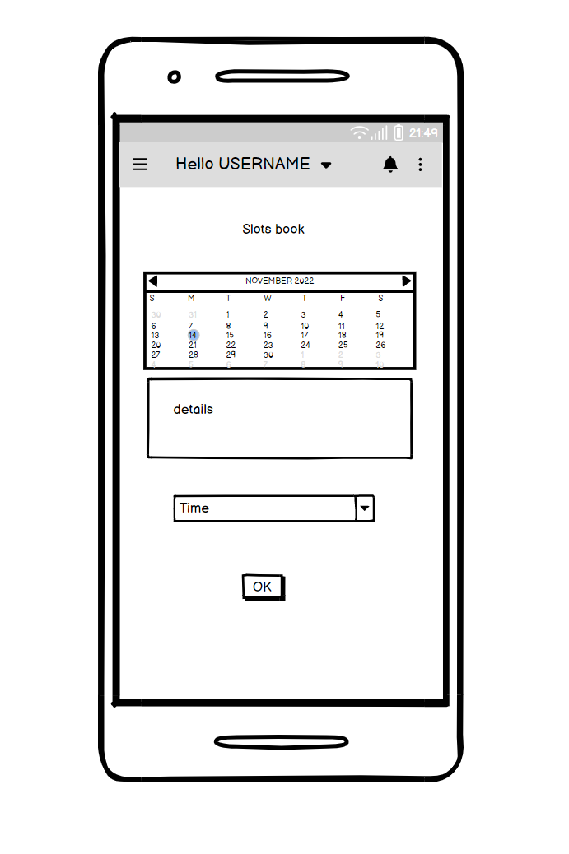

Slide 11


Salient Features of App
Anywhere - Anytime booking of slots
Linked via Firebase by google thus in-built security
can run on both Android and IOS platforms
Collects consumers reviews
Show available preferences
Developed on Dart
.

Slide 12
Schedule Timeline
Hardware IOT : 30 Dec
APP Development: 18 Jan
Test Functioning: 10 Feb
Fully functioning: 10 Mar

Slide 13
Hardware
The hardware we will use is that the microcontroller boards (like Node MCU) we plan to use are open source and cheap.
also, all the other components (relays, current sensors, vibration sensors, servos) are not expensive, so the final price of the product we will be making would be very competitive.
The hardware will also ensure that the machine will only work for the person who prebooked the slot.
It will also alert the app when the washing is over or whether the machine is empty for use.

Slide 14
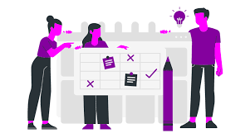
Main features:
•A device is attached as an add-on to the existing washing machine
•Resilient to unfair means
•Independent of external interference
•NOT Restricted to limited modes
•Robust and easy to maintain
•Gives control to the user at the scheduled time.
Initial Investment requirement : Rs 20,000

Slide 15
Technical Team Members
Chirag Kotian
Aman Kumar
Arpit Gupta
BTECH 2ND YEAR
ELECTRICAL ENGINEERING
BTECH 2ND YEAR
MECHANICAL ENGINEERING
BTECH 2ND YEAR
COMPUTER SCIENCE ENGINEERING
Other Team Members
Annabattula Pardhiv(cse 2nd year)
Arvind Srinivasan(cse 2nd year)

Slide 16
Thank you

