Slide 1
COEN 210 FALL 2023 ISA & Datapath: Searching an Element in an Array
Atharva Abhay Bal and Chirag Radhakrishna

Slide 2
TABLE OF CONTENTS
AIM
ASSUMPTIONS
INSTRUCTION SET ARCHITECTURE (ISA)
ASSEMBLY CODE & ASSUMPTIONS
DATAPATH
CLOCK CYCLES
CONTROL SIGNALS
PERFORMANCE ANALYSIS

Slide 3
AIM
To design an Instruction Set Architecture and a pipeline implementation of the architecture.
INPUT: an unsorted array A = [a₁, a₂, ….. a_{n}] and a value v.
OUTPUT: output = k if a_{k} = v; else output = 0.

Slide 4
ASSUMPTIONS
Word Length is exactly four bytes.
There are a total of 64 registers.
Each register is 32 bits.
2’s complement is assumed.
Time delays for individual components are fixed beforehand.
The register file is divided into 2 halves of 32 registers each.

Slide 5
INSTRUCTION SET ARCHITECTURE
(ISA)

Slide 6
REGISTERS
There are a total of 64 registers. Each register is 32 bits.
0
1
2
3
…..
61
62
63

Slide 7
R-TYPE
Format for the R-Type Instruction is as follows:
Opcode: 6 Bits.
Register Source Operand 1[RS]: 6 Bits.
Register Source Operand 2 [RT]: 6 Bits.
Register Destination [RD] : 6 Bits.
Shift Amount: 2 Bits.
Funct Field: 6 Bits.
OPCODE
RS
RT
6 6 6 6 2 6
OPCODE | RS | RT | RD | SA | FUNCT

Slide 8
R-TYPE INSTRUCTIONS
ADD R13, R12, R11
SUB R14, R13, R16
SLT R8, R19, R20
OPCODE |  |  |  |  |  | RS |  |  |  |  |  | RT |  |  |  |  |  | RD |  |  |  |  |  | SA |  | FUNCT
31 | 30 | 29 | 28 | 27 | 26 | 25 | 24 | 23 | 22 | 21 | 20 | 19 | 18 | 17 | 16 | 15 | 14 | 13 | 12 | 11 | 10 | 9 | 8 | 7 | 6 | 5 | 4 | 3 | 2 | 1 | 0
0 |  |  |  |  |  | 12 |  |  |  |  |  | 11 |  |  |  |  |  | 13 |  |  |  |  |  | 0 |  | 32
OPCODE |  |  |  |  |  | RS |  |  |  |  |  | RT |  |  |  |  |  | RD |  |  |  |  |  | SA |  | FUNCT
31 | 30 | 29 | 28 | 27 | 26 | 25 | 24 | 23 | 22 | 21 | 20 | 19 | 18 | 17 | 16 | 15 | 14 | 13 | 12 | 11 | 10 | 9 | 8 | 7 | 6 | 5 | 4 | 3 | 2 | 1 | 0
0 |  |  |  |  |  | 13 |  |  |  |  |  | 16 |  |  |  |  |  | 14 |  |  |  |  |  | 0 |  | 33
OPCODE |  |  |  |  |  | RS |  |  |  |  |  | RT |  |  |  |  |  | RD |  |  |  |  |  | SA |  | FUNCT
31 | 30 | 29 | 28 | 27 | 26 | 25 | 24 | 23 | 22 | 21 | 20 | 19 | 18 | 17 | 16 | 15 | 14 | 13 | 12 | 11 | 10 | 9 | 8 | 7 | 6 | 5 | 4 | 3 | 2 | 1 | 0
0 |  |  |  |  |  | 19 |  |  |  |  |  | 20 |  |  |  |  |  | 8 |  |  |  |  |  | 0 |  | 34

Slide 9
R-TYPE INSTRUCTIONS
AND R23, R22, R24
OR R25, R17, R18
NOR R18, R19, R15
OPCODE |  |  |  |  |  | RS |  |  |  |  |  | RT |  |  |  |  |  | RD |  |  |  |  |  | SA |  | FUNCT
31 | 30 | 29 | 28 | 27 | 26 | 25 | 24 | 23 | 22 | 21 | 20 | 19 | 18 | 17 | 16 | 15 | 14 | 13 | 12 | 11 | 10 | 9 | 8 | 7 | 6 | 5 | 4 | 3 | 2 | 1 | 0
0 |  |  |  |  |  | 22 |  |  |  |  |  | 24 |  |  |  |  |  | 23 |  |  |  |  |  | 0 |  | 35
OPCODE |  |  |  |  |  | RS |  |  |  |  |  | RT |  |  |  |  |  | RD |  |  |  |  |  | SA |  | FUNCT
31 | 30 | 29 | 28 | 27 | 26 | 25 | 24 | 23 | 22 | 21 | 20 | 19 | 18 | 17 | 16 | 15 | 14 | 13 | 12 | 11 | 10 | 9 | 8 | 7 | 6 | 5 | 4 | 3 | 2 | 1 | 0
0 |  |  |  |  |  | 17 |  |  |  |  |  | 18 |  |  |  |  |  | 25 |  |  |  |  |  | 0 |  | 36
OPCODE |  |  |  |  |  | RS |  |  |  |  |  | RT |  |  |  |  |  | RD |  |  |  |  |  | SA |  | FUNCT
31 | 30 | 29 | 28 | 27 | 26 | 25 | 24 | 23 | 22 | 21 | 20 | 19 | 18 | 17 | 16 | 15 | 14 | 13 | 12 | 11 | 10 | 9 | 8 | 7 | 6 | 5 | 4 | 3 | 2 | 1 | 0
0 |  |  |  |  |  | 19 |  |  |  |  |  | 15 |  |  |  |  |  | 18 |  |  |  |  |  | 0 |  | 37

Slide 10
I-TYPE
Format for the I-Type Instruction is as follows:
Opcode: 6 Bits.
Register Source Operand [RS]: 6 Bits.
Register Destination [RT]: 6 Bits.
Immediate: 14 Bits.
6 6 6 14
OPCODE | RS | RT | IMMEDIATE

Slide 11
I-TYPE INSTRUCTIONS
LD R23, 40(R20)
BEQ R8, R9, 200
SD R17, 100(R19)
OPCODE |  |  |  |  |  | RS |  |  |  |  |  | RT |  |  |  |  |  | IMMEDIATE |  |  |  |  |  | SA |  | FUNCT
31 | 30 | 29 | 28 | 27 | 26 | 25 | 24 | 23 | 22 | 21 | 20 | 19 | 18 | 17 | 16 | 15 | 14 | 13 | 12 | 11 | 10 | 9 | 8 | 7 | 6 | 5 | 4 | 3 | 2 | 1 | 0
38 |  |  |  |  |  | 20 |  |  |  |  |  | 23 |  |  |  |  |  | 40 |  |  |  |  |  | 0 |  | 32
OPCODE |  |  |  |  |  | RS |  |  |  |  |  | RT |  |  |  |  |  | IMMEDIATE |  |  |  |  |  | SA |  | FUNCT
31 | 30 | 29 | 28 | 27 | 26 | 25 | 24 | 23 | 22 | 21 | 20 | 19 | 18 | 17 | 16 | 15 | 14 | 13 | 12 | 11 | 10 | 9 | 8 | 7 | 6 | 5 | 4 | 3 | 2 | 1 | 0
40 |  |  |  |  |  | 8 |  |  |  |  |  | 9 |  |  |  |  |  | 200 |  |  |  |  |  | 0 |  | 33
OPCODE |  |  |  |  |  | RS |  |  |  |  |  | RT |  |  |  |  |  | IMMEDIATE |  |  |  |  |  | SA |  | FUNCT
31 | 30 | 29 | 28 | 27 | 26 | 25 | 24 | 23 | 22 | 21 | 20 | 19 | 18 | 17 | 16 | 15 | 14 | 13 | 12 | 11 | 10 | 9 | 8 | 7 | 6 | 5 | 4 | 3 | 2 | 1 | 0
39 |  |  |  |  |  | 19 |  |  |  |  |  | 17 |  |  |  |  |  | 100 |  |  |  |  |  | 0 |  | 34

Slide 12
J-TYPE
Format for the J-Type Instruction is as follows:
Opcode: 6 Bits.
Address to Jump (Target): 26 Bits.
6 26
OPCODE | JUMP ADDRESS-T

Slide 13
J-TYPE INSTRUCTIONS
JMP BLOCK (Suppose block is at address 8000)
OPCODE |  |  |  |  |  | JUMP ADDRESS - T |  |  |  |  |  | RT |  |  |  |  |  | RD |  |  |  |  |  | SA |  | FUNCT
31 | 30 | 29 | 28 | 27 | 26 | 25 | 24 | 23 | 22 | 21 | 20 | 19 | 18 | 17 | 16 | 15 | 14 | 13 | 12 | 11 | 10 | 9 | 8 | 7 | 6 | 5 | 4 | 3 | 2 | 1 | 0
2 |  |  |  |  |  | 2000 |  |  |  |  |  | 20 |  |  |  |  |  | 8 |  |  |  |  |  | 0 |  | 34

Slide 14
L-TYPE
Format for the L-Type Instruction is as follows:
Opcode: 6 Bits.
Register Source Operand 1[RS]: 6 Bits.
Register Source Operand 2 [RT]: 6 Bits.
Register Destination [RD] : 6 Bits.
Register Source Operand 3 [RU]: 6 Bits.
Unused: 2 Bits.
6 6 6 6 6 2
OPCODE | RS | RT | RD | RU | UNUSED

Slide 15
L-TYPE INSTRUCTIONS
Format: LKNG Destination, value, start_address, n
value: key element/ or value to be searched.
start_address: address of the first array element.
n: number of elements in the array.
destination: the destination register which will contain the output.
LKNG R20, R57, R43, R50
OPCODE |  |  |  |  |  | RS |  |  |  |  |  | RT |  |  |  |  |  | RD |  |  |  |  |  | RU |  |  |  |  |  | NA
31 | 30 | 29 | 28 | 27 | 26 | 25 | 24 | 23 | 22 | 21 | 20 | 19 | 18 | 17 | 16 | 15 | 14 | 13 | 12 | 11 | 10 | 9 | 8 | 7 | 6 | 5 | 4 | 3 | 2 | 1 | 0
60 |  |  |  |  |  | 57 |  |  |  |  |  | 43 |  |  |  |  |  | 20 |  |  |  |  |  | 50 |  |  |  |  |  | ---

Slide 16
INSTRUCTIONS LIST
ADD
SUB
SLT
AND
OR
NOR
JMP
8. LD
9. SD
10. BEQ
11. LKNG

Slide 17
ASSEMBLY CODE
Instruction to search for an element in an array:
(LKNG Destination, value, start_address, n)
LKNG R20, R57, R43, R50

Slide 18
ASSUMPTIONS FOR THE LKNG INSTRUCTION
The LKNG instruction reads 3 registers.
It is the only instruction in our ISA that reads from the second half of the register file.
R50 is the register reserved for storing the n value.
R43 contains the starting address of the array element (first element).
R57 comprises the value to be searched for.

Slide 19
DATAPATH

Slide 20
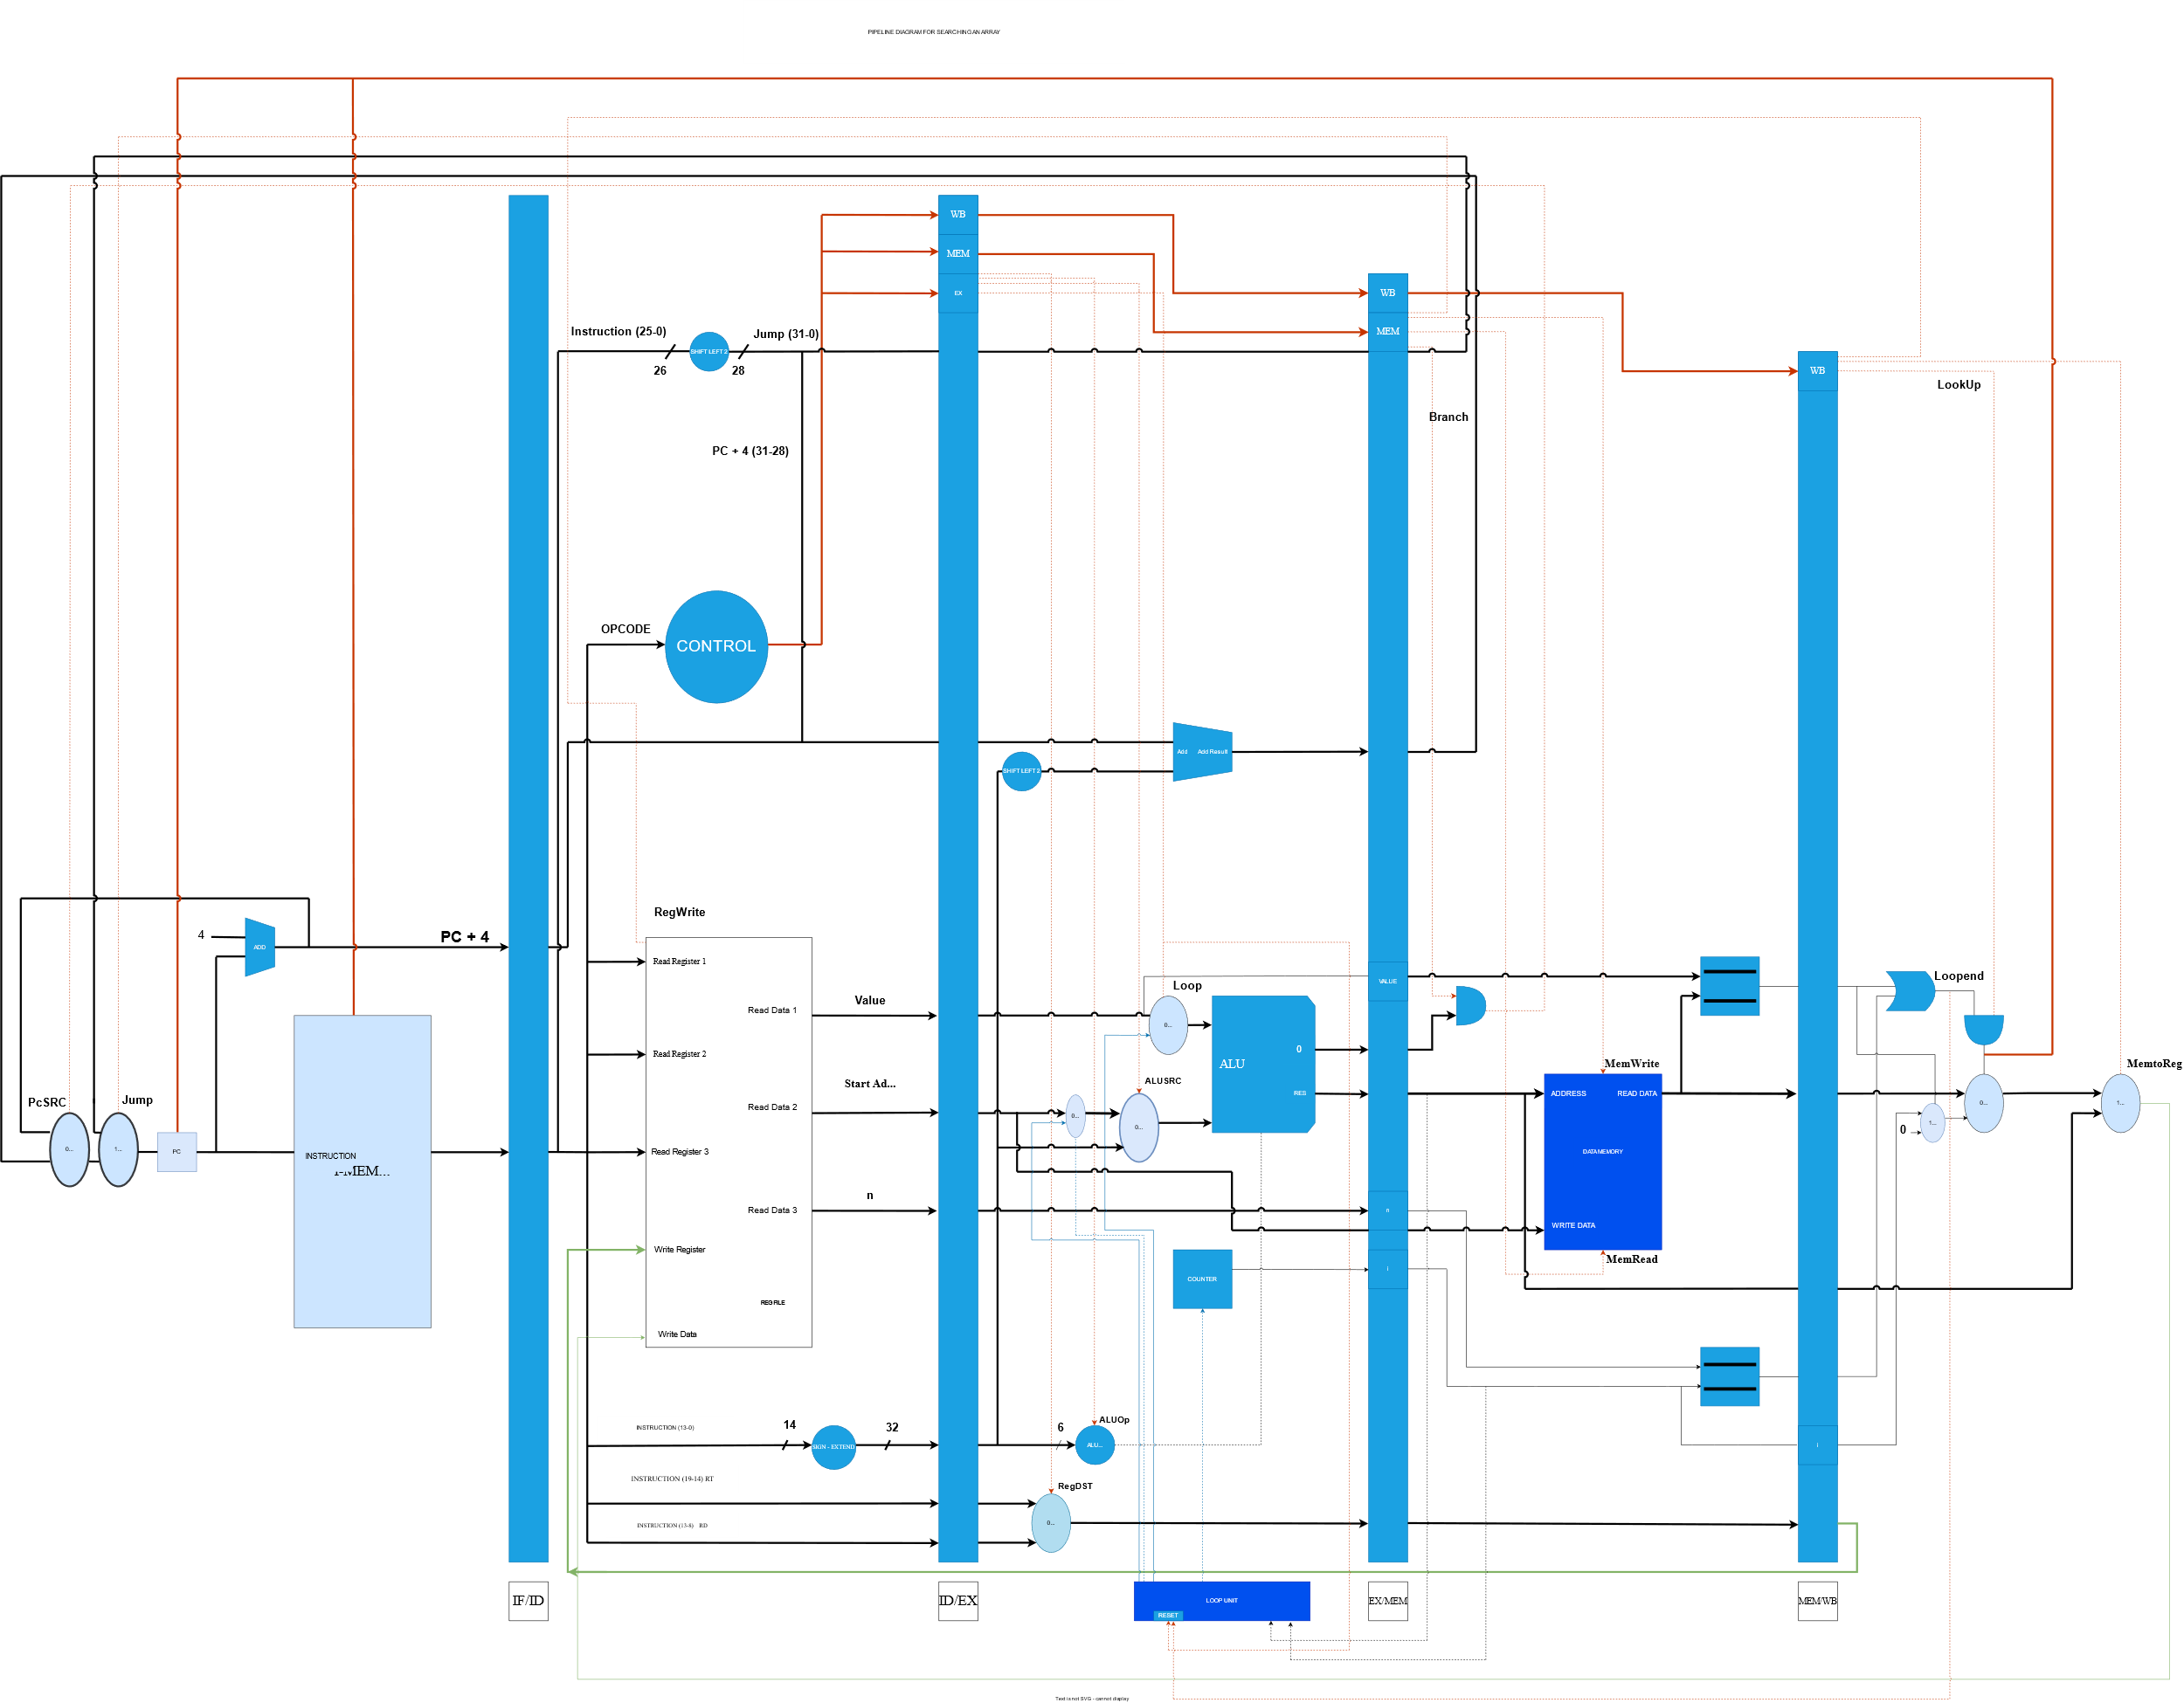

Slide 21
CLOCK CYCLES
INSTRUCTION | Clock Cycle
 | 1 | 2 | 3 | 4 | 5
LKNG Destination, value, start_address, n | IF | ID | EX | MEM | WB

Slide 22
CONTROL SIGNALS
INSTRUCTION | RegDST | AluOp |  | ALUSrc | Branch | Jump | MemWrite | MemRead | RegWrite | MemToReg | PcSRC | Loop | LookUp
Add (100000) | 1 | 1 | 0 | 0 | 0 | 0 | 0 | 0 | 1 | 0 | 0 | 0 | x
Sub (100001) | 1 | 1 | 0 | 0 | 0 | 0 | 0 | 0 | 1 | 0 | 0 | 0 | x
Slt (100010) | 1 | 1 | 0 | 0 | 0 | 0 | 0 | 0 | 1 | 0 | 0 | 0 | x
And (100011) | 1 | 1 | 0 | 0 | 0 | 0 | 0 | 0 | 1 | 0 | 0 | 0 | x
Or (100100) | 1 | 1 | 0 | 0 | 0 | 0 | 0 | 0 | 1 | 0 | 0 | 0 | x
Nor (100101) | 1 | 1 | 0 | 0 | 0 | 0 | 0 | 0 | 1 | 0 | 0 | 0 | x
Jump | x | x | x | x | x | 1 | x | x | x | x | x | x | x
Lw | 0 | 0 | 0 | 1 | 0 | 0 | 0 | 1 | 1 | 1 | 0 | 0 | 0
Sw | x | 0 | 0 | 1 | 0 | 0 | 1 | 0 | 0 | x | 0 | 0 | 0
Beq | x | 0 | 1 | 0 | 1 | 0 | 0 | 0 | 0 | x | 1 | 0 | x
LKNG | 1 | 1 | 1 | 0 | 0 | 0 | 0 | 1 | 1 | 1 | 0 | 1 | 1

Slide 23
PERFORMANCE ANALYSIS
Cycle Time = 2ns
Number of Cycles = 5 + (N-1) = N + 4
CPI = (N+4)/1 = N+4
Execution Time = [2 * (N+4)] ns
Performance = 1/(Execution Time)

