Slide 1
ADS PROJECT - Convolutional Neural Network on Semeion Handwritten Digit Data Set
- Chirag

Slide 2
What is Convolutional Neural Network(CNN)?
An architecture commonly used for deep learning.They are often used to perform object detection and segmentation
Characteristics of CNN:
It eliminates the need for manual feature extraction—the features are learned directly by the CNN
It produces state-of-the-art recognition results
CNNs can be retrained for new recognition tasks and allow for building on pre-existing networks

Slide 3
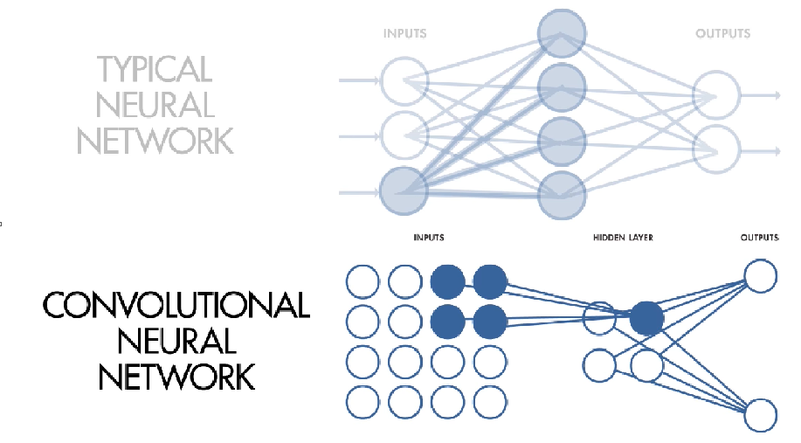
Three Important feature of Convolutional Neural Network:
Local receptive fields
These fields help to create a feature map of the image from the input layer to hidden layer neuron
- Convolution is used to implement this function

Slide 4
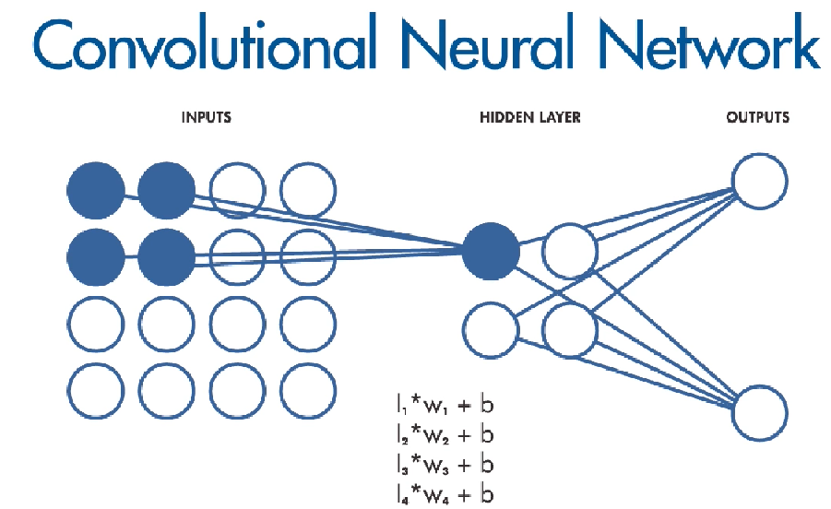
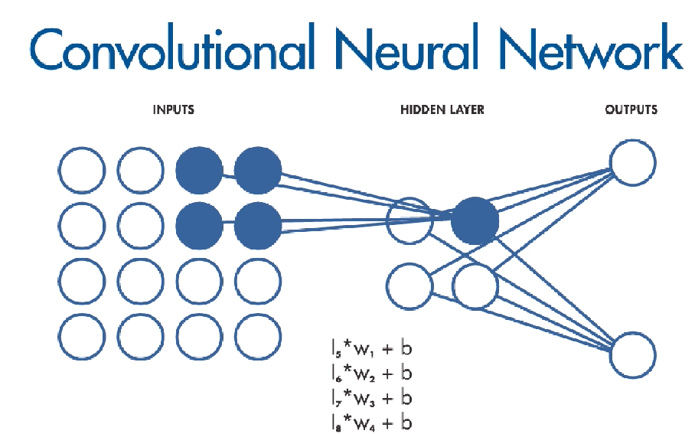
2. Shared weights and biases:
All hidden neurons are detecting the same feature in different regions of image

Slide 5
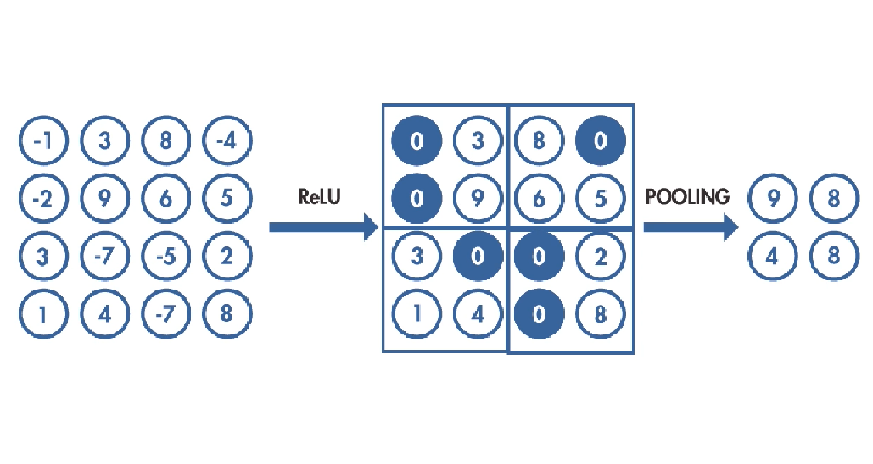
3. Activation and pooling:
Activation step applies transformation function to the output of neuron
Pooling reduces the dimension of the image by condensing the output, of the small regions of the neuron to single output
This whole process extracts the important features, that the model needs to learn.

Slide 6
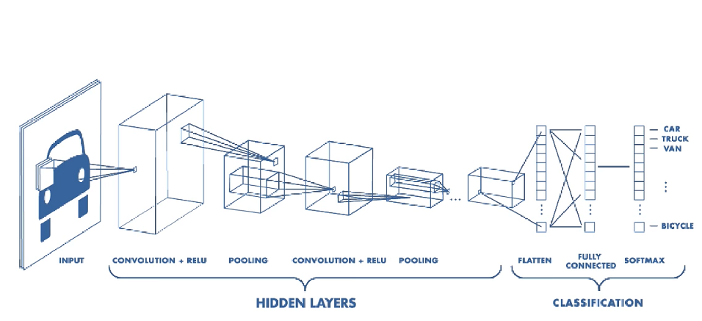
Working of CNN:

Slide 7
Semeion Handwritten Digit Data Set:
• This dataset consists of 1593 records (rows) and 256
attributes(columns).
• Each record represents a handwritten digit, originally
scanned with a resolution of 256 grayscale .
• Each pixel of the each original scanned image was first
stretched, and after scaled between 0 and 1.
• Finally, each binary image was scaled again into a 16x16
square box(the final 256 binary attributes).

Slide 8
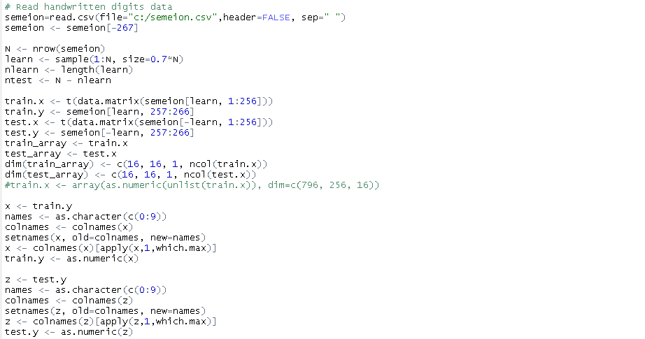
Data Preparation:

Slide 9
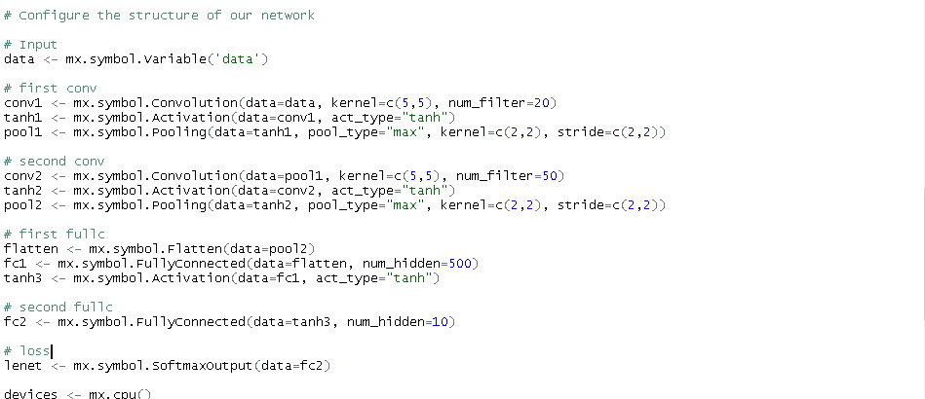
Configuration of Network structure:

Slide 10
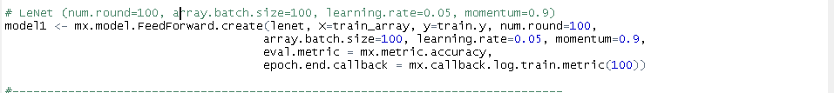
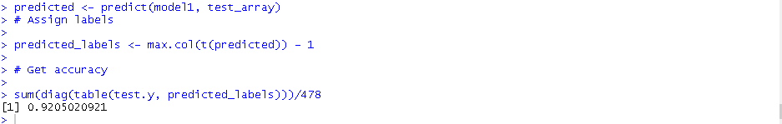
CNN Code Snippet:
CNN Accuracy Snippet:

Slide 11
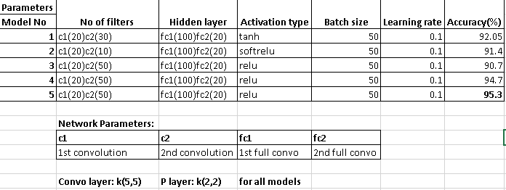
Comparison of Models:

Slide 12
Conclusion:
We were able to build an convolutional neural network that can recognize images with an ACCURACYof 95.3% using “relu” in MxNet

Slide 13
Future Scope:
CNN can be implemented using different packages like TensorFlow, Torch and neon (Using Python)
We can implement on bigger data set to see the various results
We can implement different models likes DBN and RBM
We can use GPU for faster computing

