Slide 1

Cloud Integrated Development Environment
Project Based onVirtualization, Containerization & Cloud Computing
Chirag Sindhu - 2K20CSUNO3002
CSH422B-T/P | Virtualization – Containers & Cloud | 2026 | Summer Semester
FastAPI
Docker
Redis
Python 3.12
WebSocket
Live on https://cloudide.webhop.me
Notes:
Welcome. This project demonstrates containerized code execution on a virtual machine. Walk through each slide and explain the architecture decisions.

Slide 2
Project Overview
What It Is
Why It Matters for VCC
A browser-based Python IDE hosted on a Virtual Machine
Each code submission runs in a freshly-created Docker container
Containers are fully isolated — no network, no host access
Real-time execution monitoring via WebSocket
Redis-backed metrics and event logging
Demonstrates OS-level virtualization with Docker
Shows container lifecycle management per request
Applies resource limits (CPU, RAM, timeout) per container
Illustrates cloud-style stateless execution model
Full observability stack with metrics and event streaming
Notes:
This slide explains the purpose. Emphasize that every execution is a fresh container — this is the core VCC concept being demonstrated.

Slide 3
System Architecture
Browser
HTML + JS
FastAPI
Python 3.12
Redis
State + Logs
Docker SDK
Container Mgr
Python Container
Isolated Exec
▶
▶
▶
▶
1. Request
User submits code via browser. FastAPI generates execution_id and stores initial state in Redis.
2. Container Spawn
Docker SDK creates a new isolated container from the python-runner image with strict resource limits.
3. Code Injection
User code is written into the container via a temp file. No filesystem access to the host is permitted.
4. Execution
Python runs inside the container. stdout and stderr are captured and streamed back in real time.
5. Cleanup
Container is destroyed after execution. No state persists. Redis stores final result with metrics.
6. Response
FastAPI returns execution_id. Client polls or receives WebSocket events to display results and logs.
Notes:
Walk through the flow step by step. Emphasize step 2 (new container per request) and step 5 (container destroyed) as the core virtualization principles.

Slide 4
Containerization Deep Dive
Container Isolation Model
Resource Limits per Container
Virtual Machine (Ubuntu 24)
CPU
1 core max
Memory
256 MB
Docker Engine
Timeout
30 seconds
python-runner Container
Processes
100 max
Python 3.12 Process
Security Enforcement
User Code
Network access disabled (--network none)
No host filesystem mount
No access to Redis or FastAPI
Non-root user inside container
Read-only filesystem where possible
Notes:
Explain that the nested box diagram shows the isolation layers. Docker containers share the OS kernel but are isolated via namespaces and cgroups — that is OS-level virtualization.

Slide 5
Technology Stack
Backend
Infrastructure
Frontend
FastAPI
Async REST API framework. Handles execution requests, status polling, and WebSocket broadcasting.
Docker
OS-level virtualization providing isolated execution environments per user request.
Vanilla JavaScript
No frameworks. Event-driven UI with fetch API and WebSocket client.
Uvicorn
ASGI server powering FastAPI with async I/O for concurrent request handling.
Docker Compose
Multi-service orchestration defining backend, Redis, and runner image build.
HTML5 + CSS3
Responsive layout with a code editor textarea, output panels, and status display.
Docker SDK
Python library for programmatic container lifecycle management.
Redis
In-memory store for execution metadata, logs, metrics, and event streams.
WebSocket
Persistent connection to /ws/debug for real-time execution event streaming.
Asyncio
Non-blocking I/O for container monitoring and event streaming.
Virtual Machine
Ubuntu 24 host VM on which all Docker containers and services run.
Swagger / OpenAPI 3.1
Auto-generated interactive API documentation at /docs.
Notes:
Each technology was chosen deliberately. Redis replaces a full database — no persistence needed. No Nginx, no Kafka, no Kubernetes — intentional minimalism.

Slide 6
Redis - The State Layer
What Redis Stores
Why Redis, Not a Database
HASH
execution:{id} execution_id, status, created_at, completed_at, duration_ms
Execution results are ephemeral no long-term persistence needed
Sub-millisecond reads/writes for live metrics
TTL on keys for automatic garbage collection
Pub/Sub and Streams for WebSocket event broadcasting
STRING
execution:{id}:stdout Captured stdout from the container process
STRING
execution:{id}:stderr Captured stderr and runtime error output
Execution Lifecycle Events
LIST
execution:{id}:events Ordered log of lifecycle events for the execution
Execution Created
Container Created
Container Started
Execution Started
Stdout / Stderr Chunk
Execution Completed
Container Removed
HASH
metrics:global Counters: active, completed, failed, timeout executions
LIST / STREAM
events:stream Recent 100 events broadcast via WebSocket to debug dashboard
Notes:
Redis is the only storage layer by design. No PostgreSQL, no MongoDB. Every data structure choice has a reason — explain the HASH vs LIST tradeoffs.

Slide 7
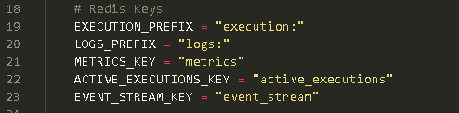
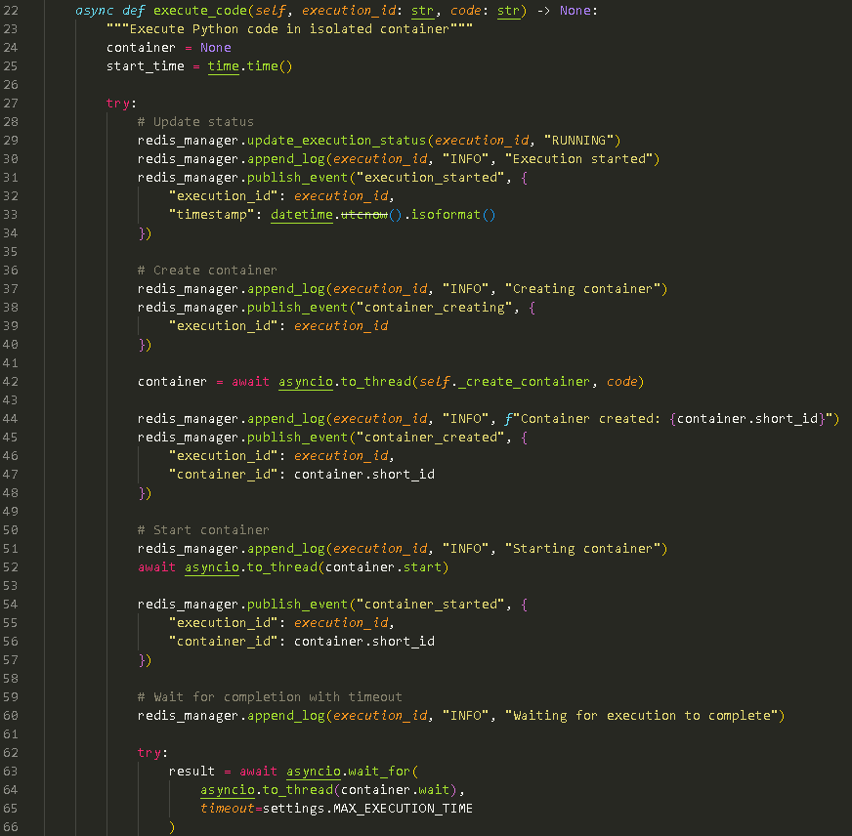
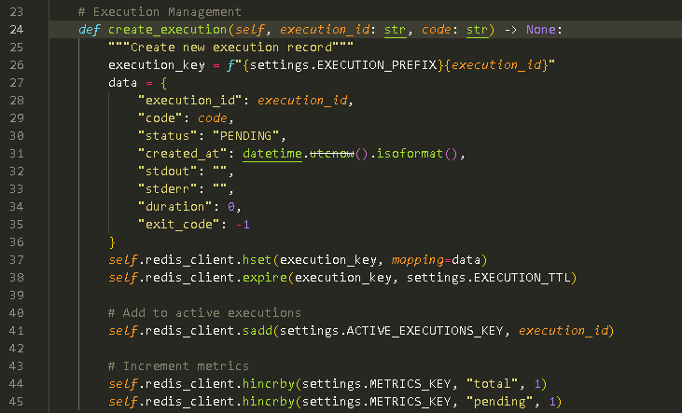
Redis - The State Layer [Continued.]
Notes:
Redis is the only storage layer by design. No PostgreSQL, no MongoDB. Every data structure choice has a reason — explain the HASH vs LIST tradeoffs.

Slide 8
Real-Time Debug Dashboard
Tracked
Total Executions
Live Count
Active Containers
Alerted
Failed / Timeout
Measured
Avg Duration
Dashboard Features ( /debug )
WebSocket Event Architecture
Server-wide metrics (total / active / completed / failed)
Table of currently running containers with elapsed time
Live event stream via WebSocket — no refresh needed
Error panel for runtime and container failures
Recent executions list (last 100)
Execution ID, status, duration for every job
FastAPI Event Every container action generates an event object with type, execution_id, and timestamp.
Redis Store Event is appended to execution:{id}:events list and the global events stream.
Broadcast WebSocket manager iterates all connected /ws/debug clients and pushes the JSON event.
Dashboard Update JavaScript receives event, parses JSON, and updates the relevant UI panel in real time.
Notes:
The debug dashboard is the observability layer. Show it live if possible. WebSocket means zero polling — events are pushed instantly.

Slide 9
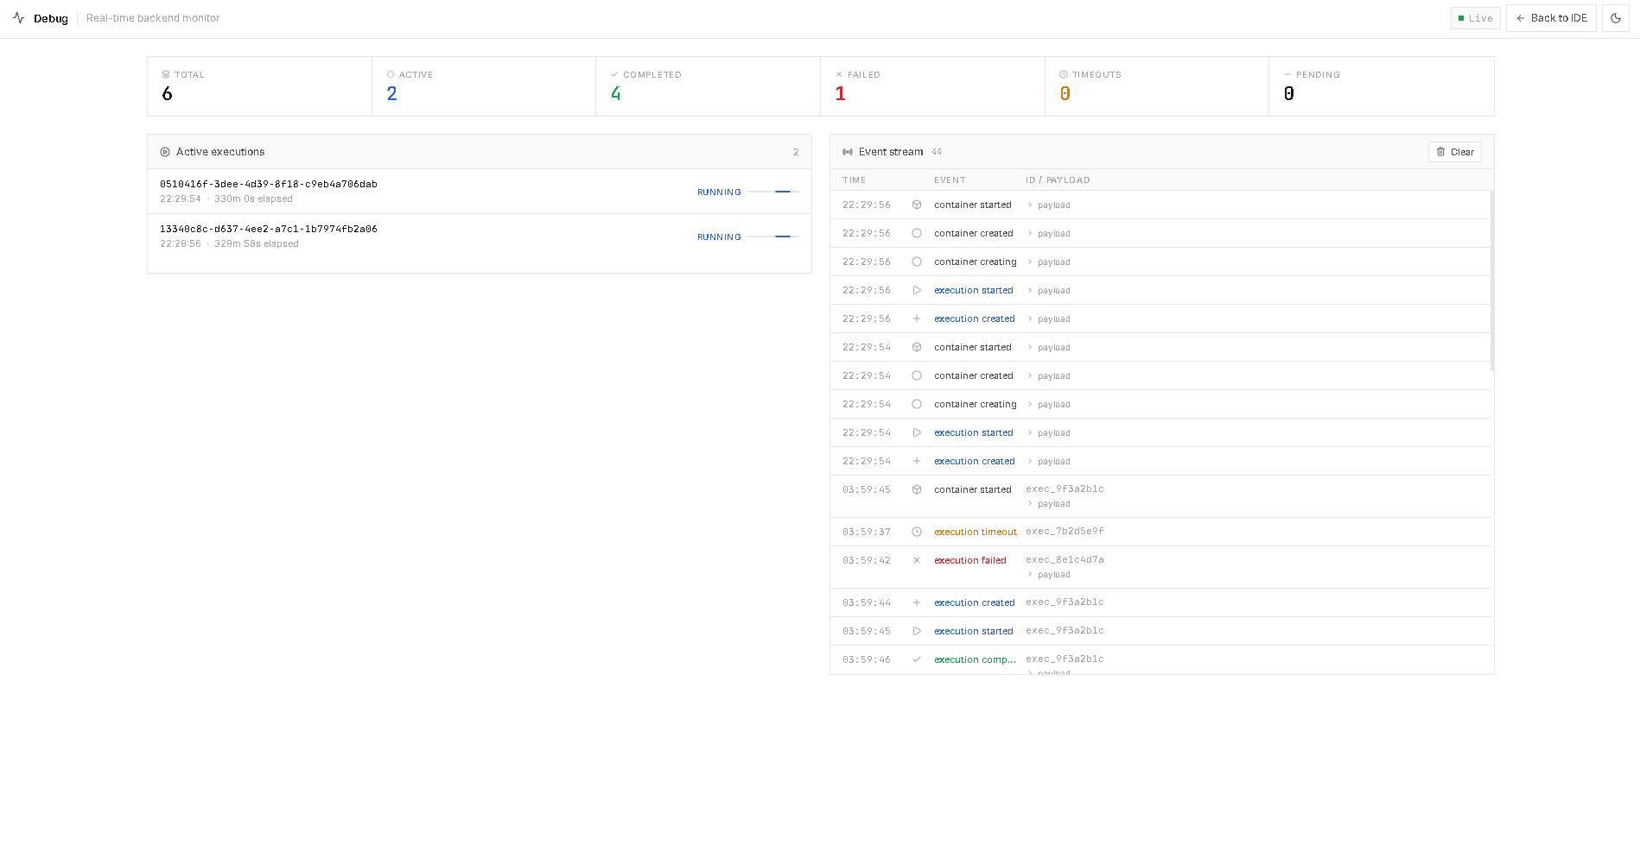
Real-Time Debug Dashboard
Notes:
The debug dashboard is the observability layer. Show it live if possible. WebSocket means zero polling — events are pushed instantly.

Slide 10
API Reference
POST
/api/execute
GET
/api/execution/{id}
Submit Python code. Returns execution_id immediately. Code begins running in a new container.
Poll execution status. Returns status, stdout, stderr, and duration once complete.
Response: { "execution_id": "uuid-..." }
Response: { "status": "COMPLETED", "stdout": "...", "stderr": "...", "duration": 0.43 }
GET
/api/execution/{id}/logs
GET
/api/metrics
Retrieve full ordered event log for a specific execution.
Returns global counters: active, completed, failed, timeout executions.
Response: [ { "event": "EXECUTION_STARTED", "ts": "..." }, ... ]
Response: { "active": 2, "completed": 47, "failed": 3, "timeout": 1 }
GET
/api/events
WS
/ws/debug
Returns the last 100 events from the global event stream.
Persistent WebSocket. Server pushes every execution event in real time to the debug dashboard.
Response: [ { "type": "CONTAINER_REMOVED", "id": "..." }, ... ]
Response: { "type": "EXECUTION_COMPLETED", "execution_id": "...", "ts": "..." }
Notes:
Full Swagger docs are live at /docs. The POST /execute is the entry point — it is deliberately async. Client gets an ID immediately and polls or listens via WebSocket.

Slide 11
VCC Concepts Demonstrated
OS-Level Virtualization
Container Lifecycle Management
Docker containers share the Linux kernel but are isolated via namespaces (PID, NET, MNT, UTS, IPC)
cgroups enforce CPU and memory limits — the kernel ensures no container exceeds its quota
This is the foundation of container technology as covered in VCC theory
Every code execution triggers: pull-if-needed → create → start → exec → capture → stop → remove
Ephemeral containers — no state survives between executions, mirroring cloud function semantics
The Docker SDK abstracts the Docker Engine API into Python-native calls
Resource Isolation & Limits
Cloud-Native Patterns
mem_limit=256m, cpu_period/cpu_quota set to 1 core equivalent via Docker run parameters
Execution timeout enforced by the FastAPI service — container is force-killed at 30s
STATUS=TIMEOUT and STATUS=MEMORY_LIMIT_EXCEEDED map to real container exit conditions
Stateless execution: no local disk, no persistent connection between runs
Horizontal scalability: multiple containers can run concurrently on the same VM
Observability: metrics, logs, and event streaming mirror production cloud monitoring
Notes:
This is the most important slide for the professor. Map each feature directly back to VCC theory. Namespaces, cgroups, container lifecycle — all explicitly demonstrated.

Slide 12
Project Structure & Deployment
Repository Layout
Docker Compose Services
cloud-ide/
backend/
main.py FastAPI app entry
config.py Env + resource config
routes/ API route handlers
services/ Execution business logic
websocket/ WS broadcast manager
redis_manager.py Redis client wrapper
frontend/
index.html Main IDE UI
debug.html Live dashboard
app.js / debug.js Client-side logic
styles.css Shared styling
runner/
Dockerfile Python execution image
requirements.txt Pre-installed packages
docker-compose.yml Service orchestration
backend FastAPI + Uvicorn. Mounts Docker socket to spawn containers.
redis Redis 7 Alpine. In-memory state store. No persistence volume.
runner (image) python:3.12-slim with pre-installed packages. Built once, reused per execution.
Deployment on Virtual Machine
Ubuntu 24 VM with Docker and Docker Compose installed
git clone → docker-compose up --build
Live at cloudide.webhop.me via webhop DNS
Backend exposed on port 8000, fronted by the VM's public IP
Notes:
Emphasize that docker-compose up --build is the entire deployment. No Kubernetes, no complex CI/CD. The VM IS the cloud here.

Slide 13
Live Demo & Access
Main IDE
cloudide.webhop.me
Write and execute Python. View stdout, stderr, execution time.
Debug Dashboard
cloudide.webhop.me/debug
Live monitoring. WebSocket event stream. Container metrics.
API Docs
cloudide.webhop.me/docs
Interactive Swagger UI. Test all endpoints directly in browser.
Health Check
cloudide.webhop.me/health
Backend health status. Confirms Redis and Docker connectivity.
Demo: Write code → Execute → Watch debug dashboard update in real time → Check /api/metrics for container stats
Notes:
Open the IDE and run a simple script. Then switch to the debug dashboard and show the event stream updating. Finally open /docs and show the Swagger UI.

Slide 14
Summary
One Container Per Request
Every code execution is fully isolated in a new Docker container — aligned with cloud function and FaaS patterns.
Complete Observability
Redis metrics, WebSocket event streaming, and the debug dashboard provide full visibility into the runtime.
Minimal, Intentional Stack
FastAPI + Redis + Docker only. No unnecessary services — every component has a clear role and is replaceable.
VCC Theory Applied
Namespaces, cgroups, container lifecycle, resource limits, and VM-hosted deployment demonstrate core VCC concepts end to end.
Notes:
Close by reiterating: the project is live, the code is clean, and every architectural decision maps to a VCC concept. Invite questions.

Slide 15
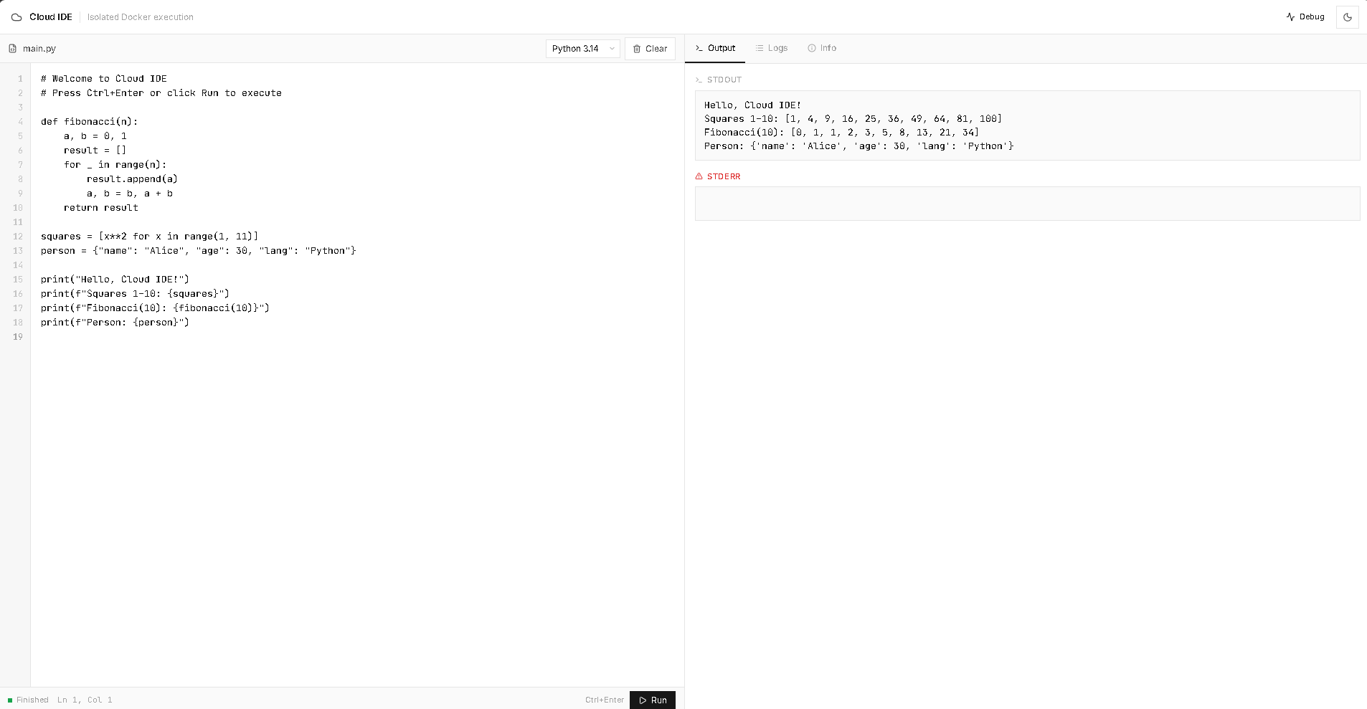
Notes:
Close by reiterating: the project is live, the code is clean, and every architectural decision maps to a VCC concept. Invite questions.

Slide 16
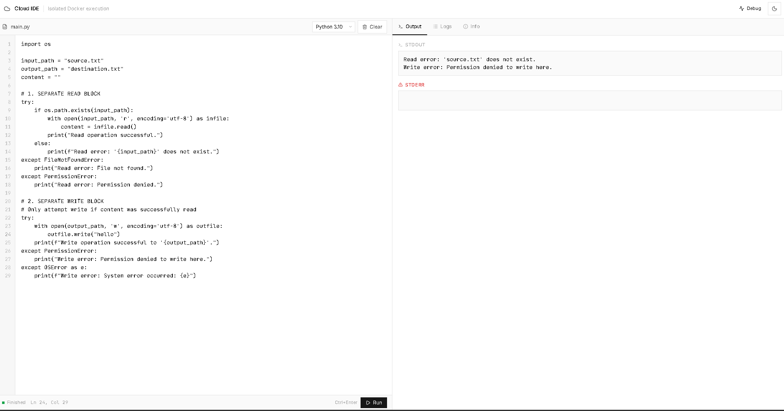
Notes:
Close by reiterating: the project is live, the code is clean, and every architectural decision maps to a VCC concept. Invite questions.

Slide 17
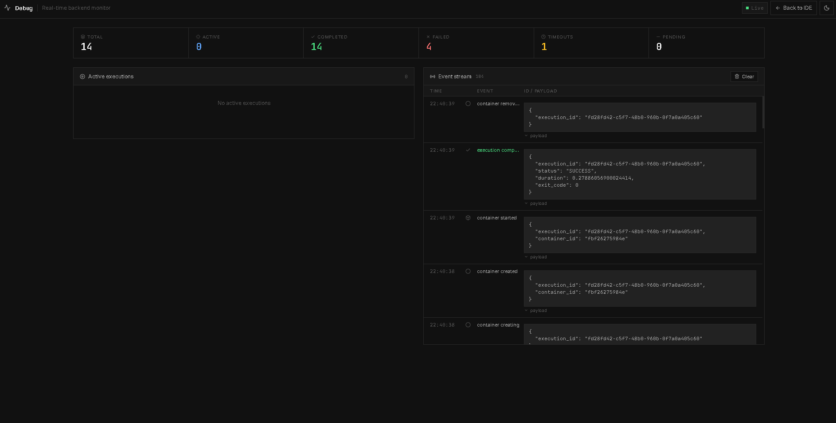
Notes:
Close by reiterating: the project is live, the code is clean, and every architectural decision maps to a VCC concept. Invite questions.

Slide 18
Thank You!
Chirag Sindhu
2K20CSUNO3002
2020-2024 VCC | SUMMER SEMESTER
https://cloudide.webhop.me https://github.com/ChiragSindhu/cloudide
Notes:
Close by reiterating: the project is live, the code is clean, and every architectural decision maps to a VCC concept. Invite questions.

