Slide 1
Computer graphics
3D transformation
Unit -4

Slide 2
TRANSFORMATION
Transformation is used to position objects, to shape objects, to change viewing positions & even how something is viewed .
Transformation is used for :
1)Modelling
2)Viewing

Slide 3
Three Dimensional Modeling Transformations
Methods for object modeling transformation in three dimensions are extended from two dimensional methods by including consideration for the z coordinate.
Homogeneous coordinates: 4 components
Transformation matrices: 4×4 elements

Slide 4
3D Point
We will consider points as column vectors. Thus, a typical point with coordinates (x, y, z) is represented as:
A 3D point P is represented in homogeneous coordinates by a 4-dim. Vect:
The main advantage: it is easier to compose translation and rotation
Everything is matrix multiplication

Slide 5
3D Transformation
In homogeneous coordinates, 3D transformations are represented by 4×4 matrixes:

Slide 6
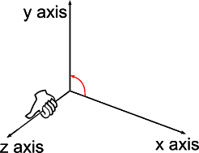
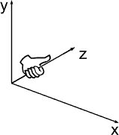
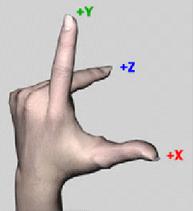
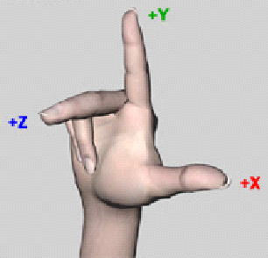
3D Coordinate Systems
Right Hand coordinate system:
Left Hand coordinate system:

Slide 7
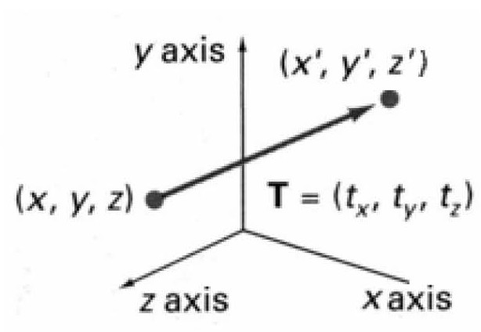
3D Translation
P is translated to P' by:

Slide 8
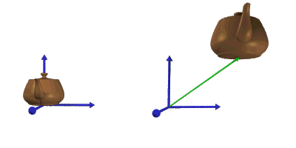
3D Translation
An object is translated in 3D dimensional by transforming each of the defining points of the objects .

Slide 9
3D Translation
An Object represented as a set of polygon surfaces, is translated by translate each vertex of each surface and redraw the polygon facets in the new position.
Inverse Translation:

Slide 10
3D Rotation
In general, rotations are specified by a rotation axis and an angle. In two-dimensions there is only one choice of a rotation axis that leaves points in the plane.

Slide 11
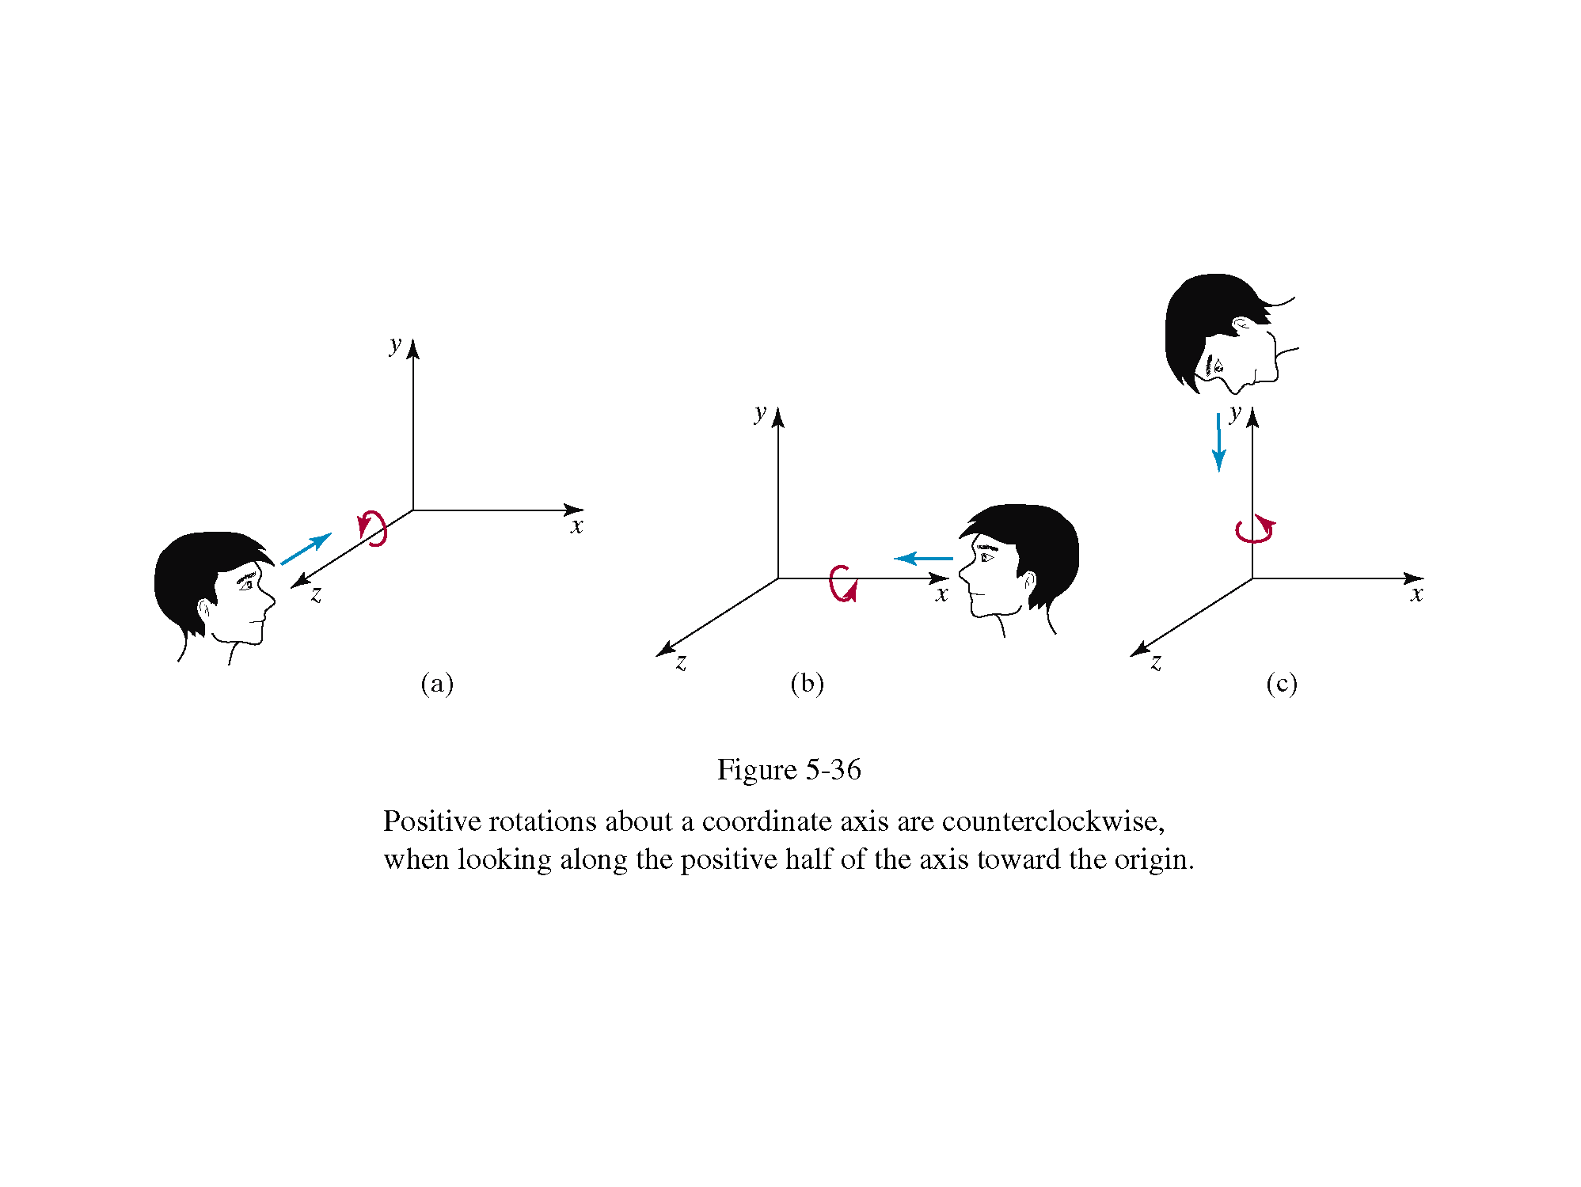
3D Rotation
The easiest rotation axes are those that parallel to the coordinate axis.
Positive rotation angles produce counterclockwise rotations about a coordinate axis, if we are looking along the positive half of the axis toward the coordinate origin. (According to right hand convention)

Slide 12
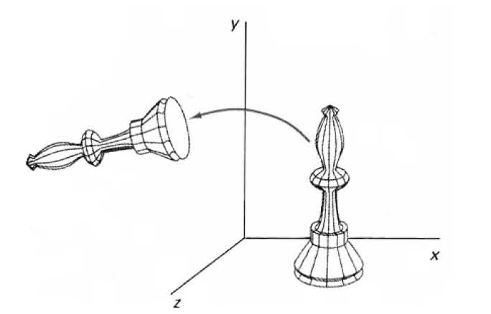
Coordinate Axis Rotations
Z-axis rotation: For z axis same as 2D rotation:

Slide 13
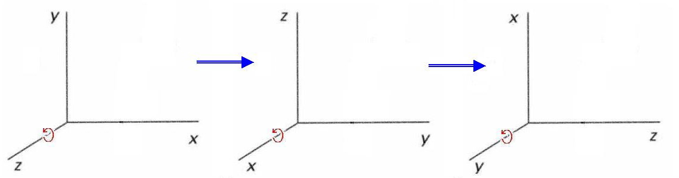
Coordinate Axis Rotations
Obtain rotations around other axes through cyclic permutation of coordinate parameters:

Slide 14
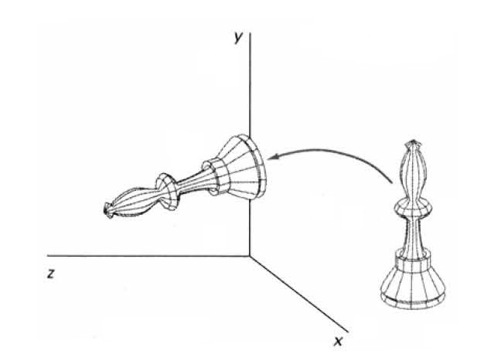
Coordinate Axis Rotations
X-axis rotation:

Slide 15
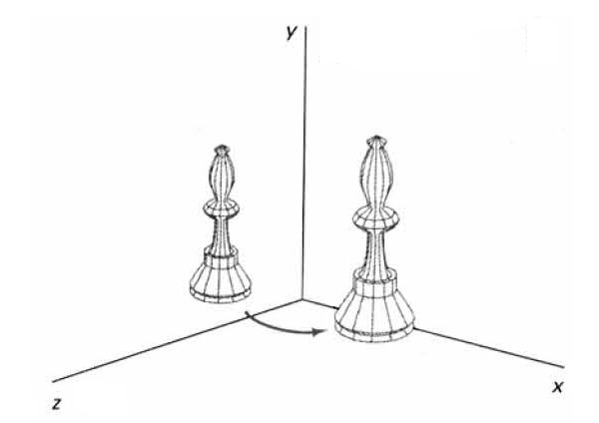
Coordinate Axis Rotations
Y-axis rotation:

Slide 16
General Three Dimensional Rotations
A rotation matrix for any axis that does not coincide with a coordinate axis can be set up as a composite transformation involving combination of translations and the coordinate-axes rotations:
Translate the object so that the rotation axis passes through the coordinate origin
Rotate the object so that the axis rotation coincides with one of the coordinate axes
Perform the specified rotation about that coordinate axis
Apply inverse rotation axis back to its original orientation
Apply the inverse translation to bring the rotation axis back to its original position

Slide 17
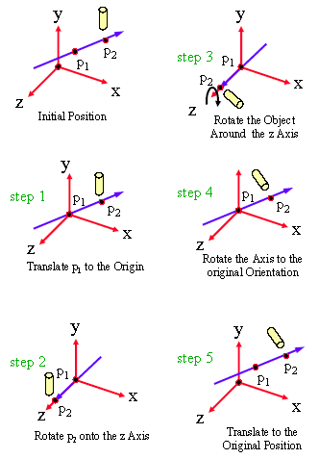
General Three Dimensional Rotations
An arbitrary axis (with the rotation axis projected onto the Z axis):

Slide 18
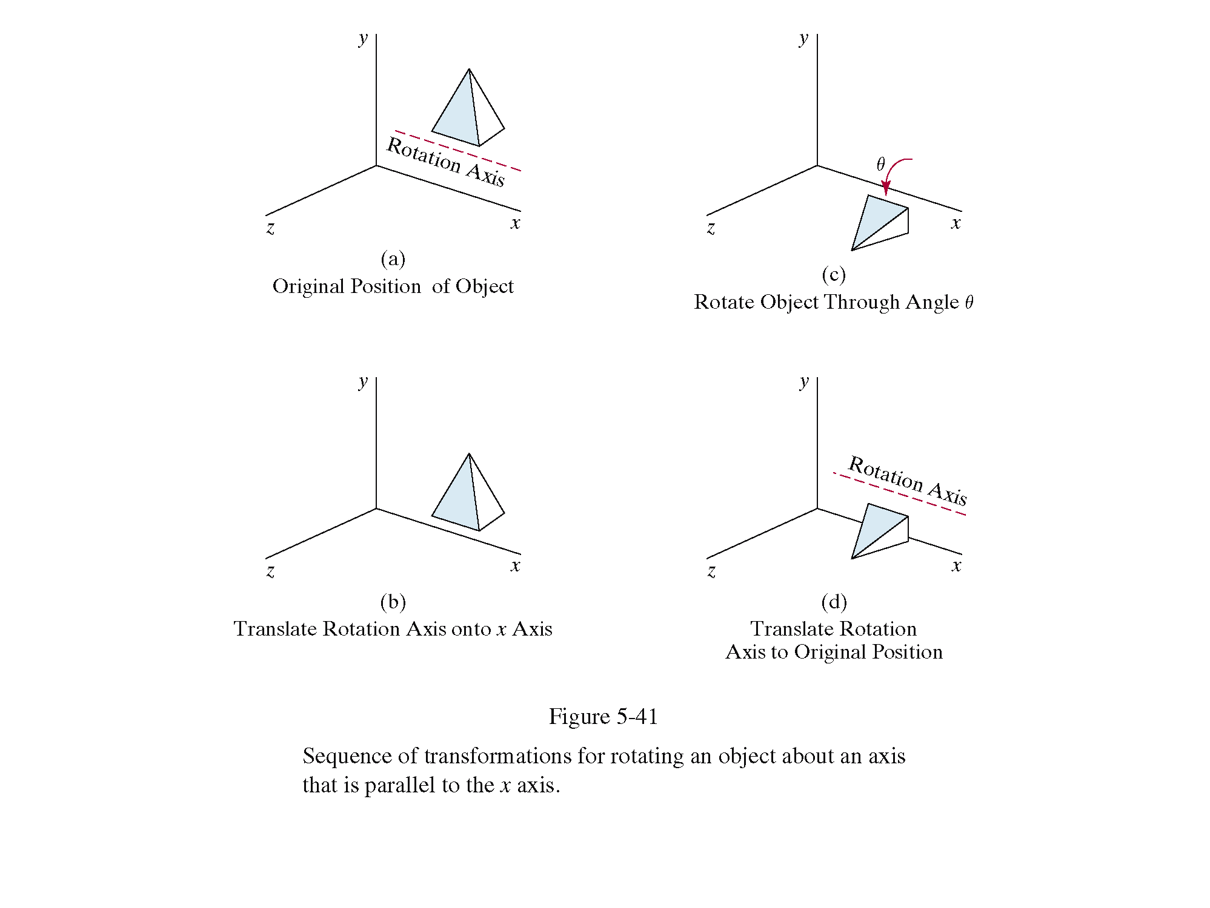
Special CaseThree Dimensional Rotations
Rotation axis parallel with coordinate axis (Example x axis):

Slide 19
3D Scaling
About origin: Changes the size of the object and repositions the object relative to the coordinate origin.

Slide 20
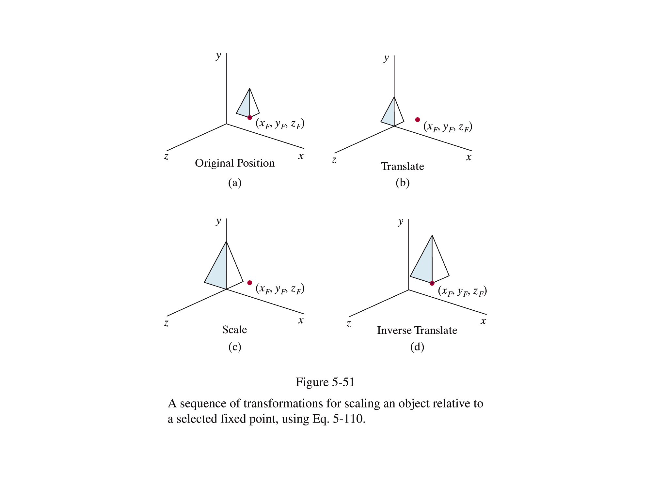
3D Scaling
About any fixed point:

Slide 21
3D Reflections
About an axis: equivalent to 180˚rotation about that axis
About a plane:
A reflection through the xy plane:
A reflections through the xz and the yz planes are defined similarly.

Slide 22
3D Shearing
Modify object shapes
Useful for perspective projections:
E.g. draw a cube (3D) on a screen (2D)
Alter the values for x and y by an amount proportional to the distance from z_{ref}

Slide 23
3D Shearing

Slide 24
Composite
3D Transformations

Slide 25
Composite 3D Transformations
Same way as in two dimensions:
Multiply matrices
Rightmost term in matrix product is the first transformation to be applied

