Slide 1

Qursor++
UI Inspector & DevTools Companion
Department of Computer Science & Engineering · Maharaja Sayajirao University of Baroda
AAKASH PATEL
RONAK SINGH
CHIRAG VASAVA
BRIJESH SEVRA
Project Guide: Jal Shah

Slide 2
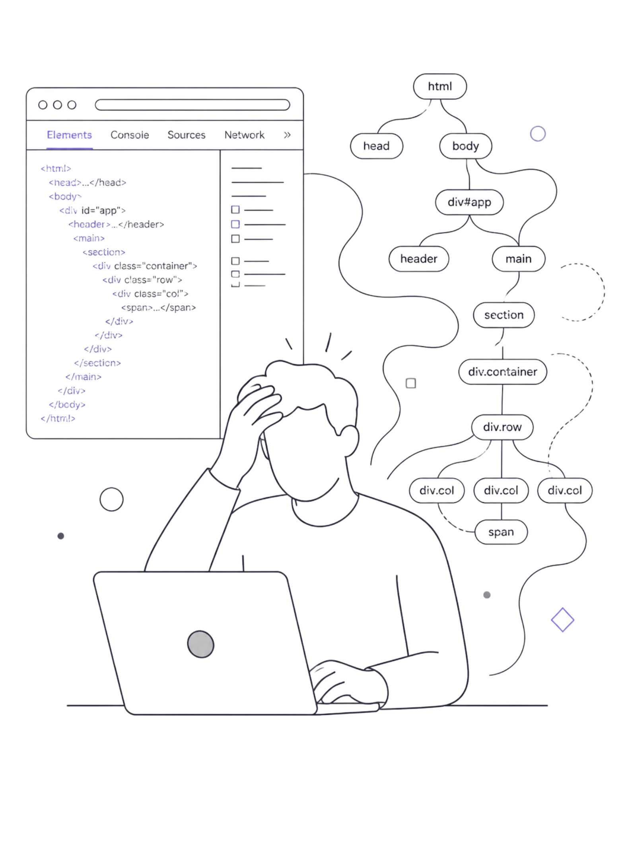
The Problem with Modern Web Inspection
Slow DOM Navigation
Manually digging through complex DOM trees in browser DevTools is time-consuming and mentally taxing.
Manual CSS Tweaking
Layout adjustments require repetitive trial-and-error with no intelligent assistance or live preview.
AI Context Gap
ChatGPT and Claude cannot perceive live DOM elements — developers must manually copy-paste HTML/CSS snippets.
Live Preview
To get a preview of the changes we require, without changing the codebase.

Slide 3
Core Objectives
Visual Element Inspection
Deep Data Extraction
Live In-Page Editing
Instant selection and inspection of any DOM element on any live website — zero layout shifts.
Harvest full HTML, computed CSS, box model dimensions, typography, colors, and DOM hierarchy.
Real-time editing workspace inside an isolated Shadow DOM container with instant visual feedback.
AI-Driven Modifications
Batch Pattern Application
Natural language prompts modify UI components via structured LLM integration.
Detect similar UI elements across a page and apply design updates consistently in one step.

Slide 4
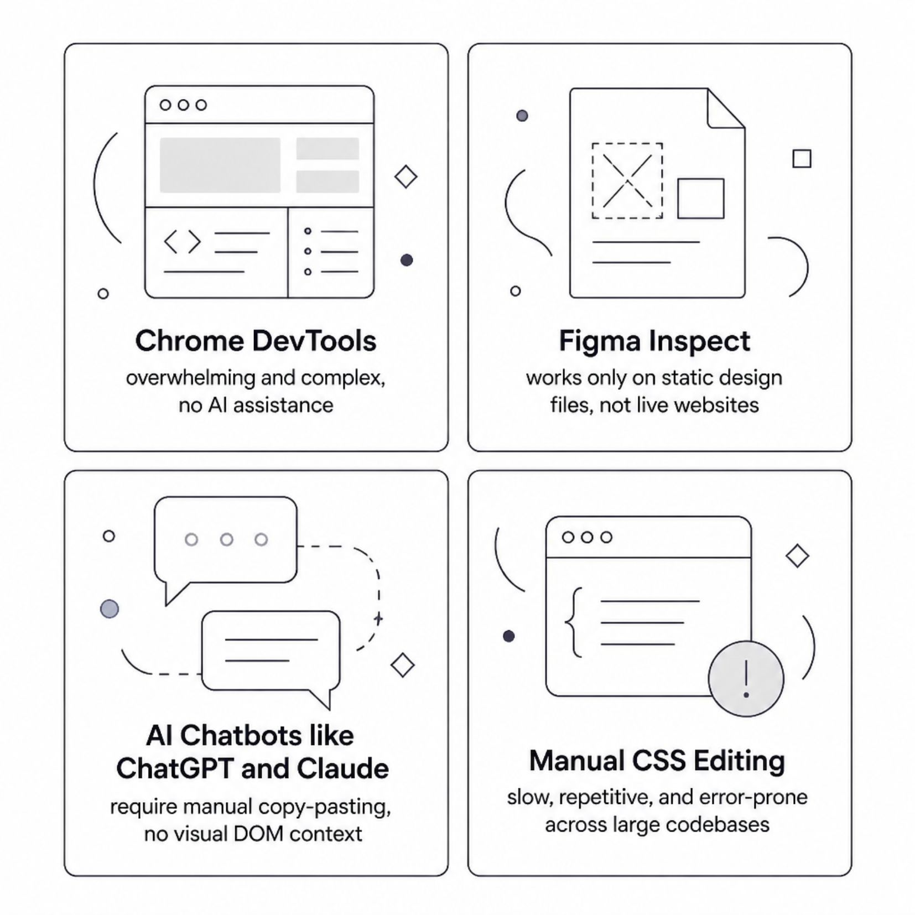

Existing Tools Fall Short
No single existing solution combines visual inspection, live style editing, AI prompting, and batch updates into one seamless workflow. Developers are forced to juggle multiple disconnected tools.
Qursor++ is designed to close this gap — unifying inspection, editing, and AI assistance in one lightweight Chrome Extension.

Slide 5
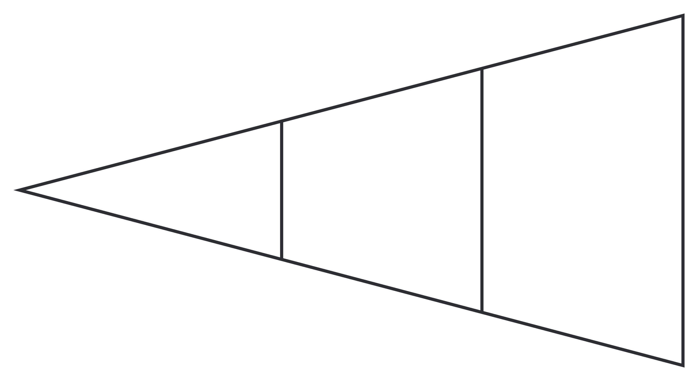
System Architecture
Selector & Extractor
Extension Engine
User Action
The architecture ensures complete style encapsulation via Shadow DOM, preventing any CSS conflicts between the extension UI and the host website — whether it uses Tailwind, Bootstrap, or custom styles.

Slide 6
Development Roadmap
Phase 1 ✅
1
Element hover highlight, capture-phase selection, CSS and layout extraction
2
Phase 2 ✅
Full HTML extraction, DOM hierarchy depth, 1-click JSON/HTML/CSS copy, Shadow DOM UI panel
Phase 3 🔄
3
Live style preview, inline property editor, AI prompt integration, natural language editing
Phases 1 and 2 are fully complete. Phase 3 (live editing + AI) is currently in active development.

Slide 7
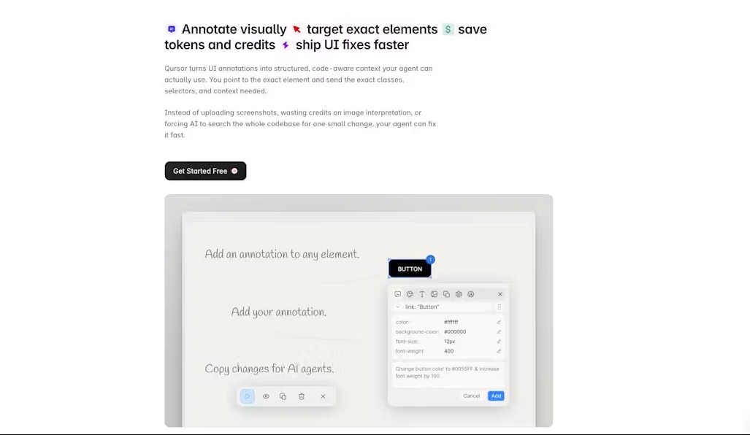
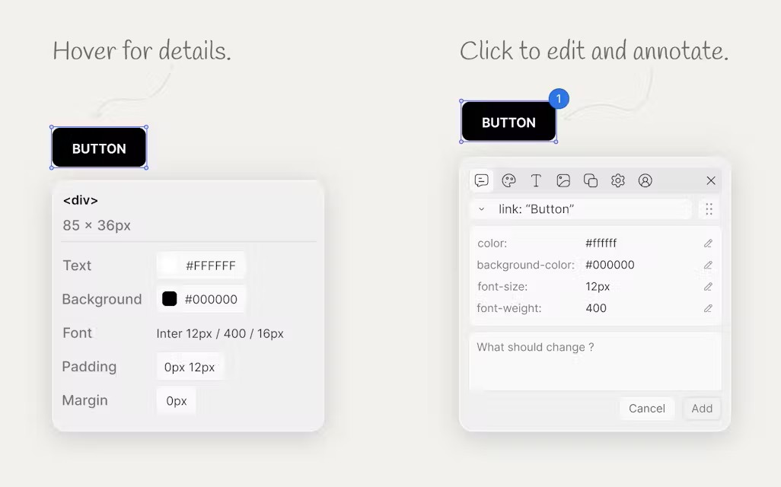
Phase 2 — Visual Element Selection & UI Overview
Popup Controller & Inspector Toggle
Provides a clean popup status badge to toggle Inspect Mode and view global keyboard shortcuts (Ctrl+Shift+I).
Live Target Picking & Isolated UI Panel
Highlights active target elements on webpage and displays the dark-theme Qursor++ UI panel inside Shadow DOM.

Slide 8
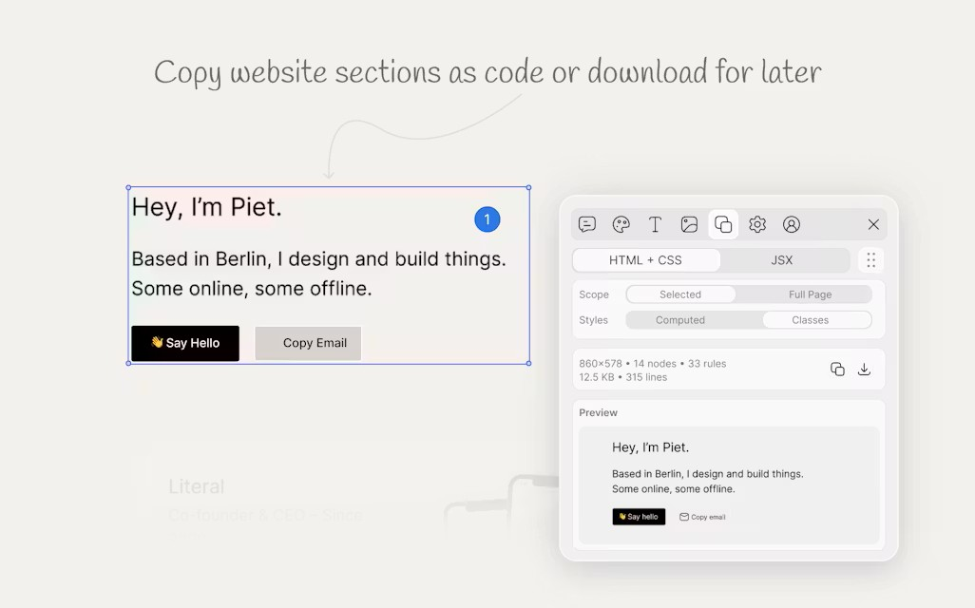
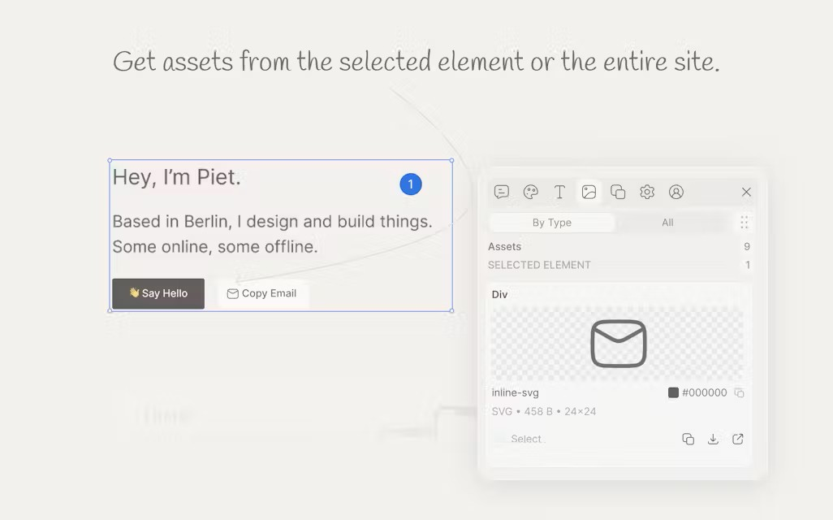
Phase 2 — Live Hover Highlight & Computed Metrics
Flicker-Free Hover Outline & Tooltip
Real-time blue border overlay with live tooltip displaying HTML tag, ID, class list, and pixel dimensions.
Computed Styles & Box Model Metrics
Harvests exact rendered layout dimensions, margin/padding box models, typography, and color conversions.

Slide 9
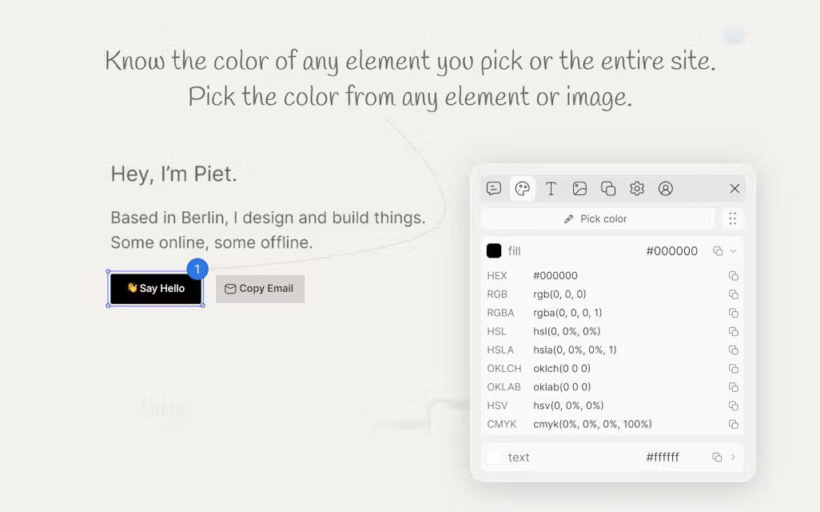
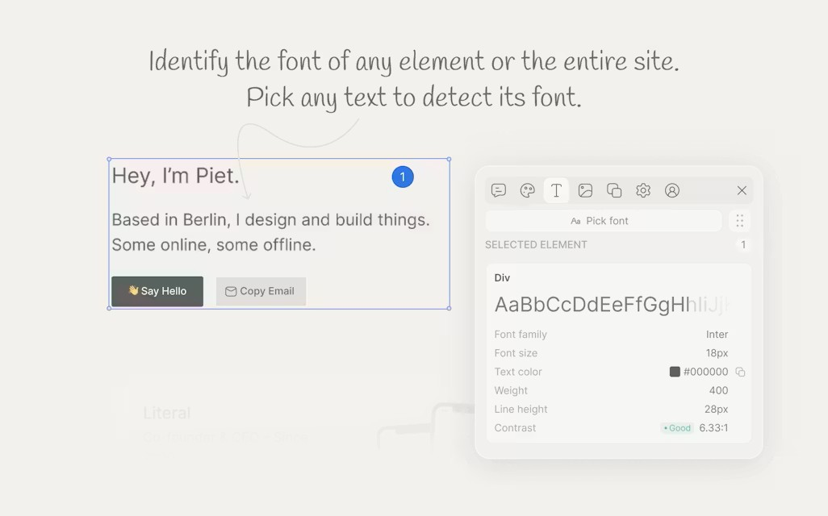
Phase 2 — DOM Hierarchy & 1-Click Data Exporter
DOM Depth & Unique Selector Builder
Calculates parent/child hierarchy depth, sibling nodes, unique CSS selector path, and exact XPath queries.
1-Click Clipboard Exporter
Exports structured JSON, raw HTML, OuterHTML, Selectors, and CSS rules to clipboard with animated toast notification.

Slide 10
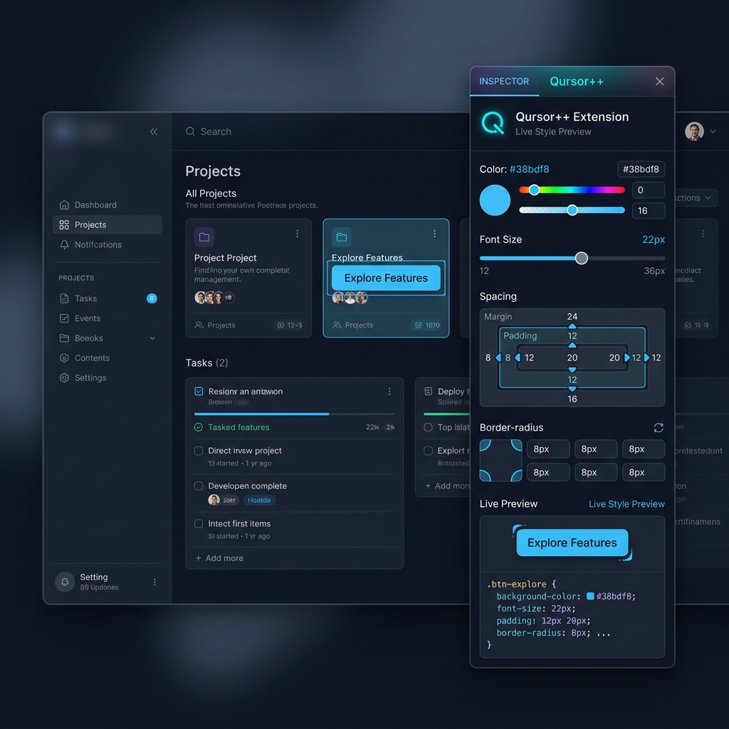
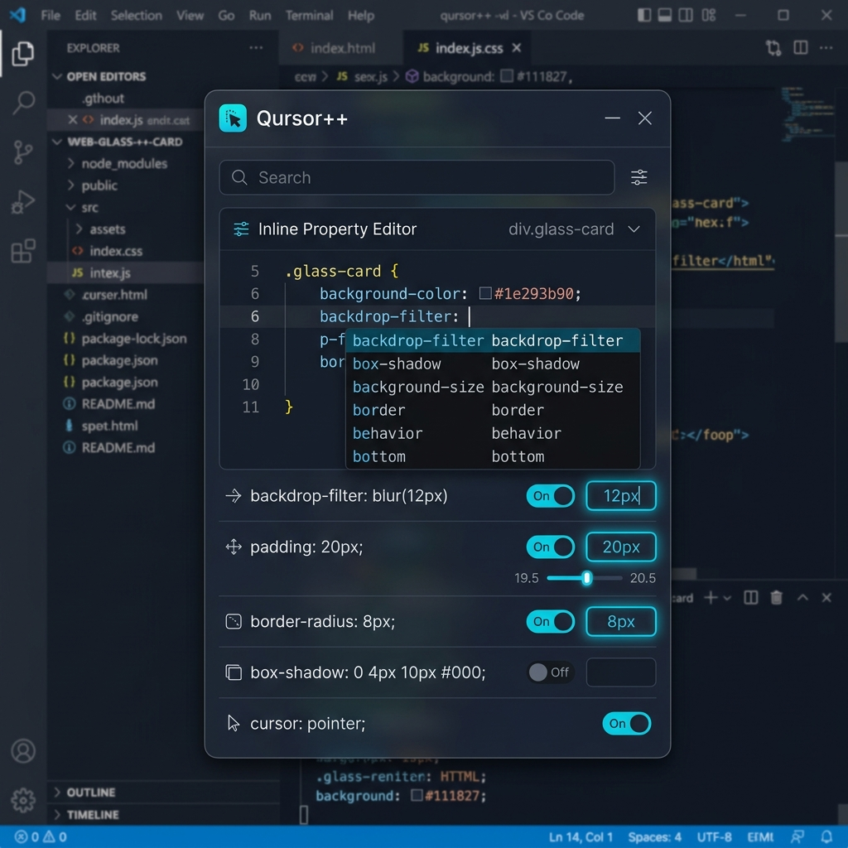
Phase 3 🔄 — Live Style Preview & Inline Property Editor
Live Style Preview Engine
Features visual color pickers, margin/padding box-model sliders, and font controls with real-time rendered preview on the webpage.
Inline Property Editor Workspace
Interactive code editor with CSS property autocomplete, rule toggle checkboxes, and cyan glowing input fields.

Slide 11
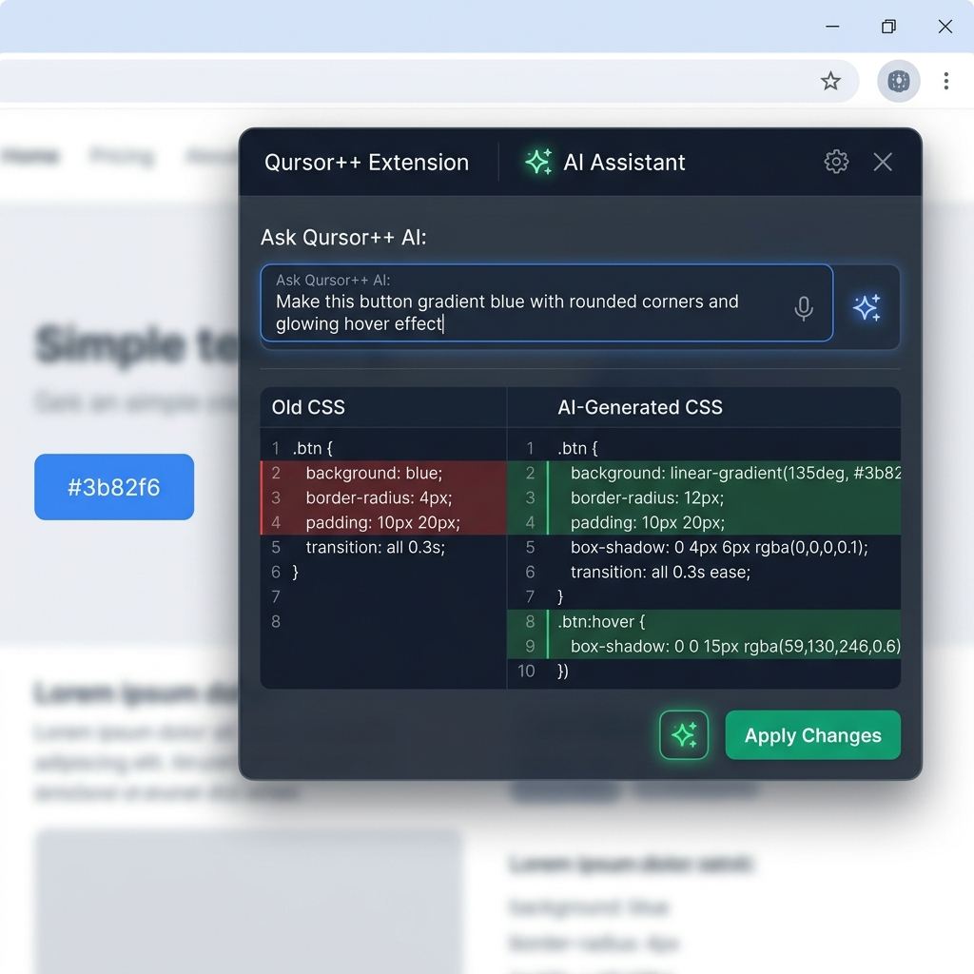
Phase 3 🔄 — AI Prompt Integration & Natural Language Editing
🤖 Natural Language UI Editing
Users prompt the AI with natural text instructions (e.g. 'Make this button gradient blue with rounded corners') to generate clean CSS.
⚡ Live Code Diff & 1-Click Apply
Presents a side-by-side visual diff comparing original CSS vs AI-generated CSS before applying changes directly to live DOM.
🔄 Project-Wide Pattern Updates
Scans webpage for matching UI components and batch-applies AI styling rules across identical elements.

Slide 12
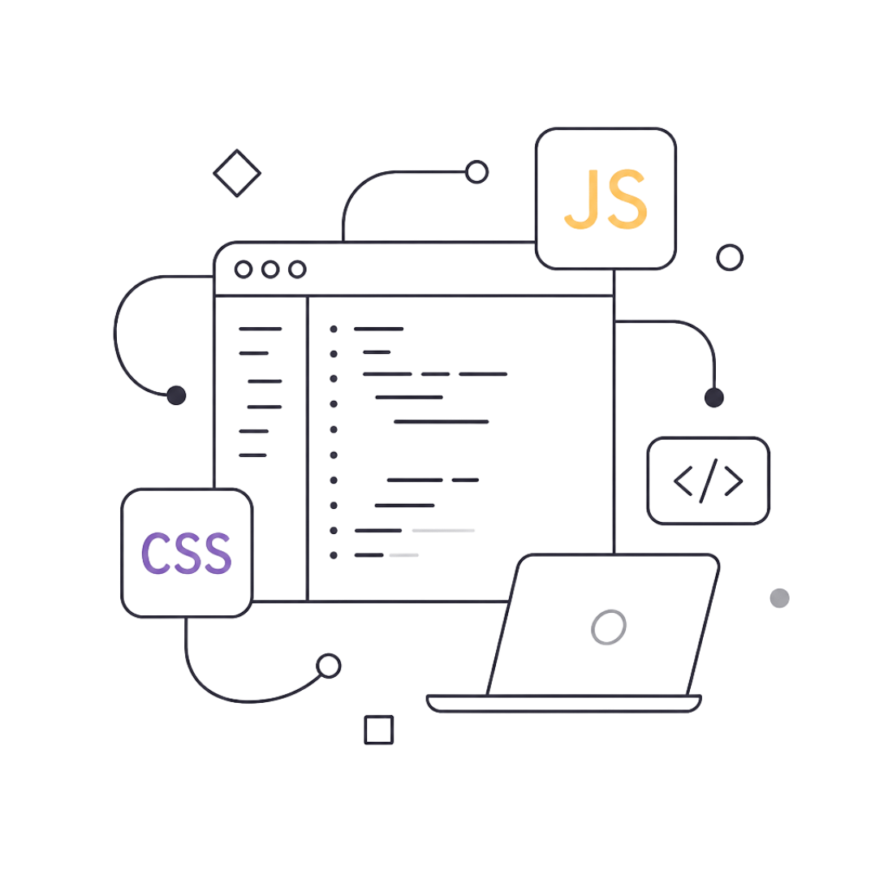

Technology Stack
Frontend & UI
Extension Core
DOM Engine
HTML5, Vanilla CSS3 with Glassmorphism, micro-animations, custom scrollbars
Chrome Extension Manifest V3, Service Workers, Chrome APIs
Vanilla JavaScript ES2023, Web APIs — getComputedStyle, elementFromPoint, Shadow DOM
AI Backend
Node.js, Express, OpenAI / Gemini API (Phases 3 & 4)
⚡ Zero external bundlers — operates cleanly in the native browser environment with zero build overhead.

Slide 13





Introducing Qursor++
A lightweight Chrome Extension built with Manifest V3 and native Shadow DOM encapsulation — an intelligent bridge between live web UIs and AI coding tools.
Select Element
Capture-phase click interception on any live page
Extract Data
HTML, CSS, box model, and DOM hierarchy
Live Edit
Inline style preview in Shadow DOM panel
AI Modify
Natural language prompts via LLM integration
Batch Apply
Pattern-match and update all similar elements

Slide 14
Project Timeline
Weeks 1–2
Key Milestones
Research, planning, Manifest V3 setup, element selection engine
Completed: Element selection, hover box, CSS extraction, DOM tree depth, XPath generation, Shadow DOM UI, 1-click export
In Progress: Live inline editing, AI API integration
Planned: Batch component matcher, rollback history
Weeks 3–4
Computed style extractor, DOM hierarchy, Shadow DOM panel UI, copy exporter
Week 5 — Current
Live editing workspace and inline style preview
Weeks 6–7
AI prompt integration (OpenAI / Gemini API), batch element pattern updates
Week 8
Final testing, refactoring, and project documentation

Slide 15

Expected Outcomes & Thank You
⚡ Instant Inspection
Point-and-click DOM inspection on any live Chrome page
📦 DevTools-Grade Data
Extract HTML, CSS selectors, XPaths, box models, and typography instantly
🤖 AI Code Generation
Transform natural language prompts into clean CSS/Tailwind code
🚀 60% Faster Iteration
Reduce frontend iteration cycles with live editing and batch updates
Qursor++ — AI-Powered UI Inspector & DevTools Companion
AAKASH PATEL
RONAK SINGH
CHIRAG VASAVA
BRIJESH SEVRA
Guide: Jhal Shah · Dept. of Computer Science & Engineering · The Maharaja Sayajirao University of Baroda

