Slide 1
An IoT- aware Architecture to improve Safety in Sports Environment
Seminar by Chirag Adiga-
1RN15EC038

Slide 2
INTRODUCTION
Smart environments are expected to be the main actors of the future internet- domestic appliances, actuators, embedded systems are proactive actors and can generate and consume data.
The designed solution has been customized and prototyped for the game of football, due to its great popularity, however, its design is generic enough to be easily applied to other team sports (i.e., volleyball, basketball,).
Concussion, Hypoglycemia, Heartbeat irregularities, Shortness of Breath are commonly suffered injuries.

Slide 3
Amongst all IoT enabling Technology, Ultra High Frequency-Radio frequency Identification UHF-RFID and Wireless Sensor Networks WSN are the two most promising solutions
UHF-RFID is a short range radio technology used for object identification and tracking within small areas
IEEE 802.15.4 based WSN is suited for environmental monitoring and localization purposes even in harsh environment
Merging RFIDs with WSNs yeild both the Object identity & location and the enviromental conditions.

Slide 4
RFIDs benifit from the multi-hop wireless system of the WSNs. (RFIDs have single hop communication with reader)
For better results, IoT communication protocols like Constrained Application Protocol (CoAP) are used .
CoAP Allows sensor nodes to run Embedded web services through which their resources can easily be manipulated.
Development of REST-style IoT systems provides seemless interoperability with cloud services, hence easily scalable solutions are implemented

Slide 5
Working Principle
More in depth, the system is able to collect both environmental conditions and players’ physiological parameters via an ultra-low-power Hybrid Sensing Network (HSN)
The above network uses a typical 6LoWPAN network embedding and also uses two new WSN nodes that uses UHF-RFID Class-1 Generation-2 (Gen-2) functionalities.
In such way, physiological parameters of player can be easily retrieved by RFID Gen2 readers deployed near the benches located in the football field

Slide 6
The retrieved data is then delivered to a Cloud platform, where a customized monitoring application makes them easily accessible via REST Web services.
Doctors, equipped with a smartphone connected to a portable UHF RFID reader, can use a customized mobile application to interact with players’ sensor nodes during their interventions
Finally, the system allows also to retrieve and store important data about the environmental conditions, which could be used to provide alternative services to citizens or researchers, within the realization of a Smart City infrastructure.

Slide 7
Radio Frequency Identification
RFID is a low-cost and low-power technology mainly consisting of passive devices, called tags, which are able to transmit data when powered by the electromagnetic field generated by an interrogator, called reader.
Since passive RFID tags do not need a source of energy to operate, their lifetime can be measured in decades, thus making the RFID technology well suited in a variety of application scenarios.
The main drawback of RFID tags stems from the fact that they can operate solely under the reader coverage region. Such an aspect limits the use of UHF RFID technology to object identification and monitoring within small areas.

Slide 8
Wireless Sensor Network
WSNs consist of a large number of low-cost, low-power embedded devices, called sensor nodes, which are able to selfconfigure and self-organize.
These characteristics make them suitable to be deployed even in harsh environments in order to detect important parameters (e.g. temperature, light, humidity, etc.) without human intervention.
The collected data are then delivered, in a multi-hop fashion, to a central point (sink) for proper utilization.
One of the main issues to be addressed in the development of complex applications is the power consumption.
WSN nodes, indeed, are usually battery-powered computing platforms integrating analog/digital sensors and an IEEE 802.15.4 radio enabling up to 100-m outdoor communication range (single hop).

Slide 9
Constrained Application Protocol (CoAP)
CoAP a specialized Web transfer protocol defined by the IETF Constrained RESTful Environments working group to allow the implementation of REST mechanisms on constrained devices.
The main idea of this protocol is to provide a lightweight access to physical resources in order to meet the limited capabilities of embedded devices, such as WSN nodes.
CoAP provides a request/response model interaction between two end-points and it includes key concepts of the Web as URI and media types.

Slide 10
CoAP, like HTTP provides the following four methods for resources’ manipulation:
(i) GET, to retrieve a representation of the resource identified by the request URI;
(ii) POST, to request that the representation enclosed in the request is processed;
(iii) PUT, to request that the resource identified by the URI is updated or created with the transmitted representation;
(iv) DELETE, to request that the resource identified by the specified URI is deleted.

Slide 11
System Architecture Design
it is composed of four main parts:
The Hybrid Sensing Network (HSN),
The IoT Smart Gateway,
The cloud platform,
The user interfaces.

Slide 12
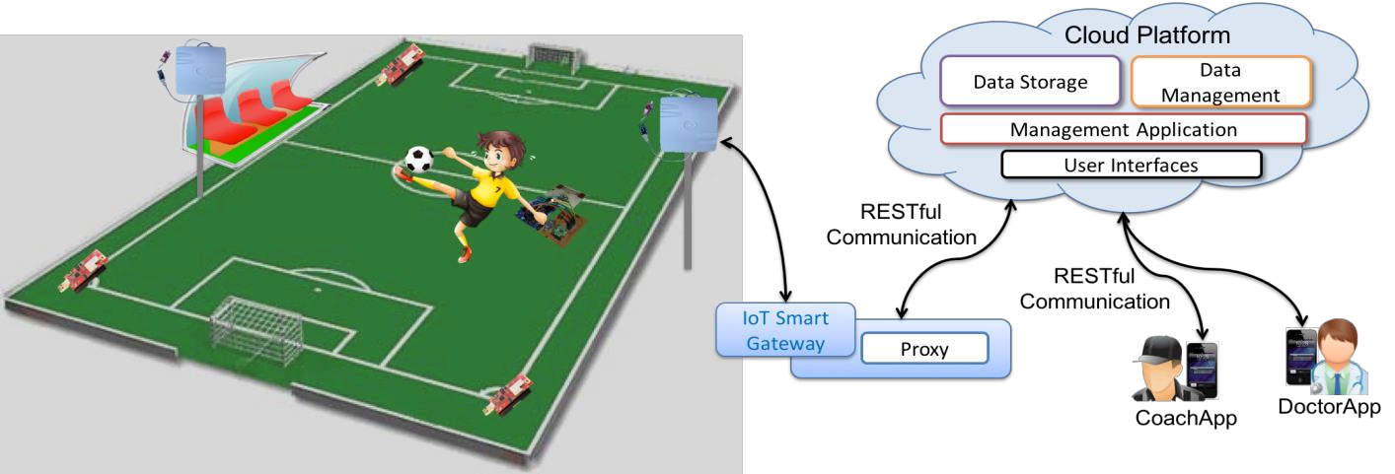

Slide 13
HSN
The HSN consists of an integrated RFID-WSN 6LoWPAN network composed of four types of nodes:
(i) 6LowPAN Border Router (6LBR),
(ii) 6LowPAN Router (6LR),
(iii) 6LowPAN Router Reader (6LRR), and
(iv) 6LowPAN Host Tag (HT).

Slide 14
According to the 6LoWPAN standard, the 6LBR is in charge of connecting the network to the Internet by translating 6LowPAN packets into IPv6 packets and vice-versa,
a 6LR describes a node able to provide forwarding and routing capabilities, while the 6LRR is defined as a 6LR interfaced with an RFID reader. Finally, an HT node identifies a typical 6LowPAN Host (i.e. a node without routing and forwarding capabilities) interfaced with an RFID Gen2 tag.
The designed system assumes that 6LR, equipped with light, humidity and temperature sensors, are deployed along the perimeter of playing field in order to detect environmental conditions, while 6LRR nodes are placed on poles located near benches reserved for players.
I

Slide 15
Indeed, the main function of 6LRR nodes is to identify and monitor players labeled with RFID Gen2 tags.
More in detail, players wear a HT node capable to detect important physiological parameters, such as body temperature and heartbeat.
During the match, sensed data are periodically logged on the memory of the RFID Gen2 tag. In this way, 6LRR nodes can retrieve such information when players approach the benches (as example, at the end of a playing period) and delivered to the IoT Smart Gateway.

Slide 16
IoT Smart Gateway
In the envisioned architecture, IoT Smart Gateway is a more powerful device placed near the exit from the playing field. It is connected, on the one hand, directly with the HSN and, on the other hand, with the Internet through a 3G-communication interface.
The gateway, therefore, plays the role of 6LBR, enabling the communication between HSN nodes and remote users. Moreover, the gateway enables the RESTful communication with the cloud platform.

Slide 17
Cloud Platform
is equipped with three different modules:
(i) a Data Storage Module, in charge of storing the received data;
(ii) a Data Management Module, responsible to remotely control and manage sensors deployed in the field; and
(iii) a Management Application (MA), able to execute the business logic.

Slide 18
In particular, the MA module plays a key role within the developed architecture.
It is responsible to timely manage emergency situations. As previously introduced, in case of critical events, such as player’s heartbeat irregularities, the HT node activates its long-range IEEE 802.15.4 radio transceiver to send a notification to the MA.
This last module is able to analyze heterogeneous information (i.e., the environmental conditions as well as the player’s physical condition) in order to detect potentially dangerous situations. In such a case, the MA exploits Push Notifications (PN) to inform the coach and the doctor in the field that the player needs to be immediately taken off the field and provided with medical support.
This strategy allows the Host Tag(HT) nodes to always use the RFID Gen2 radio interface for routine operations, e.g. data logging and identification, while keeping the IEEE 802.15.4 radio off for most of the time, thus maximizing battery lifetime

Slide 19
Mobile Applications
To make the collected data easily accessible by users, two different mobile applications have been developed.
Doctor Interface :This interface allows doctors to visualize information about players’ health status and to access to the health sensor data of each patient wearing an HT node.
In the designed architecture, doctors are equipped with a smartphone connected to a portable RFID Gen2 reader and running a customized application, named DoctorApp.
Through this App, during the playing breaks, doctors can interact directly with the HT node worn by a player and check her/his physiological parameters by reading the most recent information stored into the memory of the RFID Gen2 tag or historical information stored into the Cloud.

Slide 20
Coach Interface :This interface allows coaches to visualize current and historical information from environmental sensors and data about players’ performance as well.
The CoachApp, allows football coach to check data about the environmental conditions and to receive notifications when an emergency is detected.
Since the system collects sensitive and confidential data, the platform must ensure an adequate level of security to data access and management. For this reason, users need to be authenticated before they can access the platform.

Slide 21
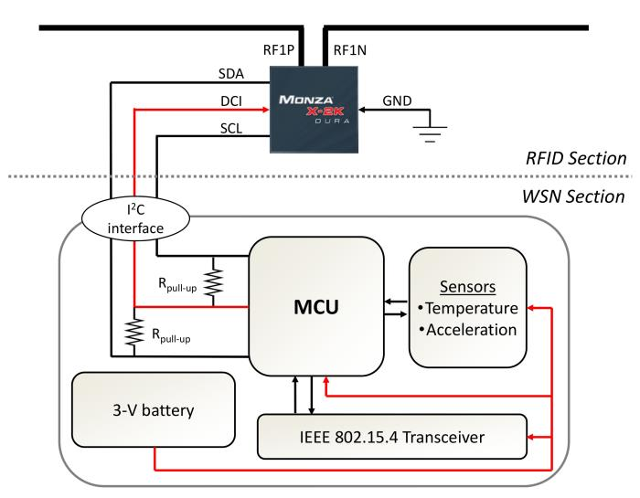
RFID AND WSN INTEGRATION
Fig. 2

Slide 22
A conventional UHF RFID tag featuring the I2C interface is physically connected to the microcontroller unit (MCU) of a WSN node.
In this way, information exchanged between the tag and the RFID reader via the EPCglobal Class1 Generation-2 (Gen2) air interface are directly available also on the I2C interface and, therefore, accessible by the MCU.
Potentially, the proposed RFID-WSN integration enables EPCglobal standardized data to be spread, in a multi-hop fashion, throughout an IEEE 802.15.4 network.

Slide 23
Design Components
The main elements are an antenna, a chip, and a battery holder.
The used chip is an Impinj Monza X-2K RFID chip, which is a new-generation UHF RFID Gen2 integrated circuit (IC) with 2176 bits of non-volatile memory (NVM) and an I2C interface.
As an I2C device, Monza X-2K operates as a standard EEPROM whose contents can also be accessed via the Gen2 air interface. In the fabricated prototype, the small female header, which exposes the I2C bus, is used to interface the RFID chip with the WSN Section thus physically realizing the RFID-WSN integration sketched in Fig. 2.

Slide 24
The RFID board is interfaced via the I 2 C bus to the MB851 board developed by ST Microelectronics.
This board (representing the WSN Section in Fig. 2) is equipped with a 32- bit ARM Cortex-M3 MCU operating up to 24 MHz and embedding 16-KB RAM and 256-KB eFlash ROM.
It integrates also a 2.4 GHz wireless transceiver compliant with the IEEE 802.15.4 standard.
The featured MCU is optimized to provide high performance at very low power consumption.
The WSN board is also equipped with an external antenna connector and 24 highly configurable GPIOs with Schmitt trigger inputs
Among the exposed GPIOs, the SDA and SCL lines, the ground pin (GND), and an output pin (DCI) have been used to implement the I 2 C communication with the RFID Section and provide power to the RFID chip.

Slide 25
Antenna Structure
Three main elements define the antenna structure:
(i) the central loop, which primarily impacts on the tuning of the real part of the input impedance and prevents potential high-voltage discharge,
(ii) the meander lines to reduce the antenna size, and, finally,
(iii) the capacitive loads at the antenna tips, which facilitate the impedance matching.
Finally, the antenna design has been optimized by setting the minimization of the reflection coefficient at the desired frequency as the fitness function and by adopting a gradient- based interpolated quasi-newton optimizer.

Slide 26
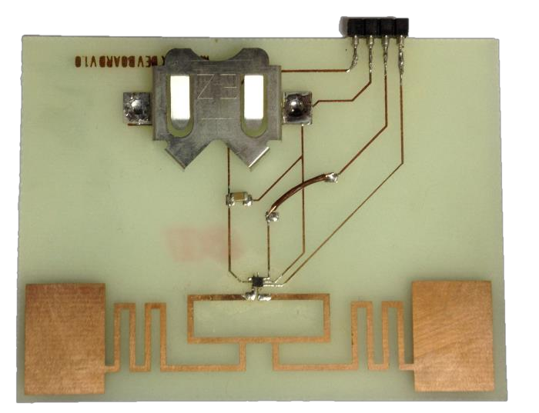
More in detail, the designed dipole-like UHF RFID
antenna takes cue from the commercial ALN-9660 RFID tag
inlay which uses meander lines to achieve a very compact form
factor (i.e., 7.5x1.7 cm 2 ).
Prototype of the developed RFID tag equipped with a small female header exposing the I 2 C interface (dimensions: 7.5x5x1.6 cm 3 ).

Slide 27
System Details:
HSN
Key elements of the designed HSN are the HT nodes and 6LRR devices
The former has been described in the previous section, while the latter consists of a commercial off-the-shelf (COTS) RFID Gen2 Reader interfaced with the XM1000 via the universal asynchronous receiver/transmitter (UART) communication bus. Specifically, the Sensor ID Discovery Gate UHF [20] reader has been used.

Slide 28
As summarized in Table 1, three different kinds of resources can be identified in the proposed architecture:
(i) health sensors,
(ii) ambient sensors, and
(iii) RFID-related resources.
6LR nodes scattered in the football field can monitor only environmental parameters and, therefore, expose just CoAP ambient sensor resources (e.g. coap://[aaaa::1]/ambient/light and coap://[aaaa::1]/ambient/temperature ).
In addition to such kind of resources, 6LRR nodes can expose an RFID resource ( coap://[aaaa::3]/RFID/reader ) which represents an aggregated information of tags read within the 6LRR RFID range.

Slide 29
Finally, HT nodes also expose an RFID resource ( coap://[aaaa::3]/RFID/tag , which identifies the memory content of the integrated Gen2 tag) in addition to both ambient and health (e.g. coap://[aaaa::3]/health/heartbeat , which provides sensor readings from the integrated 3-axis accelerometer) sensor resources.
In this way, each resource can be individually accessed from anywhere in the Internet by using CoAP methods.

Slide 30
Table 1: Typologies of resources and CoAP paths
Node | Resource | Examples of resource path
6LR | Env. Sensor | coap://[aaaa::1]/ambient/light coap://[aaaa::1]/ambient/temp
6LRR | Env. Sensor RFID Reader | coap://[aaaa::2]/ambient/light coap://[aaaa::2]/ambient/temp coap://[aaaa::2]/RFID/reader
HT | Env. Sensor Health Sensor RFID Tag | coap://[aaaa::3]/ambient/light coap://[aaaa::3]/health/heartbeat coap://[aaaa::3]/RFID/tag

Slide 31
Smart Gateway
The Smart Gateway is another important element of the designed architecture.
It works as a bridge between the HSN and the Cloud platform. It has been realized by connecting a Rasperry Pi 2 Model B board [22], equipped with the Raspian operating system, to the 6LowPAN Border Router.
The gateway has been also equipped with a 3G module, to guarantee data communication.
Raspberry Pi is a credit card-sized computer powered by the Broadcom BCM2836 system-on-a- chip (SoC). This SoC includes a quad-core ARM Cortex-A7 CPU, clocked at 900 MHz. It is equipped with 1 GB of RAM and powered by a 5 V micro USB AC charger.

Slide 32
Cloud Services
Storing, organizing, and retrieving information related to the players’ performance during a match and environmental conditions are expensive processes from both the computational and memory point of view.
For this reason, the cloud seems to represent the solution that best suits this kind of needs, as its storing and computing capabilities allow to process data more efficiently.
In the proposed system, a cloud platform has been used to store and manage the information retrieved by the HSN and all the data related to players’ health conditions.
Proposed solution was deployed on Amazon Elastic Compute Cloud (EC2).

Slide 33
PROOF-OF-CONCEPT
In this section, a prototype implementation of the proposed system is described and validated by means of a simple proof of concept.
Specifically, the ADXL345 digital 3-axis accelerometer connected to the multi-sensor board of the HT node has been exploited to detect possible heart problems and generate an alert.
According to the algorithm proposed in [23], the signal is initially passed through a band-pass filter.
Next, the algorithm computes the first and second derivative of the signal using two approximate 5-tap filters with integer coefficients. The results are added together and considered in absolute value. A 6-tap moving average is then applied, and the result compared against a threshold to detect any peaks that may indicate physiological issues.

Slide 34
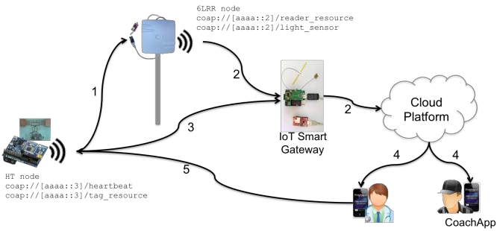
The considered validation scenario is depicted in Fig. 4. The
two main actors are: (i) the HT node, in charge of monitoring
the player's health status, and (ii) the 6LRR node, in charge of
reading and delivering to the IoT Smart Gateway data retrieved
from the memory of the RFID chip equipping the HT node.

Slide 35
To demonstrate the efficiency of the proposed system, two different use cases have been considered: (i) players' monitoring and (ii) emergency event handling. In the former, the following operations are performed:
1. the 6LRR identifies the player by means of her/his unique EPC and retrieve her/his current and historical health status by accessing the memory of the RFID chip equipping the HT node;
2. the 6LRR node sends a notification message containing the read data to the MA using a CoAP method. The MA application running on the cloud analyze the received data and store them. In the latter, the following procedure is used to handle emergency situations:
3. the HT node detects a heartbeat irregularity and activates its IEEE 802.15.4 radio transceiver to send a notification message to the MA;

Slide 36
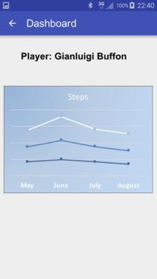
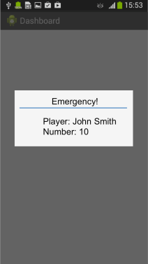
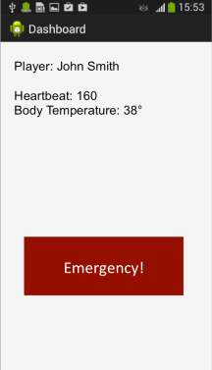
4. the MA analyses the received data and send a PN to coaches and doctors in the field.
5. The doctor receives on the DoctorApp the emergency notification (Fig. 5a) and visualizes details about the emergency event by reading data stored in the RFID tag (Fig. 5b). At the end of the football match the coach uses the CoachApp to visualize the player’s performance (Fig. 6).

Slide 37
Evolution of wireless sensor networks towards the Internet of Things: Abstract
Wireless Sensor Networks (WSNs) are playing more and more a key role in several application scenarios such as healthcare, agriculture, environment monitoring, and smart metering.
WSNs are characterized by high heterogeneity because there are many different proprietary and non-proprietary solutions.
The current trend, however, is to move away from proprietary and closed standards, to embrace IP-based sensor networks using the emerging standard 6LoWPAN/Ipv6.
This allows native connectivity between WSN and Internet, enabling smart objects to participate to the Internet of Things (IoT).

Slide 38
Building an all-IP infrastructure from scratch, however, would be difficult because many different sensors and actuators technologies (both wired and wireless) have already been deployed over the years.
After a review of the state of the art, this paper sketches a framework able to harmonize legacy and new installations, allowing migrating to an all-IP environment at a later stage. The Building Automation use case has been chosen to discuss potential benefits of the proposed framework.
[1] L. Mainetti, L. Patrono, and A. Vilei, “Evolution of wireless sensor networks towards the Internet of Things: A survey,” 19th

