Slide 1

Student Information and Performance Tracking System
Empowered aims to revolutionize the way students engage with academic information by creating an integrated platform that addresses key areas of student performance and well-being.

Slide 2
Key Features of the System
Score Analysis
Academic Performance
Counseling Support
Real-time access to student’s scores of each semester to analyze and bring outcomes
Detailed reporting on CIE and SEE grades, progress, and achievements.
Seamless access to guidance and mental health resources.

Slide 3


Academic Performance Reporting
CIE Grades
Comprehensive reporting on Continuous Internal Evaluation (CIE) grades and progress.
SEE Grades
Detailed information on Summative External Examination (SEE) results and performance.
Personalized Insights
Customized analysis and recommendations to support student growth.
Historical Tracking
Access to academic records from previous years for a complete view.

Slide 4

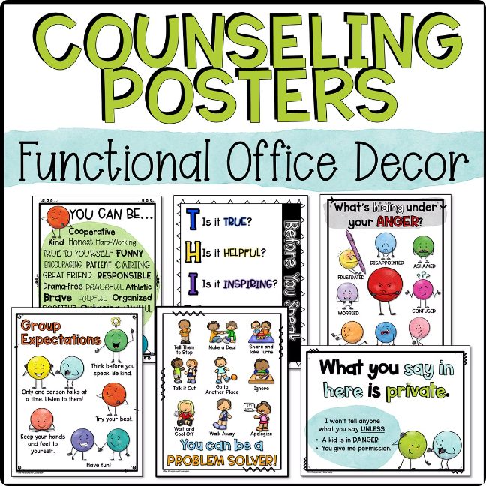



Counseling and Guidance Services
Academic Advising
Personalized guidance on course selection, study habits, and educational planning.
Career Exploration
Support in identifying interests, aptitudes, and potential career paths.
Faculty Guidance
Access to faculty experience and gains insights on the topics.

Slide 5

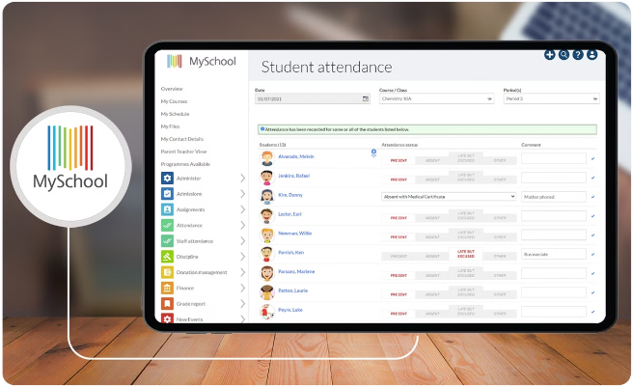
Secure and User-friendly Platform
1
Robust Security
Advanced encryption and data protection measures to safeguard sensitive information.
2
Intuitive Interface
Streamlined design and user-friendly navigation for seamless access to data.
3
Mobile-Responsive
Accessible on any device, allowing parents and students to stay connected on-the-go.
4
Personalized Dashboards
Customizable views and tailored experiences for each user role.

Slide 6

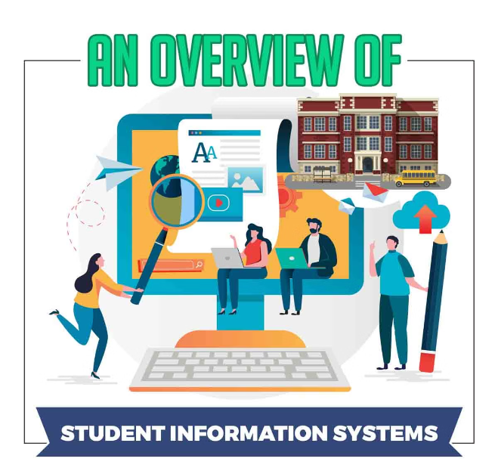
Empowering Students
Real-time Access
Students can view attendance, grades, and achievements anytime.
Transparent Communication
Seamless sharing of information and feedback between school, students, and families.
Collaborative Support
Joint effort to identify strengths, address challenges, and foster student success.
Personalized Guidance
Tailored recommendations and resources to support each student's unique needs.

