Slide 1
INVESTMENT ASSIGNMENT SUBMISSION
Name: Chirag Chhillar

Slide 2
Spark Funds Investment Case Study
Business Objective: To invest where others are investing, implying that the 'best' sectors and countries are the ones 'where most investors are investing'.
Goals of Data Analysis:
• Investment type analysis: Understanding investments in different categories to help Spark Funds decide on the best suited investment for the strategy.
• Country analysis: Understanding which countries have had the most investments in the past.
• Sector analysis: Understanding the distribution of investments across the eight main sectors.
Constraints:
• Invest between 5 to 15 million USD per round of investment.
• Invest only in English-speaking countries because of the ease of communication with the companies

Slide 3
Problem Solving Methodology – CRISP model
Business Understanding (Analysing requirements)
Data Understanding (Getting data files and merging)
Data Preparation (Cleaning and correcting datasets)
Modelling (Analysing Data based on requirements)
Evaluation (Getting relevant Output/Solutions)
Deployment
Business Understanding
Data Understanding
Data Preparation
Modelling
Evaluation
Deployment

Slide 4
Investment Type Analysis
Investment Types were limited to four types as per Spark Funds’ preference:
• Venture
• Angel
• Seed
• Private Equity
For per round : 5 to 15 million dollar as preferred by Spark fund: Venture funding is most suitable.

Slide 5
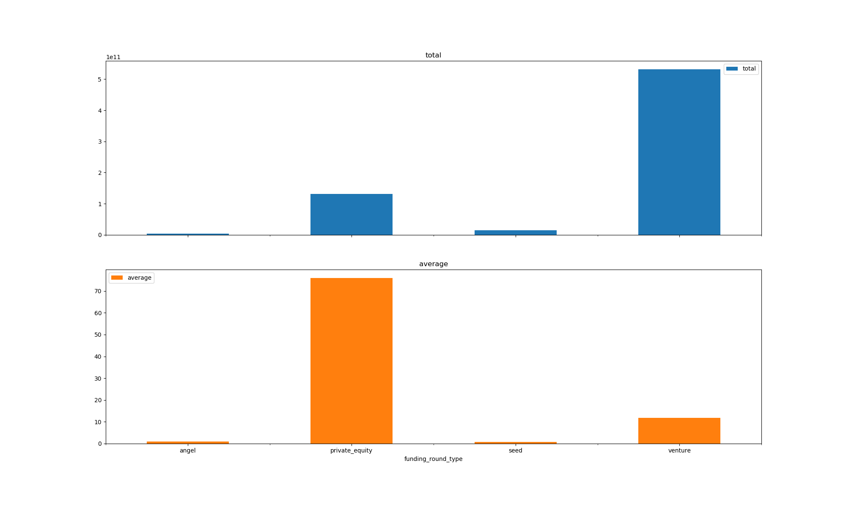
Investment Type Analysis

Slide 6
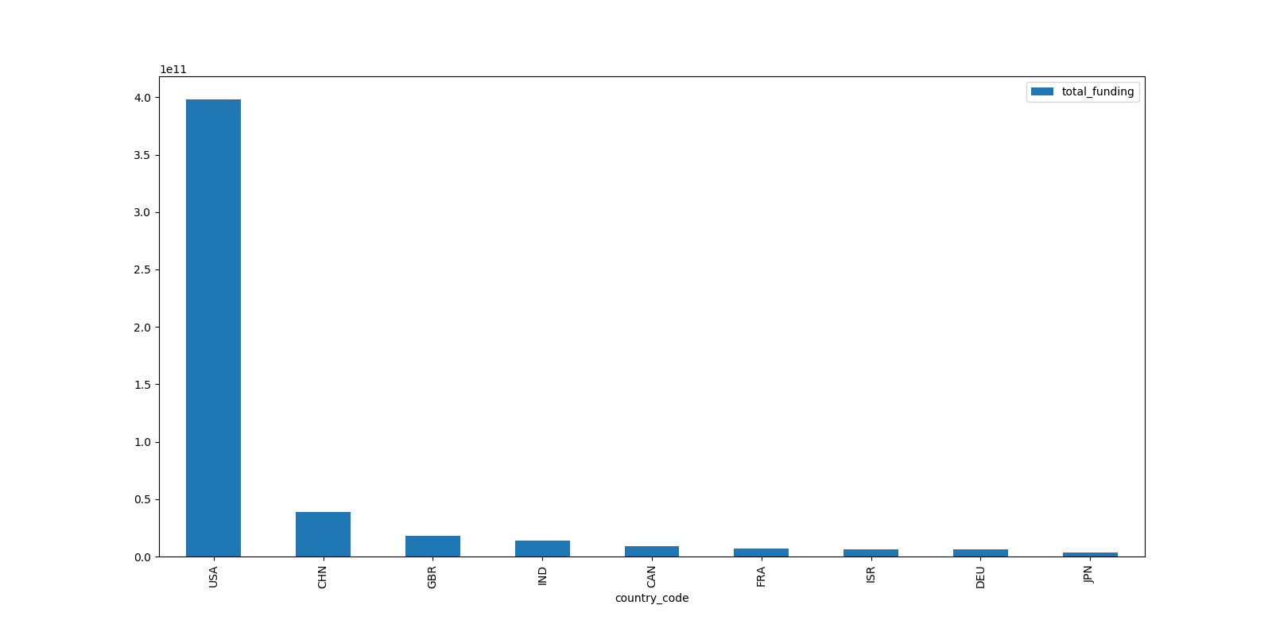
Country Analysis
Countries have been filtered based on:
• Investment type : Venture
• Total Investment in the country : USA, BGR, IND (Top 3 English Speaking Countries as preferred by Spark Funds).

Slide 7
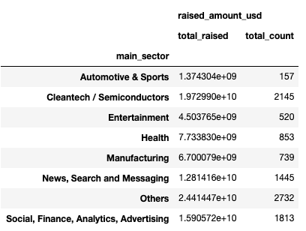
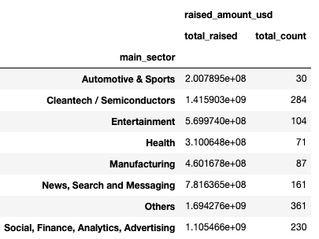
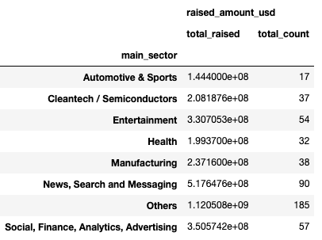
Sector analysis: Top 3 Sector in Top 3 Countries
USA
GBR
IND

Slide 8
Conclusion
The best type of fund to invest in , is "Ventures" .
• The Venture investment in the "Others" sector is the highest in all the top 3 countries.
• It is followed by "Cleantech / Semiconductors" sector, which seconds in USA and GBR, and "News, Search and Messaging" seconds in IND.
• "Social, Finance, Analytics, Advertising" sector is third place holder in all Top 3 countries.
- USA as we can see is Topping almost every investment but GBR and IND also have very good opportunities.

