Slide 1
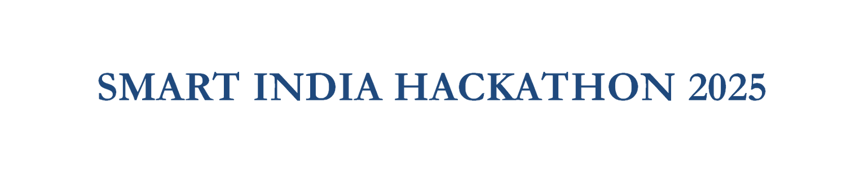





  Problem Statement ID- 25002
  Problem Statement Title- Smart Tourist Safety Monitoring & incident Response System Using AI , Geo-Fencing & Blockchain Based Digital ID
  Theme - Travel & Tourism
  PS Category- Software
  Team Name -TourDefender

Slide 2
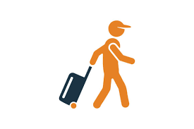


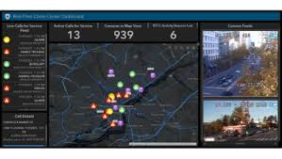

🛡️ Smart Safety Solutions
Smart Tourist Safety Ecosystem unites AI, GPS & Blockchain for real-time protection and instant rescue.
➤🔹 Blockchain ID – Secure, tamper-proof tourist identity & health records with QR check.
➤🔹 AI Alerts – Predict unsafe zones, detect suspicious activity, analyze crime patterns.
➤🔹 Geo-Fencing & Tracking – Warn before danger zones, send SMS alerts even offline.
➤🔹 SOS Button – Share live location, record 30-sec audio, auto-alert family & police.
➤🔹 Police Dashboard – Live maps & alerts for fast emergency response.
.
❌ Current Tourist Safety Gaps
🚫No Protection – Theft, scams, fake guides, harassment
🚫 No Prevention – No alerts, no geo-fencing, no disaster warnings
🚫 No Rescue – Weak networks, no live tracking, delayed response
⚠️Result: Small incidents escalate into life-threatening disasters.
😔 Tourists return with trauma instead of memories.
👉Uniqueness and Innovations
Tourist arrival
DTID+QR generation
Centralized Safety ecosystem
Centralized Safety ecosystem
Centralized Safety ecosystem
SOS button with live tracking , auto audio recording & heatmaps for rapid rescue
One-stop plateform connecting Tourist , police & authorities
Real-time safety score , anomaly detection & prevention
Police/Admin dashboard
Tourist mobile app

Slide 3
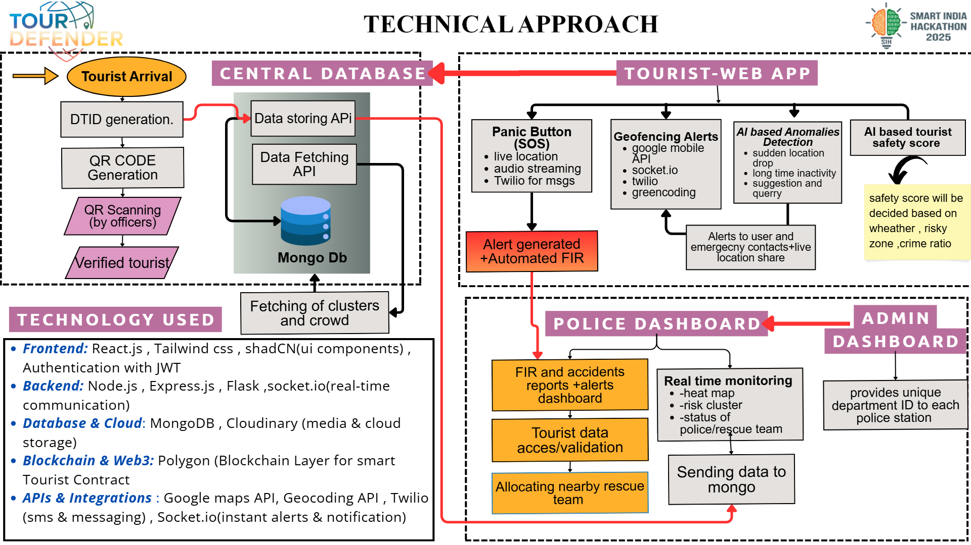

Slide 4

Viability
💻 Technical feasibility
  Adaptability: It can plug directly into existing police, tourism, and government networks without disrupting current workflows.
  Scalability: Cloud and blockchain infrastructure allow it to handle millions of tourists, growing datasets, and nationwide rollouts seamlessly.
  Global Potential: With multilingual support, evolving AI models, and modular integration, the system can expand from one city to an entire country—and eventually become a global benchmark for tourist safety.
  Future-Readiness: As risks evolve, our AI learns, adapts, and strengthens over time, ensuring this solution never becomes outdated.
  Built on a scalable and modular framework, the system can smoothly expand from local pilots to nationwide use, adapting to future technologies.Partnerships with police, tourism boards, airlines, hotels, and embassies can make adoption faster.
  Can integrate with global travel apps for seamless user onboarding.
🔄 Operational feasibility
Easy integration with police networks, tourism boards, and emergency services makes it practical for real-world adoption at scale.
💰 Economic feasibility
A cost-efficient model supported by government tie-ups, partnerships, and tourism growth, ensuring long-term sustainability.

Slide 5
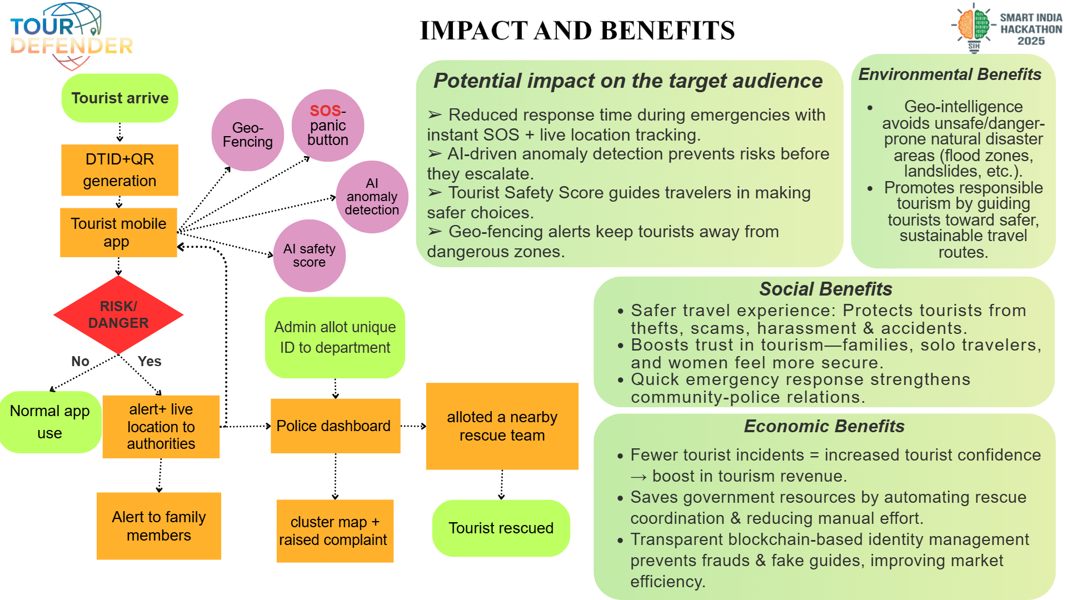

Slide 6

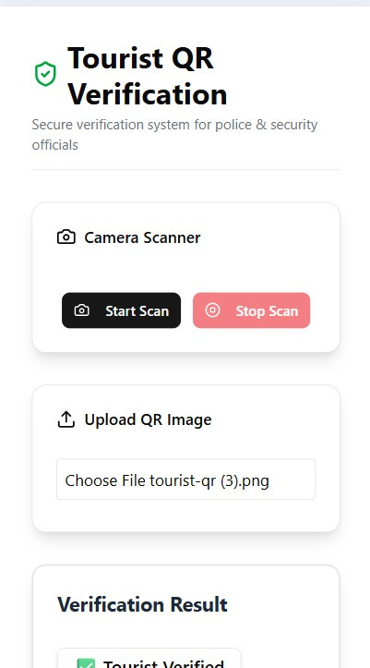
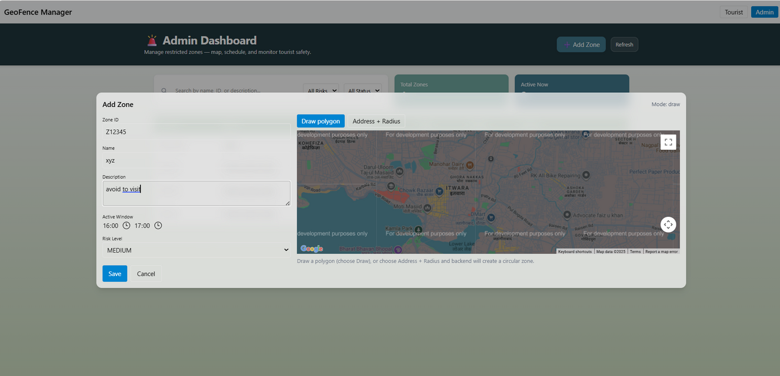
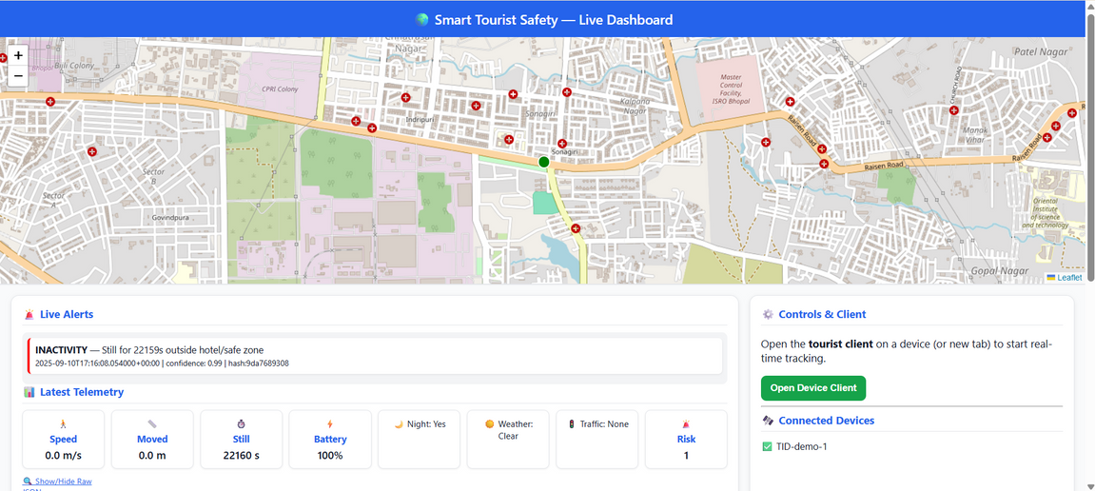
Reference | Researches
Tourist Safety data | Government and travel advisory agencies, world risk index & global peace index
Excisting Systems | Bsafe(https://www.getbsafe.com/)life360(https://intl.life360.com/)echosos(https://echosos.com/en/)Travelsmartapp(https://www.travelsmartapp.com/
Research papers | https://www.researchgate.net/publication/369230093_Safety_and_security_research_in_tourism_A_bibliometric_mapping

