Slide 1
Cloud Computing, AWS and Databricks
Basics of cloud computing and databricks

Slide 2
Agenda
AWS Cloud Computing Basics
Analytics on AWS
Databricks Basics
Git

Slide 3
Cloud Computing
What is cloud computing? – on-demand delivery of tech resources (computing power, storage, database, applications etc) through a cloud services platform (like AWS) through the internet with pay-as-you-go pricing.
Benefits –
Pay as you go
On demand delivery, get as much as needed quick, removes the guesswork for resources.
Large scale service, low price for customers
High speed and agility, reducing the cost for experimentation.
Companies can save costs by focusing on what differentiates them

Slide 4
On-premise VS Cloud computing
In a traditional on-premise execution, companies had to maintain physical presence and maintain their own hardware and platforms, which demanded maintenance and consistent performance. This is costly to firms, and experimentation impossible.
As companies scaled, maintaining a large physical presence became hard, and unsustainable. Precisely the problem cloud computing solves.
E.g. The scenario where you need to set-up an experimental environment, while an on-premise solution would be expensive and slow, cloud computing can help do this in a fraction of the time.
Cloud computing helps us to focus on what matters, while handling the redundant heavy lifting on their end. So that we can build on what differentiates us.

Slide 5
IaaS, PaaS, SaaS
Different levels of flexibility, abstraction and control.
IaaS – provides the basic building blocks (cpu, ram etc) along with networking features, and storage space. Most flexible among the 3, providing complete control over these resources.
PaaS – removes the need to manage the underlying infrastructure, providing you with the hardware and OS to deploy and manager your applications. This increases efficiency, because now we don’t have to worry about the logistical issues, and focus on what differentiates us, with everything else being handled by the cloud.
SaaS – provides a complete product. Now we don’t have to worry about anything, our only concern is how the software is going to be used by us. You can ignore how it is being managed on the other side. A basic example is using web-based mailing, where we don’t know how everything is handled, all we care about is sending and receiving mails.

Slide 6
Developer Tools – Interaction with AWS
When the infrastructure is being handled on cloud, instead of being managed physically, it is managed logically, through AWS API (Application Programming Interface). That is, we are using API calls to make changes (creation, deletion etc) in any AWS resource.
There are multiple ways, but for introduction, below four are important –
AWS Management Console – GUI interface for AWS management. No scripts.
AWS Command Line Interface (CLI) – CLI as it says, managed through commands in terminal (or powershell/cmd) like bash zsh etc. Cloudshell, a browser based shell for AWS. With this, we can script and use syntactical commands, like using the terminal, which is much faster than GUI.
IDE and IDE toolkits – allowing user to access AWS through their preferred environment (like PyCharm, VSC, etc)
AWS Software Development Kits (SDKs) – SDKs allow you to use AWS programmatically, giving conditional calls to AWS, and integrating AWS in a pipeline of actions.

Slide 7
AWS Cloud Development Kit (CDK) and CloudFormation
Infrastructure as Code (IaC) – enables the creation, deployment and maintenance of infrastructure in a programmatic way.
Development Phase - Developers write infrastructure code in their familiar language (python, java etc). The CDK code defines AWS resources as specified in the above code.
Synthesis Phase – CDK translates code into AWS CloudFormation template. This generate JSON/YAML file that CloudFormation understands.
Deployment Phase – CloudFormation provisions and configures the actual AWS resources..
Benefits – familiar programming language, reusable infrastructure constructs and share them, CloudFormation handled the execution, just need to worry about the code we write.

Slide 8
Analytics on AWS
AWS has a broad set of data analytics and AI tools, for different purposes. SageMaker is one of the main tools which helps in managing data and AI workflows. SageMaker is also a unified studio with all the analytical tools AWS offers, combining all the services in one, and making all of them easier to access.
There are 6 analytical services that AWS offers (as mentioned in the blog) –
Streaming – Continuous real-time flow of data, building and processing it as it is generated, unlike batch-wise traditional processing, which is slow and not real time.
Data lakehouse/Data warehouse/Data lake – Access and analyze data in these data systems.

Slide 9
Analytics on AWS (cont.)
Data Processing – Analyze, prepare and integrate data for further analysis and AI.
Business Intelligence – Interactive graphical interface for building and showing insights.
Search Analytics – real-time search, monitoring and analysis of data.
Data and AI governance – cataloging, discovering, sharing and govern data across AWS, on-premise and third-party sources.

Slide 10
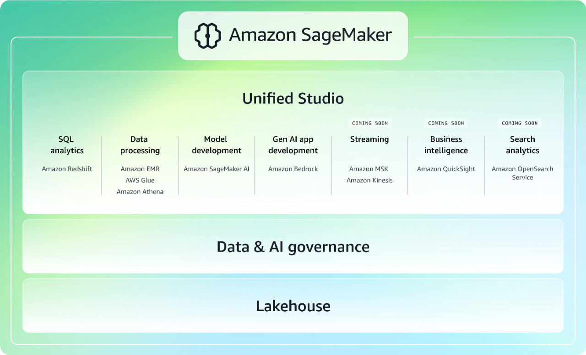
title
Blank

Slide 11
Databricks
Databricks is a unified data and AI platform, that enables organizations to operate on data, tasks like streaming, analyzing, storing etc, all done on the cloud. Which in turn helps organizations make BI and AI applications and process daily operations.
Lakebase – new kind of database, merges the reliability and developer experience of Postgres, with the scale, governance and analytics power of data lakehouse. It allows running transactional workloads, while syncing data to analytical systems, without building custom ETL (Extract, Transform, Load) pipelines. Result is ONE platform where apps, data and models work together in real-time.
Data warehouse – a database management system, that stores current and historical data, from multiple sources in a business-friendly manner?, for easier insights and reporting. Typically used for BI analytics, reporting, preparing data for ML, and data analysis. Data warehouses make it possible to quickly and easily analyze data from different operational sources (like sales, marketing, inventory etc). Data may pass through operational stores and cleansing to ensure quality for further processing.
AI agents – semi-autonomously/autonomously operating AI agents, that understand complicated goals and accomplish objectives.

Slide 12
Git Basic commands
Git status Git add <file> Git commit -m <msg> Git push Git pull Git clone <url> (local copy of a remote repo) Git branch (to show all branches) Git merge (merging branches) Git checkout -b <branchname> (creates branch) Git switch <branchname> Git remote add origin <URL> (adds origin for pushing the changes towards) Git push -u origin main (pushes main branch to origin)

Slide 13
title
Blank

