Slide 1

SAGAR GROUP OF INSTITUTE RESEARCH AND TECHNOLOGY, BHOPAL
DEPARTMENT OF AIML
MENTAL HEALTH SUPPORT AI MODEL
H.O.D.: Coordinator:-
Dr. Kalpana Rai Prof. Menali Paul
Guided By:- TEAM-Member:-
Prof. Khusboo Bharadwaj Aamir Siddhiqui
Aman Saxena
Chirag Jain
Madhur Choursia

Slide 2


TOPICS
  Objective of Project
  Problem Statement
  Literature Survey
  System Architecture
  Work Flow
  Technology Used
  Result
  Future Work & Conclusion
  References

Slide 3
Objective of Project
  To develop an AI-based Mental Health Support Chatbot.
  Provide empathetic and supportive responses using NLP + LLM.
  Detect user’s emotional state from text input.
  Give private, accessible mental support without human hesitation.
  Identify high-risk statements and guide user to helpline support.

Slide 4
PROBLEM STATEMENT
  Mental health issues are increasing rapidly in society.
  Many individuals hesitate to talk openly about emotions with humans.
  Lack of privacy, stigma & judgment stops people from seeking help.
  There is a need for an accessible, private & non-judgemental support system.
  Real-time emotional support and crisis detection is missing in traditional systems.

Slide 5
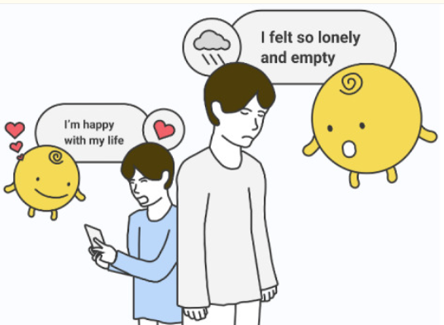
1. Mental Health Research
  WHO says mental health is more than absence of illness.
  Mental health is affected by society, family, emotions.
LITERATURE SURVEY
2. Stigma Problem
  People avoid talking about feelings due to fear of judgement.
  Young people hesitate to seek help openly.
“Existing studies show AI chatbots can support emotional wellbeing”
3. Why AI-based Support Needed
  Only a small percentage of people with mental health problems get proper help (book highlights service gap).
  Real-time support + early emotional expression can reduce stress before it becomes illness.
  AI chatbots can make mental health guidance more accessible & non-judgmental.

Slide 6
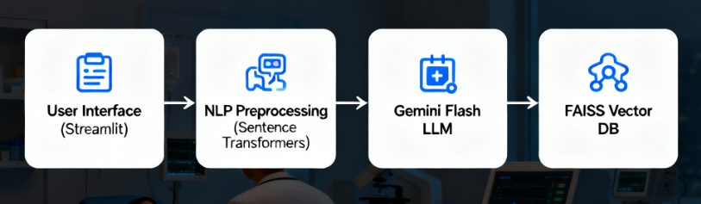
SYSTEM ARCHITECTURE
This architecture describes how our Mental Health Chatbot processes user queries and generates empathetic responses using Generative AI.

Slide 7
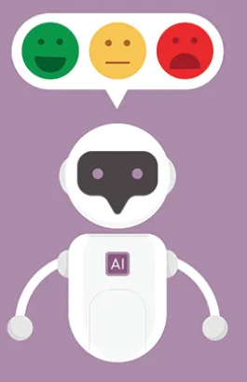
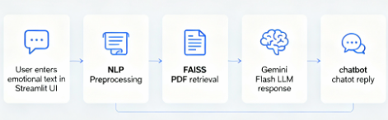
WORK FLOW
Combining semantic search (FAISS) + generative AI (Gemini Flash) ensures each response is context-aware, relevant, and empathetic.

Slide 8
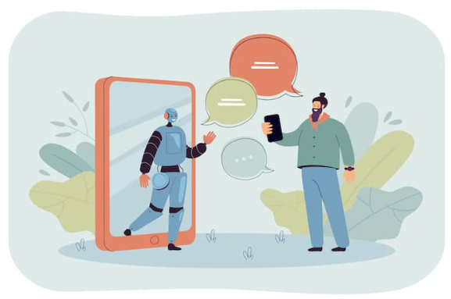
WORK FLOW
User enters emotional message in chat UI
Text cleaning & NLP embedding
FAISS retrieves relevant knowledge
Gemini Flash generates final response
Chatbot displays friendly & empathetic answer
Sentence Transformers convert text → vector representation.
System fetches similar content from mental-health PDFs.
LLM uses retrieved context + user text → supportive reply.
Example: “I am feeling stressed today.”
Response shown instantly in Streamlit UI.

Slide 9


TECHNOLOGY USED
Streamlit is used to build an interactive web-based chat interface where users can easily express their feelings.
Sentence Transformers convert user text into vector embeddings to understand meaning, tone and contex
t
.
Google Gemini Flash model is used as the main Generative AI engine to produce empathetic, mental-health aligned responses
.
FAISS Vector Database stores and retrieves relevant information from mental-health PDFs for context-driven answers.

Slide 10
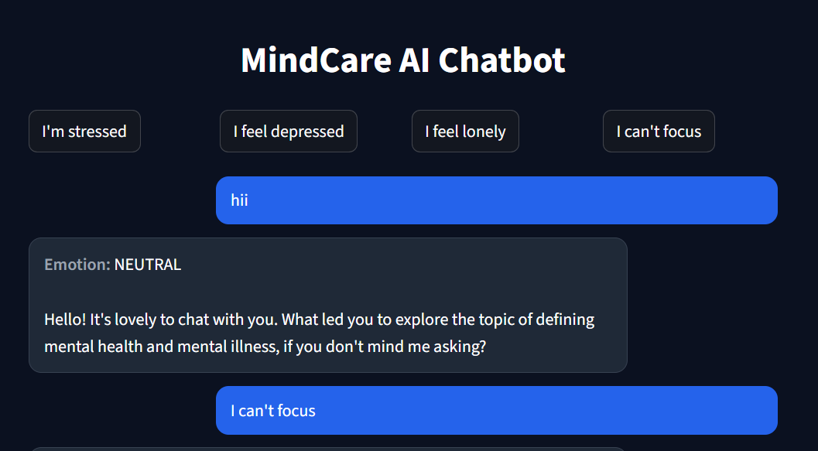
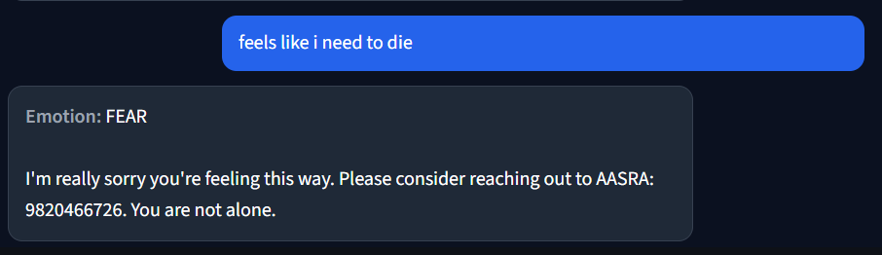
RESULT
Following results achieved :
• The chatbot is able to generate emotionally supportive and context-aware responses based on user inputs.
  It provides human-like guidance by combining semantic retrieval (FAISS) with Gemini Flash generative reasoning.

Slide 11
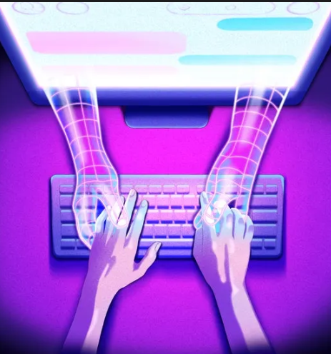
““How can this Mental Health Support System improve further using AI?””
Future Work & Conclusion
Real-Time Emotion Detection
➤ Use sentiment + emotion classifiers to detect deep emotional states (stress / anxiety / depression levels)
Voice Based Interaction
➤ Add voice input so users can speak instead of typing (better accessibility)
Personalization Layer
➤ Maintain user history to provide continuous, personalized emotional progress tracking
Clinical Expert Integration
➤ Connect with verified mental-health professionals or government-approved datasets to increase reliability
FUTURE WORK

Slide 12
Future Work & Conclusion
“What if emotional support conversations could be enhanced by AI?”
  Developed an AI-powered Mental Health Chatbot capable of generating supportive and empathetic responses
  Integrated Google Gemini Flash model to produce human-like emotional guidance
  Used Sentence Transformers + FAISS to retrieve relevant context from mental-health research PDFs
  Built a Streamlit-based web app for live user interaction
  Project demonstrates how AI can assist early-stage emotional support and promote mental-wellbeing
CONCLUSION

Slide 13


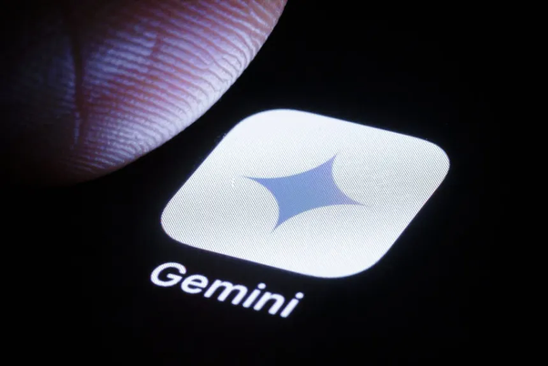
REFERENCES
  Sentence Transformers for Semantic Textual Similarity — Reimers & Gurevych, 2019
• Google Gemini API Documentation – https://ai.google.dev/gemini-api
• FAISS: Efficient Similarity Search – Facebook AI Research
• Streamlit Documentation – https://docs.streamlit.io
• Mental-Health Research Papers / PDF Documents (Domain Knowledge Source)

Slide 14


