Slide 1





Covid 19 API ETL Architecture
Statistics
Amazon S3

Slide 2
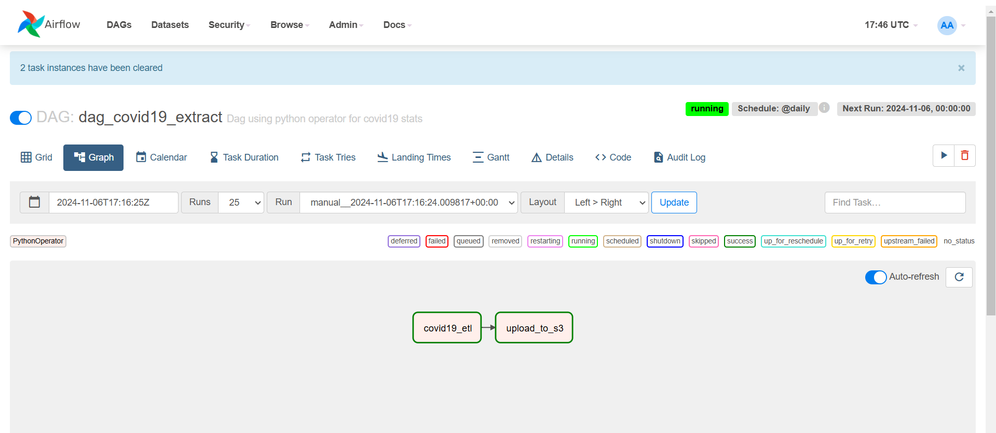
Airflow DAG and Tasks

Slide 3
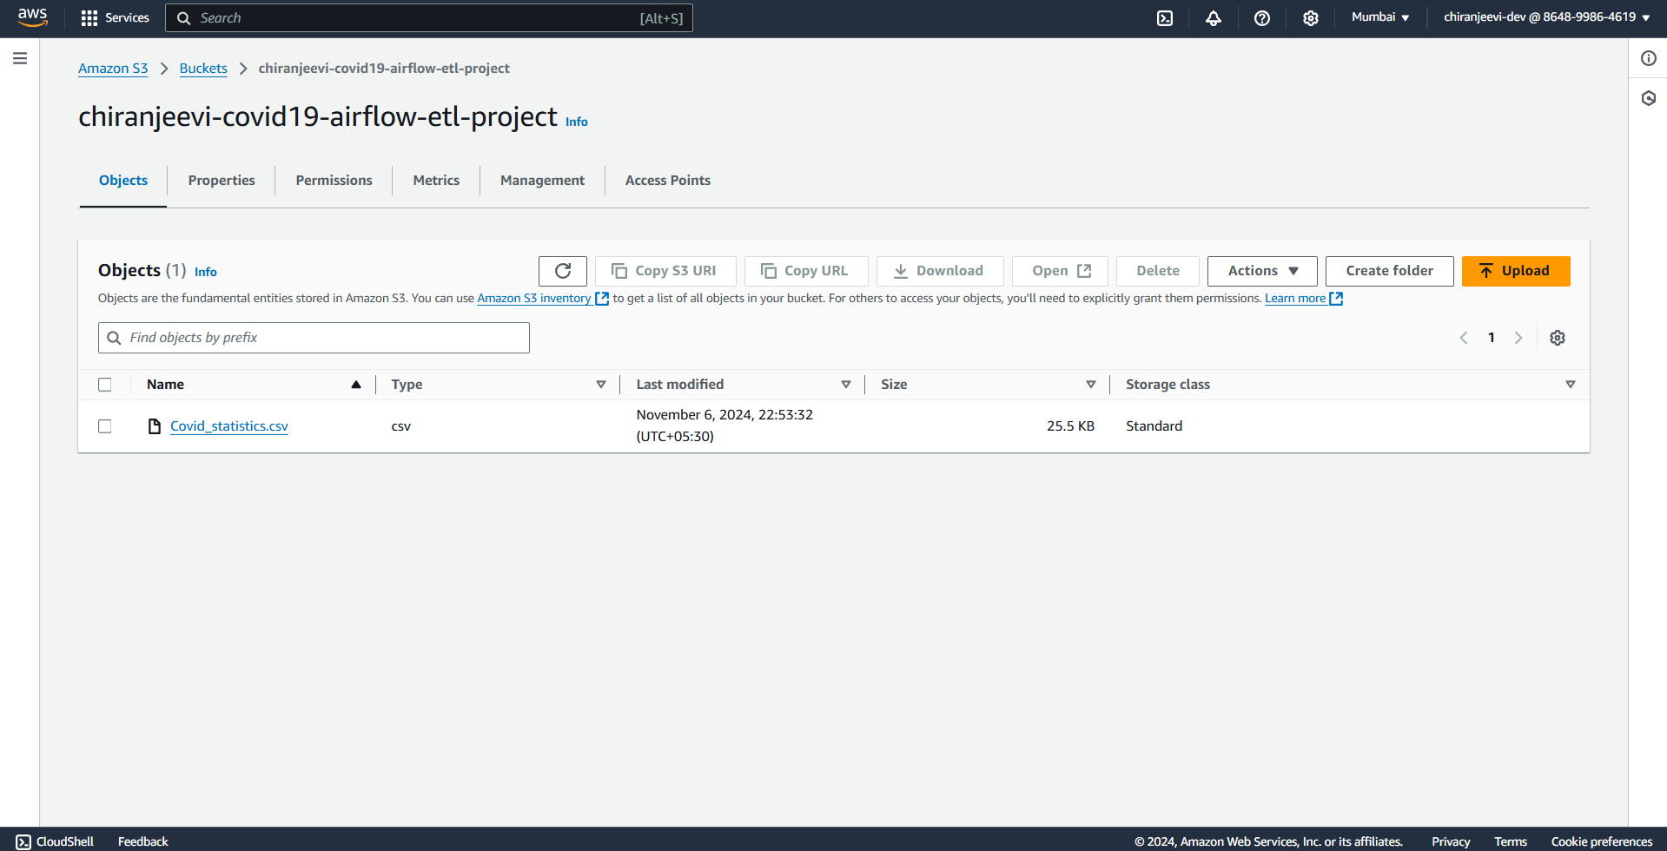
Extract file copied into AWS S3 Bucket

