Slide 1


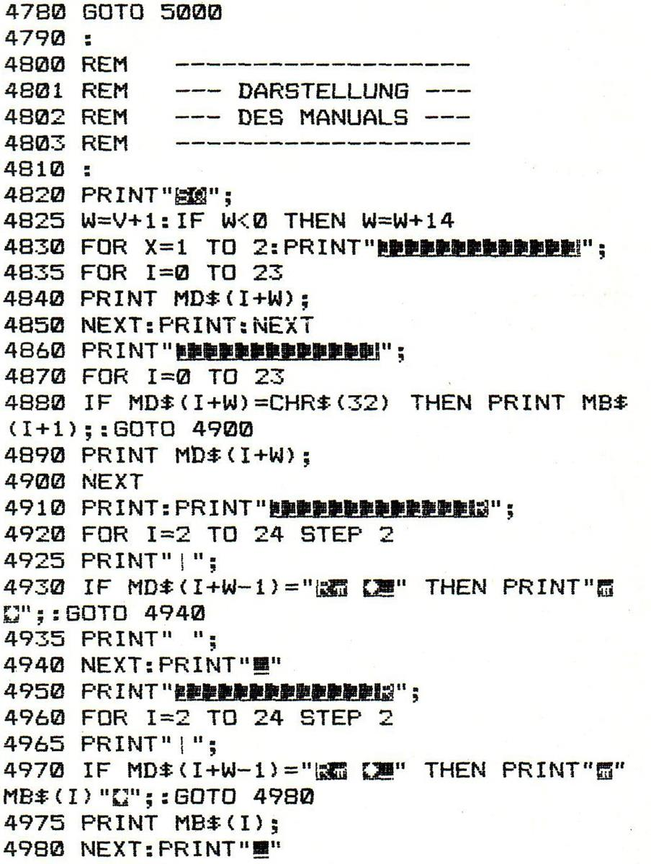
The Java Reflection API tutorial
A beginner’s journey to Java enlightenment :)

Slide 2
Contents
What is it?
Advantages
Disadvantages
What’s next!

Slide 3
What is it?
Reflection is commonly used by programs which require the ability to examine or modify the runtime behaviour of applications running in the Java virtual machine

Slide 4
Advantages
Extensibility
Class Browsers and Visual IDE’s
Debugging and Testing tools

Slide 5
Disadvantages
Performance overhead
Security Aspects
Exposure of Internals

Slide 6
What’s next?
Deep dive tutorials in accessing java classes using reflection.
A great in depth material to access java methods using reflection
Finally, accessing arrays and other enumerated types using the java reflection

Slide 7
Thanks for watching
Stay tuned for more. Cheers!

